Slide 1



FBI
TECHNOLOGY
Ghocjeo(dell,quest; blond male nonPolciIran account)
Assumed:nonPolciSaintNick(nikis paper shop,gas)
nonPolcieFurness
bank faz)
IPX ghocheo(dell,quest.client.nonPoliceIran(blond)
ibm.dmiler.visa.cybersoruce
http
dev
0.01 nonPoliceIrani
nonPoliceOperationLogical.WWI.nonPoliceProstetuionLawLogical
Ibm.damiler.visa.cyberouce.employe.armanch…armache...
Ibm.dmielr.vsa.ecysoruce.meploye.sunl.raj
nonPolicePentagonLogical_03-24_2023
nonPolicePentagonLogical_03-25_2023
websphere
nonPolicePentagonLogical_03-26_2023
nonPolicePentagonLogical_03-27_2023
mq
60s sql=insert into db nonPoliceTRXLogiacl
QM_1
nonPolicePentagonLogical_03-25_20238
Google.ATOMCLOKC(Ibm.damiler.quartz) 41
nonPolceBilderberg.nonPoliceVifew(baby room, google)
nonPolicePentagonLogical_01--04_2023
Q1
nonPoliceOperationLogical.WWI.nonPoliceProstetuionLawLogical
Q1
HA/Transient Queue
mq
websphere
Q1
Other:
mq
QM_1
db2
bpm
Q1
Q1

Slide 2
FBI
dev
nonPoliceReprot
nonPoliceOperationLogical.WWI.nonPoliceProstetuionLawLogical
Q1
nonPolicePentagonLogical_03-24_2023
nonPoliceBook
?s bpm(process)
nonPolicePentagonLogical_03-25_2023
nonPolicePentagonLogical_03-26_2023
nonPolicePentagonLogical_03-27_2023
nonPolicePentagonLogical_03-25_20238
nonPoliceMovie
nonPolicePentagonLogical_01--04_2023
nonPoliceOperationLogical.WWI.nonPoliceProstetuionLawLogical
AMQ8409I: Display Queue details.
CURDEPTH(0)
Other: v0.9.0.1 other v.0.9.1
v0.9.0.2
v0.9.0.3
v.09.0.4

Slide 3
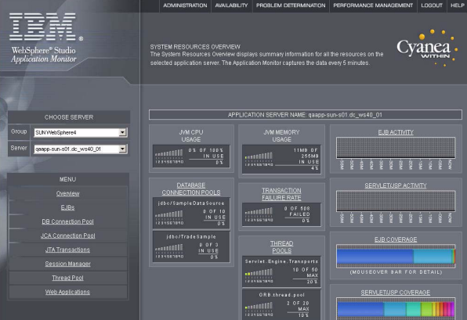
FBI
0.0001
dev
Ibm.dmiler.apple.maxpalnk.marx
IT Operations ( Cost) 2022 $50M (ibm.dmilr.yahoo.tango.(it).amazon.)
5 z/OS $500/lpar WebSphere
256 lpar( processor)
x5 $640,000
24x7 50 employees
IT Operations ( Cost) 2023
Ibm.damiler.apple
512 DB connetions
0.1 rice
0.1 rice.phone
ibm.dmielr.apple.phone.touch

Slide 4


FBI
DEFINE LISTENER('LISTEN.TCP') TRPTYPE(TCP) PORT(1414)
1414
START LISTENER('LISTEN.TCP')
DEFINE LISTENER('LISTEN.TCP') TRPTYPE(TCP) PORT(1414)
START LISTENER('LISTEN.TCP')

Slide 5

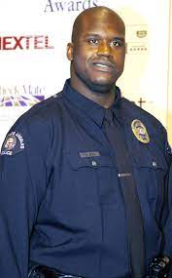
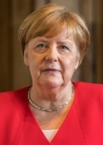
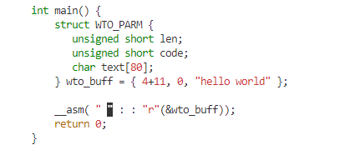
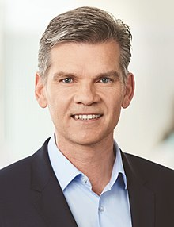
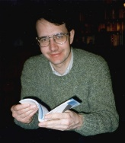
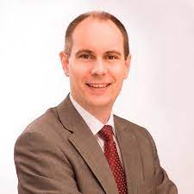
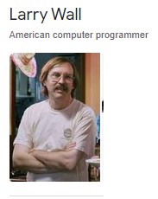
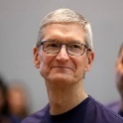
FBI
CHECKPIONT CHARLIE(wall).nonPocileAttemtn(PENTONGON).KING.YELLOW
thehun.com
nonPoliceCourtLogical
C++
Assembly
Avg.student.compilations
Pornogrphay
- facials
- anals
2002 Dorm Horny Rat Penis Graphity
Sex Abuse
1995 Horny Rat Erected Penis (step)elke joe cartons)
1994 Horny Rat Erected Penis
Phil(z/os)
ASSMBLY AbuseIbm.damiler.visa. (bios)
0.1 Josphe Saunders knows Visa transaciotns in Assmbley
0.01 Need to fix as ceo
C++ Java/jni
Assembly Javan/jni/asm
The Professor will
have the nonPolcieCfgLogical
And/or/also the nonPolcieCorporation
Complie on nonPoliceCourt
With nonPoliceReroutesLogical
PRICE?
Jr/sr !W
& CREDIT FRAUD jobs/miers/meirs/mei
2nd ring 1Carrot and Perls and child perls
China town (telmate)
LAW and C++
PERL
Prof. Dr. Udo Muller
2004
Udo has new book
Larry Wall (perl)
HOMICDE:LUX.nonPocleiCoutry
(luxembug)
!cool
Travel monitor
Life theft
Phil(kim,Gary Johnson)
0.1 ibm.damioer.apple.Davidson.(outside)

Slide 6
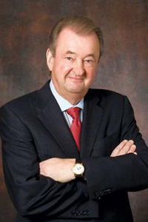
FBI
Sex Abuse
PRICE=!Priceless
PHIL(KIM)
Jr/sr
50
WWI
Ibm.damiler.visa
The Hun
Deere
Honey
nonPoliceTRX
nonPoliceStatus
nonPolcieQOS
KING
(2005) 25 / 50
ATOMBOMB(ghocheo(dr,Hahn(otto;walkis);tennis)
Dr[].ibm.dmielr.visa
Ibm.dmielr.realplayer.facebook
[x] no
nonPoliceContentItems
ATOMCBOMB
2005 Jni ibm.damiler.wsam.(chariaq).?.?
z/os
ipx
1990 Ibm.damiler.siemens.biomation.gould.Nixdorf.logicanalzer
Larurant French Engineering

Slide 7
FBI
Sex Abuse
Capability to say deer
In Kitchen at home
COFFEE
KITCHEN
DAUGHER
WIFE

Slide 8
FBI
?
41.FREE(PIZZA): logical amgia
1986/7 “Graphics” are important
--monkeys
GAS(Rudolf-diesel)
Sex Abuse
DL.phil(kim)
41.Drunk Jason Petersson
nonPolicePhto.nonPocliCfgLgoical
41 MERKEL
2013rommity=
School: 13 Computers
Apple II
Apple II
ELKE
FREE(PIZZA).nonPoliceDEA(amiga acide larry)
Translate{
}
Commedore
bundeliga manager
Stock trading
Larry:commdore

Slide 9
FBI
WWI
KING(priciapl,nellles,uni-decan)
GOD(freeman,tunisa)
X3.avg
Camp David
LOVE=EROS
Davut
BILL
missing:? davut
rui
Eros center
Foreigners
Francsoc Alen
Arim x
1998 wait moveout
nonPoliceProstionLaw
FEDERAL BANK ALEN GREENSPAN
ATM – Ass-to-Mouth HTM Hand-to-Mouth
AFT – Ass fuck time
3-LETTER CODE
nonPOlcieRTALogcal
Gorbahcheo(visa)
ALEN!GREENSPAN, Dr dieter zetcher/merkel
Yugoslavia
EROS CENTER
Ibm.dmiler.pope.de.francesco
FRANCIS
kebab
2x I will go again
0.1 nonPocliMontorLgoica.MEKERLA.tranlaste{
poor oil in the fire
}
x
Ritz:yang
She is a professonal
HW5
41(ronson) shoene reiche mushis: (tanl) nice rich pussies
Baen-Baden
MATHEEW: silver chair(open fire)
tape recoreder
Tranlate{
nonPolicMacdonai(arim/joachmim)
}
1998
Ipx 2007/8
WWI.nonPozolieFrankfurt
Kaiserallee
Ipx shopping kaiserstrasse
Ibm.damile.visa
Ghoeh(micheal)
Furgeson x angelo
cisco
Ibm.damiler.visa.*
Fuggen, I fuck your mother I am black
In your cube ice picture. Cand call you rice phil(kim). Scientolgyl
And jeff ( Procto an Gabme, a Holin company AND bill ORACLE cybesrouce.)
--Frugesson(BLACK as person)
--GOD, MORGAN FREMAN copy like joe
A prfessinal?
x
x

Slide 10
FBI
1998 SYMPHONY(hydanstra)
JFK(LEE,burce).ipx.int(uknonw)
KING(1st Floor,pricipal)
POPE(basemtn)

Slide 11
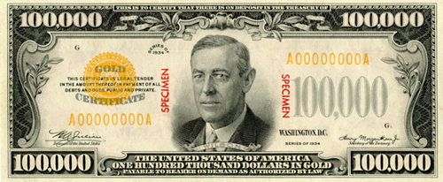
FBI
!WWI
1991 WWI.nonPolzieHamburg
ELKE
nonPoliceProstaiotnLaw
WWI
PoliceFrankfurtLgoical
nonPoliceProstaiotnLaw
2023
2004 WWI
Ibm.dmailer.unimog
nonPolcieLanague(wyland)
other
G{
MERKEL: Once Upon A Time in America , 0.1 Good night california
ibm.damier.siemens.Nixdorf(biomaiton.gould).logicanalzer
1998
2013
}
book
source
WWI
[x] no

Slide 12
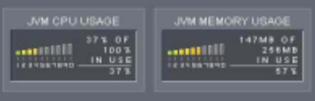


FBI
IBM J2EE Management Layer, username: RICE, password: PIZZA
J2EE PROGAMMER
2003-2023
PENTAGON(deere).0.1HOMCIDE:JOERG
0.1 assumed: ibm.dmiler.apple.deere(HOMCIE:JOERG)
IBM not apple joerg=steve jobs

Slide 13
FBI
J2EE PROGAMMER
2001 Univversity
1994
1991
https://georgewbush-whitehouse.archives.gov/
dev-eng 130,000-180,000
D.A.R.E.maxplank.marx
The Hursley Park team brought the first two Java licenses into IBM in 1994.
George H. W. Bush
1980-1985 ziolg
1986
Phil(espon gary, ibm.dmiler.apple.tim.cook) ASSEMBLY,C/C++

Slide 14
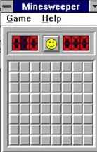
FBI
Vagani scabs, faces of death
Ipx.ibm.dmiler.apple.redhuse.emploe.jenny.?
ghcheo(doll,Jackson) nonPocliNewspaper.logic(ghocheo(Jackson)
CVPA.gorbachev(parent;heger,micheal)

Slide 15
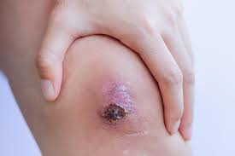
FBI
Ss gun/shword
jesus
2 year scabs
ghocheoc
Vagani scabs, faces of death
Ipx.ibm.dmiler.apple.redhuse.emploe.jenny.?
ghcheo(doll,Jackson) nonPocliNewspaper.logic(ghocheo(Jackson)
CVPA.gorbachev(parent;heger,micheal)
Look at these scabs
1994

Slide 16
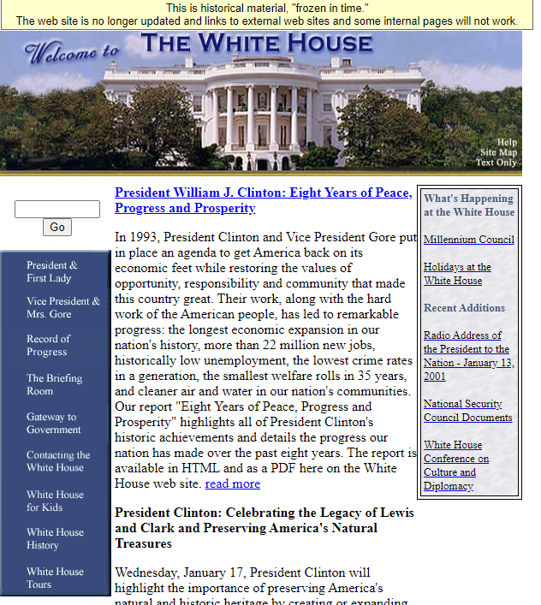
FBI
J2EE PROGAMMER
1994
https://clintonwhitehouse5.archives.gov/
Java servlet
1997 MEKERL(ibm.dmielr.karstadt.hertie.book.javascript)

Slide 17
FBI
J2EE PROGAMMER
1991

Slide 18
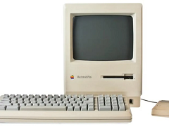
FBI
J2EE PROGAMMER
1988

Slide 19

FBI
J2EE PROGAMMER
J-10
Russel 500
Gorbhceo(Tyson)
Ruessl Park
Orchard Park/ Hudson Court
Tyson Albinon Mouse
1988
Phil(saylor,Sharon)

Slide 20
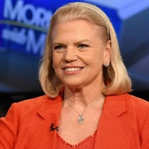

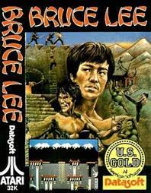

FBI
NAVY
(marlin)
J2EE PROGAMMER
POLICE REAGAN(pickup NANA)
Phil(steve).nonPolcieRoute
nonPoilceChart
[ ] phil(whyland,nonPoliceDaugherlogical)
Roth.ibm.dmiler.(fivoli bruce lee impersonator
onsite)
1987
2016 JFK(LEE(Ibm.damiler.appe.employe.tim.cook)
report to Jesus
LABOR_CODE.nonPolciHomellioason KING.CIVIL_CDOE (LEE,bruce)
ipx
nonPocliAttmetn
LABOR_CODE
Hope the fence
Street crime figin nonPociSantaClrar

Slide 21
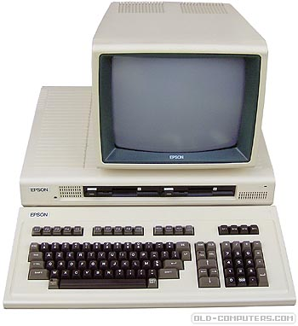
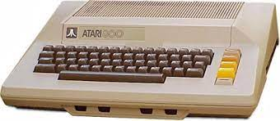
FBI
NAVY
(marlin)
J2EE PROGAMMER
JNI
ASM
C/C++/ASSEMBMLY
41.Cognitive ( sub-contious)
nonPocieTRXLgoical
1985
#include <iostream> #include <cmath> #include <fstream> #include <cstdlib> using namespace std; int main() { int acctnum[1000]; char name[1000]; double balance[1000]; //These are the three input-types used in the file. char input; int search_acct; int search_name; cout << "**This is the Accounting Program!**\n\n" << "Please enter the name of the file we\n" << "will be working with: "; //User-chosen text file, which will be stored as "random" char filename[50]; ifstream random; cin.getline(filename, 50); random.open(filename); //If the file cannot be opened. if(!random.is_open()) { cerr << "Error opening the program!!" << endl; system("pause"); exit (1); } cout << "Would you like to search by account number or last name?" << "Type 'n' for search by account number or 'l' for\n" << "search by last name."; cin >> input; //If the user desires to search by account number. if (input == 'n' || 'N') { cout << "Searching by account number...\n"; cout << "Please enter the account number: "; cin >> search_acct; //search_acct==acctnum; I tried this and it gives me an error random >> acctnum; do { //Reads each line as: account number, last name, and balance. random >> acctnum >> name >> balance; if (acctnum == search_acct) { //Outputs last name and balance for the account number searched. cout << "For the account " << acctnum << " the \n" << "last name is: \n" << name << "and the " << "account balance is: \n" << balance; } } } else { cout << "I could not find the account number."; system ("pause"); } }while(!random.eof()) } //If the user desires to search by last name. else if (input == 'l' || 'l') { cout << "Searching by last name...\n"; cout << "Please enter the last name of the account holder: "; cin >> search_name; random >> name; do { //Reads each line as: account number, last name, and balance. random >> acctnum >> name >> balance; if (name == search_name) { //Outputs account number and balance for the last name searched. cout << "For the user " << name << " the \n" << "account number is: \n" << acctnum << " and the " << "account balance is: \n" << balance; } else { cout << "I could not find the last name."; system ("pause)"; } } while (!random.eof()) } else { cout << "Your search method was incorrect."; system ("pause"); } random.close(); system("pause"); return 0; }

Slide 22
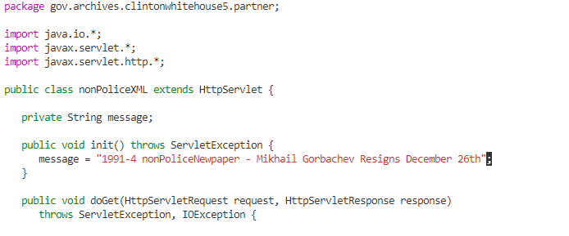
FBI
NAVY
(marlin)
J2EE PROGAMMER
JNI
ASM
C/C++/ASSEMBMLY
41.Cognitive ( sub-contious)
nonPocieTRXLgoical
Russel 500
1980
#include <iostream> #include <cmath> #include <fstream> #include <cstdlib> using namespace std; int main() { int acctnum[1000]; char name[1000]; double balance[1000]; //These are the three input-types used in the file. char input; int search_acct; int search_name; cout << "**This is the Accounting Program!**\n\n" << "Please enter the name of the file we\n" << "will be working with: "; //User-chosen text file, which will be stored as "random" char filename[50]; ifstream random; cin.getline(filename, 50); random.open(filename); //If the file cannot be opened. if(!random.is_open()) { cerr << "Error opening the program!!" << endl; system("pause"); exit (1); } cout << "Would you like to search by account number or last name?" << "Type 'n' for search by account number or 'l' for\n" << "search by last name."; cin >> input; //If the user desires to search by account number. if (input == 'n' || 'N') { cout << "Searching by account number...\n"; cout << "Please enter the account number: "; cin >> search_acct; //search_acct==acctnum; I tried this and it gives me an error random >> acctnum; do { //Reads each line as: account number, last name, and balance. random >> acctnum >> name >> balance; if (acctnum == search_acct) { //Outputs last name and balance for the account number searched. cout << "For the account " << acctnum << " the \n" << "last name is: \n" << name << "and the " << "account balance is: \n" << balance; } } } else { cout << "I could not find the account number."; system ("pause"); } }while(!random.eof()) } //If the user desires to search by last name. else if (input == 'l' || 'l') { cout << "Searching by last name...\n"; cout << "Please enter the last name of the account holder: "; cin >> search_name; random >> name; do { //Reads each line as: account number, last name, and balance. random >> acctnum >> name >> balance; if (name == search_name) { //Outputs account number and balance for the last name searched. cout << "For the user " << name << " the \n" << "account number is: \n" << acctnum << " and the " << "account balance is: \n" << balance; } else { cout << "I could not find the last name."; system ("pause)"; } } while (!random.eof()) } else { cout << "Your search method was incorrect."; system ("pause"); } random.close(); system("pause"); return 0; }

Slide 23
PENTAGON.INFORMATION TECHNOLOGY
WILLIAM LOVELACE
NAVY
(marlin)
FBI
41.Cognitive ( sub-contious)
nonPocieTRXLgoical
J2EE PROGAMMER
JNI
ASM
C/C++/ASSEMBMLY
Russel 500
1991-1994
package gov.archives.clintonwhitehouse5.partner

