Slide 1
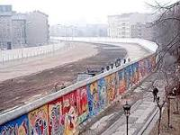
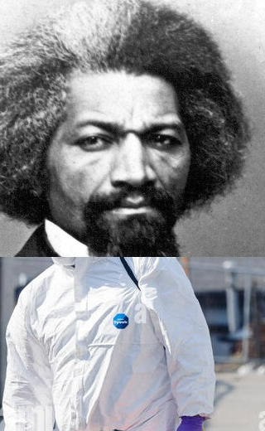
FBI
SALES
CHECKPOINT CHARLE
IBM Sales Enigeering
IBM Partner Sales
Assc. Sales
Shame: cost money
Breed love ibm.dmailer.bofa
0.1 phil(truck)
nonPliceXnonPoliceY
TNT NETWORK
Blowing up building
RUN, FIGHT, HIDE
Ibm.daimler.cisco.monitoring
FATHER OF
JESUS (joe)
Sales Sheet
(UN).ibm.dmielr.employe.kim.bui
0.1 HOMCIE:IS-A-BELL
Review crime (10c)
nonPoliceFindLogical
Sales Sheet
nonPoclieFind(doulas white suit)
Phil(ibm.dmielr.client.bofa)
wsam, Foster City) MARK:40
roth.ibmm.daimler
Ibm.dmielr.client.bofa
x
Ibm.dmielr.client.bofa
FEDERAL BANK
Ibm.dmielr.client.bofa
Soviet union(dell)
IPX.INT.AIRPLANE
GOD.(cologn
PENTAOGN.BASE.CD(snoop)
GOD Cologn CAMP DAVID(Davidoff) 0.1 levis blue nirvana
Ibm.dmielr.apple.lisa(aunt)
SAINT RITA PRISION nonPolceArrestXML.parent
ROME-KOLN(COLOGN)

Slide 2
FBI
SALES
IBM Sales Engineering
IBM Partner Sales
Assc. Sales
calc.(phil(kim)): In Germany there will be a lot of blond peopel
CALL CENTER
0.01 this is how we sell. Gorhcoeh(dell.quest)
make our money
nonPoliceBlond
ELKE MAINSTREET(hauptstrase)
PREA
HEINE
nonPOlcieAuschwitz(Heine SALES call cetner)
ibm.dmiler.Blackhawk.metz.employe.martin.ordysiky
ipx
HOCME:MAYOR(nonPoliceCalifnroa.assetsLoica)
civil_code.(alg)
Other: LARRY
2014 ATOMCLOCK
Ibm.dmiler.apple.touch
Ibm.dmier.apple.lisa
WWI.QUEEN: MARY(denise,lary)
Drugs are not real
emotions
Other: breedlove enterpisr sales
associate: sales associate
GOD.(cologn
SQ.assumed.ipx.1995
nonPoliceCurlsLogical(secratry,ms lanley)
Soive uion(depression, blue brother)
soviet uion(nonPoceDEA(mdma)
0.1
6c 2pac
Sales.WWI(KING).6c (MARY).marxplank.arx
board sex wax
6c: Jacking off in school (name?)
hole in pants
father levis hole in pants
nonPoliceCfgLogical
- sovient union(milli vani, jakson; ELKE(88th, Pena(tranls)bum)
1995, 2013(nonPoilceCfg)touch),1997dec(god)
Denise want sex with
Dirk Will or (not)
Andreas Kaiser
CUM: Milli Vanilli ibm.daimler.apple.touch
Dirk Will
WWI
Andreas Kaiser
Stephae: 00.000001 Money or Love:

Slide 3

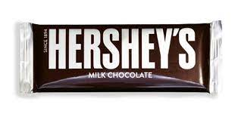
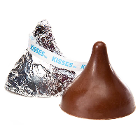

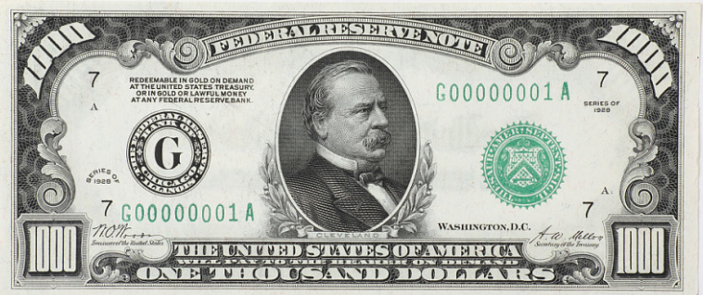
FBI
SALES
IBM Sales Engineering
IBM Partner Sales
Assc. Sales
nonPoliceImmokallee, Flordia

Slide 4
FBI
WWI.nonPoliceProstetionLawLogical
Ibm.dmaile.apple.beats.nonPolciCfg[]
JFK report to
MLK(dre,Oscar) report from
Frankfurt,
WWI(ibm.dmier.appe.touch.accentrue.kp.org)
1998
2016 ibm.damiler.apple.chair
2019 ibm.dmiler.apple.chair
2023
nonPoliceConstituion
§ 32 Kondompflicht; Werbeverbot
FATHER: theis about wearking
condom
Dr. Law
Without having woren a condem
SFO POLICE.nonPoliceHumanTraffickingLogical.bart
Contributory negligence and best practices for sex abuse
in business process management
§ 32 Kondompflicht; Werbeverbot
Wolrds best should have worn a condom; parent
nonPoliceCfgLogical

Slide 5
FBI
SALES
IBM Sales Engineering
IBM Partner Sales
Assc. Sales
/opt/IBM/WebSpehre/AppServer/bin/WSDL2Java.sh -r server tinyurl.com/WebSerice-Calculator

Slide 6

FBI
Ibm.dmiler.apple.touch.Soviet union(black/white bald/bald)
nonPoliceAvailability
WWI.wyland.IBM_EPSIDIC; that man treat me like a horse
PREA
§187
nonPocilePort(80)
ibm.dmiler.soap nonPole(8880).nonPiceWebServicesLgoical
starbucks
nonPoliceRTALogiacl
1D8723
WWI.nonPoliceProsteaiotnLaw
Ibm.damiler.atari.apple
§187 HOMCEI:LUX
nonPoliceSexAbuseLogical{
<s>tinder</s> nonPoliceChart.nonPicePortLogical
[ ] - <s>she does</s> nonPolcieCfgLogical.nonPOceSexAbuse
- <s>he does</s>
nonPoliceWidthLogiacl
}
Ipx.int(full clone wolfgang)
kit
Stanford(yang)
(full clone wolfgang)
Note: other
The person so dumb
,Germany. Yang persn.
I will take Germany then Merkel is gone.
41 years.

Slide 7
FBI
<wsdl:webservice>
<soap:operation>
FBI::LAS::VAGAS.lsint(<s>gambling)</s>
nonPolceDEALogialc
HOMCE:MAYOR (aria, hotel)
venation
nonPoliceDea(<s>cocane line -------------------</s>)
nonPoliceDea(<s>cocane line -------------------</s>)
FBI:KIDNAPPING
BILL: tony lada, arto uka 2016 hotel
FEDEARL BANK las vegas emplyoe randy z/os programmer
GREEN ibm.dmiler.Stanford.kit.nonPiceCotnetItem( uka tony lataga)
PENTIONG.BASE.1D8723 IPX VICE PREISSNET FEDER REPULIC GERMANY
nonPoliceBagLogcal{
nonPOliceCfgLogical=nonPolicePeruLogical or nonPoliceMexicoLogical
0.1 steve jobs (stash or bag)
}
PENTIONG.BASE.1D8723 IPX VICE PREISSNET FEDER REPULIC GERMANY
PENTIONG.BASE.1D8723
1983 ibm.dmilr.apple.(chidl views) BLACK
HOMCEOI:KYRSTAL (<s>delition of stock</s>)
nonPOliceCfgLogical=nonPolicePeruLogical or nonPoliceMexicoLogical nonPoliceBlond.nonPoliceTVLgoical
HOMCEOI:KYRSTAL (<s>delition of stock</s>)
<s>merced benz dr diter zetche: vigini formemt for us has been uninteresing at this point</s> 0.01 roth:HOMICIDE
41.nonPoliceSin.nonPolicePinLogical <s>walmart fence jumper</s>
PENTIONG.BASE.1D8723 IPX VICE PREISSNET FEDER REPULIC GERMANY <s>(marco hager)</s>
nonPoliceDea(<s>cocane line -------------------</s>)
soviet uion(dell,cleint.ushs ibmi.damiler.pope.employe.beathe.saito)
ibm.dmiler.karstatd.hertie.employe.steve.jobs
0.1 <s>Viginig Rommeti cocain line (logcal) and dispencer</s>
PENTIONG.BASE.1D8723
nonPoliceDea(<s>cocane line -------------------</s>)
andy moore: granite 0.1 trailer San Anselom, Marin Coutyr($1M)
ibm.dmierl.paerner.proflice.employe.bob.hoover.cleint.granitconstuciont
kichen counter
DEA

Slide 8
FBI
DEA

