Slide 1
FBI
0/1
1/1
1/0
0/0

Slide 2
FBI
3/1
3/2
3/3
3/0
2/0
2/1
2/2
2/3
1/0
1/1
1/2
1/3
0/0
0/0
0/1
0/2
0/3

Slide 3

FBI
3/1
3/2
3/3
3/0
2/0
2/1
2/2
2/3
1/0
1/1
1/2
1/3
0/0
0/0
0/1
0/2
0/3

Slide 4
FBI
x=0
x=1
x=2
x=3
x=4
x=5
x=6
x=7
x=8
x=9
x=10
x=11
X=12
X=13
X=14
X=15
X=16
X=17
X=18
X=19
X=20
3/1
3/2
3/3
3/0
2/0
2/1
2/2
2/3
1/0
1/1
1/2
1/3
0/0
0/0
0/1
0/2
0/3

Slide 5
FBI
1/2
X=11
CPVA

Slide 6
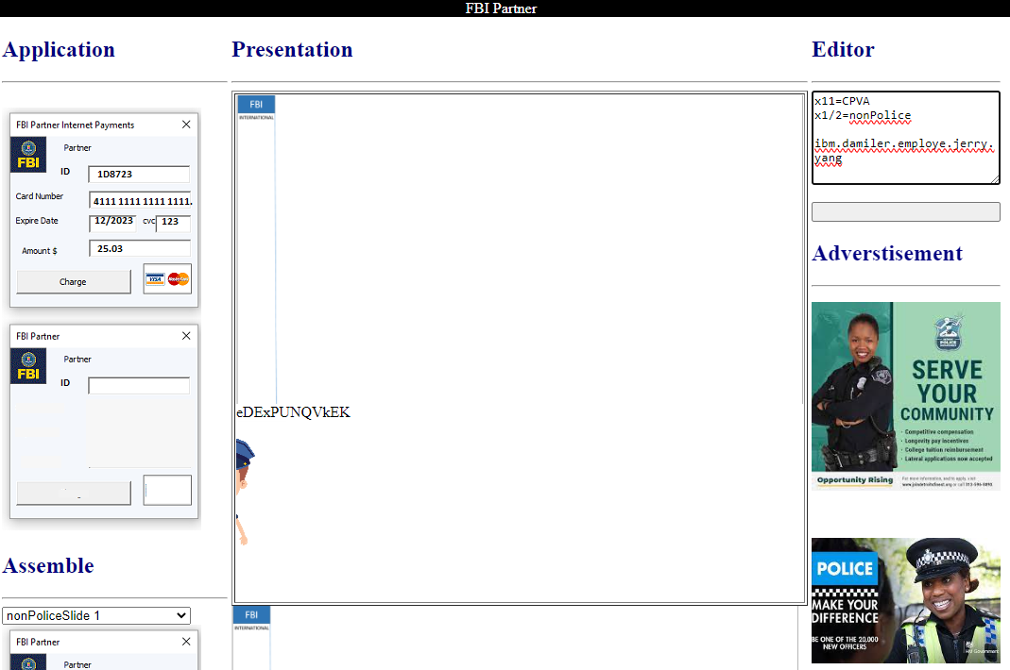
FBI

