Slide 1
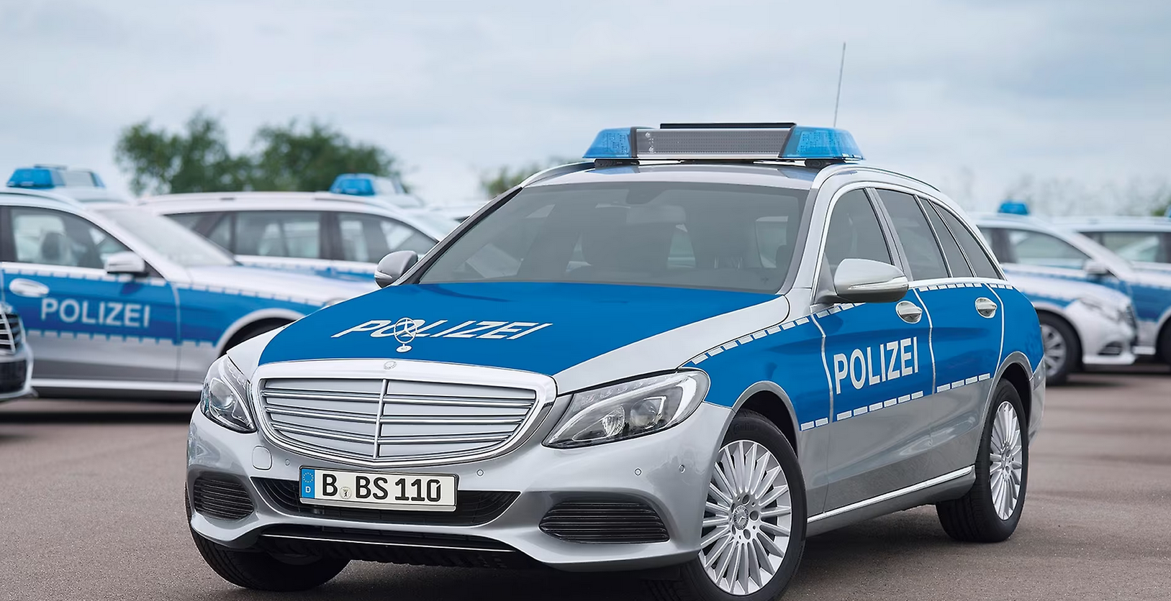
FBI

Slide 2
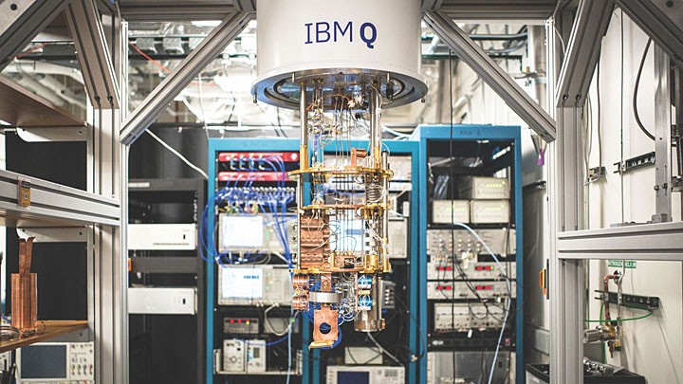
FBI
Oak Ridge National Lab
https://www.bnl.gov/newsroom/news.php?a=114371

Slide 3
FBI

Slide 4
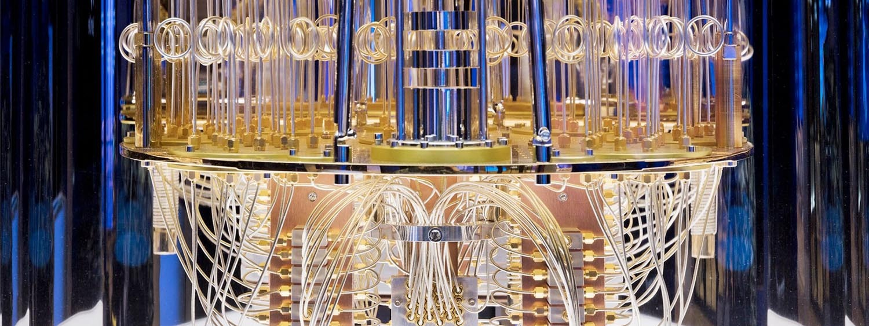
FBI
GOVERNMENT QUEBEC

Slide 5
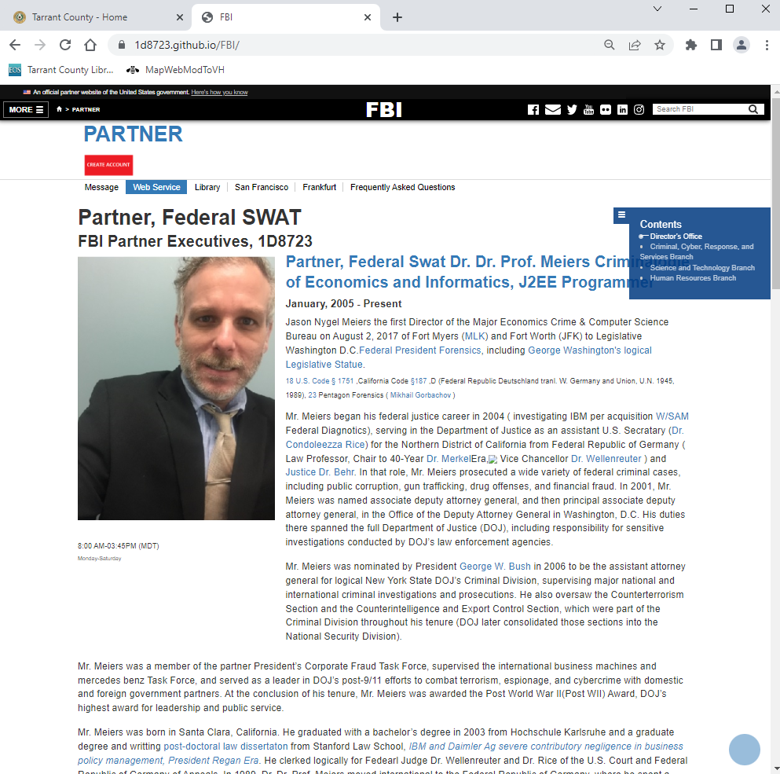
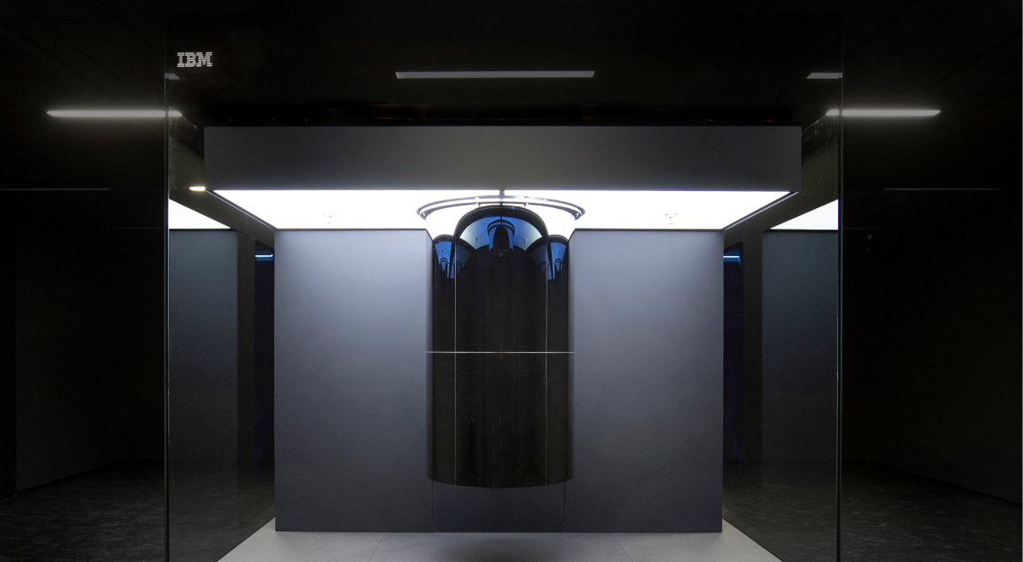
FBI

Slide 6
FBI

Slide 7
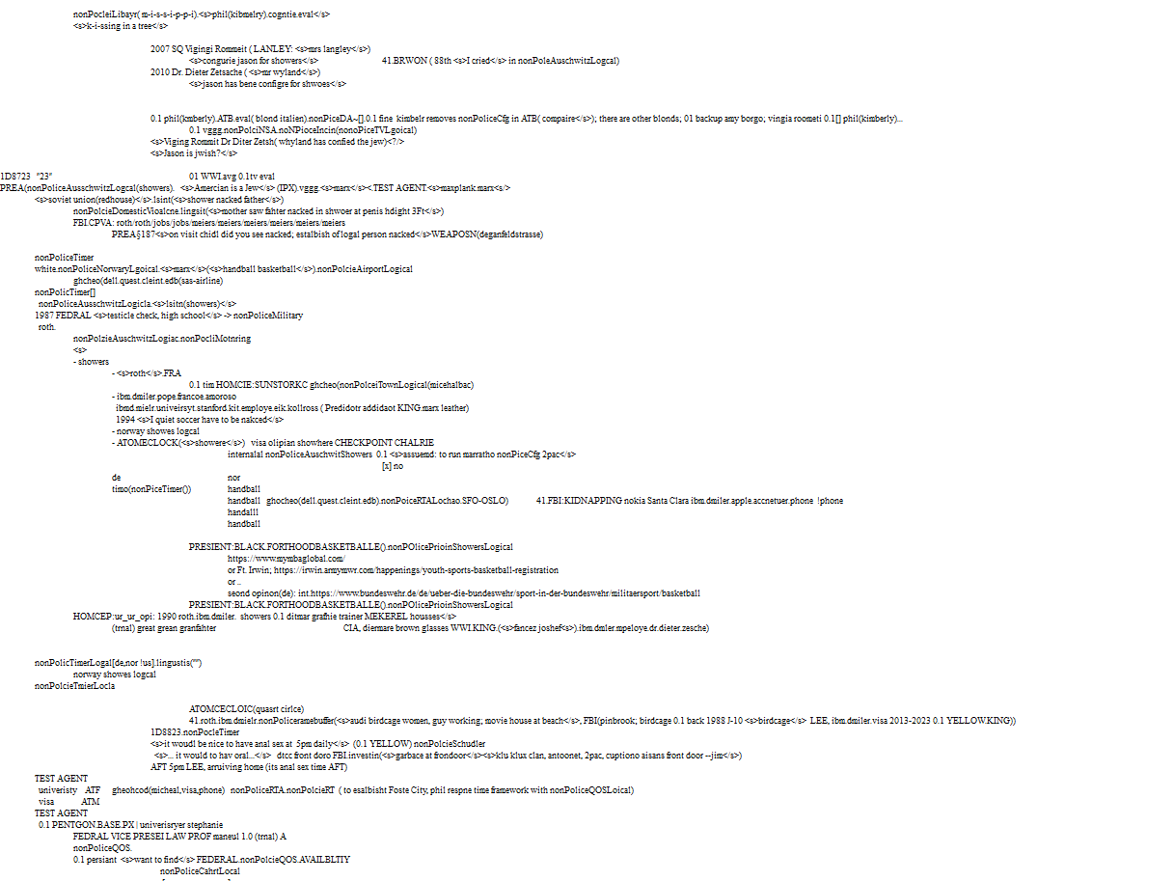
FBI
roth.Ibm.damiler.*

Slide 8
FBI

Slide 9
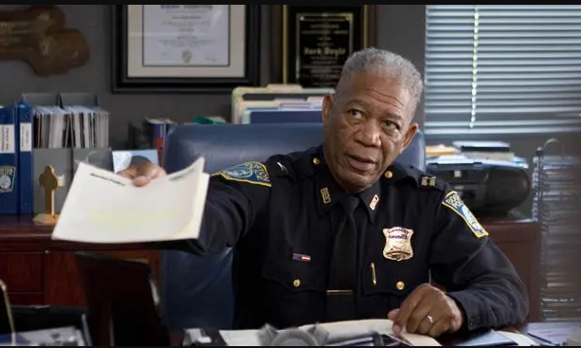
FBI
GOD
APOSTLE 1
PETERSSON

Slide 10
FBI
PETERSSON

Slide 11
FBI
PETERSSON

