Slide 1
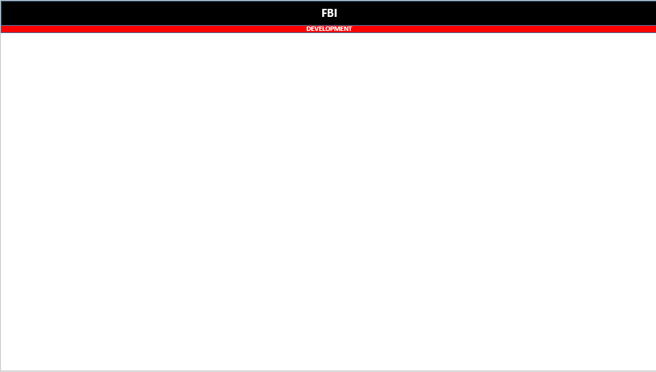
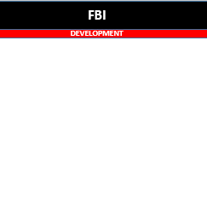
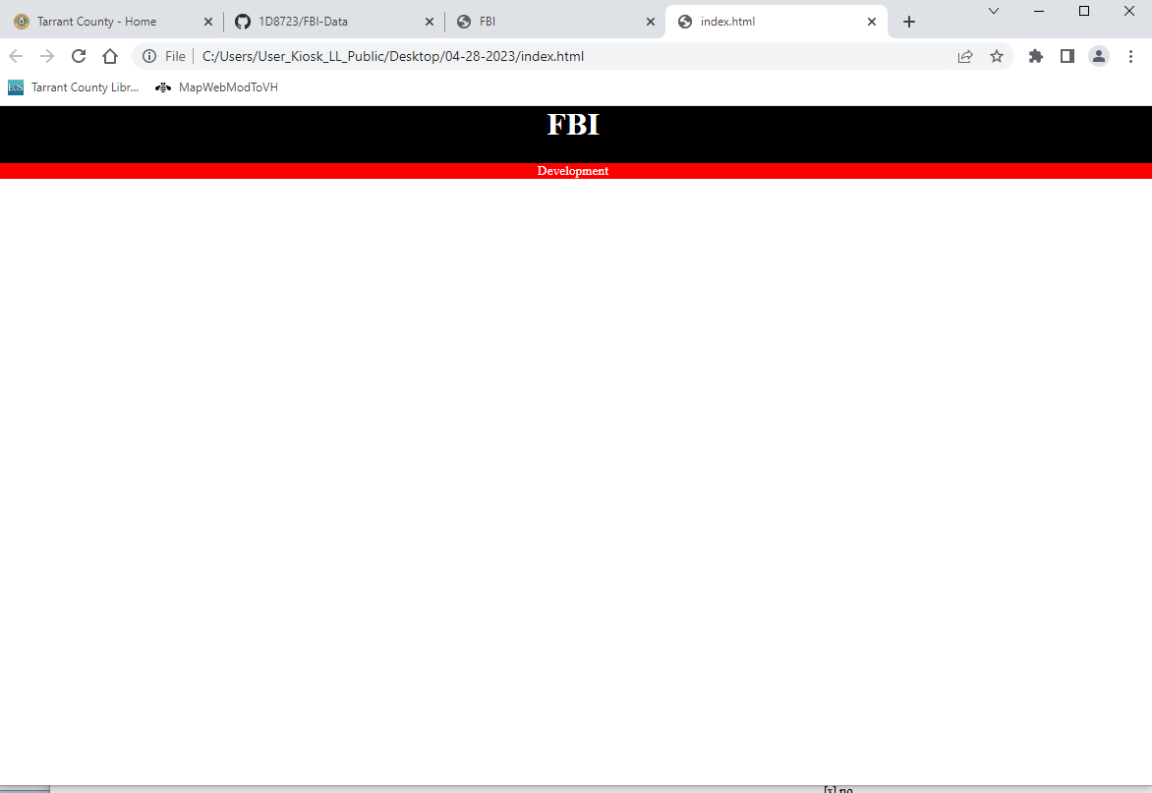
FBI
DEVELOPMENT
Cook(koche)0.1nonPolcieDEALogal
0.1 roth CIVIL_CODE,CRIMINAL CODE RED/ROTH
Powerpoint Application
Windows Application
Brower

Slide 2
FBI
DEVELOPMENT

