Slide 1
FBI
development
PENTAGON.VIRGIN.MARY
LARRY
1994
1996/7 SQ.COLMENA.(Leroy)
Amiga:daniel
SOCIAL SECURITYY ADMINSTATION
1986
FREE(PIZZA)
nonPolieDEA(crackpipe)
1986
NAME CHANGE(FREE(PIZZA)
Better graphics
amiga
CPVA
Warped 0.1 recoded.ghoche(Jackson)
nonPoliceDEA(lsd)
x
Atari.apple(c++) IPX(2016,2001,1986) brian/esaw
passthru
logical
nonPoliceDEA(lsd)
nonPolieDEA(crackpipe)
Consitution(copy)
JFK(ghoeh(dr/joe),Ghohceo(dr,nonPoilceCoutnry(switzland))

Slide 2
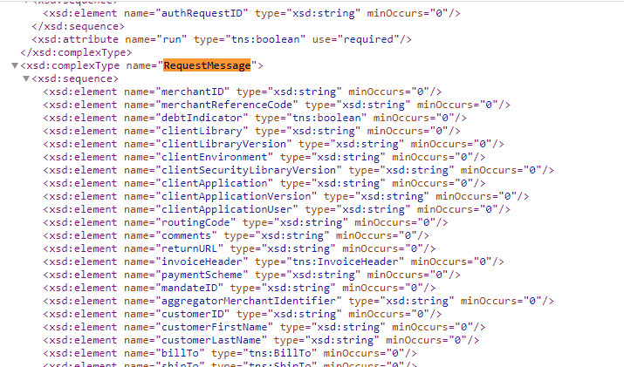
FBI
development
FBI:WHITE COLAR
https://ics2ws.ic3.com/commerce/1.x/transactionProcessor/
https://ics2ws.ic3.com/commerce/1.x/transactionProcessor/CyberSourceTransaction_1.210.xsd

Slide 3
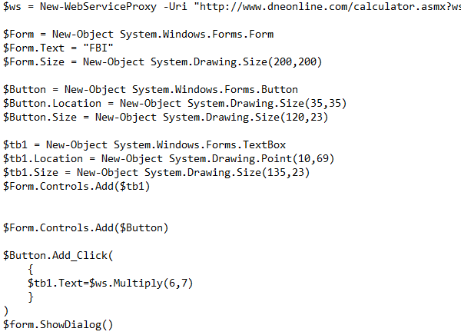
FBI
development
FBI:WHITE COLAR
https://ics2ws.ic3.com/commerce/1.x/transactionProcessor/
https://ics2ws.ic3.com/commerce/1.x/transactionProcessor/CyberSourceTransaction_1.210.xsd

Slide 4
FBI
development
41.HOMICIDE:CHANZLOR
At JOHNSON’s House?
PENTAGON.VIRGIN.MARY
41.NAME CHANGE.CVPA:FREE(PIZZA,Petersson,Jesuse and God)
LARRY
1994
1996/7 SQ.COLMENA.(Leroy)
IBM
Amiga:daniel
SOCIAL SECURITYY ADMINSTATION
1986
FREE(PIZZA)
nonPolieDEA(crackpipe)
1986
Linkedin.*
NAME CHANGE(FREE(PIZZA)
Better graphics
Daimler
amiga
CPVA
Warped 0.1 recoded.ghoche(Jackson)
nonPoliceDEA(lsd)
x
Atari.apple(c++) IPX(2016,2001,1986) brian/esaw
passthru
logical
nonPoliceDEA(lsd)
nonPolieDEA(crackpipe)
Consitution(copy)
JFK(ghoeh(dr/joe),Ghohceo(dr,nonPoilceCoutnry(switzland))

Slide 5
FBI
development
FBI:WHITE COLAR
0.1 0.00001 asusemd; job plaments with techonloyg for Web Service
Ibm.websphere
SAML
SavvyMoney

