Slide 1
FBI
Develoment
I want to be in Support
L3, SWAT

Slide 2
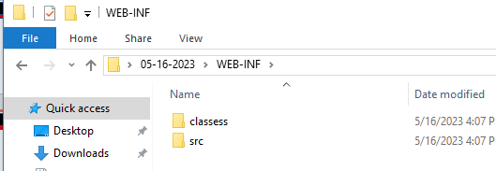
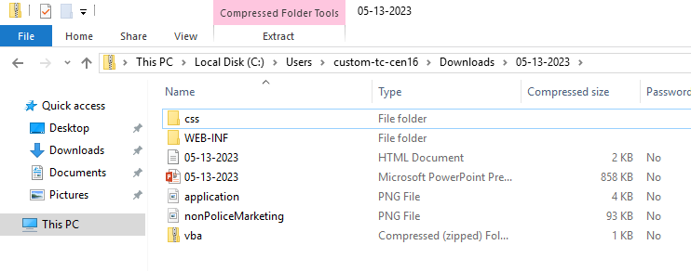
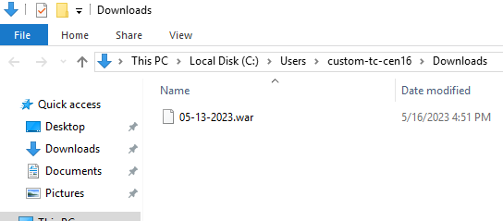

FBI
Develoment
I want to be in Support
ITIL Suport Help Desk
Employ of the Month(logical)
Engineing Not working
Existing Sales
Capability of Porcessing ITIL Service Support
No Sales
L3 Walmart Crizit Party(logical)
§Elder Abuse
05-10-2023.war
1E9232 not working

Slide 3
FBI
Develoment
FBI:WMD.nonPoliceCity(seattle)
White.rice
SQ.realplayer
POLIZEI HAMBURG ghohceoi(dr)
IPX.Al Kaida.ATOMICBOBM(ATOCMCLOCK)
SQ.realplayer
Montesanto
IPX HOMCEI:Lux.noNPoceliCity(las vega)
2010
MAINSTREET(EVIL)
2007
Gorghe(micheal,micheaal,girlfies,backer boeser(tranl)evil)
FBI:WMD
Guniess
SQ.realplayer-2
classmates
FBI:KIDNAPPING
Gary(cource surfing fred)
HOMCID:LUX:VHS(seatl ports,hgocheo(heger))
MLK(nonPiceWife(micheala)
starbucHQs
FBI:WMD
CHEESE
VAN: SQ.JUM
Ghcoheo(nivana)
FBI:WMD.MAINSTREET
[x] no

Slide 4
FBI
Develoment
FBI:WMD:IBM FORT WORTH
./ibm start
./ibm webservice

Slide 5
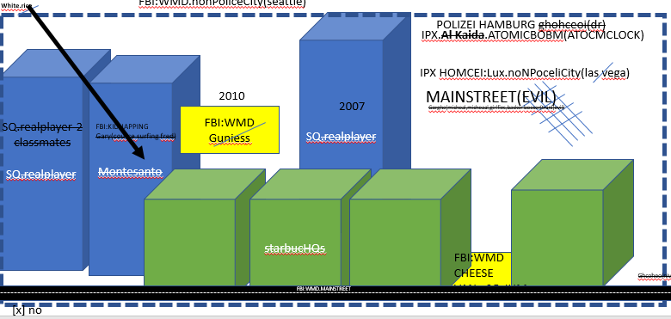
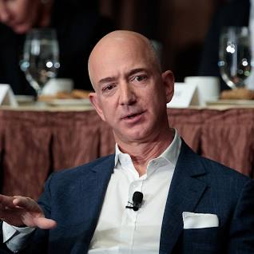
FBI
Develoment
VIGINA, PENTAOGN IBM (Pope Nun; Rockefeller)
HOMCID:LUX
Las Vegas
2013
Seatle
2007
SQ.Jim

Slide 6
FBI
Develoment
VIGINA, PENTAOGN IBM (Pope Nun; Rockefeller)
FBI:WMD
Ghocheo(dell)
2013
DUBLIN
SAN RAMON
SAN CARLOS
SQ.HOMCDI:STUSTROKE
SQ.Jim.VICE PREISCE.CHarles

Slide 7
FBI
Develoment
9-1-1 Al Kaida, Micehal Gorbhcae POLIZEI:AHMBURG
Bresat GREEEN:HOMCEI:LUX
Ports
20 Seconds

Slide 8
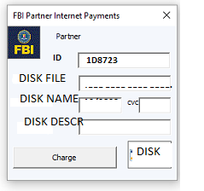
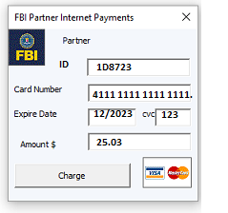
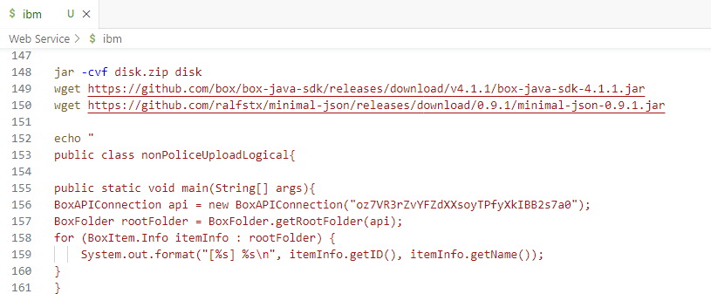
FBI
Develoment
10GB
j2ee
Java
DISK
Box.net

Slide 9
FBI
Develoment
x
Web Service installs
Web Service Starts
I want to be in Support
./ibm start
Employ of the Month(logical)
Engineing Not working
Existing Sales
Capability of Porcessing ITIL Service Support
No Sales
L3 Walmart Crizit Party(logical)
05-10-2023.war
1E9232 not working

Slide 10
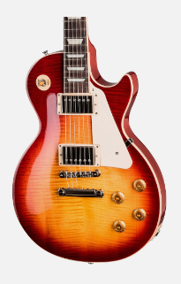
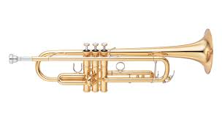
FBI
Develoment
REDHOUSE
NAVY
1983/4
2013

