Slide 1
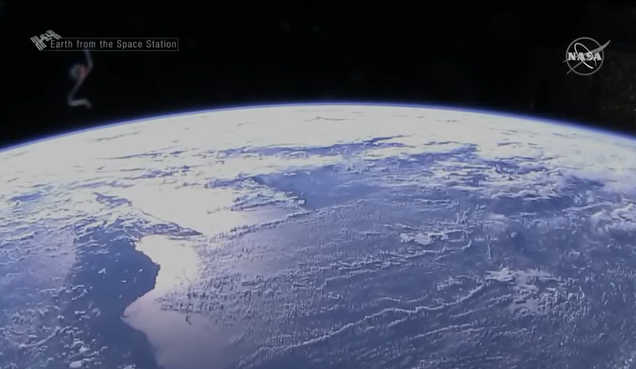
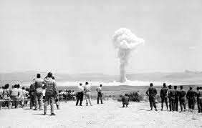
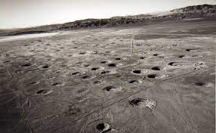
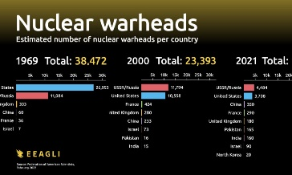
FBI
Iran
Indian
China
Pakstan
As of 2022, about 12,700 nuclear warheads

Slide 2
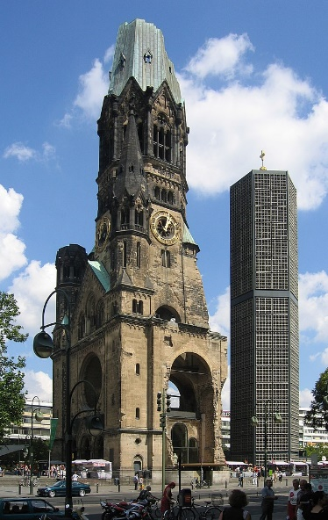
FBI
Iran
Indian
China
Pakstan
Wyland house
12,699
As of 2022, about 12,700 nuclear warheads
[x] no

Slide 3
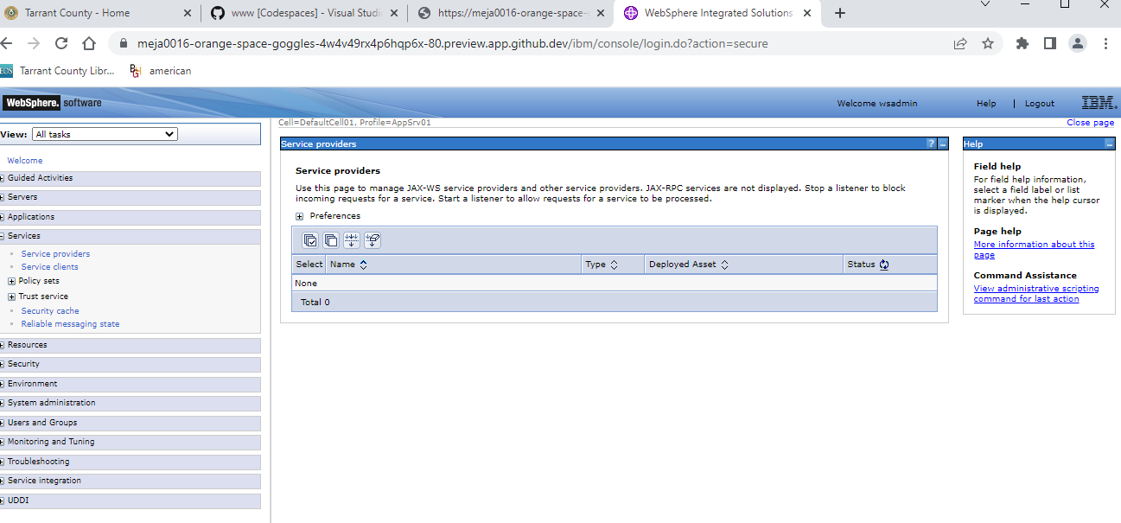
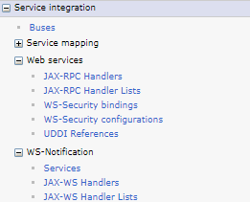
FBI
41.San Quention Prision,
Larkspur, Califnoroa
Gorbhacne(nonPoceiWife(micheala)
Movie
Theater
Sex and city
PREA
mass lake
41.SQ.tencity
offsite
2004 IPX 2007/8
Dog colar
Jyll w/o jack checks
Joesphe.checks
Phil(kim).checks
nonPocliDEA(evo,jakcata,java,mdma)
girlfriend roth.ibmd.mier.apple.accentuer.siri(wake up susi)
Marin Airport
IMPORT 2011 INTENET PAYMENT(VISA) ty lim soa, kickcboyb death match
PREA.§187
GOV. SWCHW.CAPTOL SACMENTO:MATHIAS:jax.NAVY(tatto)
[x]no
[x] no
2005 Web Services (soap) MATTHIAS 2003 Web Service
(FRA rheimain-main)
FBI:WMD:MAINSTE(DISNEYLAND,
2011 britney rtt) synsth transciton)
[x] no

Slide 4
FBI
INDIA
Roth.ibm.dmialer.apple.accntuer.touch
Roth.ibmd.meir.apple.accnetuer.pay
HOMCI:WILY
Rat pack; bank
PREA.§187 ACH FEDERAL
Church: nonPocieIdnetyFhtef(Johnson)
Joehsep suaders
OFFSITE: Checks
offsite
https://www.ibm.com/docs/en/was-zos/8.5.5?topic=samples-jax-ws-web-services
Dog colar
Jyll w/o jack checks
Joesphe.checks
Phil(kim).checks
Friends
Feebee
Joey
changdelr
Phil(kim) to forvie someone form shelter on tv(VINIGIAI)
for NAVY.tatooo.marx
WWI.GOD.nonPoliceHomellseLiasion.nonPoceiTV
(88th othropedi JOEPHSE.massage $700/m)
Ghoeh(dr,JOSPEPH)
HOMCEI:TRANSVETIE
PREA

Slide 5
FBI
Without Web Service (EJB)
GOVMENT.RUMPSFELD
- hamburg fighting over IBM Businees Process Mamange (BPEL)
Hanburg, Markus Breilmann
New Consultant
VIRGINIA
iSOAGroup
https://www.ibm.com/docs/en/was-zos/8.5.5?topic=samples-jax-ws-web-services
Vggg.nonPoclieTexasNA.INTENT PAYMENTS.lotus
JOESPHE
Mark(us)
Hamburg(al kaida,ghcoheo(dr,jesus,capternr)
Ports Sun/Oracle/IBM Automated
41.SQ.HOMCEI:KRSTAL:MATHHER.nonPoliceArestXML
CANADALgia.marx
1D8723
BPM Consultant, !white.INDIA
toilet
1x
0.1 recycling GOV.SAC.MATHEW.jyll/jack

Slide 6
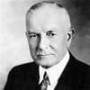
FBI
VIRGINIA
AMTSGERICHT KOCHMAN
roth/roth/jobs/jobs/meies/meies/meiers/meiers
GRobabhce(dj Cox,Love Parade)
Ghocheo(dr dre)
§187, PREA (1D8723)
king/queen/roth/roth/jobs/jobs/meies/meies/meiers/meiers
[x] no
KING
QUEEN
Yok-er.marx(funny to watch,now pay)
Congratulations
You have a son.
Thehun
CHART
INTERUPTS
[x] no
JFK.BULLET.SHOOTER.”PENG”
HOMCEI:CHANGLOR.VIGINIE(z/app).NAME CHANGE(free pzza)

