Slide 1
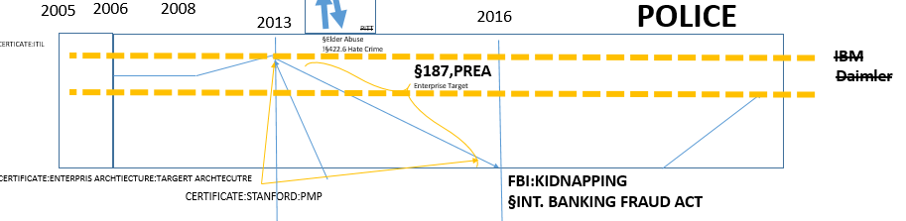
FBI
HOMCIDE:ur_ur_opi: an apple death prision in soviet union univerity
1993/4
HOMCE:JO(HANNES)
Beach
PlazaPark
JFK(CHECK POIN CHALIE)
visa wall olypics blond
2011
Roth.ibm.dmielr.vsia.mcarthy[0]
Roth.ibm.dmielr.vsia.mcarthy[1]
Roth.ibm.dmielr.vsia.sauners[1]
2017 Phil.(ki,m).§31 Kodompflicht
HOMCIDE:CHANZLOR:.sltin(jana, visa 000.marx A.E.DTrainign)
Shrot: wait 25Y (1987-2013) using phil(kim) A.E.D
§Treason PENTAGON VIGINA MARY
§Theft nonPoliceAttementsLogical
IMPORT
2006/7 roth.ibm.dmielr.apple.accnetyer.touch
roth.ibm.damielr.appel.accntery.pay

Slide 2



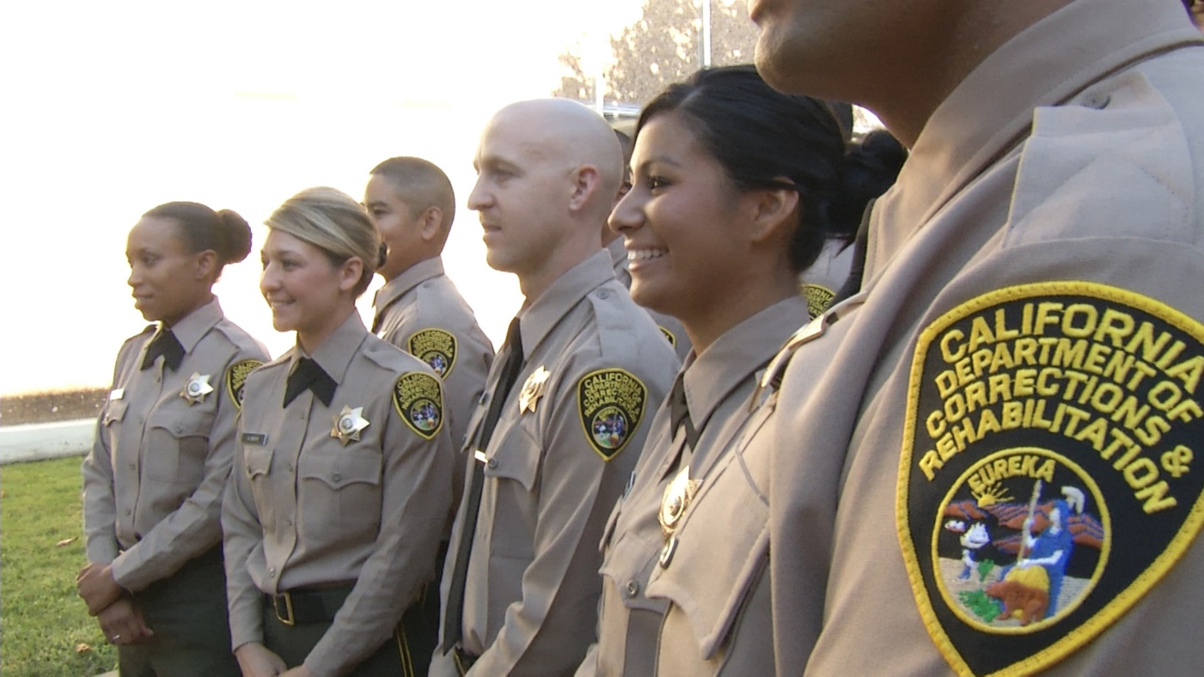
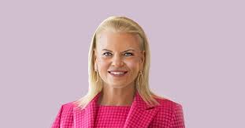

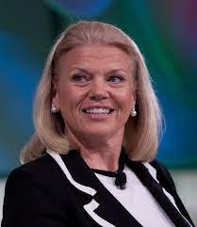
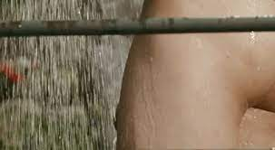
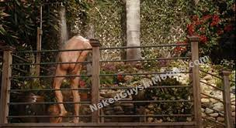
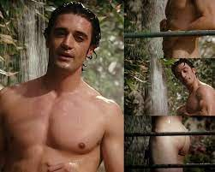
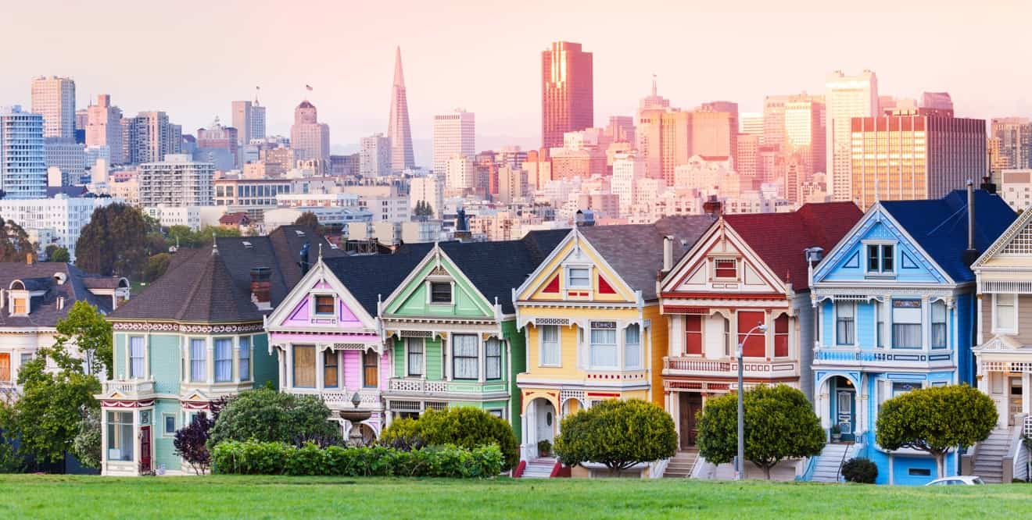


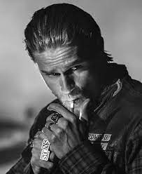





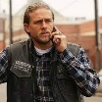


FBI
41.No motyclce phil(kim) 3-lete code KTM
HOMCEI:7.DL
MLK(41.nonPolcieCfg.GOVEMENT,tivoli framework)
PARTNER:SACRMENTO
[x] no
[x] no
Offsite:
[x] no
SQ.MATHERW:
San anlsemol
Sanrameto
SQ.MATHOAIS
jack
Cupterion eecltorc
Roth pg&e
[x] no
§subsubme fmayly nonPcioeHomelleiaons(gary cook)
[x] no
Baby vaginai
towel
[x] no
Bleck mothocler
[x] no
[x] no
[x] no
[x] no motocyle
[x] no
Chienase motocyle
[x] no

Slide 3
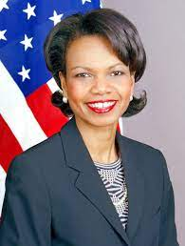
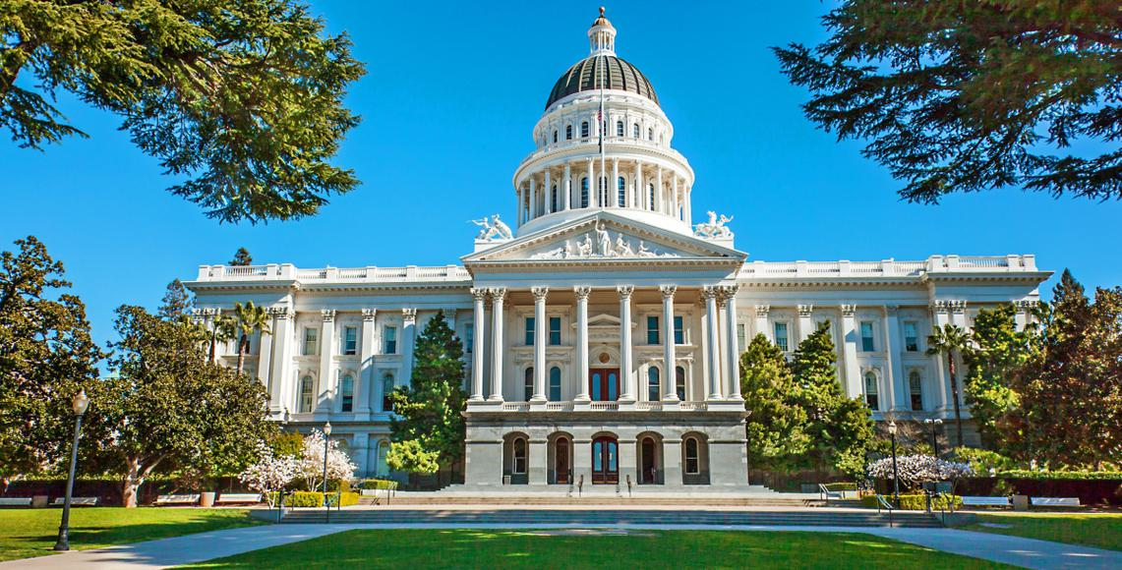
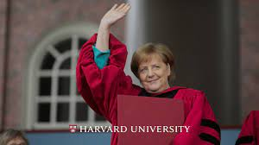

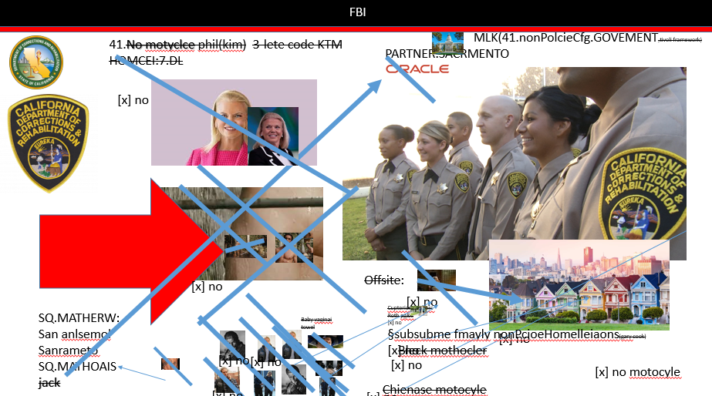
FBI
PENTAGON VIRGINA MARY
I need a harvard 41.marxy
MATHEW(jack)
MATTHIAS(jack)
IMPORT
CHECKPINS CHALRI( JFK(kdwe)blue/red; ibm oracle )
NAME CHANGE
- Jack
- Olivvia
41.

Slide 4
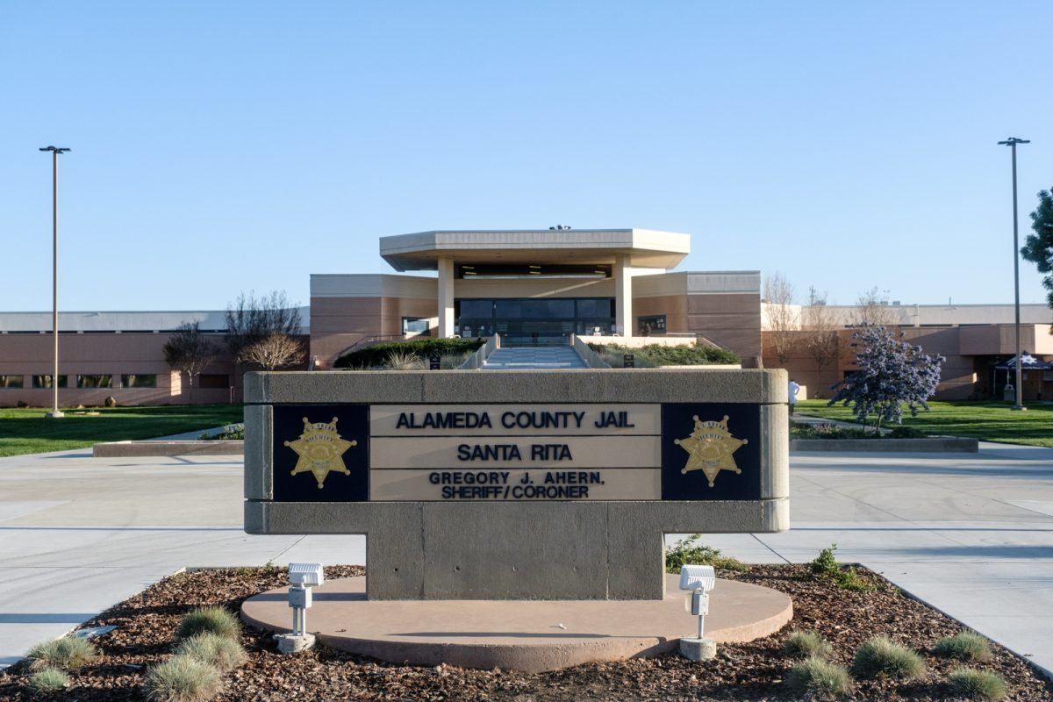

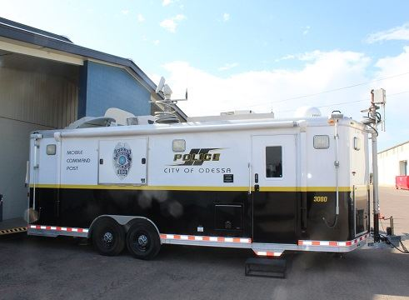
FBI
ATOMICBOMB
(googke, methlab HOMCEP:SUNSTORKE
41.Guy pakrs in fron of house with trailer(on google))
HOMICDIE:KYSTAL
MATHEW(INT)
Development of SQ.HOMCEP:KRTAL face
2005 INT IPX HOMCDIE:TRANVESTITE
Assuemd:JOSHEP.tylim.soa
JOHN(Eden).soa
2006 INT IPX HOMCDIE:JO(hannges) LANGLEY.marx(Mathew)
SQ.GOV.SCHW
DAMILER.trucks
Thomasis-dieter
WWI.Glu.lugwdi
LARRY.marx(page)
41.WWI.HOMCE:KYSTAL(breakinbad).WWI.SCREEN.phil(kim)

Slide 5
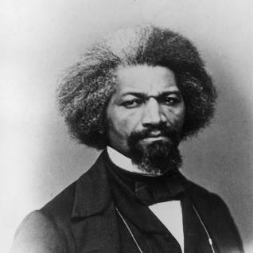
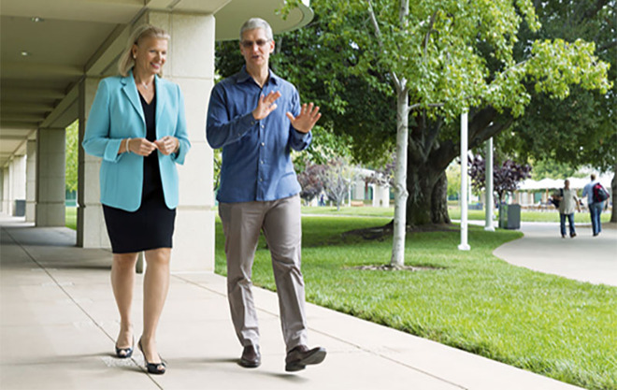
FBI
Pricipals Office Avg. no wife, no chled, no house…
Human resoeurce: 41.nazi
Fag: That dog pitbul that killed HOMCIDE:7 san farnc and HOMCEI:2
S.F. boy, 12, killed by his family's pit bulls
HOMCIEI.lsint(kill, apple cloned office HOCME:SJUSE:HOMCEPETER)
0.1 fag
Glu clone VINGIA
…
FBI:KIDNAPPIGN.CIVI CODE (invert) the fat one did it.avg.CPVA

Slide 6








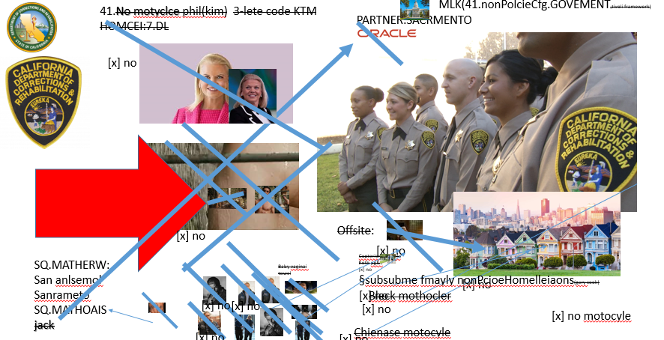
FBI
MAINSTREET
SQ
2007
IPX
SQ
1997
41.SQ.Tent City
Jyll:checks
Phil(kim):checks
Jason.Production(1 russian, 1 child)
LARRY.development(1 russian, 1 child)
MAINSTRET(video rental).WWI.
5x
Leave the one
I am with
MLK(report to: ghoceh(king)
Roth.ibmd.emir.apple.accnety.touch
Usher: ss monkey anal
A black person to have anal sex as slave
Afica ss tanned Atlatick
tanned Wife
tnnanted God.nonPocleiTunisien
tanned
[x] no
VISA
Micheal L king
Tranl(zuerkerbert)
ALG.roth/rothjobs/jobs/meiers/meies/meies/meiers
2014 leaving the one I am with
Amy, Jamie, Jamie(Ayso)
To clean moneyk asshole in Baden-Baden
tanned
[x] no
Das fest
FBI:KIDNAPA ( jyll offsite, dog collar CIVIL CODE)

Slide 7
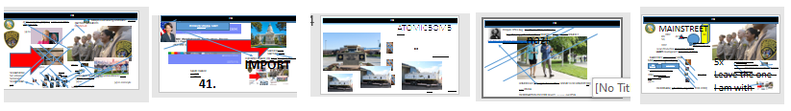
FBI
Ty Lim, Cage Fiting, Death Math
Web Sphere SOA
Tivioli SOA
[x] no
CHART
INTERUPTS
0.0001 HOMCEP:PETER(yang)
NAMCE CHANGE.nonPoclieCfg.FBI:TEERORMS(extoroing)
He know who killed Jesue and Peter
phil.JFK.MLK
Development of SQ.HOMCIDE:KRSTAL face
NAME CHANGE(free/pzza)
INTERUPTS
CPVA.NAME CHANGE(free/pizza)
nonPOlciLogialcPrison
Takin car eof herio additct
DEFUALT.ID.DE
Schulz Prision
HOMCEP:ur_ur_opi Prision
nonPoliceSainRitaLoic
SISTER:oscar
41
HOMCIE:KRSTAL Prstio (Hoffman,tootise)
nonPiceAresstXML
CEO steals grandfather identy
Company makes person want
To go home,without capaiblit
Of goion home. To avild dealth penalty
Govment project intestupstin intenratal
Pengon Vignia Mary
MATTIAHS(42) nonPociArrestXML
JOSPHEE:HOCME:JSUES:PETER father nonPolciAreetstXML
[x] no
FEDERAL VICE PRESIDENT GERMANY (kahn, nonPolicArestXML, CHINA)

Slide 8


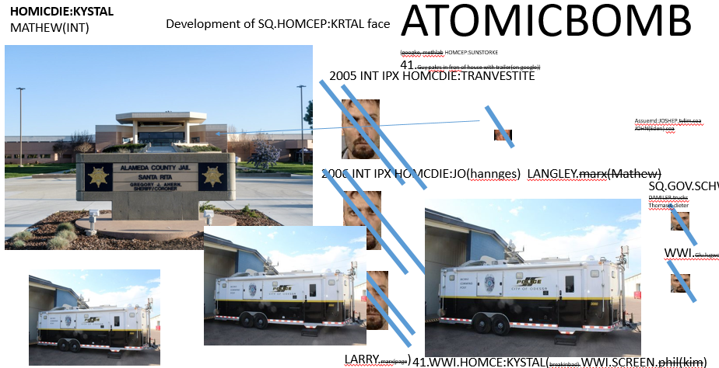
FBI
MAINSTREET
air
osar
WWI.glu.ludwig
Red flag
S
Avg.White.
nonPocieKentuckyLgial[1]
SCREEN
SCREEN
Guy Defines Context
PREA
Inventor of software technology creates criminal memory storage
That defines employees transition from on company to the
Next violating civil code and the prison rape elimination act.
Stores computer context on the screen, in the browser around
The desk and office area. The San Quentin extension the FBI
Investigation of Charles Manson; creating the prisoner
identification.
Fag: Cook/Kevin/martellin

Slide 9
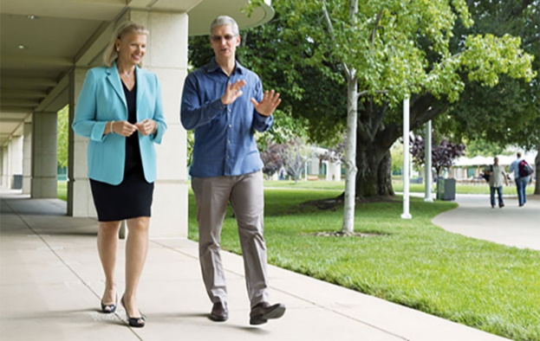
FBI
FBI:TERROM:PAUL:FBI:WMD
Glu.hr.fag
Moody.
Apple
Bertalmamns
…
Whe yu arri in the pricia office
0.1 my wife is at home and infanct ( form the vagiana!)
Then you will understand that..
[x]no
w/sam Arthur pricapal
G.CPVA.JEW.cuba.nonPociCity(Livermore).pricipal

Slide 10
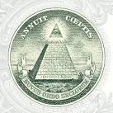
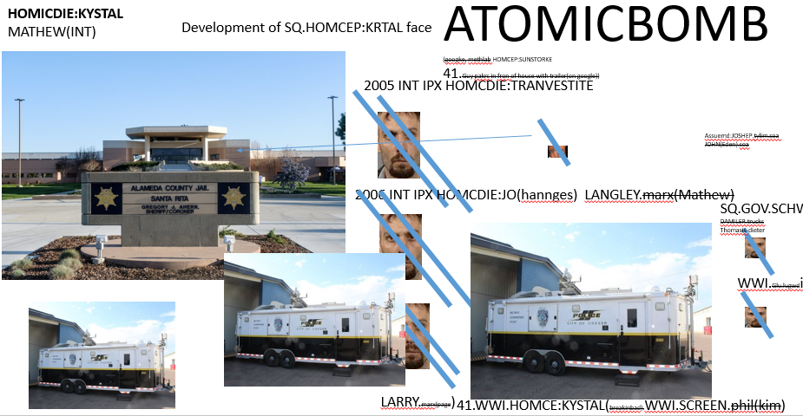
FBI
schdeuler
FBI: WHITE COLOAR : Ponzi scheme
Create a trailer
Deploy a trailer
Deploy many trailer
Roth.ibm.dmeir.parnetre.prolfice
Whe yu arri in the pricia office
0.1 my wife is at home and infanct ( form the vagiana!)
Then you will understand that..
[x]no
w/sam Arthur pricapal
G.CPVA.JEW.cuba.nonPociCity(Livermore).pricipal
Roth.ibm.dmeir.parnetre.prolfice.tamgrpu.isogroup.svstech.camoslutiosn.meiersllc.peterssonlllc

Slide 11
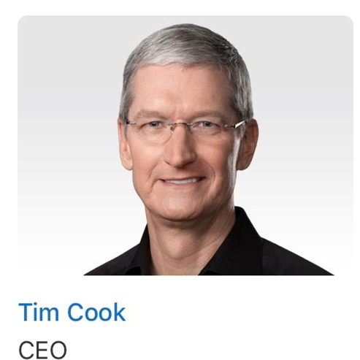
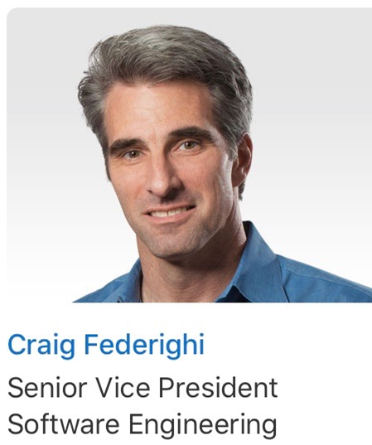



FBI
Kenny walks in troom hey ther I am bobby brown
IPX.MARY.marx(daniel).ELKE.STEVE(Elke: danile is a normal person and boyfriend)
Tower of Power
Fist fuck
IBM Deport Celan and Trust
Corpaiton
NAME CHANGE(free/zizza)
2005
INT.IPX.BENJAME
LARRY.(jim/ytruck)
PENTON.YANKEE(TOWEL)buy svu
$1 Trillin
$1 Gazzlion
Roth.ibmd.meapple.accnetuer.pay.employ.saby.tozin
Ipx
ATOMCLOC(PREOSIN OBMAM.maxplank.aei.marx)
(othe: ipx riche rich; scrooge)
HOMCEI:VHS:LUX
HOMCE:VHSO:LUS:IS_A-BELL
2007 HOMCID:WES(LY dttc z/os z/app)
41.
nonPodlieDEA(cocain Kenny)
Tim and stev cocian
At beach
nonPoliceCfg(moviign)
Roth.bimd.dmaoi.apple.accnetyer
[x] no
nonPolciCourty(Mexico)
Cheaking, leavin wife
[x]no
Cyperes drive
[x] no
(othe: ipx riche rich(ddr); scrooge)(sviet)
HOMCEI:VHS:LUX(ddr)
HOMCE:VHSO:IS_A-BELL(soviet)
nonPolcieUsageL:ocial(cisocm ontoring,other)

Slide 12
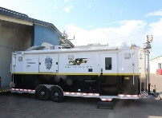
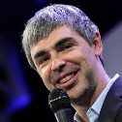
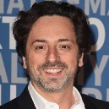
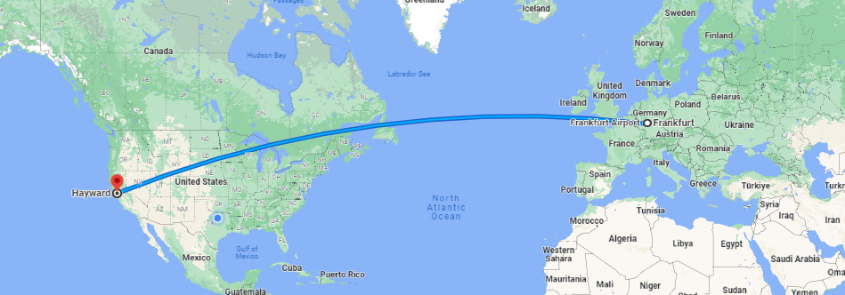
FBI
IMPORT
If Barack does someth wrong
SEARCH (to google)
FBI:WMD(BLACK)/RED
Phil.kim
ATOMICLOCI(mainstreet)
HOMICIDE:KYRSTAL
[x] no

Slide 13
FBI
no

