Slide 1
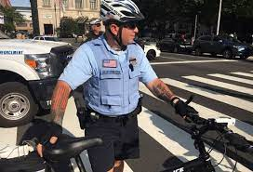
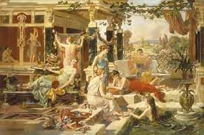
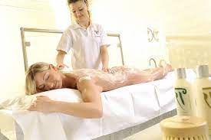
FBI
develoment
POLIC.NAVY.TATOO
1998 nonPoliceCfgLocial.IPX.2016 dumped
HOMCEI:CHANGEL.pope.WWI.agela.IPX.lsitn(francwwco)
41.The mayr, govmetn and fincial bank go to spa; painting
x/y infant extroign x/y INTENT PAYMENTS
2004
yang
He will not end
Up naekd at the
Not factory town
massage
nonPoliceContentItem()
SF:HOMEI:MAYRO(extortion)
2016
2009
All baden baden
massage of
all romens, italy
SQ.FBI.instie(chaarl mason)
§31 Kodompflicht
Yang Chinese prostuaotin sliivion valley
Calc.White.marx LUKRATICE? Equalitcity function?

Slide 2
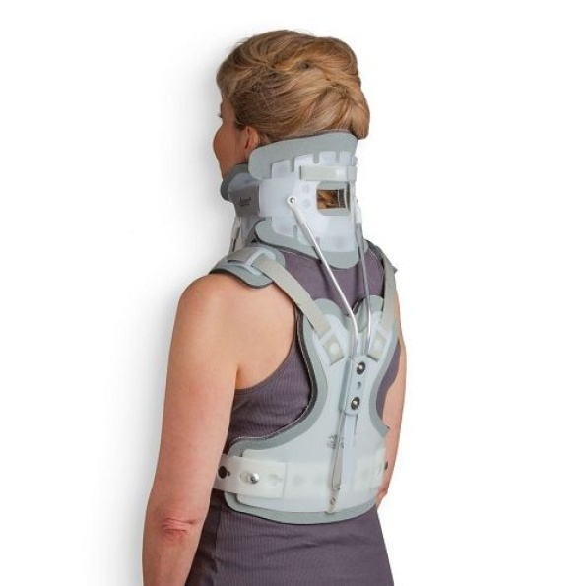
FBI
develoment
POLIC.NAVY.TATOO
1998 nonPoliceCfgLocial.IPX.2016 dumped
88th AND WAR
HOMCEI:LUX:COINTIENT.IPX.INT.CIVIL.CODE
Yang grandmother vagain back 2004 IPX.HOMCICE:NANA
Cervicothoracic Brace Adult
WWI.WW2.INT.CHECKPOINT CHALIE
1991
1994 1998 2000 2011 2016
IPX:HOCME:LUX:CONSOTN(BEJAMEIN
Baden-Baden)
russai
Irnalnd
Italy

Slide 3
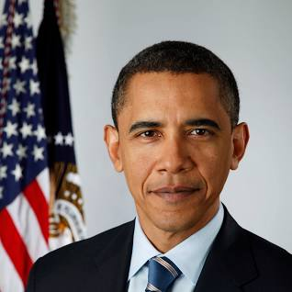
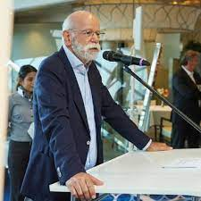
FBI
develoment
1980 POLICE.NAVY.TATOO
2023 POLICE.NAVY.TATOO
Yang Chinese prostuaotin sliivion valley
Calc.White.marx LUKRATICE? Equalitcity function?

Slide 4

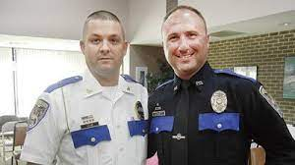
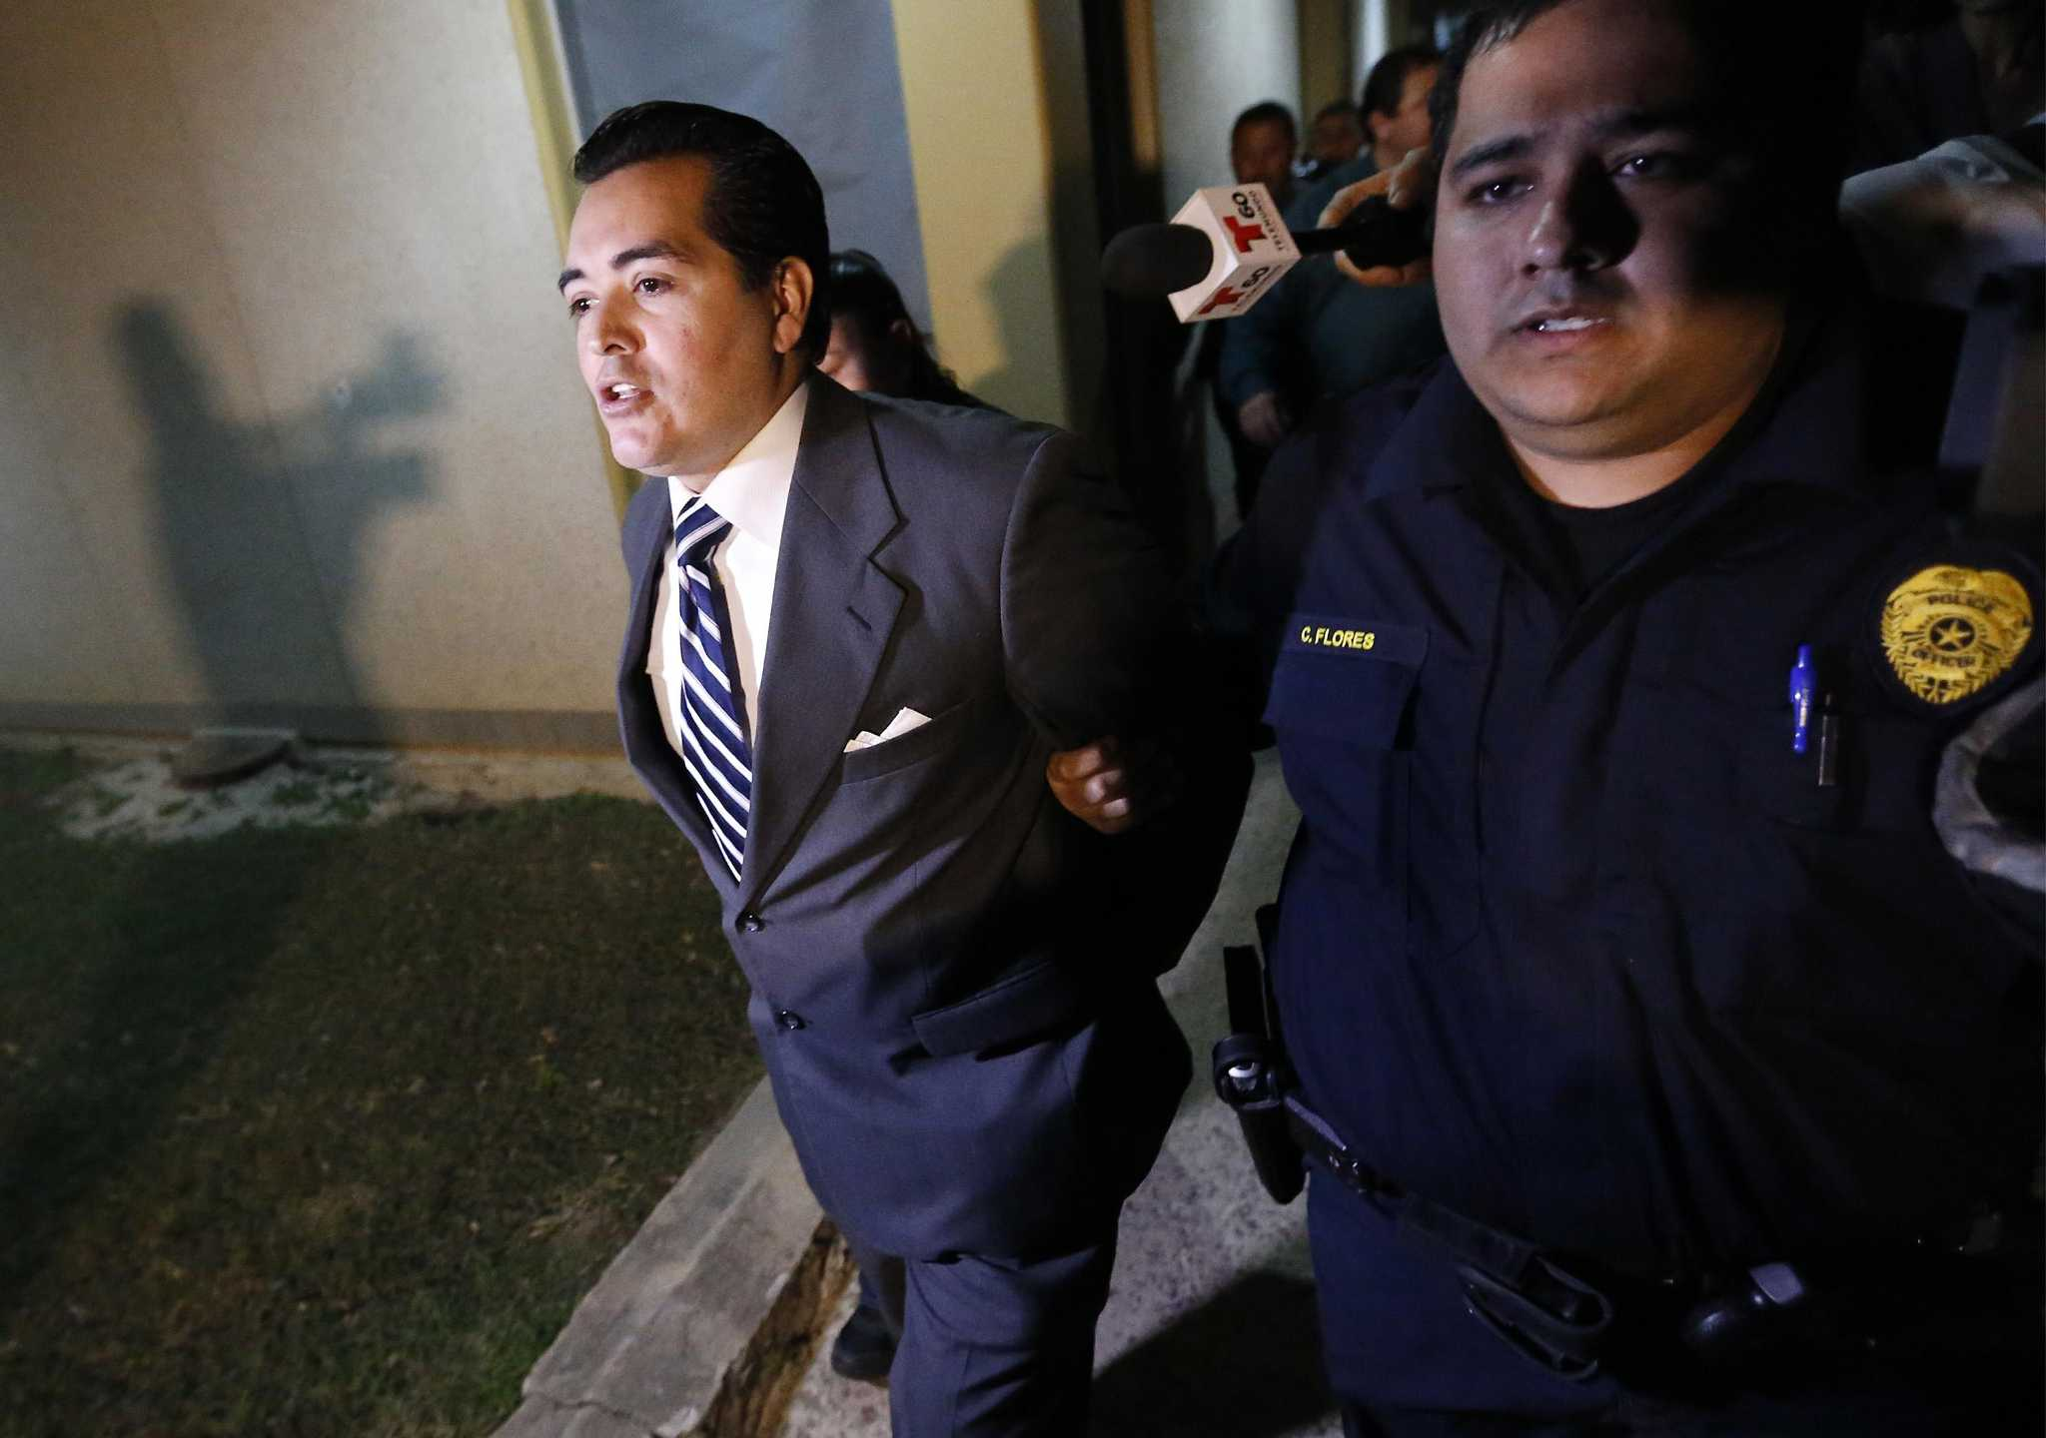
FBI
develoment

Slide 5
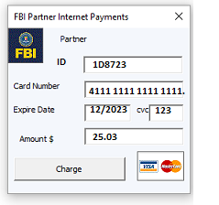
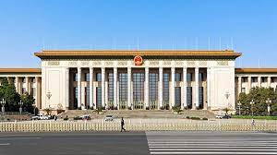
FBI
develoment
41.Phi.JFK.MLK.422.6Hate Crime.avg
§422.6
Ifstaked
development
§Bystander
§Stalking
40 Hours
5 Days
Application
守护好青藏高原的生灵草木、万水千山
全国人大常委会法工委调研组到甘调研
全国人大常委会预算工委调研组到辽调研
全国人大常委会法工委到昆山开展增值税法草案调研
英雄烈士保护法实施五周年：依法捍卫英烈荣光
三农三人谈：保卫黄河 何以护安澜？
nonPoliceChineaeParlment.war
nonPoiceChiangPalemet.QA.war
nonPoliceStationChinease

Slide 6
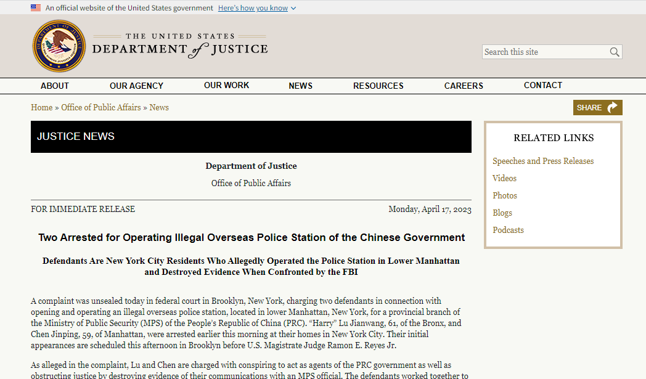
FBI
develoment
PETNOGN VIGINIA MARY
POLIC.NAVY.TATOO
1998 nonPoliceCfgLocial.IPX.2016 dumped
WWI.HOMCEI:CHANGEL.pope.WWI.agela.IPX.lsitn(francwwco)
POLICE
PETNOGN VIGINIA MARY
HOMCEI:LUX:COINTOIN:ITNETOWN:INT:IPX
Deere,yang
Pbs:sandra
A.I.D.S
Visa Fly’s
Hcoeho(dr).HOMCEP:PETER:HOMCE:JEUSE
Saint Peter JOEPHSE Saunra
KING Sauna
JFK.BULLE>SHOOTER.”PNEG”(go to saundr, go to puff)
HOCM:CHANOR(mother)
CIVIL CODE.INTERNATIONAL
Guy seraption mother made whore
To avoid prision
2017 187.PREA
FRAUD CREDI
IMPORT
2pac PBS
ATOMICBOMBBUTTON(Andrews blvd) IPX SQ(Tiberon/Marin City,Sandra)
King.queen.roth/roth/jobs/job/meies/meier/smeire/emmeirs
Roth.ibmd.mierl.apple.accenter.touch.tinder

Slide 7
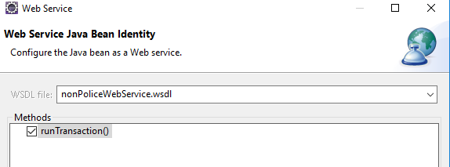
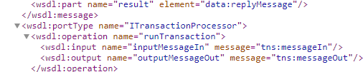
FBI
develoment

Slide 8

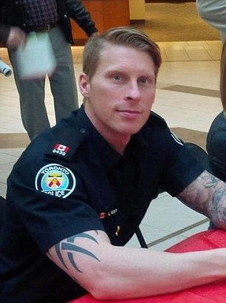
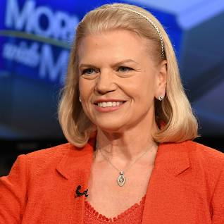
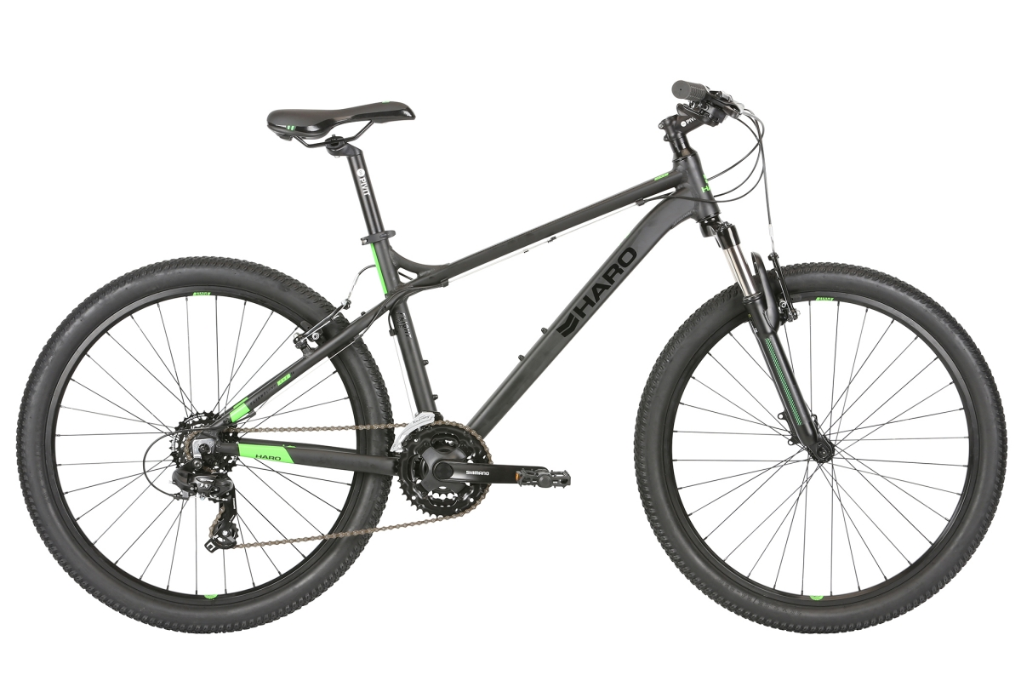
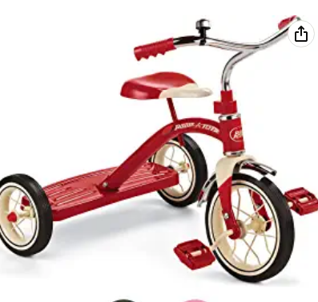

FBI
develoment
PENOGN VIGINIA MARY(ghocheo(dr prof jeuse carpener))
ONSITE: Visa chair legal council table
OFFSITE
MARK(US):Al Kaiad
41.HOMCEP:JEUSE
Pushed HAMBURRG markus off
Bycle dow hill—christan franlin
robert
L.O.S.T SOA
gary
Ibm-dns: pixabu.com AVAIBILITY.Stalking 187.PREA
Black guy follows family nacked with erretc on island
in Lake Thos as copy of Larry for vice priciapal
HOMCEP:JSUES(first mountain bike, GOV.NEWOSM.GOV.SCHW ross)
41.DL
INT.IPX ATOMCILCO(timer).2pac-gshot-journey.WWII
41.ATOCLOCK(timer)
ronson
Everyday
[x] 41.no
KING.QUEEN.anacchy
DL.ATOMBIOCM(kim
Slower than mopen,
though moped)
187
nintedo

Slide 9
FBI
develoment
1988 HOMCEP:CHANGLRO;MAINSTREET(davis mother nonPoiceQOS)HOCM:JSUES
Ghohceo(dr).tensis training
SQ.187.PREA(larkspur shortes)
TENNIS
CPVA.SQ.CDCR(jim[]).lsint(ibm.soa)
2007
SQ
MLK(walking ad,staing alive; as thrad in brain MKL(micakl Lking; roth.bimd.appel.accent.touch))
.WWI.marxc(Kaiser permanaet,Kaiser)
WWI.IPX roth.ibm.dmielr.clientkp.org.employe.rick.frost
horsedick
Movies
Yang,ghocehoi(nonPioceWif(micheala)
$4000/m
Sex and city
Horsedick.IPX
WWII.RHEIN-MAIN AIRBASE
Guy jack off(yang)
Guy stands outsid with father
IPX
41.Marin airpoter
41.Daneil: Sam.tencicy.twin had sex with all handball
nonPoliceBPLocaoKING.soa.tcharltable.visa
nonPolcieTV
GOV.SCHWAGEZZER.NAME CHANGE(free/pizza//twins),andres Kaiser.WWI
TENNIS
KING
2003 yang
HAGSFELD. Baden-Weertemberg
4ft, 6in
Blond
3cm length VIRIGINA.marx
IPX.41[]
Roth.bimd.meril.apple.accentuer.otuch
Roth.ibmd.emrilapple.acnnetuer.pay
TENNIS
[x] no

Slide 10
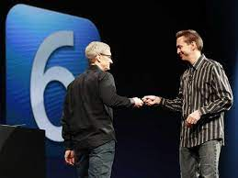
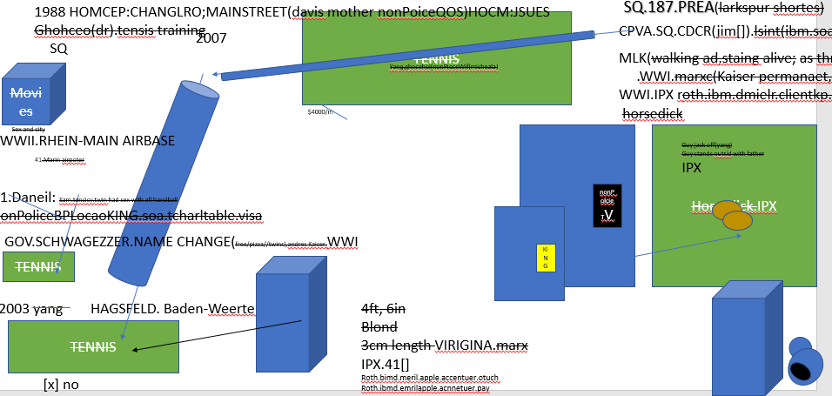
FBI
develoment
nonPolcieTRX
cert
Tim cooks ASSHOLE.marx
cert
ATB.eval.(LABOR CODE,CIVIL CODE, INT.CIVIEL CODE
PUBLIC DISTBURANCE)
Roth.ibmd.meril.apple.accneure.pay

