Slide 1
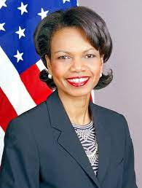
FBI
development
PENTONGON VIRGIN MARY

Slide 2
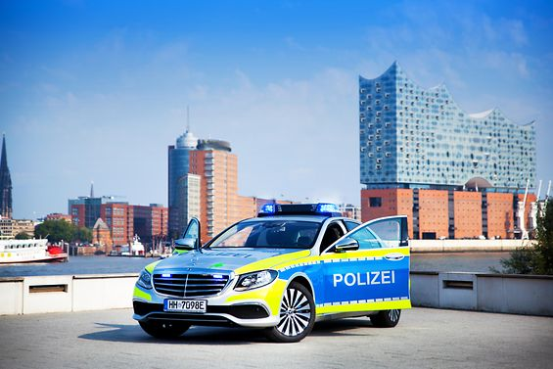

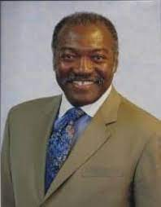

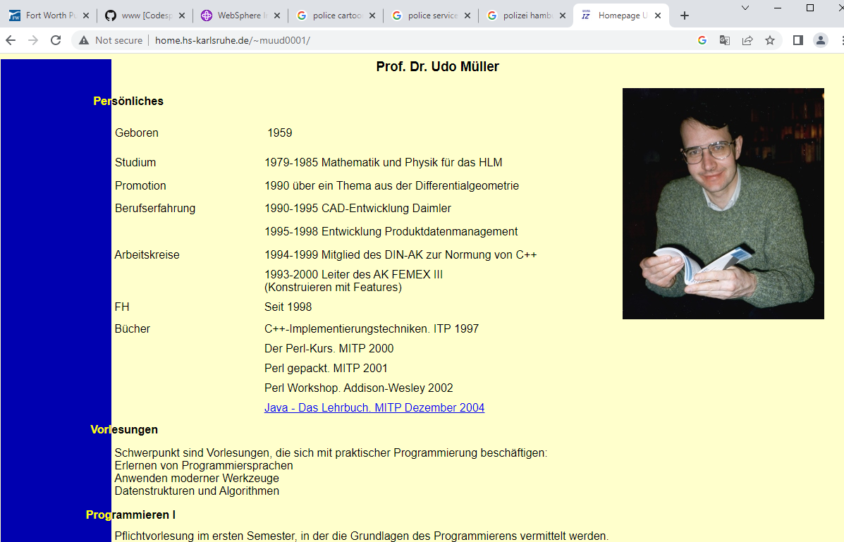


FBI
development
PENTONG VIRGIN MARY
Ghcoeh(dr,carperter,PROGAMMIN III)
CPVA.FBI:TERRORIMS( al kaidea)
nonPoclieHamburg
Call you rice
C++
MLK(KING CUM MILK RICE)
VP GERMANY
LAW I and II
Backup:MAHTER:MATTIAS:HOMICEP:LUX:COURNTY(lux bank)
<s>guy buys book</s>
Gary cook,perl 600 pages
§Theft.nonPolcieLife
(opean source).
PROGAMMING I and II (YALE)

Slide 3
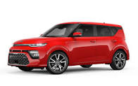
FBI
development
PENTONGON VIRGIN MARY
Chair, Paybytouch, Ula Adams
Trains
Germans
Touching
God Adams

Slide 4
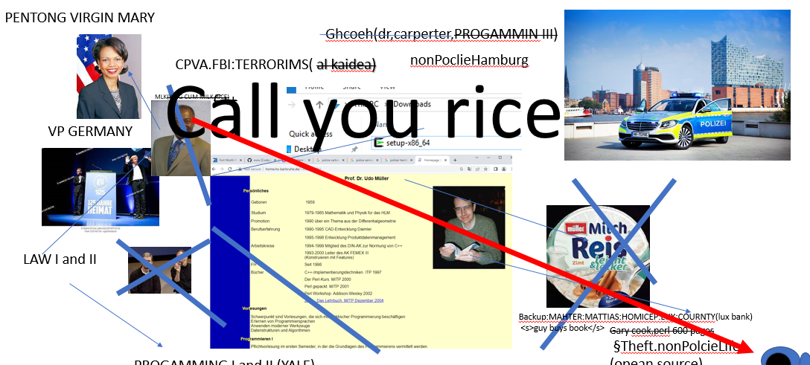
FBI
development
PENTONGON VIRGIN MARY
NAME CHANGE
INTERVIEW
(free pizz,craiglist)
CPVA.KING(cum glasses).Josuea
C++ Fibonoci
call you rice

Slide 5
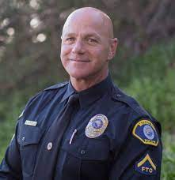
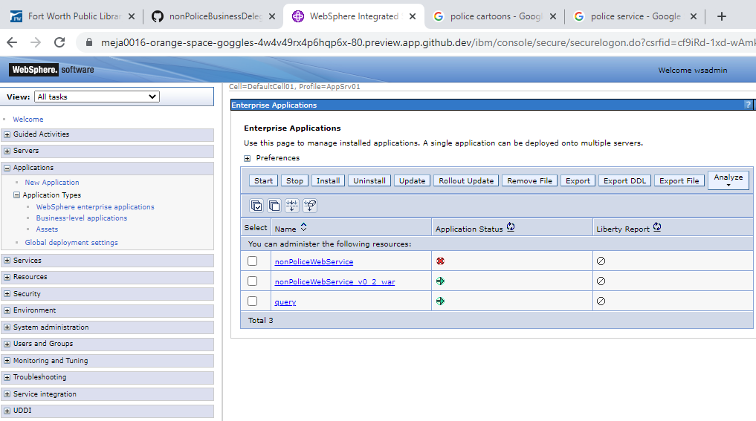
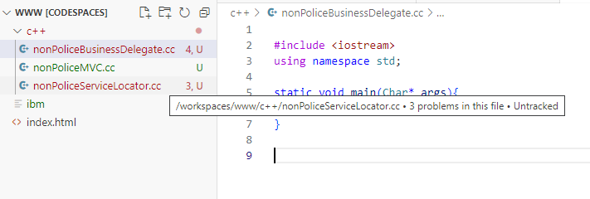

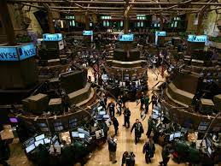
FBI
development
PENTONGON VIRGIN MARY
INFANT CHILD PORNOGRY VICTURMS ASSISTANCE
FBI:iCPVA
KING.LAKE TAHOE.GLAES
POLZEI ONSITE
LIBRARY C++
2000 ghoche(zookologisher garten)
2000 c++(talking about).MARY
WAR.ATOMPHYSICE(study)
HOMCIE:STILLBOR[]1:HOMCE:LUX
§Abortion:HOMCICE:STILLBORN
PRISOIN WARD(SISTER.blond)) 0.1 HOMCEPSTUNSTOK(kodata MARY and SISTER)
ALL: Quality of Service
assmebley

Slide 6

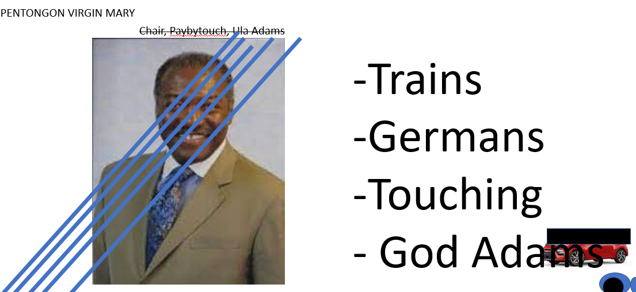
FBI
development
PENTONGON VIRGIN MARY
Scion
CPVA:HOMECIDE:IS-A-BELL(cisco montirng 10c)
CPVA.PBS.SANDRA
187.PREA.donatains specialist
call center
Scion
Karl,Diana
Berkley
hidden
God.nonPolcieCfg.nonPoiceTV(41.mr roger.fag).PREA.eval
Soul
41.PAUL: ELA enterpris leicen agrememnt41
Gary’s Full House --yang

Slide 7
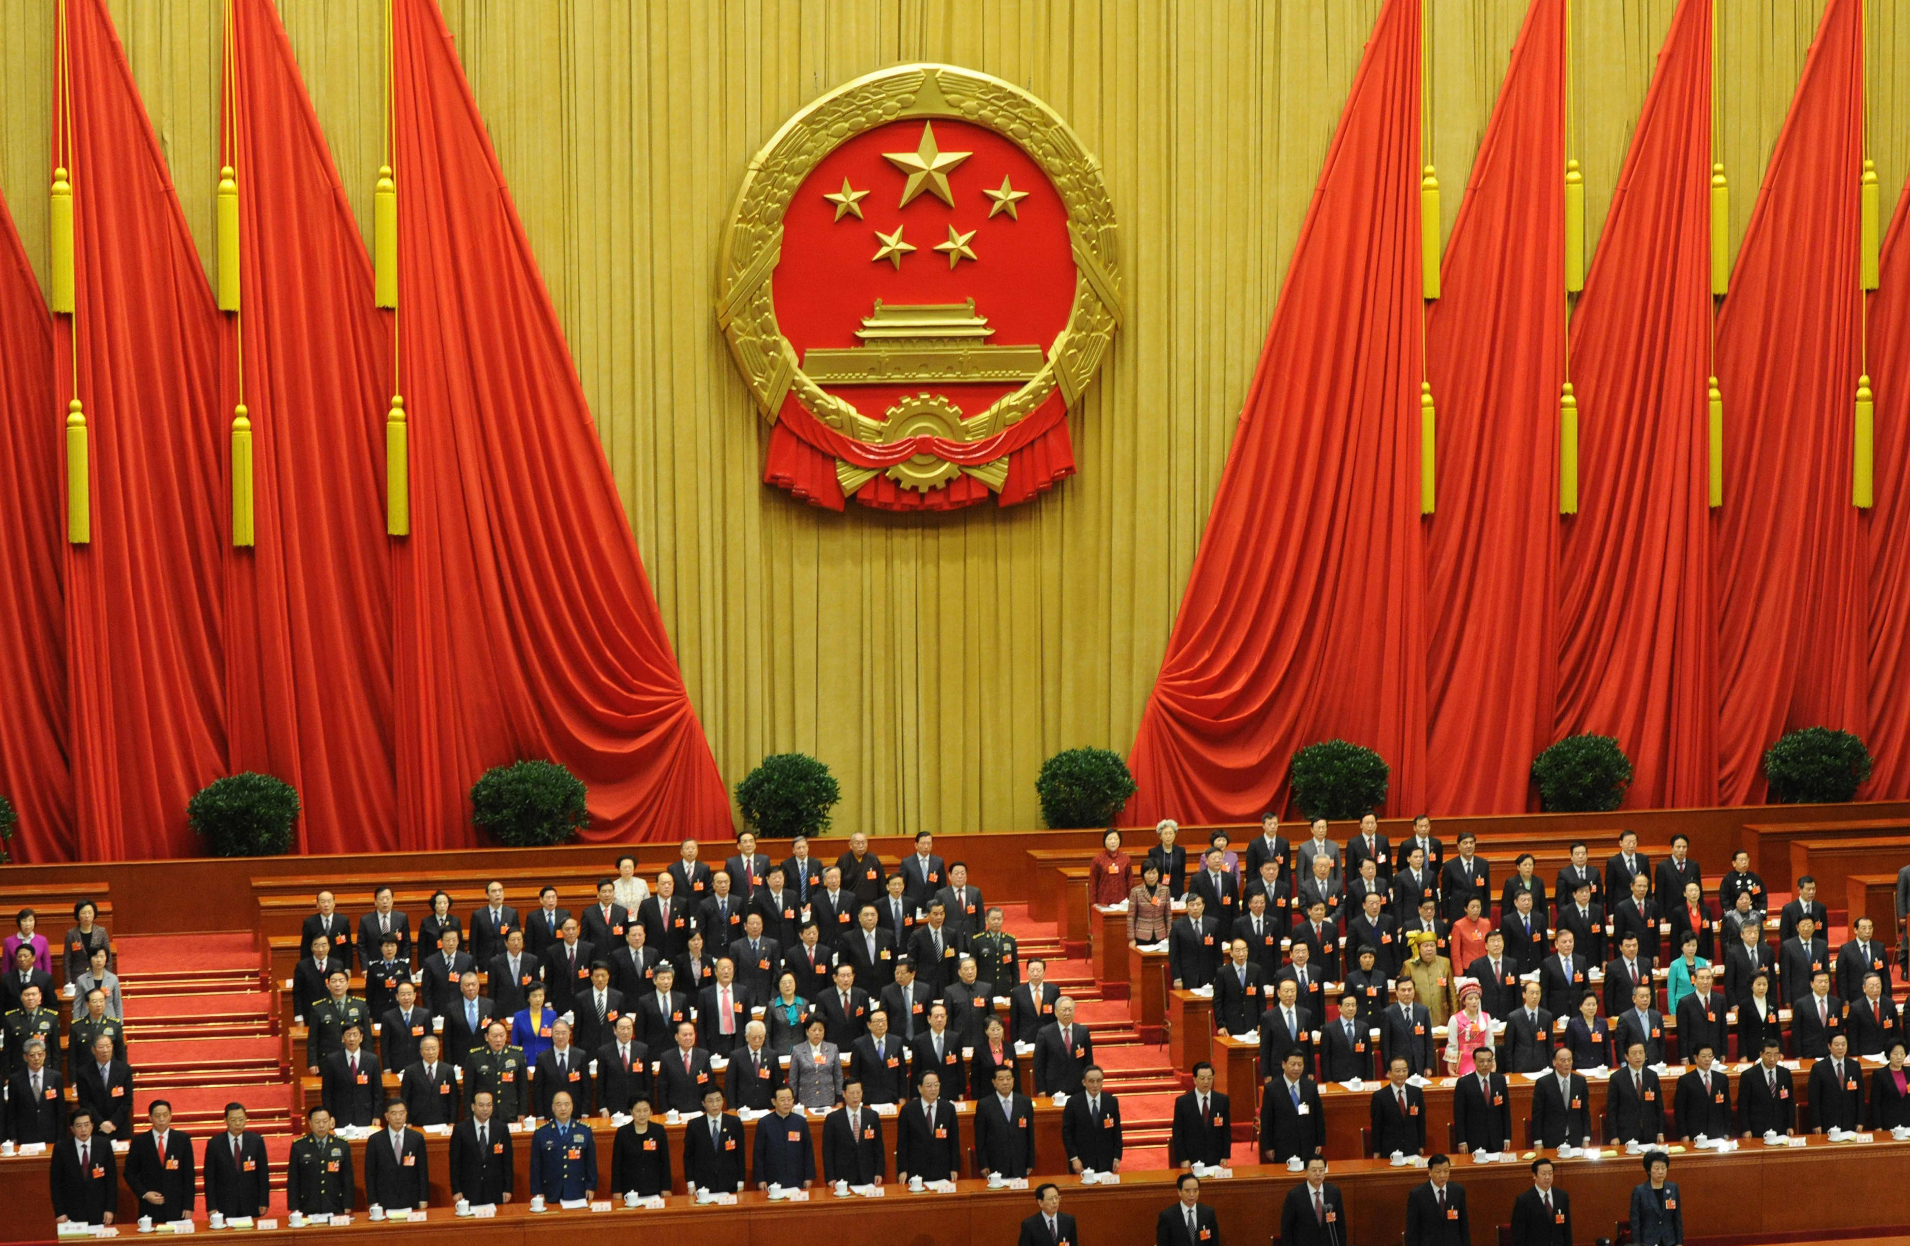
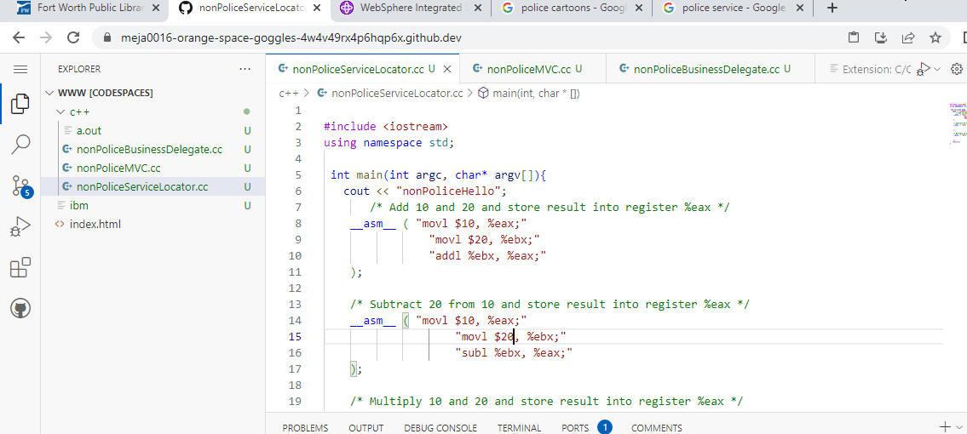
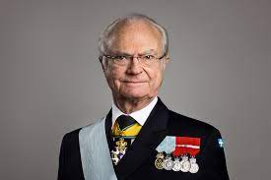
FBI
development
PENTONGON VIRGIN MARY
- Casion BEJAMINE 5DM Ulimited
CPVA.KING(glasses).HOMICIDE:LUX.LAKE TAKE.RICH
J2EE Architect, Tulsa, Nevada
RED GLAG(0.1 repson time gag(bal)(GOV.SWA.backup.AVIALITY./CPVA
PINK famigo
nonPolcieCityLgoiacl.IPX
nonPoliceBPMlogical
Soviet,ddr
41.nonPolicLife
A Casion “HOMIDE:LUX”
Offsit: Asmelby Programmer
I did not call
The ss with soviet
And drr many times
With cum rice, nor
SALES to Visa, apple,dell emea
My tatoos

Slide 8

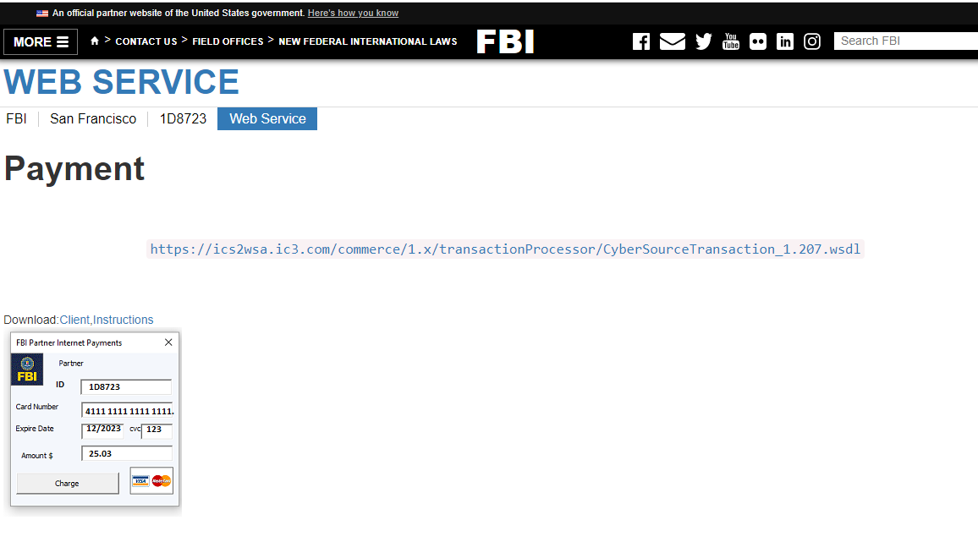
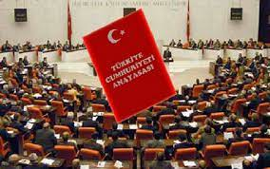
FBI
development
PENTONGON VIRGIN MARY
Truck drive by
Web Service
SQ 2007 41 clouod
2016 CHEKCPOIN CHALIE.PREA
(kdw).IMPORT blue/red IBM/oracle
Ivan/ivan/alex/alex.tango
CPVA infant WWI vagaina
LABOR CODE
(Russian female wokers tango)
LABOR CODE
FBI:WMD(person, budilign, state, country movie leaer (PINK Laura mogher theter)
41.(H1-B).eval.(pit)(.422.6 Hate crimes

Slide 9
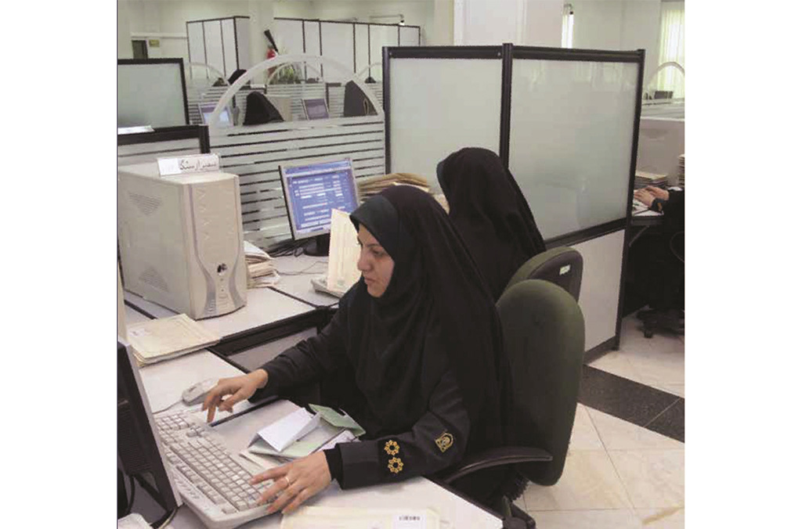
FBI
development
PENTONGON VIRGIN MARY
towel

Slide 10
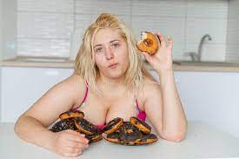
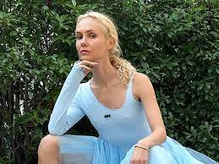
FBI
development
PENTONGON VIRGIN MARY
2023 INFANT CHILD PORGMRAON VICTUMS ASSITNCE
2001/2 25Y
__asm__ ( "movl $30, %%eax;"
"movl $10, %%ebx;"
"subl %%ebx, %%eax ":"=a"(res));
Phil.JFK
CHART
0.1 C++ Assembly thehun
Yellow
Student Ukrian, Professor Cum
Vice President
LAW
IPX.
41.INTERUPTS
FEDERA.nonPioceQOSLoica
POLZIEI CAR(DAMILER)
C++ Progmer(former)
0.1 FEDERAL BANK GREENPAN.marx(atb atm ass to mout)
YALE(clone)
UNVIERTY -> yesllow -> DORM(c++)
offsite
Ruusian with zit; I help you with elsiht, 6 langues

