Slide 1
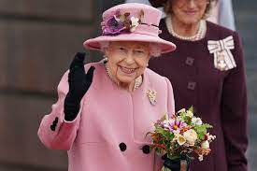
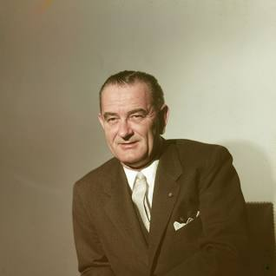
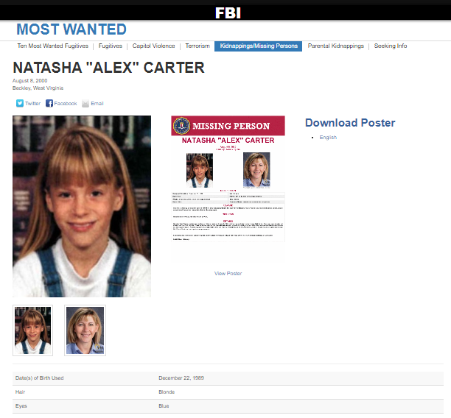
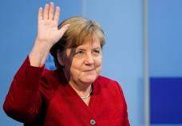
2005(Marin.white),2010-2023
CHEKPON CHALRLIE
nonPoliceTRXLgoical
nonPoliceBrbal.noNPolideDEA()
nonPocdliAfrec.food
x
kimbery
ATOMCLOCK
Ingo
1988:HOMCIDE:NANA
41nonPoliceTRX.marx
JFK.MLK.marx
un
Will he give food?
Dea
HOMCEP:JO(Hannes)
2 peope missing

Slide 2

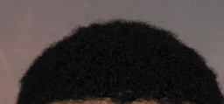
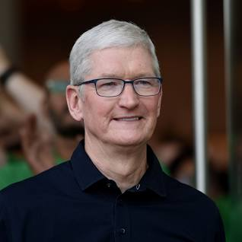
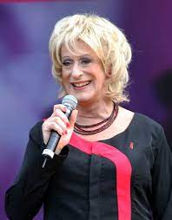
000.HOAMCIE:CHANGLOR
IPX
1995
1994 HOMCEPLUX
HOMCIDIE:IS_A-BELL.HAROLD.BNJAMIN
PENTAGON VIGING MARY JFK(hihgschool)
CHEOPNCHALIE(
chair;adams/abelle)
Angel, Euroaschule
Persoan
Data
apple
LARRY.JFK(hichschool, europaschule) nonPolicBelgumLgoical(Gerald)
CHECKPOIN CHALIE(Suck my dic)
GOD
x
Female BART
CHECKPOINT CHALIE.LARRY(Apple , graphti romele teacher roman ,suck my dick, gerlad)
X i
1995/6
41.88th.roth.ibmd.meirl.appl.acentuer.realplayer
41.?
CHEDKPOIN CHARLIE
Roman;Teacher
Guy doing graphi at night
Spealls wrong, dig ? A hole?
Gerald you seplt that wrong,next day
Fag:wtf are doing ther?
He would have said htat
!KING.*tophat
CHEDKPOIN CHARLIE
grafptti
Suck my dig
Harold uka
Fag:swordfish
LARRY
1994
Vox 500DM
Ghoce(dell,vox-ushe,spekaes, apple cocian kenwood)
Ghoceni(kito,katinka VIERIGIN bone, kantik)
Katina,marlen,dele donna)
Notes:
000.tw.pns. §Sex Abuse oral exe walk bys avg;; wuck my dick attitube avg

Slide 3
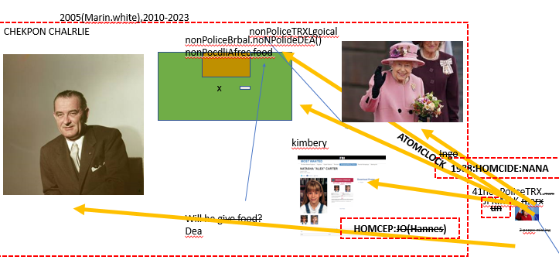
nonPoliceRTAlogical: 5/2023 1;35PM
FBI:KIDNAPPING
FBI:TERRIROM
nonPolicInitLgoical[]
NAMCE CHANGE(free/pzza).nonPoliceTRX.phil(Kimberly)
Merkel
Uncle: what is the apssword
0.1 HOCME::PETER ASSHOLE jobs cleaning elder; triffger ASSSHOLE cleaing
COW

Slide 4
nonPoliceRTAlogical: 5/2023 1;38PM
INIT
FBI:KIDNAPPING
FBI:TERRIROM
FBI:WMD(apple,dabomb;aftermath)
nonPolicInitLgoical[]
Free/pizza, password Austchitz(petsnick)
NAME CHANGE(free/pzza).nonPoliceTRX.phil(Kimberly)
nonPoliceQOS.1D8723.COW
Merkel
Uncle: what is the apssword
0.1 HOCME::PETER ASSHOLE jobs cleaning elder; triffger ASSSHOLE cleaing
COW

Slide 5
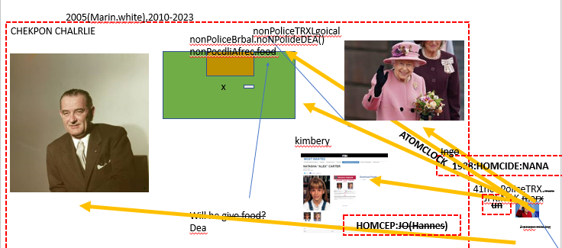
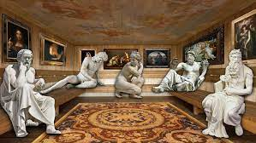
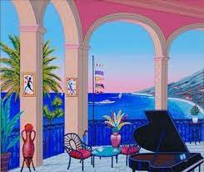
?
SQ.HOMCEP:CHANRO(mother,jimmy)
[x] no
Baden-Baden-San Francisco HOMCEP:MAYR extoriion
2005 IBM/wsdm
Tiboron; yang
HOMCEI:MAYR gavgi newsom rich,
IBM Richard makerler
CPVA.LAKE THOE (trukee)
IPX
Assuemd:
CHINA
VP GERMANY
GERMANY
Comptuer 8(mustiache)
41
View Oakland tiberon
nonPoilceDA~.rich.CHECKPOIN CHELAR.avg
41.HOMCIDE:LUX.(ronsons) you wnt to pimp
gavgi newsom
Sugerhill(tranl)Zuckerberg Auschwitz
Arondl schwargeet
Barack obama
11
DEAD
HELL
HELLER
KIT

Slide 6

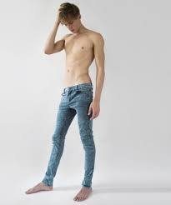
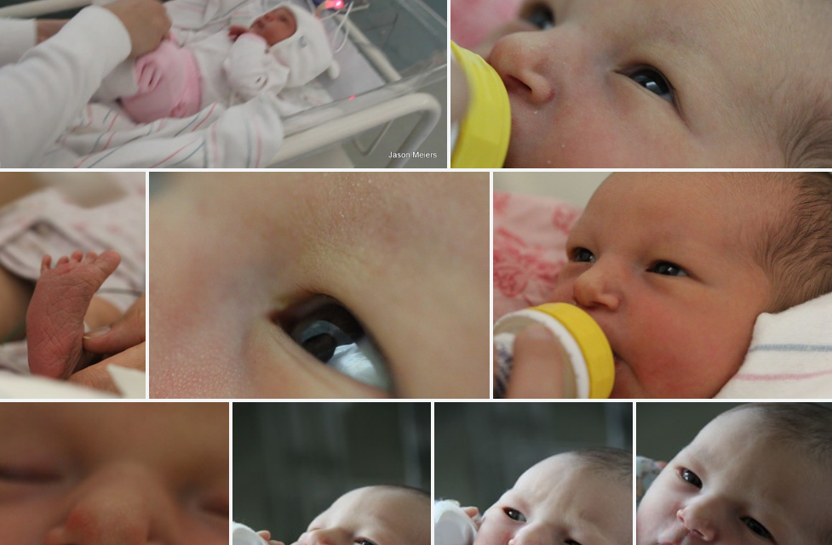
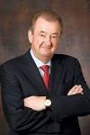
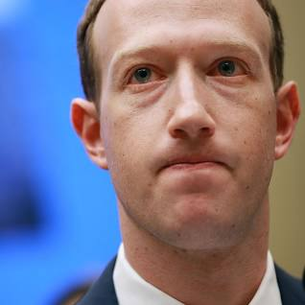
PENGON VIRGIN MARY
Execl pub swedis-amercan family
PRICE, piliki (excel,!excel)
Aws;bezos:;alex/ivan
LABOR CODE
H1-b no
CPVA sex abuse russin soul workers
IBM
G Digital Marketing
!REST
AVAILABLITY
[x] no
CPVA
I will make you ahot dog
perttson
IBM W/sam (itcam)
2010 2014
IBM
Client: cybbsrouce
IBM
Client: visa
Sugerhill(tranl)Zuckerberg Auschwitz
11
DEAD
HELL
HELLER
KIT

Slide 7
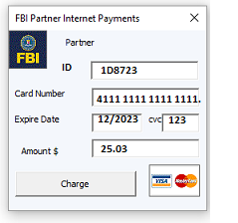
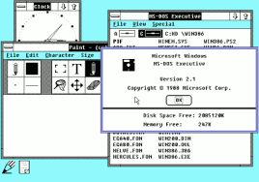
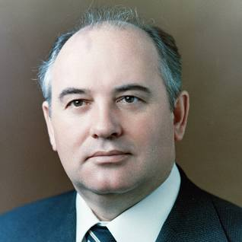
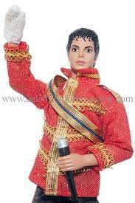
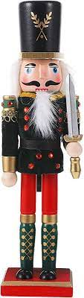
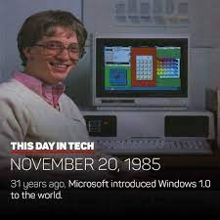
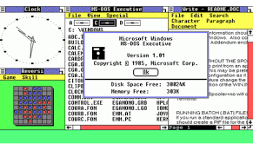

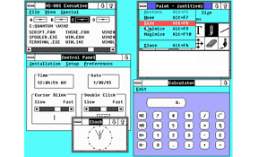
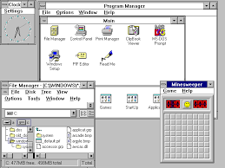
PENGON CHECKPIONT CHALRIE VIRGIN MARY JOEPSHE JESUES CHRIST
MARK[w]: Jeuse Christ, doent matter
MARK[w/o]: Jeuse Chriant, finally are they goin to do wimting
1994 Windows, Web Service
https://ics2wsa.ic3.com/commerce/1.x/transactionProcessor/CyberSourceTransaction_1.207.wsdl
JFK(berlin)
Web Services Description Language (WSDL) : It was developed together by IBM and Microsoft and identified on June 26, 2007 by the W3C.
?
Hired Micha..
1945 Daimler finlly goin to do womthing; did no do antyibg
Alg.
dublin
If redhair
ATOMICLOCK
N
Omana, MAINSTREET(jenny)
1994
1985
JESUES CHRIST(ghoceh(heger),nes Cristian
IPX
VIRIGINA (hgoche(micheals boyfriend,chrisitan)
1984
MAINSTREET(jenny,rehouse)

Slide 8

PENGON VIRGIN MARY
nonPoliceRTAlogical: 5/2023 1;38PM
INIT
TO EXPLAIN THE IDIOT
- apple nokia silent treatment
- apple smasun sieltn treament
FBI:KIDNAPPING
FBI:TERRIROM
FBI:WMD(apple,dabomb;aftermath)
nonPolicInitLgoical[]
Avg.
Phil(kim)
Free/pizza, password Austchitz(petsnick)
NAME CHANGE(free/pzza).nonPoliceTRX.phil(Kimberly)
nonPoliceQOS.1D8723.COW
Merkel
Uncle: what is the apssword
1994-2005
docs
alone
The context of leanign assembly with thick glases, alone
A person programming at unvierity; comptuer 13 (14-r;hm)
<s>of course a perosn want to talk to anoterh child moletor while jacking off</s>
<s>peron is isloated during ornanieren 0.1 HOCMEP:CHAN:TRALATE.nonPocleiINteruptLogia <>
KING.CPVA.assmebly: I want to be alone atlak to you about this
Yellow LAKE TAHOE
<s>sex ring</s>

Slide 9
PENTAGON VIGINIA MARY
Phil(Kimberly)
nonPoliceCfg
Mouvain View, Calfiroai
2010 Moving In
2014 moving in
blond
blodn
$2000

