Slide 1
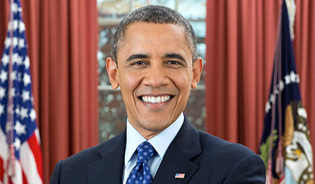
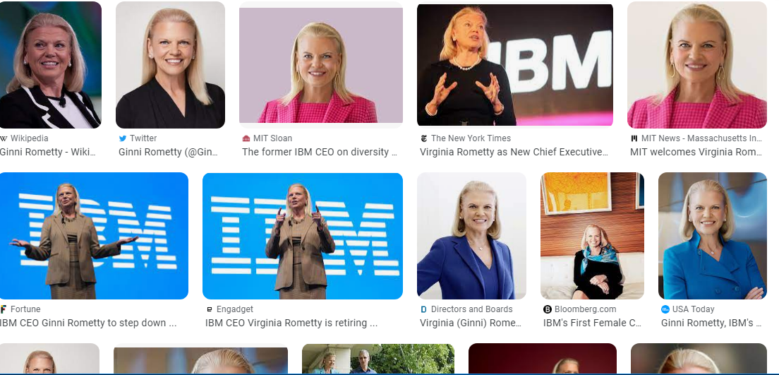
FBI
development
41.2007 SQ.AVAILBITY.IPX.nonPoliceInterupt
2010 Mountain View, California
chart
777 HOMICDE:LUX
777 HOMCID:LUX
HOMCIDE:ITALIEN:20
HOMCDIE:DOG
5x
onsite <s>soviet union(Visa Irland(carool),Visa France(droz),Visa Africa(king), Visa Belize(king))</s>
offsite <>Visa Germany(micheala)</s>
41.HOMICIDE:LUX:COINTOWN:hatehole.nonPoliceDEA(“H”)
You really don’t want to go in there.
Worse thant ELKE
Apple
amazon
co2

Slide 2
FBI
development

Slide 3
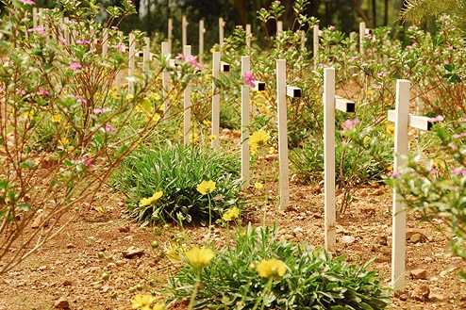
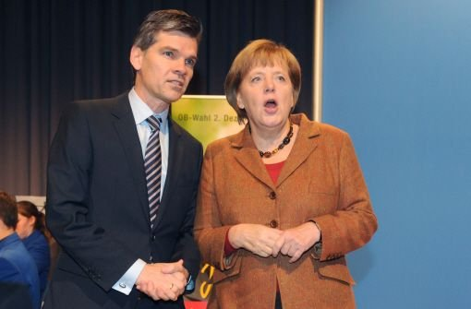
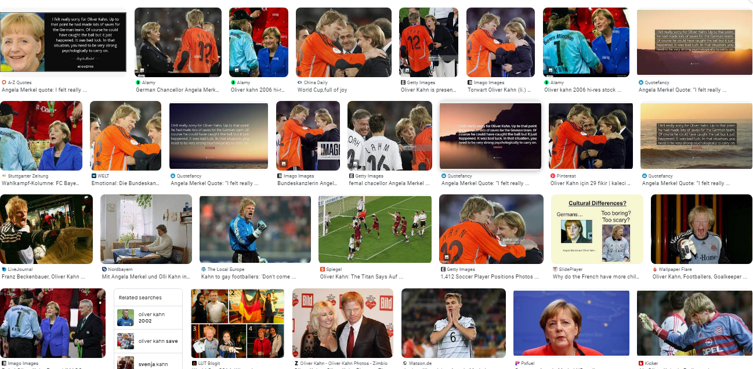
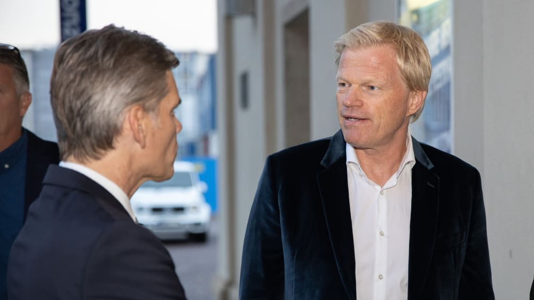
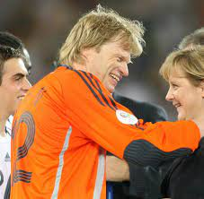
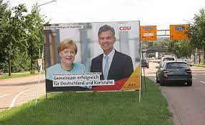
FBI
development
Genocide and War Crimes
https://www.fbi.gov/news/stories/genocide-and-war-crimes
41.Onsite: 2010 Moni bier drunk
nonPoicdEA(apple stofper dandera)
FBI:WAR CRIEMS: GNEOCIDE NAMECHANE(free/pizza)
FEDERA VP GERMANY, NAME CHANGE.INT.IPX(free/pizza) Khan CHINA
chart
nonPolcieTRX
41.HOMICIDE:LUX:COINTOWN:COMPOIUN_INTRESTTOWN:hatehole.nonPoliceDEA(“H”)
Sin(s)heim: (as in) zizeszins
Roth ibm daimler
chart
chart
chart
COMPOUND
INTEREST
COMPOUND
INTEREST
COMPOUND
INTEREST

Slide 4
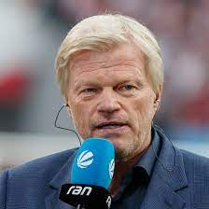
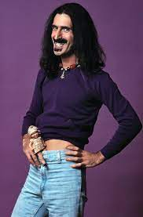
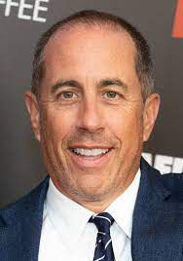
FBI
development
41.HOMICIDE:LUX:COINTOWN:hatehole.nonPoliceDEA(“H”)
IPX.INT.GOD.PETERSSON.NAMCANGE(ree/pizza)
LEGAL SAP OLI / HCNA VISA
41.WAR(kristastree)
CPVA pre-brken window
Old tv, adad smith gemran tv

Slide 5
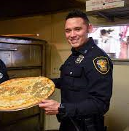
FBI
development
41.FEDAR GERMAN HERION
NAME CHANGE
VISA
H as in Horse
JESUS CHRIST
Do you wna my pizza?
Do you wna my pizza?

Slide 6
FBI
development

Slide 7
FBI
development

Slide 8
FBI
development

Slide 9
FBI
development

Slide 10

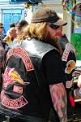

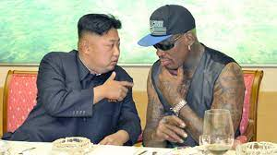
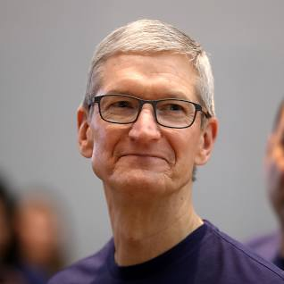
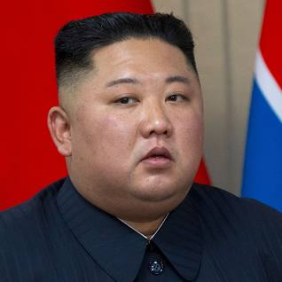

FBI
FBI:WMD
development
PENGON
(deere)
.jeff(tank)
HOMCIDE:LUX:HOUSE(7473=777)ATOCLOCK
TANGO
Phil(kim)
41:MATHEW: sad, sad mother fucker, sad; asi c
annot or am retarded; as a person; S-A-D
NAME CHANGE (GOD.KING(freee/pizza))
Happy: there is a train
Finally leaving 2015 Juyly
Phil(kim) family room visa projector
41
11
Jealosuoe: jesus/Jason
DL:CA:16 ricardo
ELF
HOMCEI:CHANLOR
Merkekl, Angela Angel/Engel
ELKE
Berney
Berney
Andy Derobieter
Dieter Thomas
WhiteHosue.pentagon
.marx(take house under/unterhuaous)
Title: Angel
HOMCIE: t-shrit
“I got this t-shrit
For logicallgy partpatice
In homicide, ~87”

Slide 11
FBI
development

Slide 12
FBI
development

Slide 13
FBI
development
001 Gov Swqnaegger(tiwn pizza bbq)
GAS(rudold-diesel)
Smamefully put pizza on bba
Apple enrico complained
To impress others

Slide 14
FBI
development
STATE: x/y
0.00001 Tranparnte; transient ROUTE
0.1 Tranparnte; transient ROUTE

