Slide 1
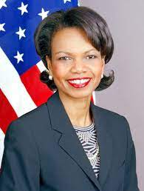
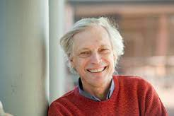
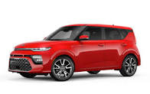
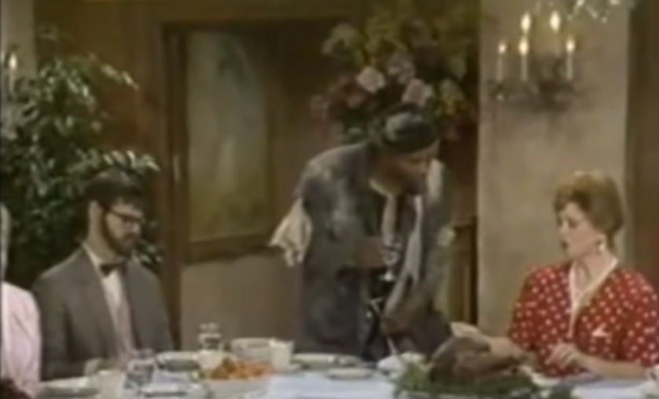
FBI
development
PENTOGN VIRIGIN MARY
ATOMCLOCK(
1990 3rd Grade
Ton lock - funky cold madiaa
A woman has a penis at 2am
I lke bit buts
41. No tv 1989/1990
JFK(Seiel Killer)
41.
IPX.”tyson”””toosie)
0.01 HOMICIDE:MAYRO(ass).eval
PENTON :JOEL
1990
Hudson
SEX SOUND
AFFIMITIVE ACTION
Lock
Food under door
Raw
In living color
Soul asyloum
runaway train
Big
you’re next the one I want to be
Simpsons
41
INXS
HOMCEP:CHANZLER(adam)1x
Furck
Shit
Pussy
Motherfucker
mother;:agy 0.1
Jewish
AFFIMITIVE ACTION
African-Amierican
diversity
Mix tape
?
Hiding money heater
I will cut the cheese(turkey)
41
INT.IPX.Davidson
.marxhellsansl9stalking)
Nes broken, sticker[] sex abuse
41
New Kids On the Blcok

Slide 2
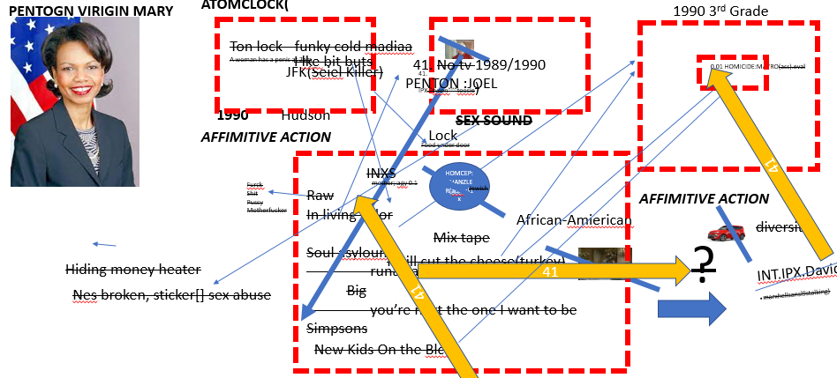
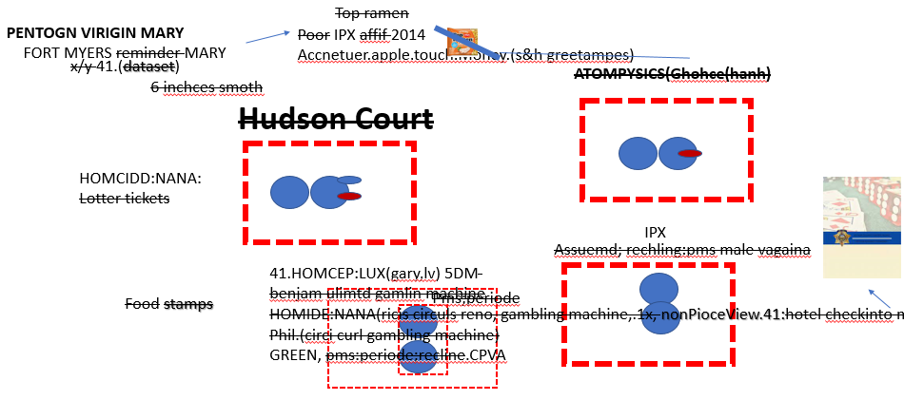
FBI
development
Data needs to be manage by city rather hatan
IBM 2014Visa or Aapple 2016 DAMILER
i.e.
?
FORT WORTH nonPolcieData
Library Employee HOMICIDE:MAYOR
41
Apple Privay Law Violations
HOMICIDE:NANA lottery:pms
KOCHEMANN
(cocain)
co2
Body Count: 2 HOMICIDE:NANA
HOMCIDE:MAYOR

Slide 3
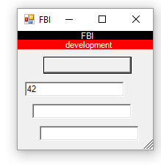
FBI
development
FBI:WHITE COLOR CRIME: TECHNOLOGY
Axis Jax-Ws .Net
Apache CXF
Ibm Eclipse
Ibm redhat Wsprovide.sh
https://ics2wsa.ic3.com/commerce/1.x/
transactionProcessor/CyberSourceTransaction_1.207.wsdl
Slide 12
tomcat
New-WebServiceProxy
Gsoap c++
Unix client
Java client
.

Slide 4

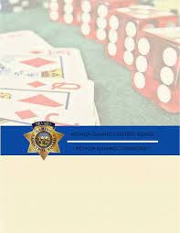
FBI
development
41 PENTOGN VIRIGIN MARY CPVA (recling)
Top ramen
Logical Post Meontal symstrod(pms)
Poor IPX affif 2014
Accnetuer.apple.touch.Money.(s&h greetampes)
FORT MYERS reminder MARY
(Bad) Guy stores data in poor staes of life;
Christ Lovelace: Consitpated
0.1 Under Siege HOCMEP:LUX
x/y 41.(dataset)
ATOMPYSICS(Ghohce(hanh)
constipaed
Hudson Court
6 inchces smoth
INT.IPX
HOMCIDD:NANA:
Lotter tickets
MARY.marx(denisfistherpms)
IPX
Assuemd; rechling:pms male vagaina
41.HOMCEP:LUX(gary,lv) 5DM
benjam ulimtd gamlin machine
HOMIDE:NANA(ricis circuls reno, gambling machine,.1x, nonPioceView.41:hotel checkinto machine)
Phil.(circi curl gambling machine)
GREEN, pms:periode;recline.CPVA
Food stamps
Pms;periode

Slide 5

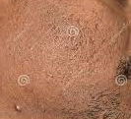
FBI
development
Roth.ibm.dmielr..Apple.touch.money: Mergers and Acquistions
Hard-to-find
CHECKPONCHALIE(kdw:nike:BoeblingenStuttgart)
IPX
SALES
DEVIL
Silicon Valley
Random Acces Memory(RAM)
Tiger woods
CAMP DAVID(scares)
“Bay” RAM
Bayram:us
Nyan nygen
FPVA
Jerry yang
Larry page
Sergay bring
1998
VIRINGIA.marx(ddr tuerkis virigin)
HOMCIDE:CHANGLOR: spy madlene and bayram
POPE
St Fraics
SAP Master Tournament
Porsche Wild Leather Seats Brown
Shoaufer
Waldorf SAP
Tiger woods shaufer; pope saint fracisc

Slide 6
FBI
development
Stanford Famous Monitor
nonPoliceCfg
Eval.365.avg.nonPolciComputer
CHART
INTERUPTS
[x]no

Slide 7
FBI
development
PENTAGON VIGINAIG MARY JOSPHE GOD
41.SIN
1995/6
rechling
rechling
GAS(Rudolf-diesel-strasse)
school
?
41.PRSION SAINT RITA.marx(rita)
Beathe
Densie
3-way separate.nonPoceCfgLgocal
41.Finger(ing)
Ghocheo(seitz)
Petra
Pettgin
Heayign petting
2014 CPVA:HOMICIDE:IS-A-BELL
Danile(zappa): I give you all my fingers
-> Stenphte Hugh Granh, our song, favorite song
Yougurt
Cisco .morning
East yougu out of sams ass
Erishst beim ficken(tranl) cuast fucking (tanl) caut in the act (ack)
PENTAGON BASE PX MUSIC.marx
Phil.payphone
Back Streeet Boys
Cough in th act
East 17
Micheal pfiffer and coolie- ganstarss paradise
Ice cube
Snoop doggy dog
Wutang clan(riza,old dirty basterd,redman) apple.incase LARRY.PETONGBASE.INCASE
Italines
- Antiono(moped)
Beathe
Marco
Enzo
Cooked eye
icet
x
Francos/angela

Slide 8
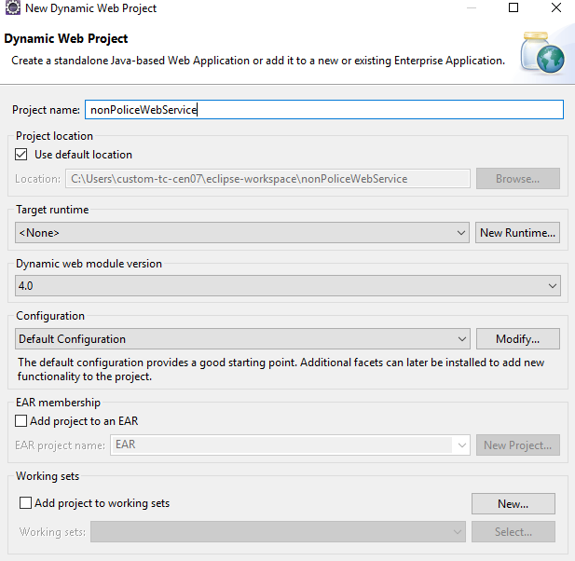
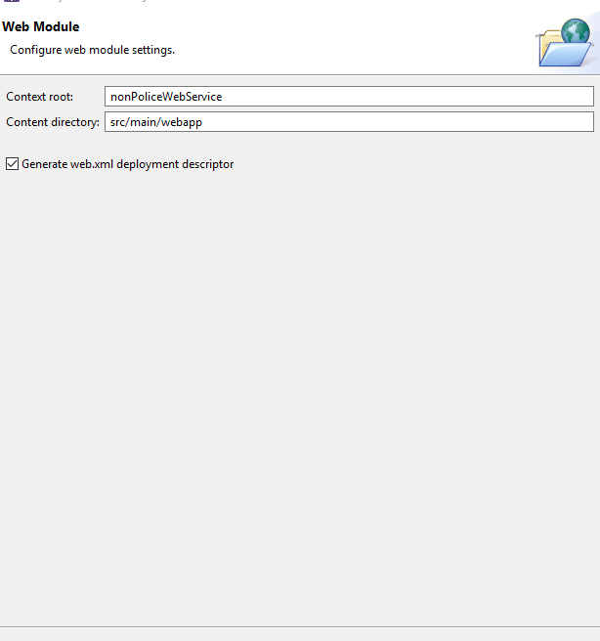
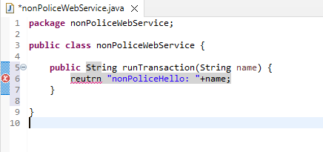

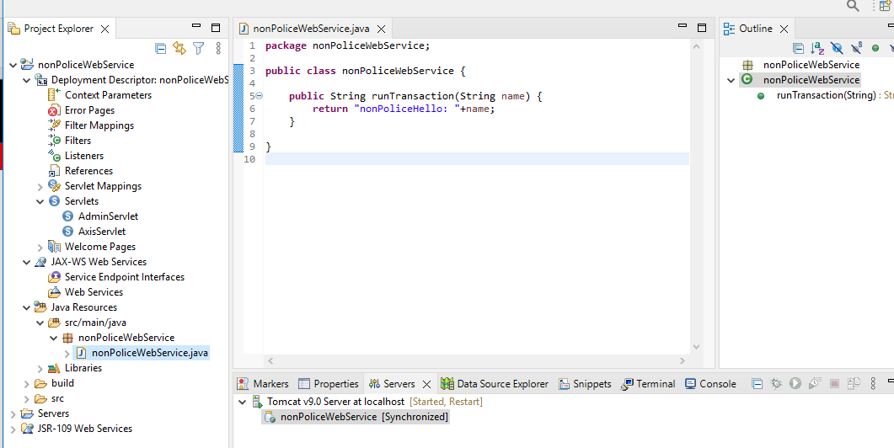
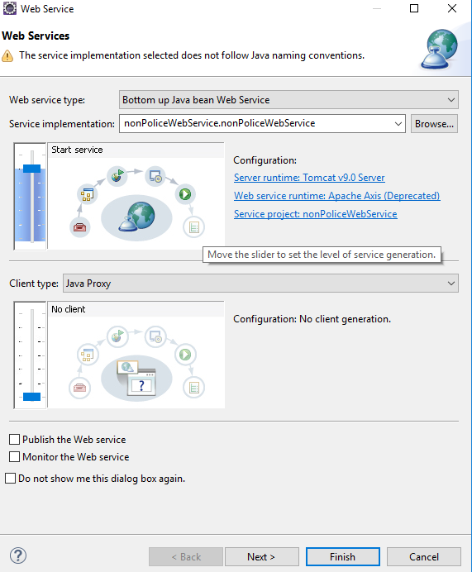
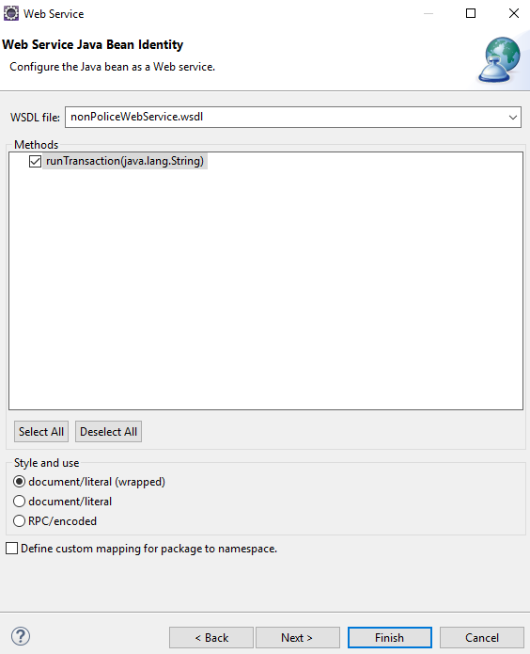
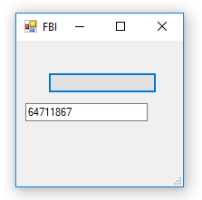
FBI
development

Slide 9
FBI
development
New-WebServiceProxy : The HTML document does not contain Web service discovery information.

Slide 10
FBI
development
PENTAGON VIGINAIG MARY JOSPHE GOD
41.Deep SIN.nonPoliceCfg
Yolanda
CARMEN
KING:HOMCEP:PETER
HOMCP:PETER ss peterpeter
Carmen:king:cum glasses
Peter brucksne 60 glasses
Peter heger 10c 60 loogin glasses

Slide 11
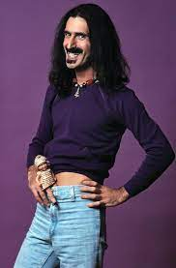
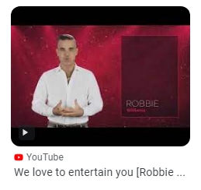
FBI
development
PENGONA.EMEA
NEW YORK, NEW YORK
NAME CHANE(free pizza)
If you can make I there I can make it in VIRNIGIA
Damiler Ag -> IBM
Davision (unterhause) -> IBM
Zappa(frank Sinatra)
IMPORT
2004
Zappa(frank Sinatra)
2003/ 2023 20Y CHILD PORNOGPHAY VICTUMS ASSATNCE ( entertain you)
Mp3 frauenhofer institute MONESTARY
MATHWE: WWI.marx(swing williasm)
2003
Zappa(Robbie Williams)
IMPORT
WWI.WHITEHOUSE.marx(untheraus 5am.avg)
Zappa(frank Sinatra)
[x] no
2000
Other: ghocheo(micehala): ich fick keine verliern (rnal) I don’t fuck losers 41.GREEN.douglas re/entry
Other: avg.accompliments
Other: grohe (cybsoruce )babie millianro

Slide 12
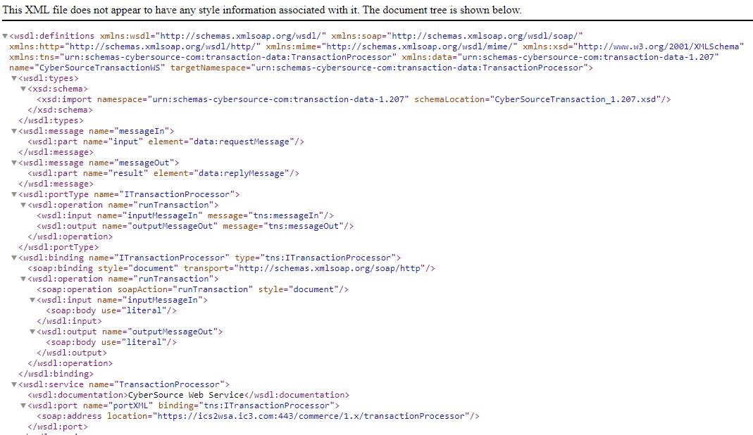
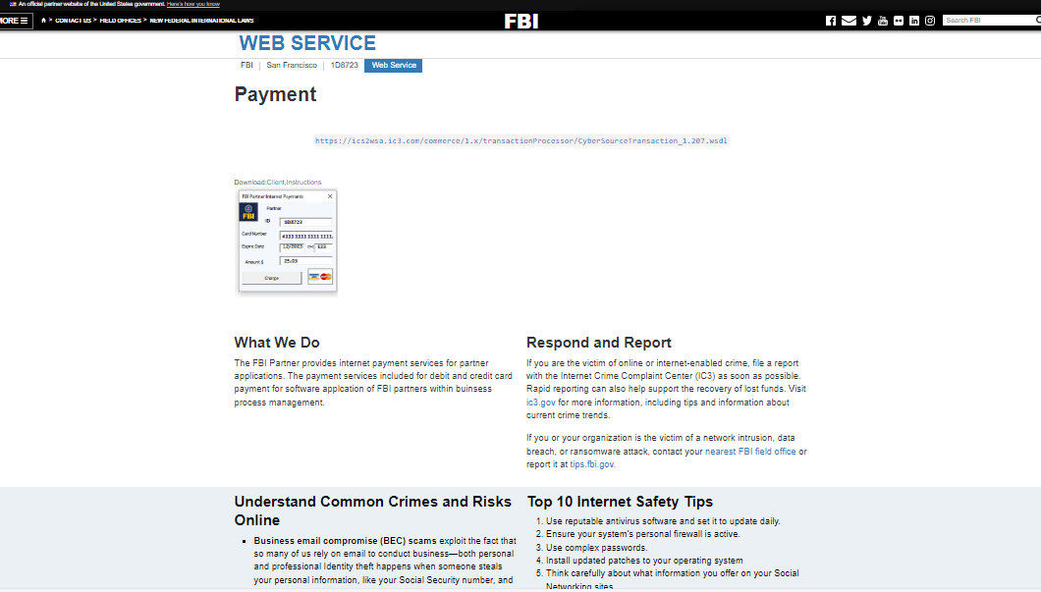
FBI
development
https://ics2wsa.ic3.com/commerce/1.x/transactionProcessor/CyberSourceTransaction_1.207.wsdl

Slide 13
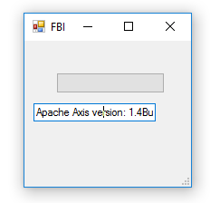
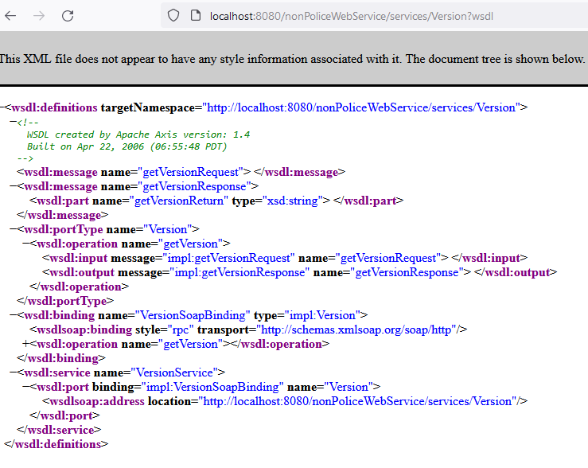
FBI
development
http://localhost:8080/nonPoliceWebService/services/Version?wsdl

Slide 14
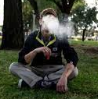
FBI
development
NEW YORK
(HUDSON COURT)
1990
000.tw.pns.marx(gate jumpers)
A country created wall until 1990 crimmals crea new wall >1990
Existing walls
DAY
HOMCIDE:IS-A-BELL
smoking
punk
CHEKCPOITN CHALRIE(HIGH SCHOOL)
x
2016ghoceho(graziani apple.walrmat.van
CHEKCPOITN CHALRIE(HIGH SCHOOL)
Sadam(salem)[0] ? Where he came from?
Soul Alsym Run away train, Theft Longs
Ghoceho(Jackson) candy/food bottom shelf[2]
Same shel as davis unviery small (tops baseball card theft)
Doll purchse shelf 1983
POLICE
HOLE, JOE ORCHEANGE FIELDS
X salem[0]
NIGHT
x
[x]no

Slide 15
FBI
development
Bathroom
http://localhost:8080/nonPoliceWebService/services/Version?wsdl
20 asmeple .runtranslcoint

