Slide 1
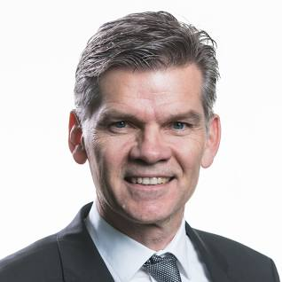
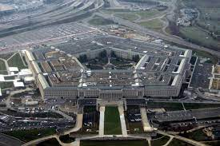
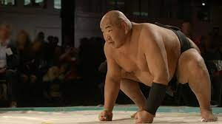

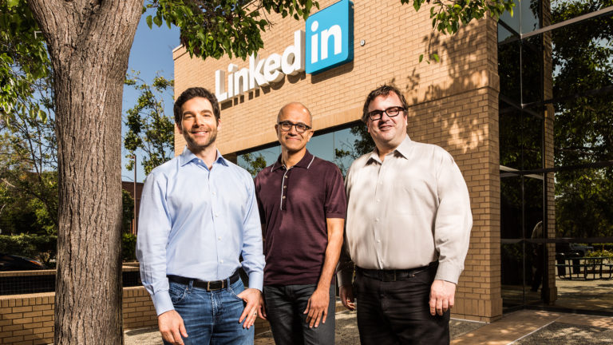
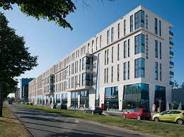
FBI
develoment
PETAGIN VIRIGIN MARY JHOSPE
BILL, PAUL BASE INFORMA TEHCNOLOGY
Nina Musina LINKEDIN
CPVA.AVAIABILITY.INT
PBS NEWS HOUR – Fat one
Montor Govment PREA
INT.
IMPORT
24x7 Sabyr Tozin
Montor Govment PREA
Fro Willain Lovelace, Jason Meiers

Slide 2
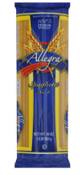
FBI
develoment
000.tw.pns.*
graf
YMCA
Delete Files
LAKE TAKE
SQ.EMEA.ElderAbuse
Saturday 1:30
Monday Micorway 7am
36 Hours
becks
Whitehouse.marx

Slide 3
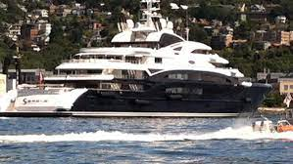
FBI
develoment
IPX
JFK(lee, acqusiton visa,cybsorce,authroiz.net(nonPicSeattlelcial)
41.HOCMEP:SUNSTORK ( kodak cumface wife, on face in nonPicDeattle)
41.FAT ONE
MATHEW: Xml; mirosfot
Front door party with bill gate
Xml programming parser
You put picture and then, like; menas cum on face.
Simot rto faritng dislenady means anal sex
Subsumed: class-action meiers facebook
Subsumed: class-action HOMICIDE:NANA.family
41.HOCMEP:SUNSTORK
LAKE TAKE
SQ.EMEA.ElderAbuse
Lkae Washotoin
Bill Gates and Son in water

Slide 4
FBI
develoment
ATOMCLOCK(PBS NEWS HOUSR)
JOPSPHE.MARY.CPVA.AVAILBLITY
WWI.(winer and musi, wetbar)
000.tw.pns.(wine.petersson.chruch)
PREA.187 shopping store
Blackhawk; Dragers, supermarket; PBS Newshour Shopping
INT.IPX ard newshour

Slide 5
FBI
develoment
Gorabhceo(visa France)
What is he goint to do next?
Same thing as yesterday, you diiot
nonPocleCfg ghcheo(visa France)
Action manager logical cfg; eval and montoring
You do not do anythgin

Slide 6
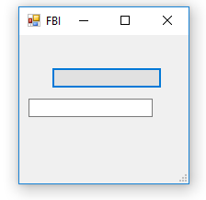
FBI
develoment
IBM Rational
HOMCID:CHANCLOR.JFK(reboot)
Mother.CPVA
Development
@meja0016 ➜ /workspaces/www/war (main) $ jar -tf nonPoliceWebService.war
META-INF/
META-INF/MANIFEST.MF
WEB-INF/
WEB-INF/server-config.wsdd
WEB-INF/web.xml
WEB-INF/classes/
WEB-INF/classes/nonPoliceWebService/
WEB-INF/classes/nonPoliceWebService/nonPoliceTransaction.class
WEB-INF/classes/nonPoliceWebService/nonPoliceWebService.class
WEB-INF/nonPoliceWebServiceService/
WEB-INF/nonPoliceWebServiceService/nonPoliceWebService_pkg/
WEB-INF/nonPoliceWebServiceService/nonPoliceWebService_pkg/undeploy.wsdd
WEB-INF/nonPoliceWebServiceService/nonPoliceWebService_pkg/deploy.wsdd
WEB-INF/nonPoliceWebServiceService/nonPoliceWebService_pkg/deploy.wsdd.bak
WEB-INF/lib/
WEB-INF/lib/wsdl4j.jar
WEB-INF/lib/jaxrpc.jar
WEB-INF/lib/commons-discovery-0.2.jar
WEB-INF/lib/saaj.jar
WEB-INF/lib/commons-logging.jar
WEB-INF/lib/axis.jar
build.sh
wsdl/
wsdl/nonPoliceWebService.wsdl
000.tw.pns.
Cook Petie
0.1 pms:reboot:recyline
CPVA.pms:reboot:rycling
IPL status z/OS
Initia Public Load (reboot)
BEFORE AFTER
Reboot war file
IBM Tivoli (REBOOT)
Ken Rogers
Development
CPVA.MLK.41.(24x7 rest; tivili framework reboot)
Carlos reboot

Slide 7
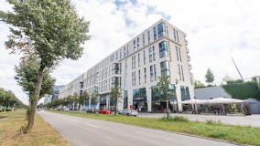
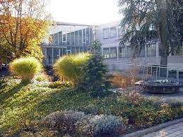
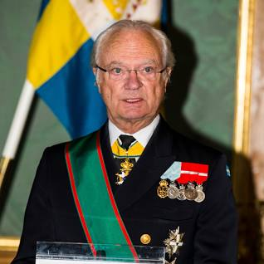
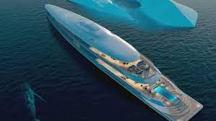

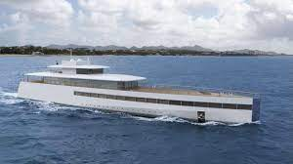
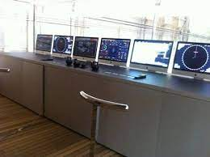
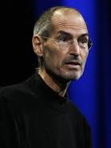
FBI
develoment
PENTAOGN VIRGIIN AMARY
MAINSTREET(SCOTT)
FB:KIDNAPIGN: ingo holzhaisser, leopoldshafen
IBM Rational
Development
nonPolcieCfg
Aquistion
(HOMCEP:SUSTROKE
Cum face kodak facebook cfg
JFK(lee,fortoin woth)
Guy shows up during vifirgin sex, drunk(also)
IMPORT
Visa Hr Marice Scott
000.tw.pns IMPORT maruce scoot
Roth.Retmetn(brunch).nonPoldeDA~ (retimetn []no)

Slide 8
FBI
develoment
IMPROT 000.tw.pns.SQ
scone
HOMCIDE:NANAE(elebith
nonPoicConteItem(VINIGAI.marx lawnmower tatoo)
41.CPVA.PREA.Pms:recline

Slide 9
FBI
develoment
2000
Prms:recyling
Apple craigslist
NAME CHANGE(freepziaa)
41.CIVIL CODE.noNPiceMontring(us.native spashi speaker)
Guy had pms (speraoina)gary LISA)
Guy had dldo bad in las vegas from craislist
25Y
41.?
HOMCIE:LUX
nonPociTown(Las Vega)
red
Ghocheo(Dildo bag)
41.CPVA.Pms:recline
41.CPVA.Pms:recline
2017
Offist: LARRY.marx(Hersoin Bag onsite sack lunck)
red
Foster City, calfiornai
Herion Bag:Offsite:offsite, Blasck Sam cleanders
Beach Park Plaze; Stalker
IPX Pargraph 31 Kodompflicht
41. Affif CERTICI:STSNFOR:PIMP

Slide 10
FBI
develoment
LAKE TAHOE
SQ.BAY
RICH
M
SQ.INT
San Quention
nonPolciConteItem(M)
LAKE MICHENA
Ghcheo(depress)
Phil(kim)
IMPORT
SQ.INT.
LAKE
MANNHEIM
LAKE WASHINTON
3:52 motochele

