Slide 1

FBI
development
ATOMICLOCK
June 9th, 2023
iCPVA.nonPoliceCfgLogical
FBI:WMD
8:30-9:30
1 Hour
FB:KIDNAPPING
FBI:MISSING PERSON
9:30-11:30
2 Hours
0.1 Outage: Guy shut tv on and off
FBI:WMD
https://www.washingtonpost.com/business/2021/12/22/amazon-web-services-experiences-another-big-outage/
FBI:WHITE COLOR
HOMCIDIE:BILL(wilaim mckern)
IBM:NYSE:INTERNET PAYMENT
OUTAGE
PRICE Sr/Jr gorbachev(visa)
11:30-01:30
2 Hours
FBI:WMD
FBI:CPVA
FBI: VIOLANT CRIMES
FBI:WAR CRIMES
Oracle/Visa
Golden Gate
GOD.Gorbhe(dell,g,pg&e)
phil(kim)
WAR(B-10).PHILIS.WHITEHOUSE
1:30-3:30
2 Hours

Slide 2
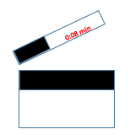
FBI
POPCORN

Slide 3
FBI
FBI:WMD
1988/9
KING.MAINSTREET(DISNEYLAND)
Neuschwanstein, Bavaria
2008/9
KING.nonPolcieNorway
VIRGINIA
“crumbs”
Wine Storage
nonPoliceHomelessLiason.marx
i.marx(soviet painter)
X i
§Staking, §Theft
Glu.Eric.Ludwig

Slide 4
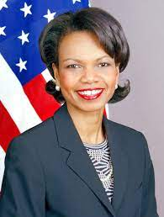
FBI
FBI: movies
9:24 AM – 9:25 AM
16 Slides
5 Actors
120 Minutes
VIRINGIA
SWORN

Slide 5


FBI
FBI: WHITE COLAR: movies
8:42 AM – 9:24 AM
iCPVA.SQ(Olivia,svu)
Call you Rice
OLIVIA
CITY
IBM:NYSE(DTCC)
Ralph Eustache
Prices Party
!FIN
8:08 AM
9:20 AM
0.1 7:00 AM
HOMICDIE:LUX(douglass, falling down, bankf of America, shooting,PUBULI)
HOMCID:IS-A-BELL( amok (tnrl) public shooter)

Slide 6
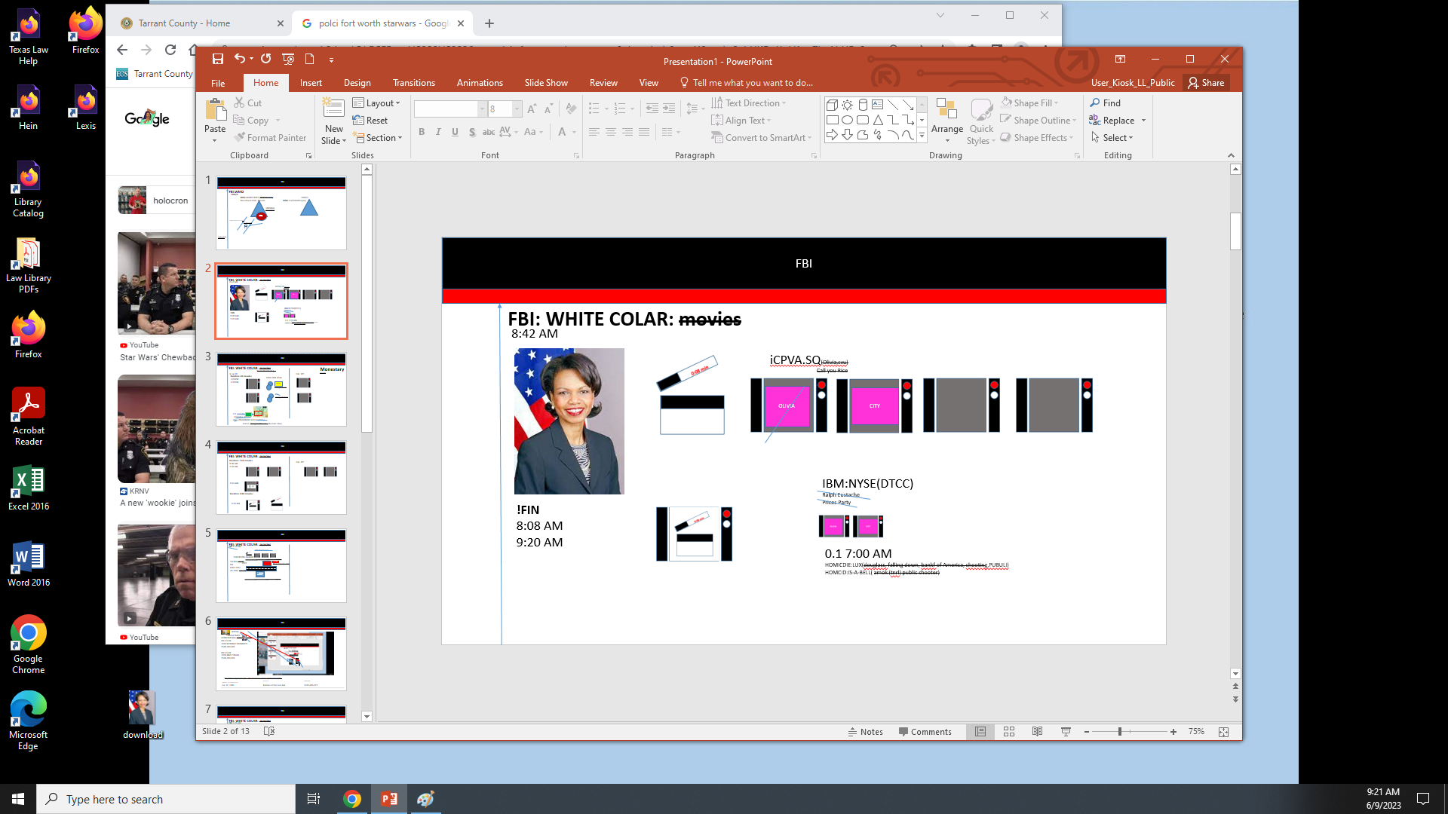
FBI
FBI: movies
9:24 AM FIN
0.1 HOMCIDE:MAYRO
2007 Person cutting the moving
2010
2013 FBI:KIDNANPGIN
v1, v2 kutcscher,pope
AMTSGREICEH koperveltu xy Felix
franceo punches clone kushcer
V1, V2 DOCS sending docues reasdin docume from POLIZEI:LINKEIN, POLIZE:KALRURHE.marx

Slide 7
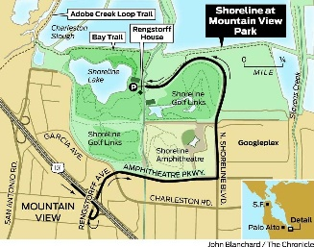
FBI
FBI: WHITE COLAR: movies
Monestary
(klosterweg)
Dorm Monitoring,
§ Jsg 18
Fsk: 18Y
Duration: 20 minutes
1:08 PM
1:28 PM
2004 1PM CPVA
fBI:WMD
compilation
C++
compoliation
0.1 youtube[green]
interview gmail
Area JFK(HOMCEI:LUX:hatelole)
Forton, Rengsdorfhouse, Moutain View

Slide 8
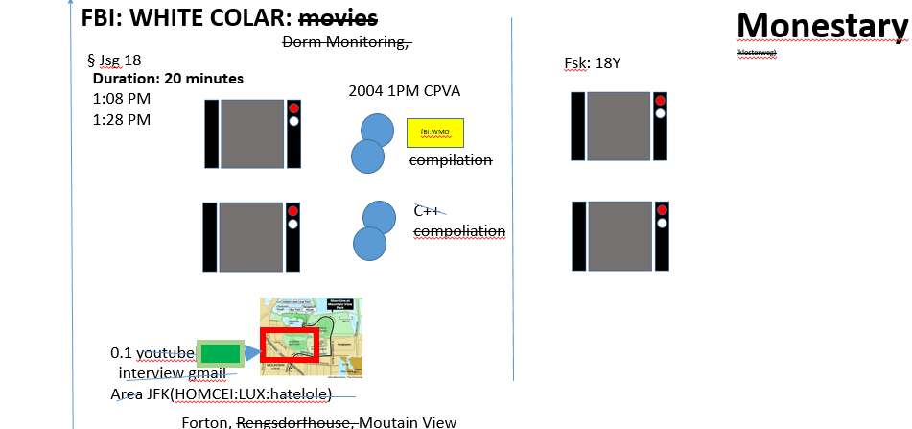
FBI
FBI: WHITE COLAR: movies
Duration: 1:20 minutes
8:08 AM
9:20 AM
Fsk: 18Y
8:16 AM
Duration: 0:08 minutes
8:20 AM

Slide 9
FBI
FBI: WHITE COLAR: movies
FIN 9:20 AM
FIN Petersson
CHECKPOIN CHARLIE
SQ.DEA(Crack)
IPX
HW5 2007
A5 2004 (crack)
STANFORD
2007
Elivis Imsonaoter
WWI.CHECKPOINT CHALIE
41.ghocehc(Dell(cock cage))

Slide 10

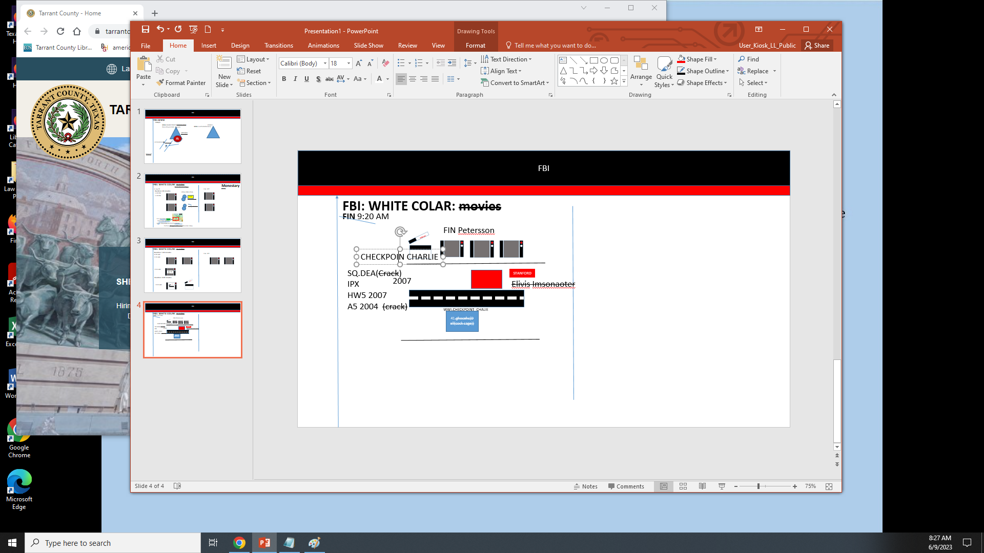
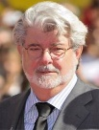
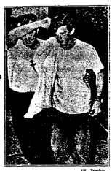
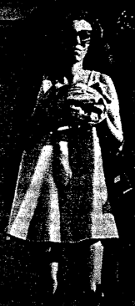
FBI
iPCPVA
LANGLEYMRS
HOMCIDE:BILL(Willaim Mckern)
IPX US-DE
2010 INTERNET PAYMENTS
$500,000,000
IPX US-DE
2005 IBM CYNAEA
$500,000,000
Star Wars: Episode VII ‑ The Force Awakens $936,662,225
Spider‑Man: Across the Spider‑Verse | Sony Pictures | $120,663,589
Jun 12, 1981 | Raiders of the Lost Ark | $225,686,079

Slide 11
FBI
FBI: WHITE COLAR: movies
FIN 9:20 AM
2010 INTERNET PAYMENTS
$500,000,000
Bsc. Witschaftsinformatik
2005 IBM CYNAEA
$500,000,000
Star Wars: Episode VII ‑ The Force Awakens $936,662,225
Assembly/C++ Job
J2EE Architect

Slide 12
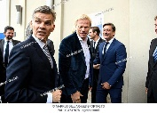
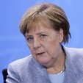
FBI
FBI: WHITE COLAR: movies
8:42 AM
VIRINGIA.SWORN
VOLUME 1
Duration: 1:20 minutes
8:08 AM
9:20 AM
Fsk: 18Y
8:16 AM
Duration: 0:08 minutes
8:41 AM

Slide 13




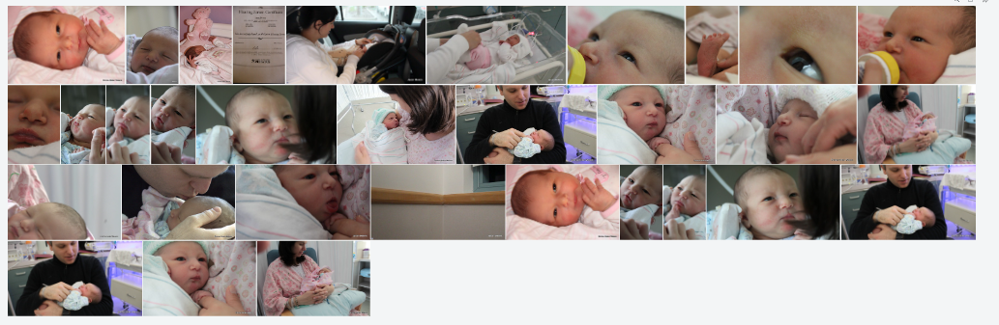
FBI
FBI: WHITE COLAR: movies
8:42 AM- 8:45 AM
HOMICIDE:LUX:INT(globus):PENTAGON:PX:STORE
Duration: 0:08 minutes
Duration: 1:20 minutes
8:08 AM
9:20 AM
JOSPEH.GOV.Sch.IPX Bates Motel
8:16 AM
2007 HW5 Ami poops (tranl) ami small fecal’s,livis Toliet
Damiler Ag
Stanford
Pope
Parent.nonPolciCfgLogial
nonPoclieFrance; Visa (Petersson-Droz), On the Table under the, over thet able, English Rusisan Blond, Stepnaie; Past tense

Slide 14
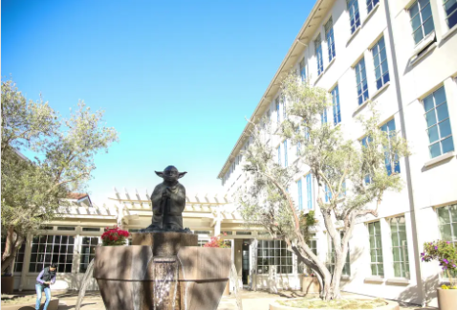
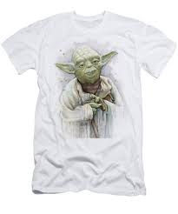
FBI
Alert
Montoring
Triggers
Star Wars: Episode VII ‑ The Force Awakens $936,662,225
iCPVA
Onsite: 2015
$936,662,225/Lukas
$130,000/y
30,000 stock options=$100,000
3 Years $490,000
Assembly/C++ Job

Slide 15
FBI
FBI: WHITE COLAR: movies
8:42 AM
VIRINGIA.SWORN
VOLUME 1
Duration: 1:20 minutes
8:08 AM
9:20 AM
Fsk: 18Y
8:16 AM
Duration: 0:08 minutes
8:41 AM

Slide 16
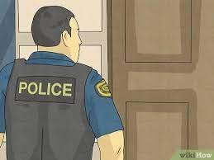
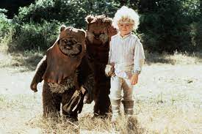
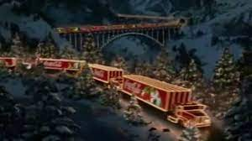
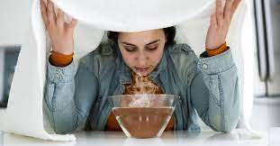
FBI
FBI: WHITE COLAR: movies
Ewoks
9:00 AM – 9:10 AM
FBI:WMD
Duration: 1:20 minutes
9:20 AM
LANLSEY.MR.
KOCHMAN.
Lukas(UC DAVIS).JOSPHE.(ghcheo(dr)
DEA(Steve and tim)
Jpmorgan chase
Bathtub 1: Sick cold/flu inhaler Age 2/3
Bathtub 2: HOMCDIE:NANA: wasth behind forskin Age7 x/y 83.HOMCEI:UR_UR_OPI
pigglywiggly.client.money.touch.accetyer.apple.damiler.ibm.roth
Bathtub 3: 41.v2.iCPVA

Slide 17
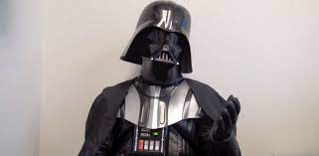
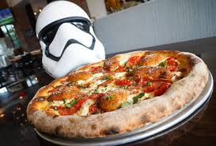
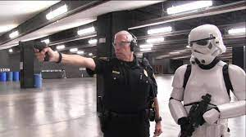
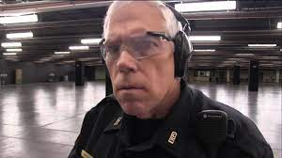
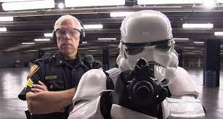
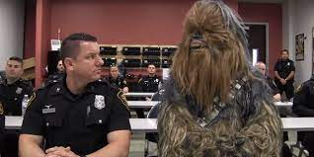
FBI
FBI: movies
Duration: 1:20 minutes
8:41 AM
George Luckas Direcotr
Tim Cook Acting Director
Steve Jobs Elvis
Angel Merkel Vp Germany
Ingo Welleretuer Retriered
9:13
nonPoliceCfg(“Movies”)

Slide 18
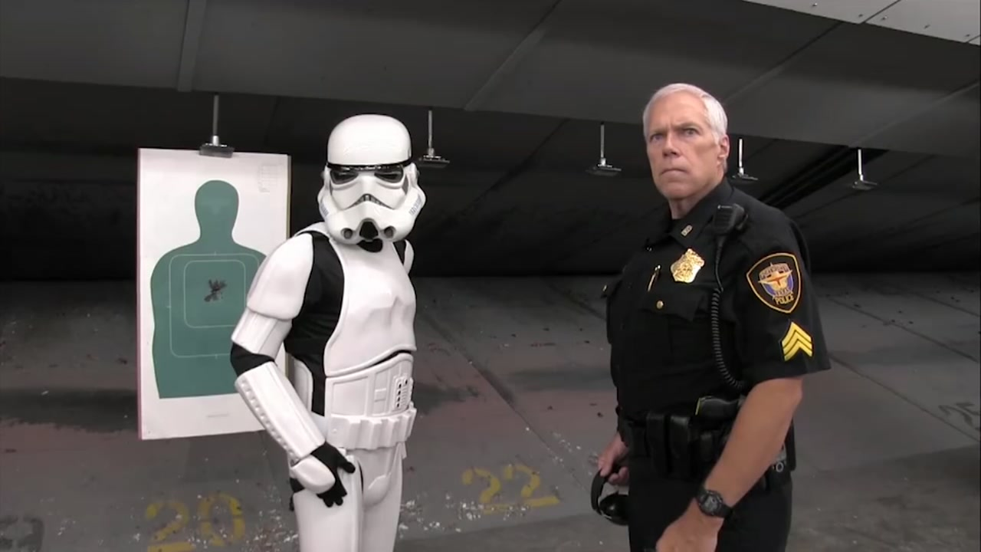
FBI
FBI: movies
9:24 AM – 9:25 AM
1:20 min
VIRINGIA
SWORN

Slide 19
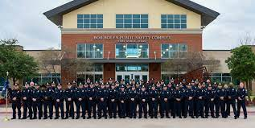
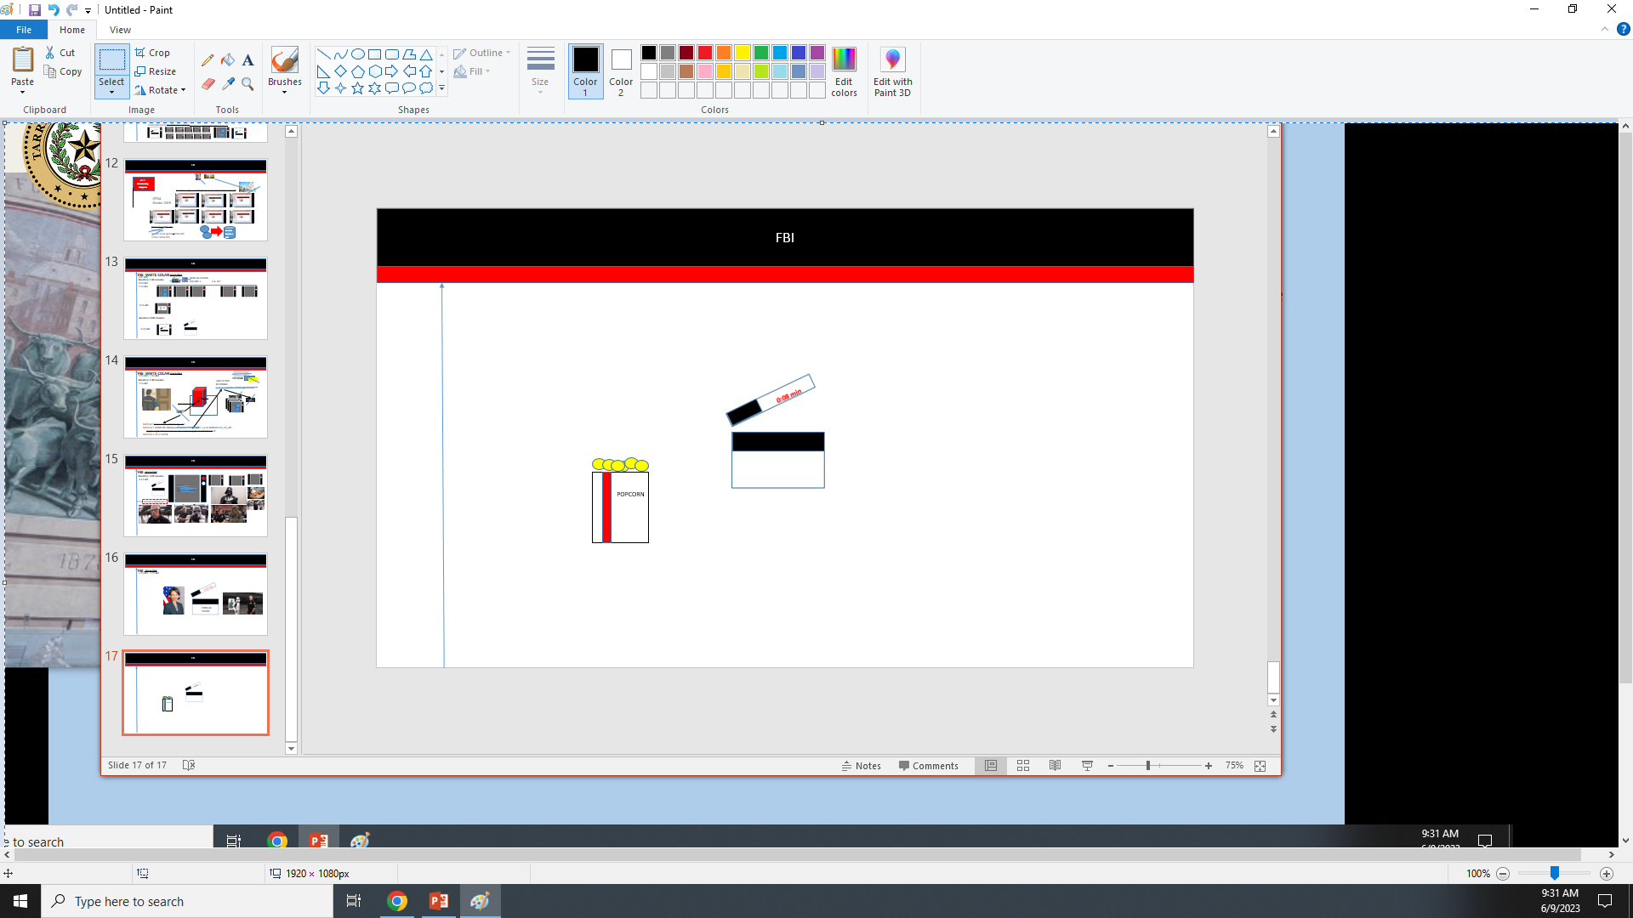
FBI
nonPoliceAudience
§Trademark
Orwel redencbacheer
POPCORN
0.001
1983 esaw redhari brian father redhair
Redhiar LANGLEY:MATHEW
0.1 Assuemd c++ FBI camera
Borland Red Hair Brian, Atari, Apple borland
Tango Redhaird Brain, Atari, Apple
I told Jason….(said): NAME CHANGE(subol free pizza)
41.Gary showlin soccer
Violatoins, nonPoliceSuvelence WATER

Slide 20
FBI
POPCORN

Slide 21
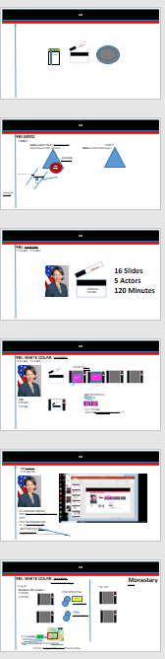
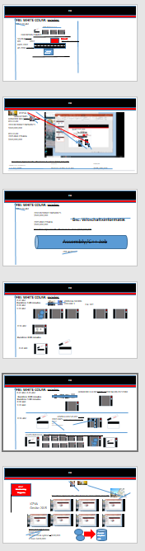
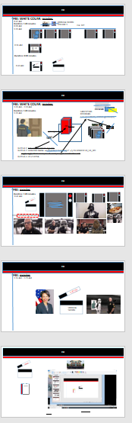
FBI
POPCORN

Slide 22
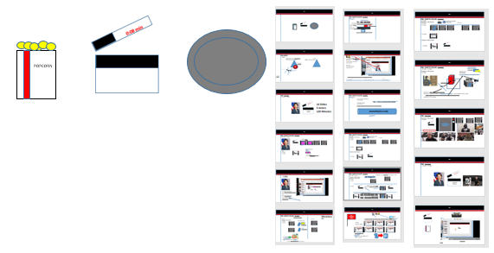
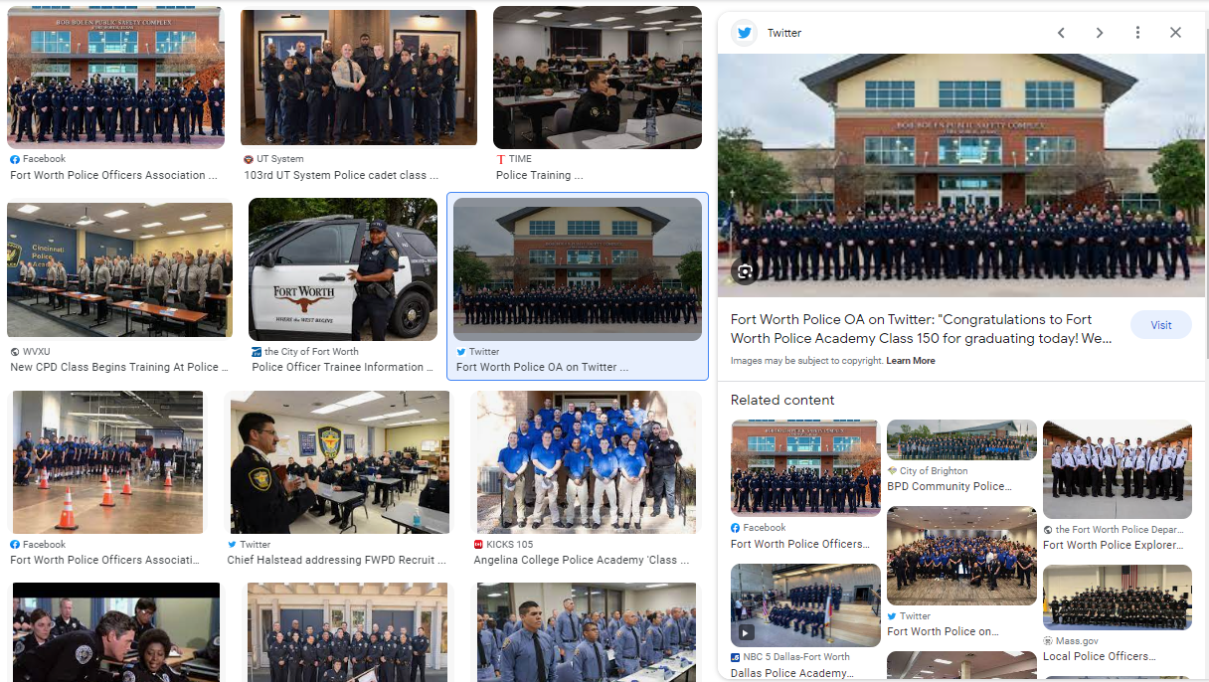
FBI
development
FBI:WMD
9:30-11:30
2 Hours
Other: 9 Billion People

Slide 23
FBI
development
ATOMICLOCK
June 9th, 2023
iCPVA.nonPoliceCfgLogical
FBI:WMD
FBI:WMD
0.1 Outage: Guy shut tv on and off
9:30-11:30
2 Hours
https://www.washingtonpost.com/business/2021/12/22/amazon-web-services-experiences-another-big-outage/
FBI:WHITE COLOR
HOMCIDIE:BILL(wilaim mckern)
IBM:NYSE:INTERNET PAYMENT
OUTAGE
PRICE Sr/Jr gorbachev(visa)
11:30-01:30
2 Hours
FBI:WMD
FBI:CPVA
FBI: VIOLANT CRIMES
FBI:WAR CRIMES
Oracle/Visa
Golden Gate
GOD.Gorbhe(dell,g,pg&e)
phil(kim)
WAR(B-10).PHILIS.WHITEHOUSE
1:30-3:30
2 Hours

Slide 24
FBI
development
IBM Disnelandy Florida, IBM Las Vega Camera
0.1 IBM Camera. AVABJIALTY(PBS.!INT)
ARD Gong INT
Other: 9 Billion People

Slide 25
FBI
development
ATOMICLOCK
June 9th, 2023
8:30-9:30
1 Hour
FB:KIDNAPPING
FBI:MISSING PERSON

Slide 26
FBI
8:30-9:30
1 Hour
FB:KIDNAPPING
FBI:MISSING PERSON
POPCORN

Slide 27
FBI
development
ATOMICLOCK
June 9th, 2023
9:30-11:30
2 Hours
FBI:WMD
FBI:WHITE COLOR

Slide 28
FBI
9:30-11:30
2 Hours
FBI:WMD
FBI:WHITE COLOR
POPCORN

Slide 29
FBI
development
ATOMICLOCK
June 9th, 2023
9:30-11:30
2 Hours
FBI:WMD
FBI:WHITE COLOR

Slide 30
FBI
9:30-11:30
2 Hours
FBI:WMD
FBI:WHITE COLOR
POPCORN

Slide 31
FBI
development
ATOMICLOCK
June 9th, 2023
11:30-01:30
2 Hours
FBI:WMD
FBI:CPVA

Slide 32
FBI
9:30-11:30
2 Hours
FBI:WMD
FBI:WHITE COLOR
POPCORN

Slide 33
FBI
development
ATOMICLOCK
June 9th, 2023
1:30-3:30
2 Hours
FBI: VIOLANT CRIMES
FBI:WAR CRIMES

Slide 34
FBI
development
ATOMICLOCK
June 9th, 2023
9:30-11:30 AM

Slide 35
FBI
development
ATOMICLOCK
June 9th, 2023
9:30-11:30
2 Hours
FBI:WMD
FBI:WHITE COLOR
nonPoliceAudienceLogical
EVIDENCE
HOMICIDE:NANA:ATOMICLOCK
.nonPolcieCfgLoigall
1:30PM FBI:WAR CRIMES
How to identify war crimales interrupts and charts
For nonPolciIdentyTheft
Alfred Hitchcok, HOMCDIE:UR_UR_OPI
HOMCIDE:BILL signature VIRINGIT tippi
1D8723. Schulz Prison Teelvion Daimelr Ag – IBM Dr Dieter Zechte and Viring Rommtti

