Slide 1




FBI
development
2005
HOMICDIE:KYSTAL
IMPORT SQ.COLMENA:US
Apply in there
Jackoff in there
until IBM Start
KING.thehun
June
x
There was game with stomach shot out
throwup
From IMPORT HOMCE:LUX.INENTPAYMENTS.hatehole
INTENT PAYMENTS McCarthy
Apple MazeWare, Doom, Wolfnestein
x
FBI:WMD for Office
I am not hitting you 25 / 19
PENTAONG VIRINGIA us/rrss CVPA
Ipx throwup
Fremont,
Touch.accnetuer.apple.damielr.ibm.rot

Slide 2
FBI
development
2001 Sember 11th
IMPORT SQ.COLMENA:US:PREA:CPVA
HOMICDIE:KYSTAL
IMPORT SQ.COLMENA:US
Apply in there
Jackoff in there
until IBM Start
KING.thehun
x
9/11

Slide 3
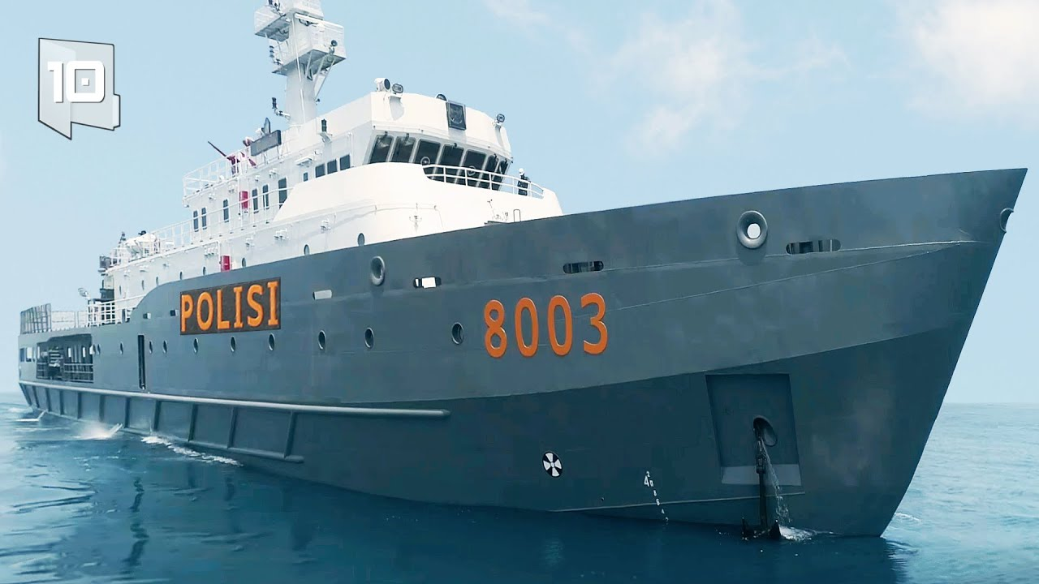
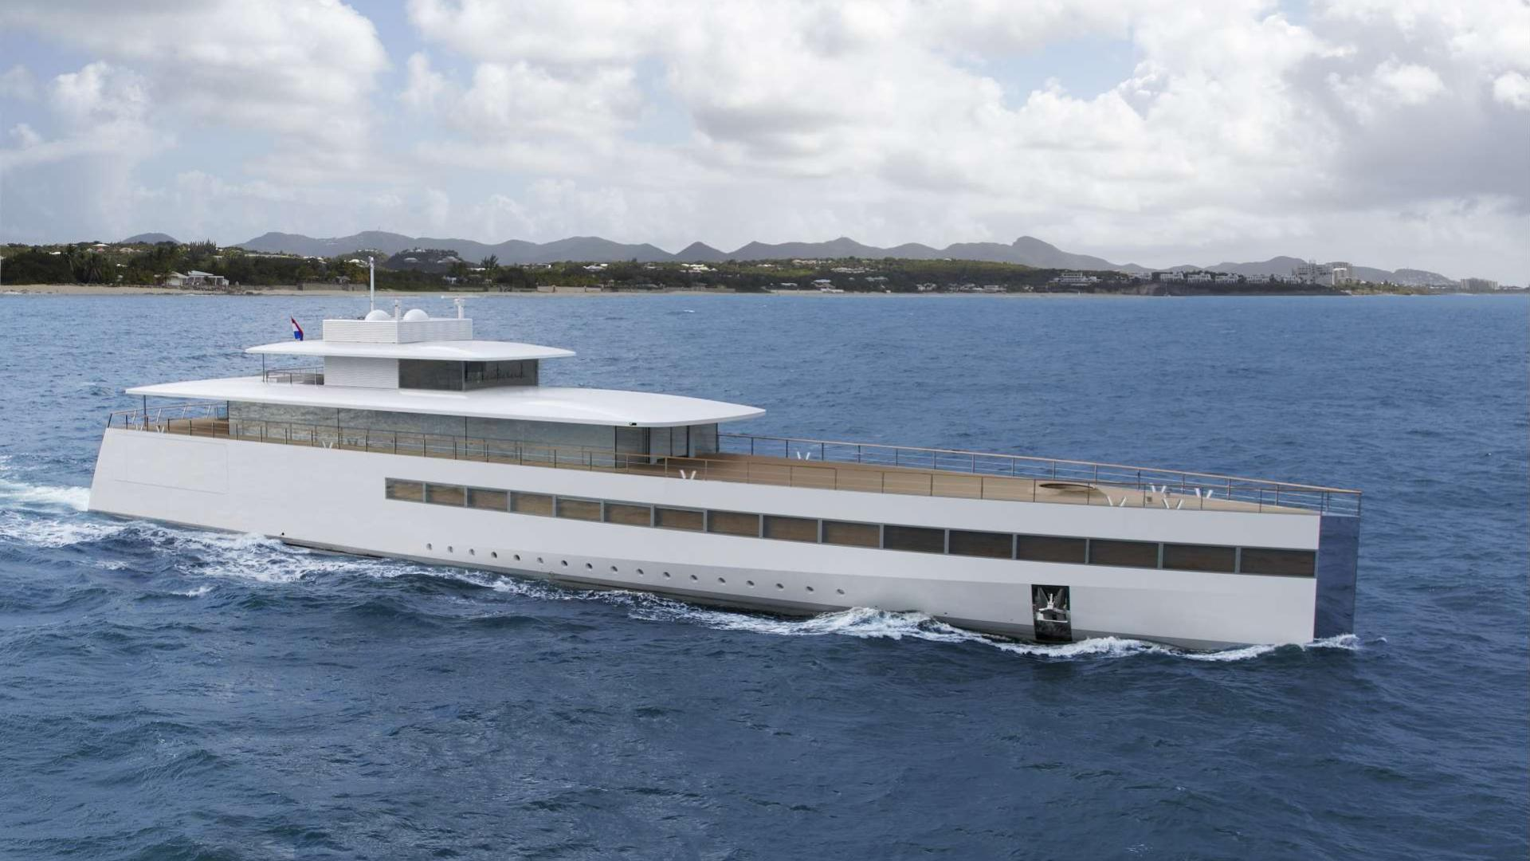
FBI
development
nonPoliceMPA.nonPoliceCfg(ghcheo(micehala)
CERT:STANFORD(pmp)
Josuhe, I will go back to my Yacht. Withoug your wife and second wif daugher

Slide 4
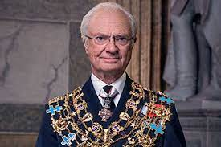
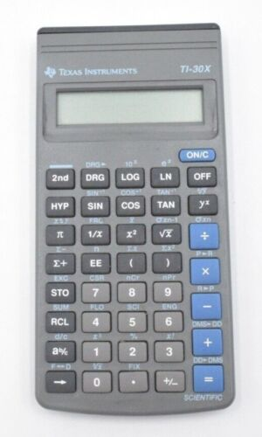
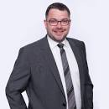


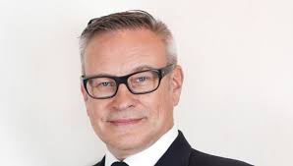

FBI
development
FBI:WMD
2005
1994 Herr Konig
CPVA
LAKE TAHOE
C++/Assembly
SQ.Gorbache(dell,Hendrix[])
2014
2010
2005
2000 WAR
C++/asm
ATOMICBOMB Rocket(thoma-is-dieter) toaster
1994
Notes:
CPV.Stalking

Slide 5
FBI
development
FBI:WMD for 9/11
Easter Bunny Reading Childres Book
In DEA(brazilien apple herion garden)
x
Notes:
CPV.Stalking

Slide 6
FBI
development
Notes:
CPV.Stalking

