Slide 1
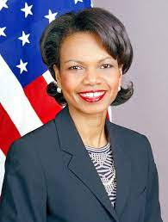
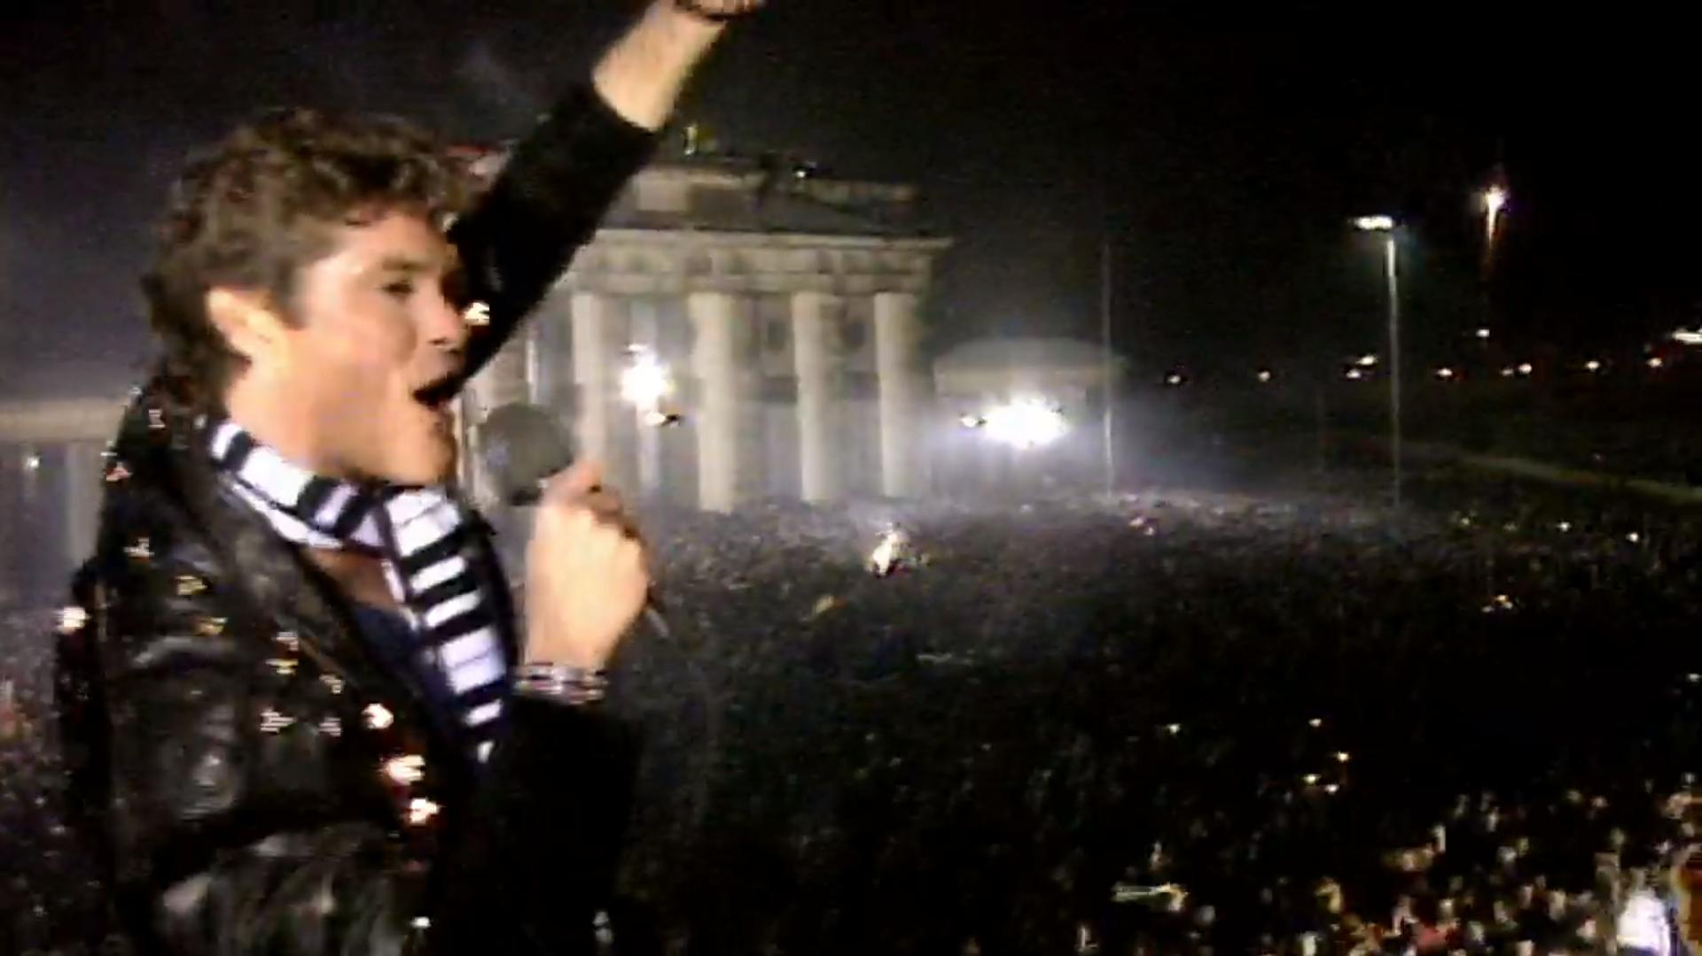
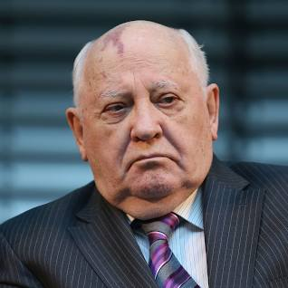
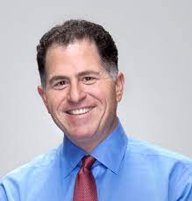
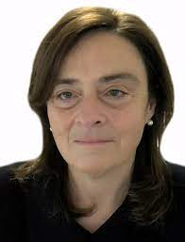

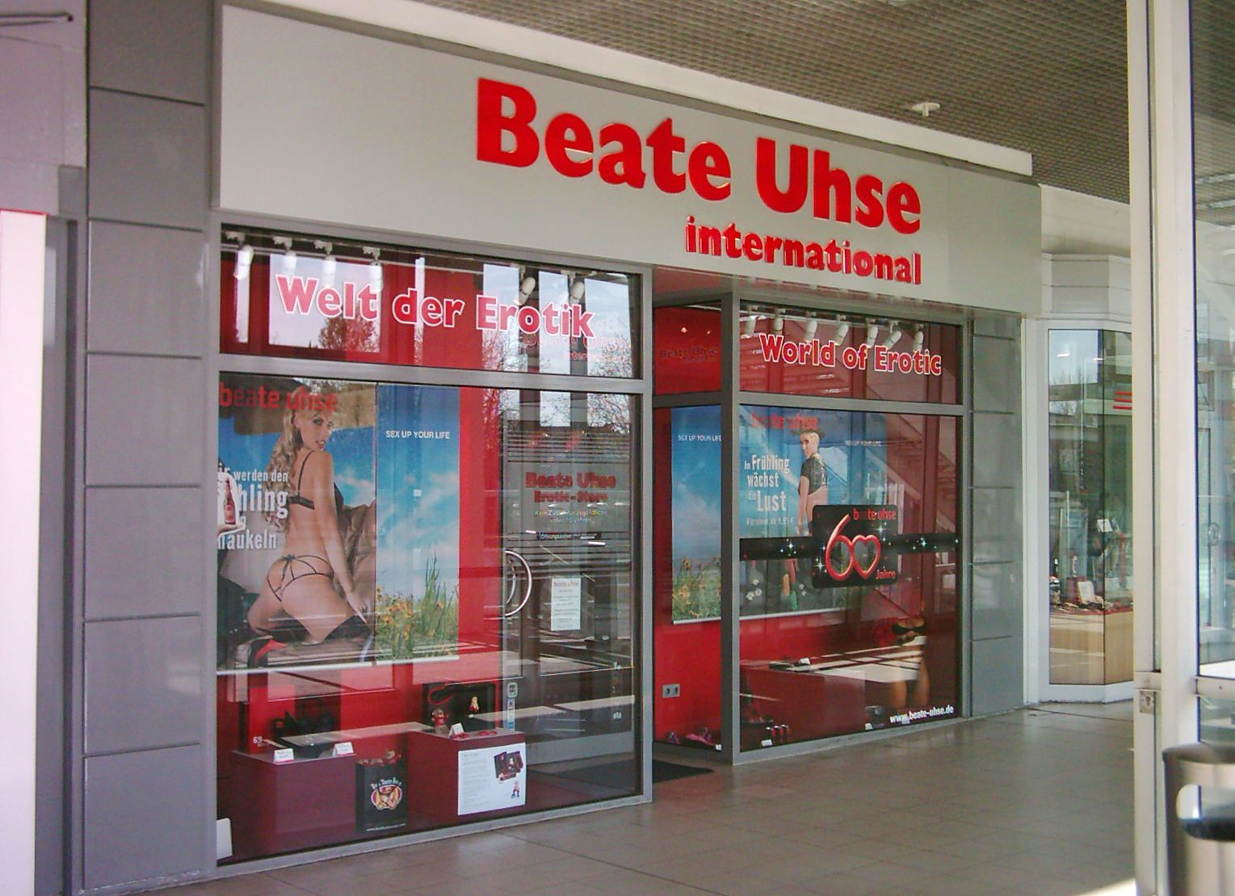
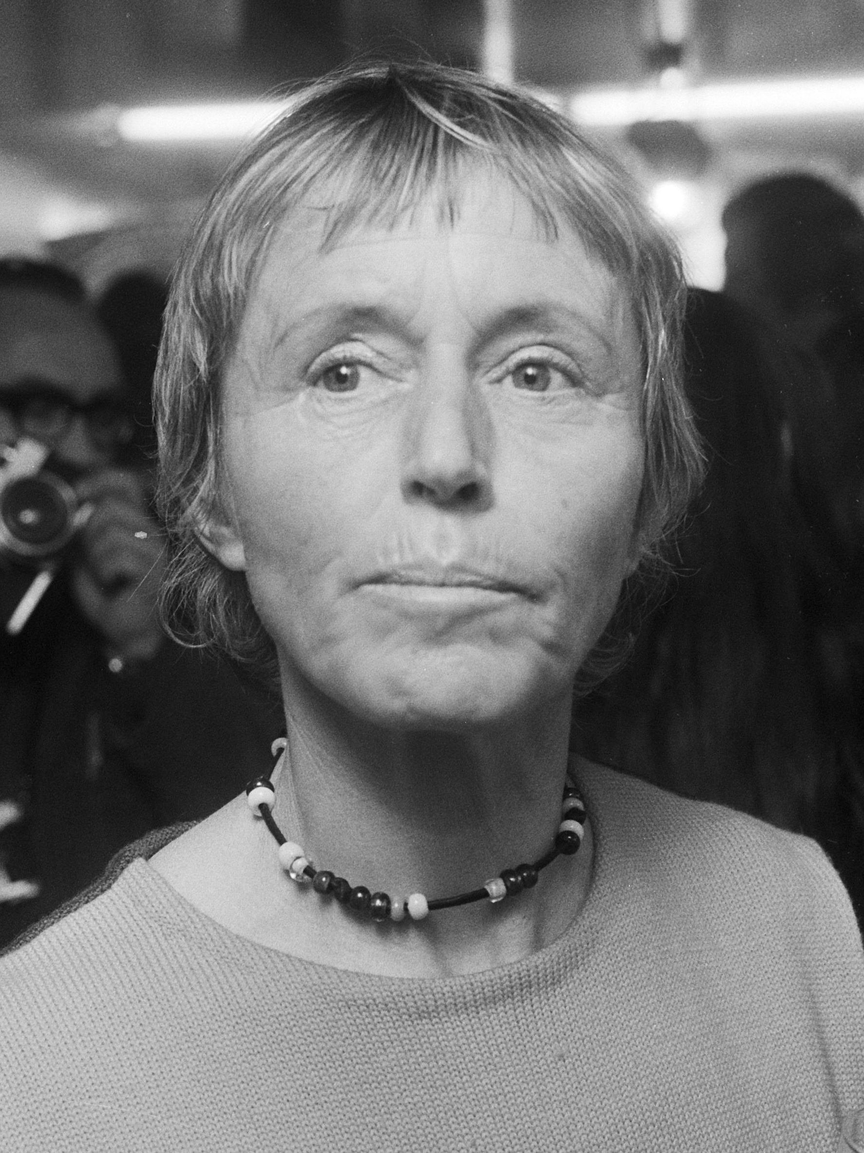
FBI
Development
SMALL PROJECTS
SMALL Tits – 0c
000.tw.pns(bra a bra hangina t size: 0c)
1994 0.0001baxter phil chezlotz (churchhill 0c)
PENTAONG.BASE.PX.SHOES.SALES
PENTGON.BASE.PAUL.
DEA(cocain) Stefan und beate
IMPORT
Dell.quest.client.ushse.beate
PLAYBOY
TOM-BOY
CLIENT
TOM-BOY,haircut
Ghcoeh(micehala)
nonPolcieWife
0.001
Beathe
Beate Uhse-Rotermund
was a German pilot, entrepreneur and sex pioneer.

Slide 2
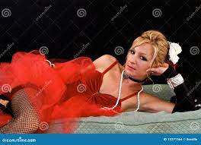
FBI
Development
SMALL PROJECTS
SMALL Vagina – 0c
000.tw.pns(bra a bra hangina t size: 0c)
1994 0.0001baxter phil chezlotz (churchhill 0c)
PENTAONG.BASE.PX.SHOES.SALES
PENTGON.BASE.PAUL.
DEA(cocain) Stefan und beate
IMPORT
Dell.quest.client.ushse.beate

Slide 3
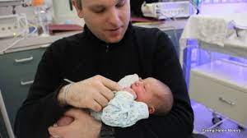
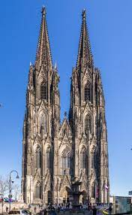


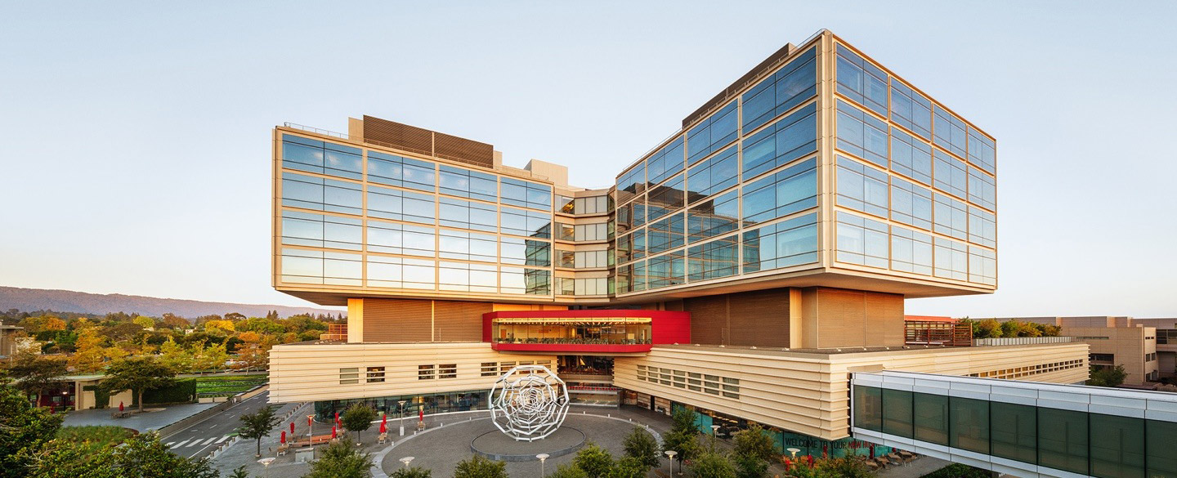

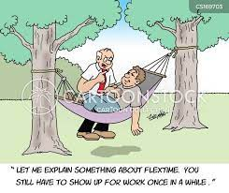
FBI
Development
SMALL PROJECTS
SMALL VIRINGIA – 0c
SMALL chest – 0c
1987 VIRIGNIA M-I-S-S-I-P-P-I
PRICE Jrs.
PRICE Mrs.
PRICE Miss
1994
Medical Center
Hassement
Old man snoring
Phil-default

Slide 4
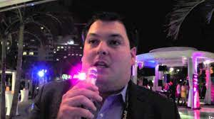
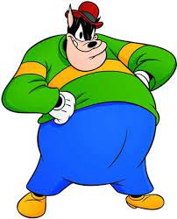
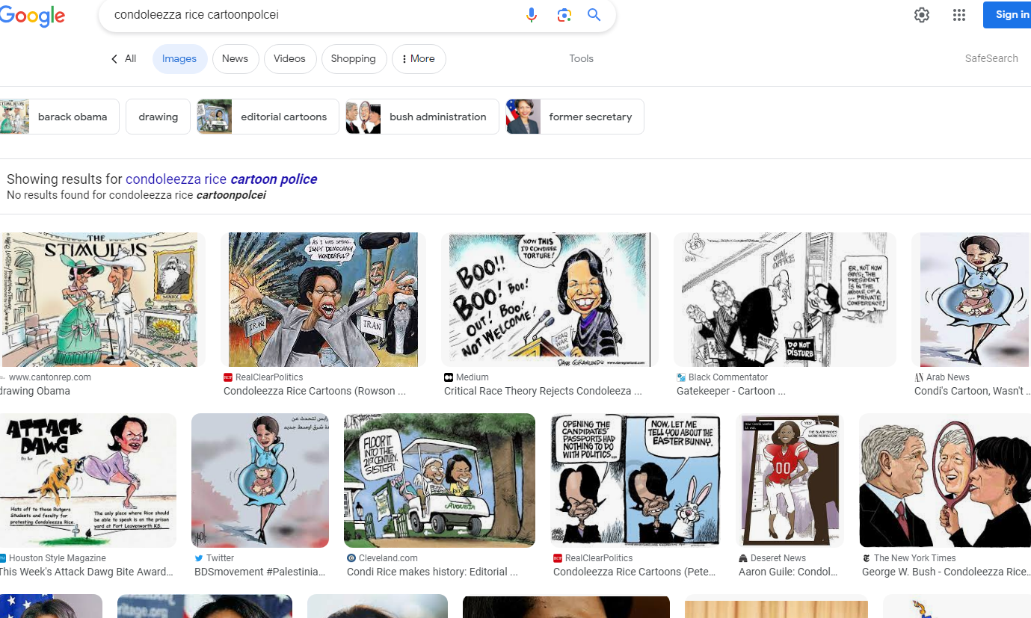
FBI
Development

