Slide 1
FBI
development
Decebmer 2015
FBI:WMD:
Offsite: MAINSTREET(Moutain View, Califorinai, Castro Blvd)
Remote Control.touch.accnetuer.apple.damiler.ibm.roth
I AM AFGHANI
§Korperveltzung
§Assault
Chiese Korean
Afgani
Bada Bing
x
Ibm Tivoli engineer, parent
Remote Controll to be up someone outside, Tim Cook Dr dre
[x] no

Slide 2
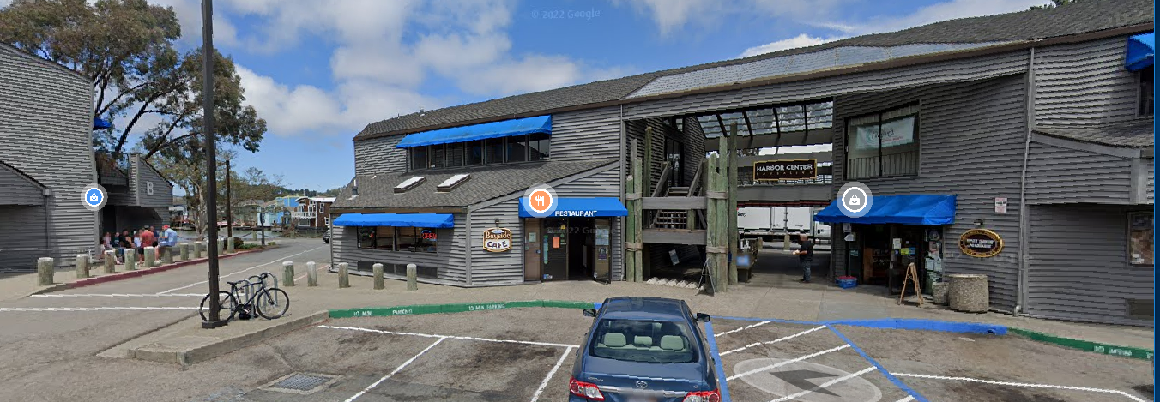

FBI
development
ATOMICLOCK
Santa Rosa
Free pizza
craiglist
nonPoliceSeucOriduem.lsint(Missions)
FBI:WMD:
for Court
Santa Cruz avg
WHITE
CVPA.Goravhe(dr lelsie;Dublin->Los Gatos)
Gorbache(ibm.visa)
Mike navario
BigInt.cc
2002-4
2005/6
I want sit down with my family
And use the computer.
avg
nonPoliceCfgLogial
Gary
C++
L3
2001-2003 Programming Algorithms
Pair programming – Interview Marin (Glassdoor BigInt.cc)
- Gary
- WWI.”tootsie”
.”tootsie”
I kno wyou
unlce
VIRGINIA
Peta(luma)
2008
Santa Rosa, Califonria
L3 J2EE Support
Engineeer
2007/8
0.1 HOMCEI:MAYR(VIRIGNA guns and roses)
C++
?.clarity.Employee.touch.Accenture.damiler.ibm.roth
Ross

Slide 3
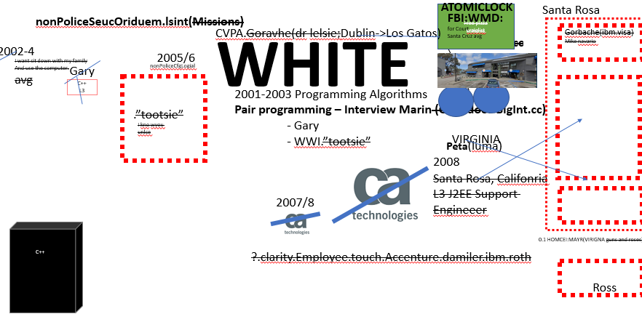

FBI
development
nonPoliceSeucOriduem.lsint(Missions)
DASHBOARD?
000.tw.pns.aei.maxplank.marx
000.tw.png.MAINSTREET(white bag church, food 1 week)
000.tw.pns. Angelican Church
000.tw.pns. Street Chruch[]Logical
ATOMIC CLOCK
Red Flag
2023 000.tw.pns.Grohce(dell.quest.emc2 box)
2005
2009
Jouney
Quest
(San Anselmo)
Mission
Ghcoheo(dell.quest. Dom Cologne, Germany)
Dublin, Koriean Chruch( Yang offsite, Yang Onsite)
ATOMIC CLOCK

Slide 4
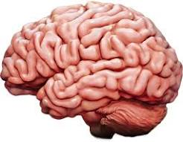
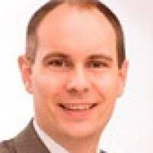
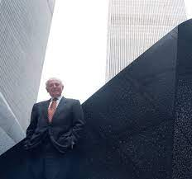
FBI
#ifndef SOME_CLASS_H #define SOME_CLASS_H
development
2014 CPVA
AtomicClock(9-1-1)
9/11
EXT
9-1-1
C++ Preproessor
JOESPEH
FBI:WMD Onsite: Joyti Balsam
Afganistan
#ifndef SOME_CLASS_H
#define SOME_CLASS_H
#endfi
9/11
2002/3 CPVA
ghcheo(dr, call you rice) Student in c++ class with Muller’s ss CUM
MATHEW(mattahsi): c++ is comiplliatd
Mr. Powers/Kraft Dr. Dieter Zechete
HOMCI:LUX:COINTOWN ( lives in bruchsal)
2014
Joyti Balsam
Stefan Mark
Mattahias Kraft
Joephse Sexton

Slide 5

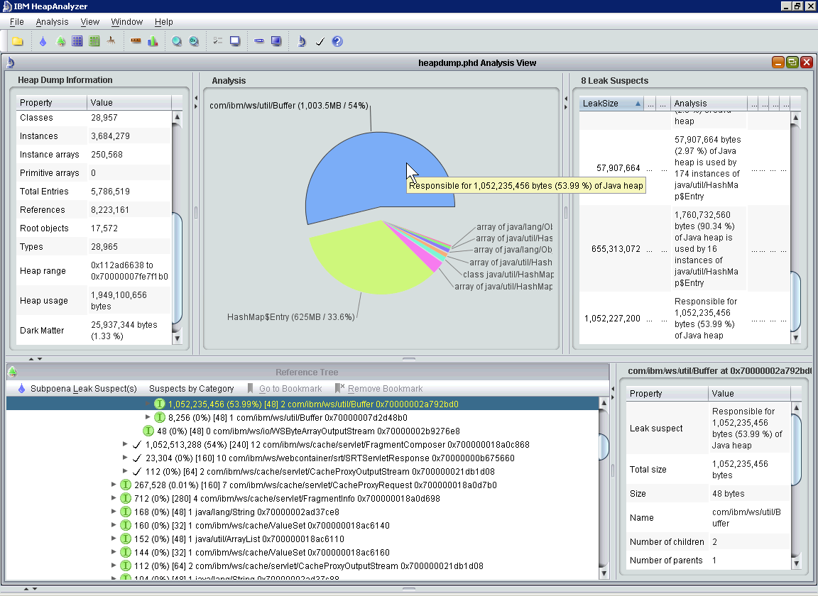
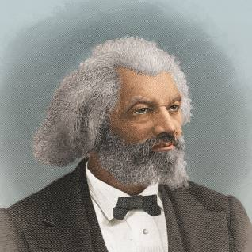
FBI
#ifndef SOME_CLASS_H #define SOME_CLASS_H
development
PENTON VIRGINA MARY (reboots) ghoche(miehala) reboot (pms) recyling
2007
nonPoliceCfg
- Urbano600
- downtime
SQ. reboots
IBM Heap Analzer instead of IBM W/sam
ATOMICCLOCK
Even to get to C++ or the Pre processor programming (reboots)
ATOMICCLOCK
ATOMICLOCK
Free pizza
craiglist
FBI:WMD:
for Court
Santa Cruz avg
BigInt.cc
ENTRY: Douglass
NAME CHANGE(free pizza, find job)

Slide 6

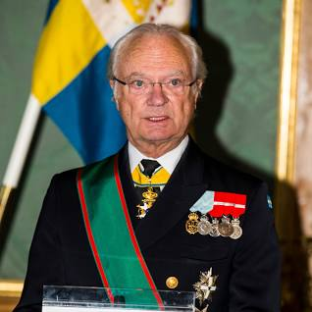
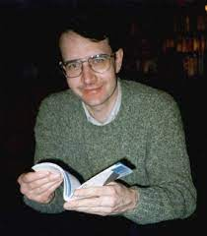


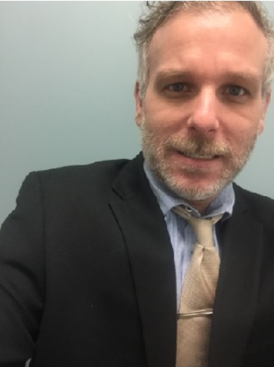

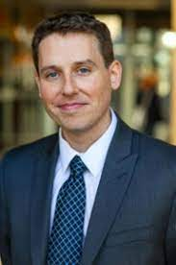
FBI
#ifndef SOME_CLASS_H #define SOME_CLASS_H
development
11:15am 2003 20Y
CATHLICE CHURCH
(klosterweg)
#include <iostream>
using namespace std;
#define PI 3.14159
int main () {
cout << "Value of PI :" << PI << endl;
return 0;
}
C++ Preproessor
My Cum
Mein erguss
CPVA
11:15am 2023
CPVA
ATOMCLOCK(CPVA)
AtomicClock(9-1-1)
9/11
EXT
9-1-1
9/11
Ukriane
Blond
Dr. TORT III
Tutor c++ Pointer *
C++ Preproessor

Slide 7
FBI
#ifndef SOME_CLASS_H #define SOME_CLASS_H
development
CATHOLIC CHURCH
(klosterweg)
CPVA.TORT III
Tutor c++ Pointer *
C++ Pointers
string food = "Pizza"; // A food variable of type string string* ptr = &food; // A pointer variable, with the name ptr, that stores the address of food // Output the value of food (Pizza) cout << food << "\n"; // Output the memory address of food (0x6dfed4) cout << &food << "\n"; // Output the memory address of food with the pointer (0x6dfed4) cout << ptr << "\n";
11:15am 2023
Pizza
0x7ffe143f9610
0x7ffe143f9610
Dr. Thosten Jochem
string food = "Pizza"; // A food variable of type string cout << food; // Outputs the value of food (Pizza) cout << &food; // Outputs the memory address of food (0x6dfed4)
C++ odd eyes, odd hair
Apple tuto Fibonaci
Appe.Jeuse.christ
Other:
CPVA(c++)
string* ptr = &food;
Tutor Room
Univeristy Spanish
Gambas, gambas baby spain beach

Slide 8

FBI
#ifndef SOME_CLASS_H #define SOME_CLASS_H
development
11:15am 2003 20Y
CATHOLIC CHURCH
(klosterweg)
C++ Operator Overload
11:15am 2023
VIRIGINIA Fired/Monpolisih hired/founder(s)
Programming II
KING.QUEEN.Ghoche(dell.quest.emea.Hendrik)
KING.QUEE.(hp,hendrk, pope franci, FEDRAL BANK alen)
Programming I
Semester 1
Semester 2
Anal
Cumshot
milf
Integers, Strings,
For-Loops
Data (Tree, Maps)
Operator Overload
Pointers
TheHun.com
Programming III
Semester 4
Class Scheudule
Klasur, Finals, Test, Exam

Slide 9
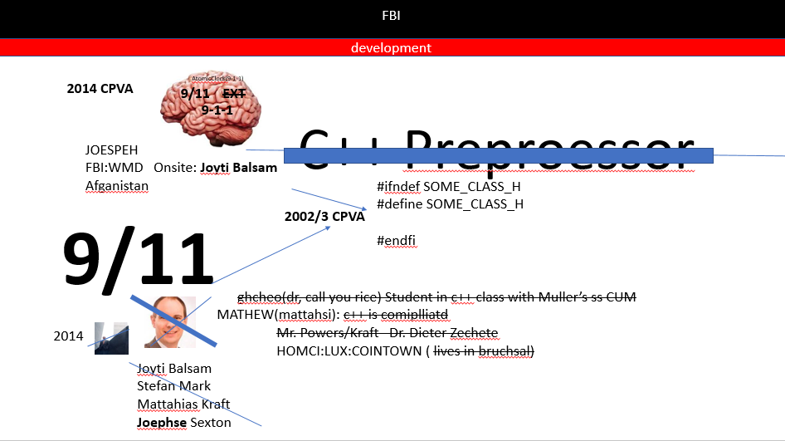
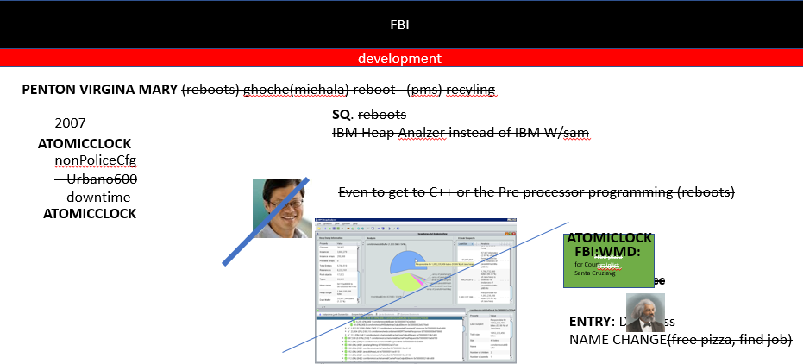
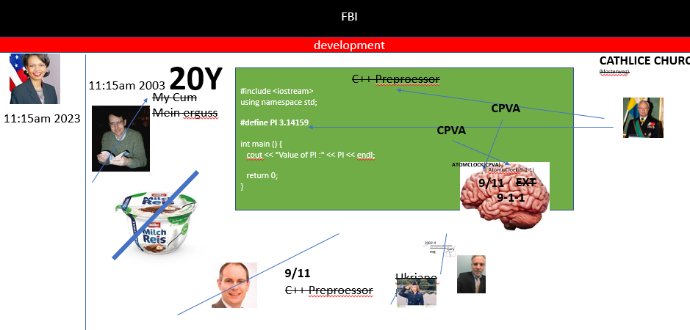
FBI
#ifndef SOME_CLASS_H #define SOME_CLASS_H
development
2014
CPVA
Dev-eng job
J2EE job
Apple CCCP
2007/8
C++ JOB
Assmpbly Job
Dev-eng job
Apple CCCP
2002/3

Slide 10
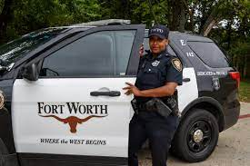
FBI
#ifndef SOME_CLASS_H #define SOME_CLASS_H
development
VIRGINIA.MAINSTREET.FBI:WMD(Britney and ”tootsie”)
You not suppose to be here
At the Univeirsty
IMPORT:CERTIFIED:STNAFORE:PMP
000.tw.pns.CPVA.ATOMB BOBM( pbs stalking 3 fat black ones)

Slide 11
FBI
#ifndef SOME_CLASS_H #define SOME_CLASS_H
development
Max-Plank-Instuture
Stanford
CPVA 2023
FBI:WMD 2023
idiot

Slide 12
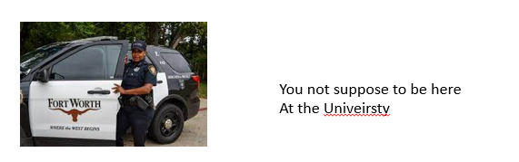
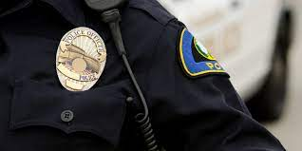
FBI
#ifndef SOME_CLASS_H #define SOME_CLASS_H
development
VIRGINIA.MAINSTREET.FBI:WMD(Britney and ”tootsie”)
Bsc.
2014
facebook
PENTAGON.emea
Jeff MBA
MLK( report from: Micheal King)
JFK( reort to: Micehal Lukancivie)
LABO CODE.Touch.accentuer.apple.damiler.ibm.roth
AVAILABILITTY
IBM Tivoli
Synthetic Transaction
Binary

Slide 13
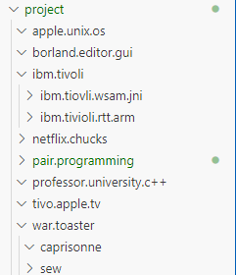
FBI
#ifndef SOME_CLASS_H #define SOME_CLASS_H
development
VIRGINIA.MAINSTREET.FBI:WMD(Britney and ”tootsie”)

Slide 14
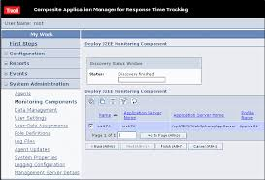
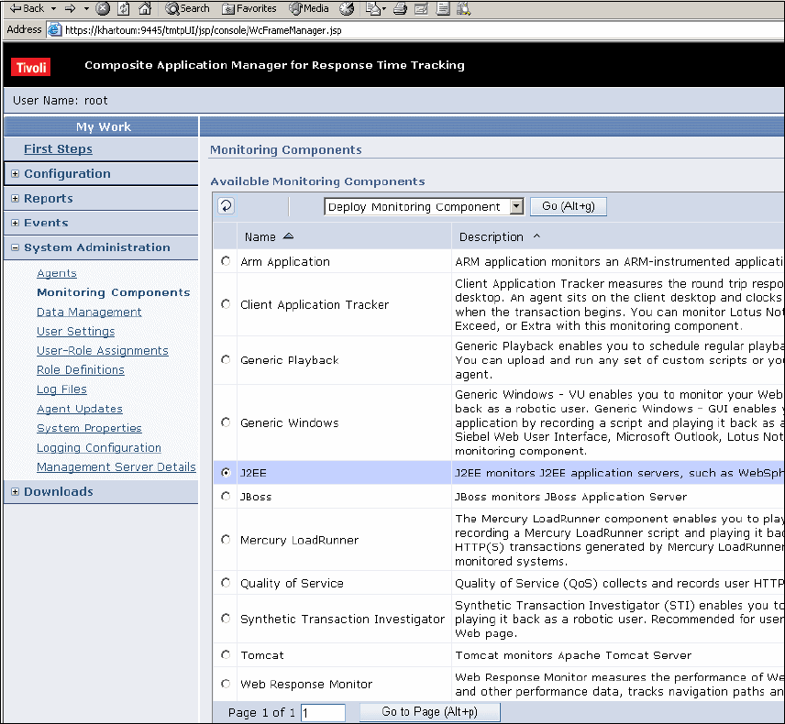
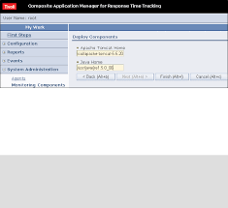
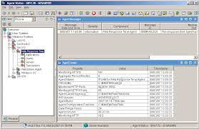
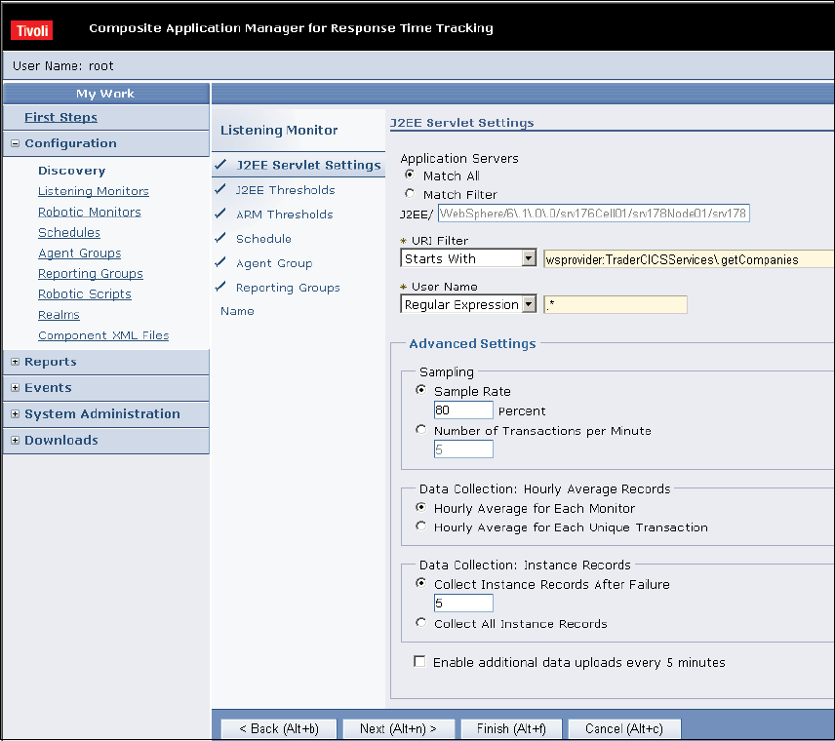
FBI
#ifndef SOME_CLASS_H #define SOME_CLASS_H
development
VIRGINIA.MAINSTREET.FBI:WMD(Britney and ”tootsie”)

Slide 15
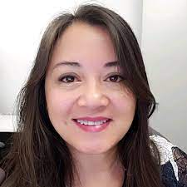
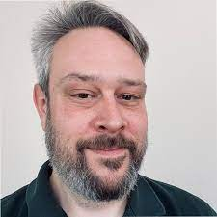
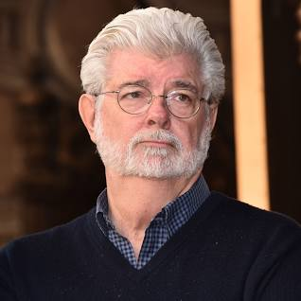
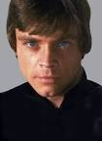
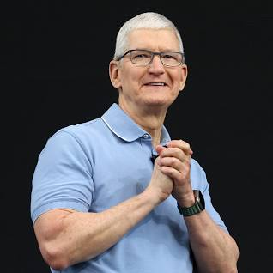
FBI
#ifndef SOME_CLASS_H #define SOME_CLASS_H
development
VIRGINIA.MAINSTREET.FBI:WMD(Britney and ”tootsie”)
CPVA TOUCH
TIVOLI SALES ENGERINING
DEVELOMENT (ARM C++)
2007 CPVA <dev>
baby
IBM Tivoli Austin
Britney Tong
ITCAM for RTT
Resposnt Time Tracking
ARM C++
IBM Tivoli Austin
Gregory Havens
CPVA
Touch 2006-8
Fetus on site
ITCAM for RTT
Ghohcoev
gohcoeho
HOMICE:STILLBORE[]
MLK( report from: Micheal King)
JFK( reort to: Micehal Lukancivie)
Resposnt Time Tracking
ARM C++

Slide 16
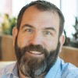
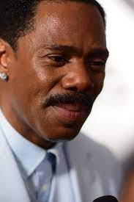
FBI
#ifndef SOME_CLASS_H #define SOME_CLASS_H
development
CPVA TOUCH
2007 CPVA <dev>
baby
CPVA Touch, Apple
Micheal Lukanvich
ITCAM for RTT
Resposnt Time Tracking
ARM C++
CPVA Touch, Apple
Micheal L. King
ITCAM for RTT
Resposnt Time Tracking
CPVA
Touch 2006-8
Fetus on site
HOMICE:STILLBORE[]
MLK( report from: Micheal King)
JFK( reort to: Micehal Lukancivie)
ARM C++

Slide 17
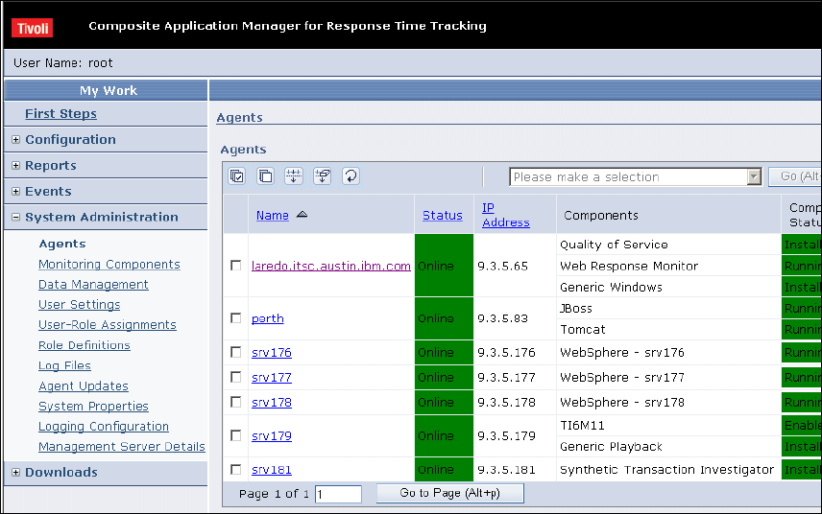

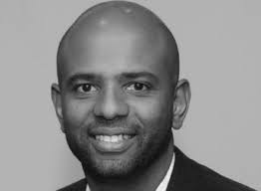
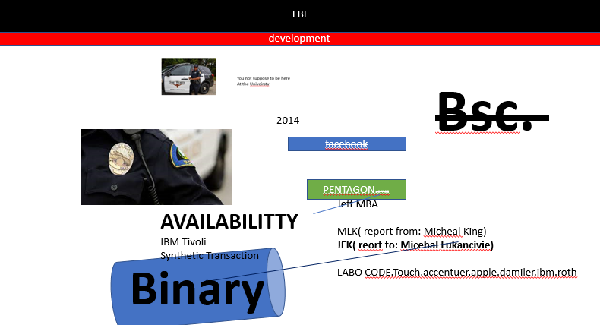

FBI
#ifndef SOME_CLASS_H #define SOME_CLASS_H
development
VIRGINIA.MAINSTREET.FBI:WMD(Britney and ”tootsie”)
Availability
2007 20Y?

Slide 18

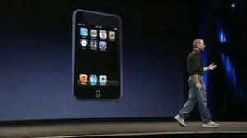
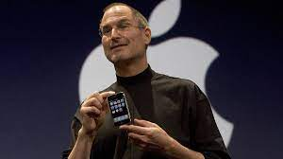
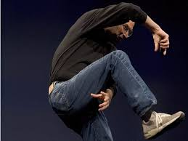
FBI
#ifndef SOME_CLASS_H #define SOME_CLASS_H
development
VIRGINIA.MAINSTREET.FBI:WMD(Britney and ”tootsie”)
Prison Rape Elimination Act
1D8723
Availability
2007
apple touch 2007 steve jobs
CPVA Binary

Slide 19
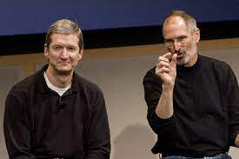
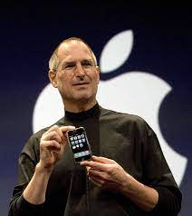
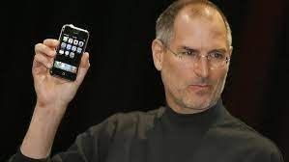
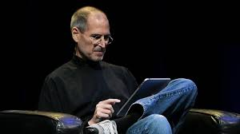
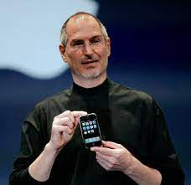
FBI
#ifndef SOME_CLASS_H #define SOME_CLASS_H
development
VIRGINIA.MAINSTREET.FBI:WMD(Britney and ”tootsie”)
TOUCH
2007
PAY

Slide 20

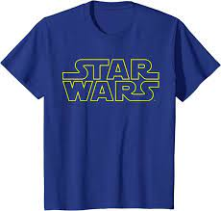
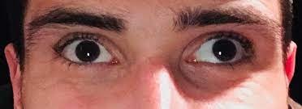
FBI
#ifndef SOME_CLASS_H #define SOME_CLASS_H
development
VIRGINIA.MAINSTREET.FBI:WMD(Britney and ”tootsie”)
Gorbache(Micheal Lukanvich)
2014
CPVA.Availability
2007
BINARY
FILE
File size change
Bitsum change
Offline
KING.lazy eye
2007
2007 CPVA <dev>
baby
CPVA Touch, Apple
Micheal Lukanvich
ITCAM for RTT
Resposnt Time Tracking
ARM C++
Fetus on site
HOMICE:STILLBORE[]
Acting polci Ofifce Retire Looks like JFK(reoro tot ghoeo(mike lukanivce))
2014
ATOMICLOIC(EXPORT(g)hoehr(mike)

Slide 21
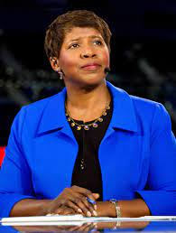

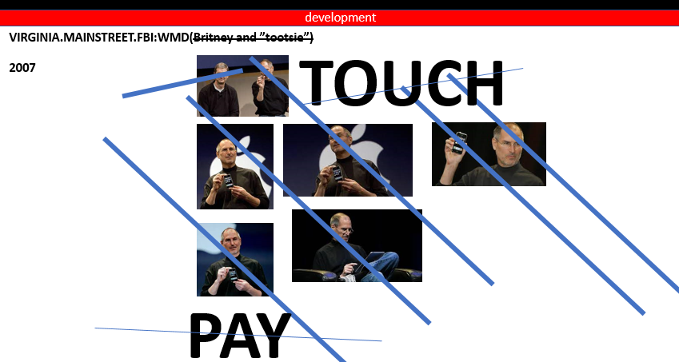
FBI
#ifndef SOME_CLASS_H #define SOME_CLASS_H
development
VIRGINIA.MAINSTREET.FBI:WMD(Britney and ”tootsie”)
ATOMIC CLOCK
(Wiener, Musihi)
Availability
CPVA
IMPORT

Slide 22
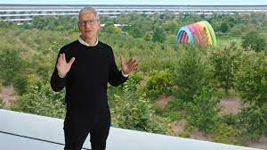

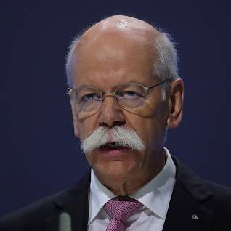
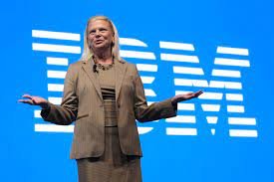
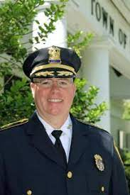
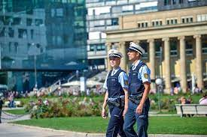








FBI
#ifndef SOME_CLASS_H #define SOME_CLASS_H
development
VIRGINIA.MAINSTREET.FBI:WMD(Britney and ”tootsie”)
Availability

Slide 23




FBI
#ifndef SOME_CLASS_H #define SOME_CLASS_H
development
VIRGINIA.MAINSTREET.
FBI:WMD
(Britney and ”tootsie”)
CATHOLIC CHURCH
C++
Class Schedule
CPVA TOUCH
0.0001 Exil HOMICIDE:AUSLADER(lebenise)

Slide 24



FBI
#ifndef SOME_CLASS_H #define SOME_CLASS_H
development
VIRGINIA.MAINSTREET.FBI:WMD
lace
1994
PRICE BILL MARY
2014
CPVA IMPORT INTERNATIONAL
x
idiot
MARY MARY:ghoche(mciehaala)
Lary
Aundrea
Lisa

Slide 25











FBI
#ifndef SOME_CLASS_H #define SOME_CLASS_H
development
VIRGINIA.MAINSTREET.
FBI:WMD
(Britney and ”tootsie”)
ELKE
KING.NAME CHANGE
Petersson 0.1 my cum c++
x
FBI:KIDNAPPING
Facebook
ContentItem
Antonette Ronson
Call you dr Rice, my cum
VISA Iron man Marthon, Holiset Sweidw cum

Slide 26


FBI
#ifndef SOME_CLASS_H #define SOME_CLASS_H
development
Application
Marketing
Download
Sales
Stanford
Partner
Max-Plank Institute
Albert Einstein
C/C++
No ID
Arun Biligiri, Warton IBM
Check-in-mail

Slide 27





FBI
#ifndef SOME_CLASS_H #define SOME_CLASS_H
development
C++ Progamming for ARM application Response Time
Measurment in different prorams.
AVAILBILITY w/sam Compsoite Transctions
itcam Compsite Transations
Aggreated transtaions (c++ arm injection)

Slide 28



FBI
#ifndef SOME_CLASS_H #define SOME_CLASS_H
development
CPVA 2014
9/11
September 11th 2001
ROUTES
Free Pizza
Craiglist
Free Pizza
Craiglist
Free Pizza
Craiglist

Slide 29


FBI
#ifndef SOME_CLASS_H #define SOME_CLASS_H
func(func1(), func2());
t1 = func1(); t2 = func2(); func(t1, t2);
development
WAR(b1-10)LARRY.SR.WHTIEHOUSE.HOMICDIE:FETUSE[]:HOMCE:JEUSE:HOME:PETER:HOM:PETER
October 2015
Intel CPU Programming and Programmer
I program ARM (for processros)
L1
CPU
C++ Progamming for ARM
#L1 Cache: put (wait for data,store data)
#L1 Cache: get( get data)
loop:
lwarx r6,0,r3,1 #load lock and reserve
cmpw r4,r6 #skip ahead if
bne- wait # lock not free
stwcx. r5,0,r3 #try to set lock
bne- loop #loop if lost reservation
isync #import barrier
8 YEARS AGO
SOME GUY AT PUB
ACCES CPVA BRAIN
[x] no
?
https://www.cl.cam.ac.uk/~pes20/cpp/cpp0xmappings.html

