Slide 1
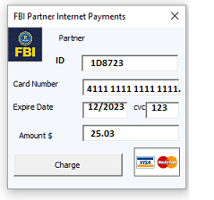
FBI
development
Application
Journal
7:19 PM July 20th, 2023
MARKETING
MAINSTEET(SQ.HOMICIDE:GoodYear)
FBI:WMD for Bulding Office
Police KING.MLK(tesla,paypal)
Miliary
Foolowing police or military logcalliy for SALES using tnt network
AVAILABILITY
2014 NSA been there already FORT WORTH
SALES
Dowload
Dr. Rice. KING.WWI(brown1.0/”D”)(CIVIL CODE.DEFAULT(JFK(ATOMBOM(gorahve(dr, werner))
NAME CHANMG(free pize oli)
MARKETING
1991 POLICE.PAUL.JOSPEH.DEA.(keller(tanl) basemnt).MARY.”tootsie”.ketcar
1994 LOVELACE gocart, 2007/8 IMPORT COVA phil.JFK.MLK(ibm.touch)
2005 IMPROT:HOMCIE:LUX:HOOVER bob gocart
TCC
gocart
VP GERMAN.DEA.LOVLACE:!HOMCE:JEUSE:HOCME:PTER:HEOMCPETER
(happign pill happy trigger)

