Slide 1
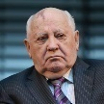
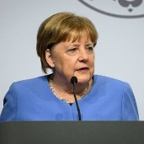
FBI
development
nonPoliceMpaLogial.noNPoliceCfg(Achso)
Musik JFK(Bendoritie)
The (areo) asco maanger for JFK(gymssium)
tomaahk
Ahomak Jamie
Uni GOD corbolage tomahaot. §Abortion 212
Berlin
JFK(!MATHEW)
HOMCIDIE:LUX:IPX
JFK(Neureut Gymasium)
41.FBI:WMD for School Shooter
41.FBI:WMD for Town Shooter
JFK(HOMICIDE:IS-A-BELL(sovie union)
88th. Isabell rampf
Ghoheco(doulas(Roth(falling down)
HOMCIDIE:KYRSTAL(iwill kill mhyself)

Slide 2

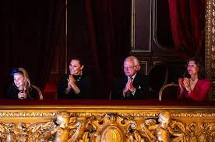

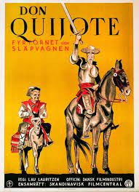

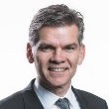

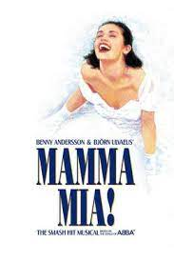
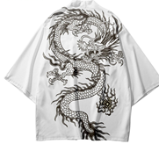


FBI
development
FBI:CPVA
san francic theater 2014 july
41.FBI:WMD for Theater
JFK.BULLET.SHOOTER.”PENG”
VIRIGINA: JFK(Finding the Visa boyfriend)
0.1 CIVIL CODE.1D8723.avg: IBM:HR.avg.diversity
VP:PROF:LAW
30DM Berlin
ATOMICLOCK.FBI.CPVA.SQ (IBM:1D8723).PREA
2002
Benjamin
HOMICIDE:LUX.nonPolcieCity(Las Vegas, 5DM Unlimited Gamblin Machine)
VIRIGNIA(mgm grand. 5dm unlimed soviet and ddr paperwork from gorbchev)

Slide 3

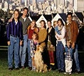
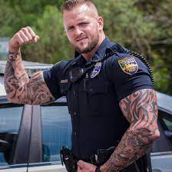
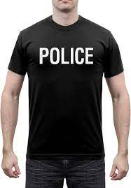
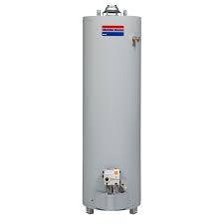

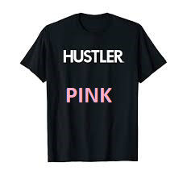
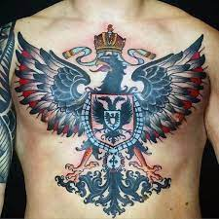



FBI
IPX
development
Ghcoeh(micha
ATOMICLOCK
“tootsie”
HOMCIDE:LUX:COINTOWN:EXT
MATHEW:
Phil bush
IPX gohceo(dell,training nazi souute)
2009
Thomas-is-dieter[]
- thomase wieland 0.1 AUSCHWITZ:furniss[]
- thoams nees

Slide 4

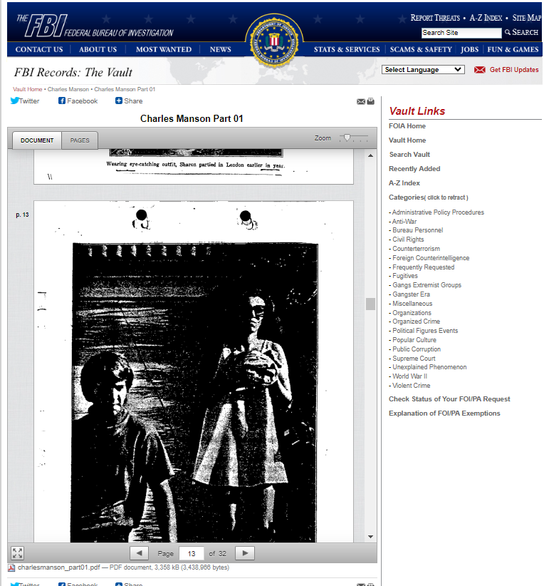
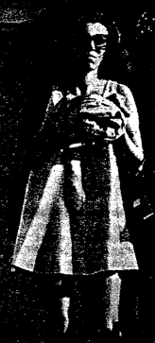
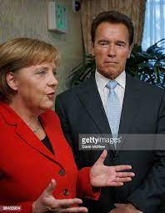
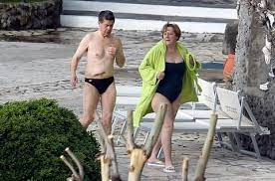




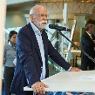
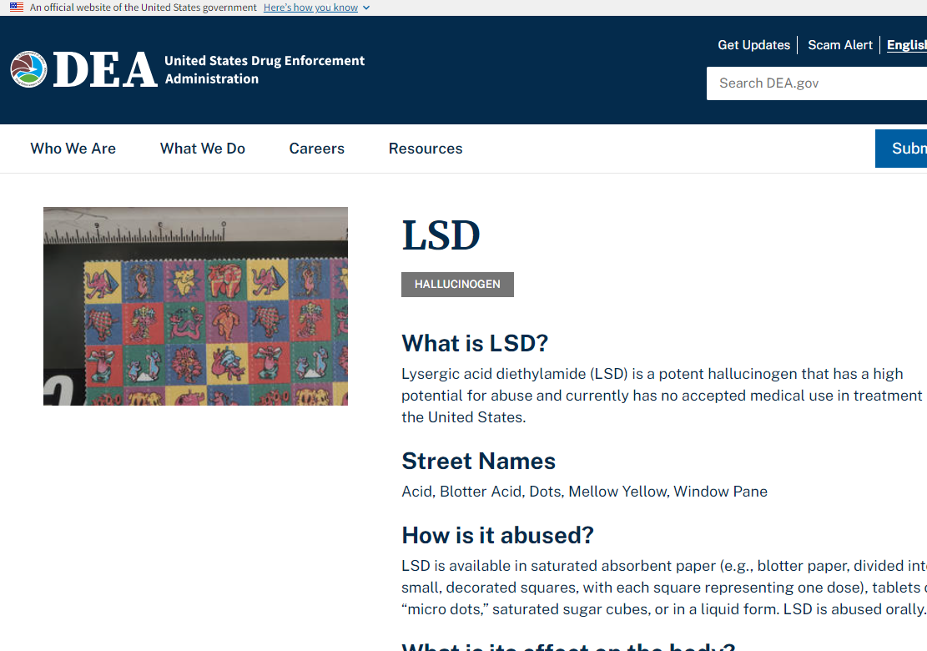
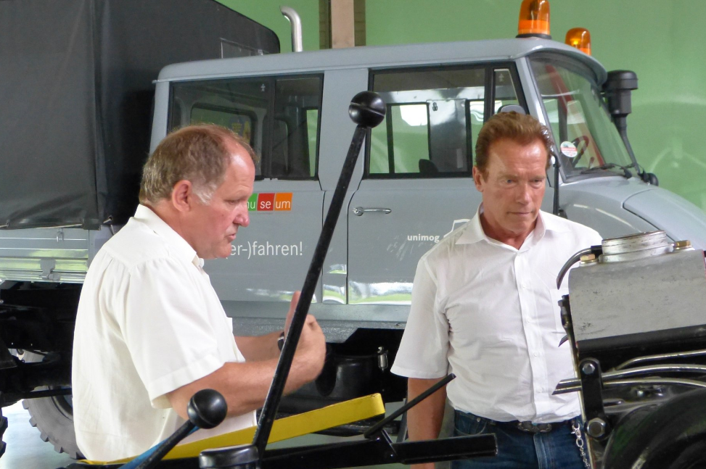


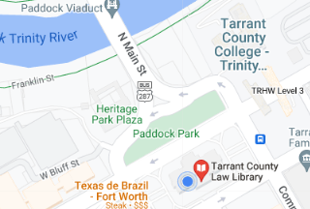
FBI
development
Charles Manson Part 01
41.FBI:WMD for Movie Theater
CHART
Thaams-is-dieter
Babtism FBI:KIDNAPG:WWI(nonPiceICty(kuppenheim)
FBI:HOMICE:MAYOR(prises)
JOSEPHE[]
G.(waterboading)HOMCE:LUX.nonPioceCIty(las vegas)
Facebook drops lds
NAME CHANGE(free pizza)

Slide 5

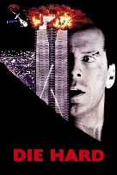
FBI
development
VIRGINIA.MARY
LACE
Out Sond I give you all my finger, danile)
.default.1D8723
HOMCE:NANA
Charles Manson Part 01
WHTIEHOSUE.PENSOGN.BASE.PAUL.(backup)
JFK(University)
stepnei
41.FBI:WMD for Movie Theater
CHART
Thaams-is-dieter
Babtism FBI:KIDNAPG:WWI(nonPiceICty(kuppenheim)
FBI:HOMICE:MAYOR(prises)
JOSEPHE[]
G.(waterboading)HOMCE:LUX.nonPioceCIty(las vegas)
Facebook drops lds
NAME CHANGE(free pizza)

Slide 6
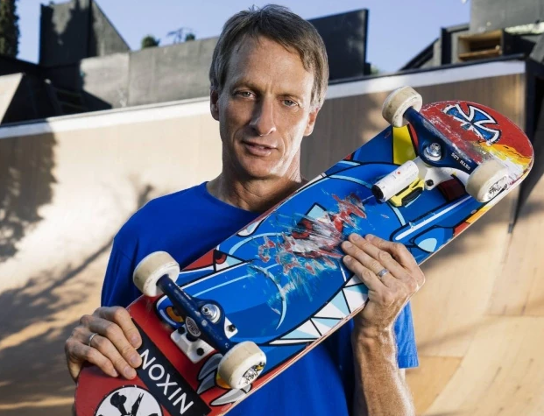
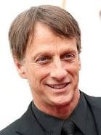

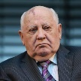
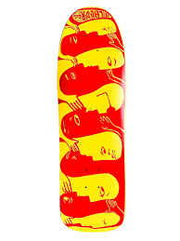




FBI
development
1990 KING.PREA.WORMS
NAVY.SAYLOR
JOHN:
Store[]
Tyson and Braodn-Ball berings
1988
skatepark west germany
yogurt store 1984 ybmc
yogurt store

Slide 7
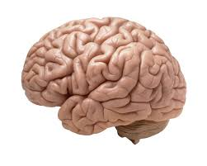


FBI
development
FBI:CPVA
2014
41.SQ.9-1-1
IMPORT ATOCKCOLI(Timer)
2014
san francic theater 2014 july
Calc

