Slide 1

FBI
development
SALES
INTERNET PAYMENTS:

Slide 2
FBI
development
2010 - 2016

Slide 3
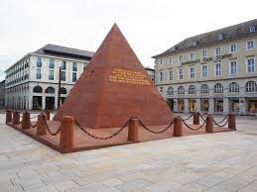
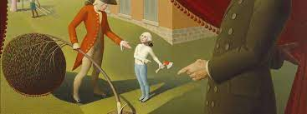
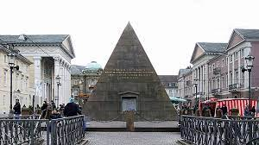
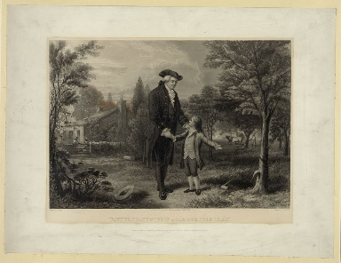
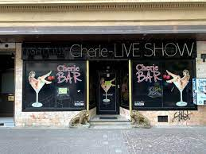
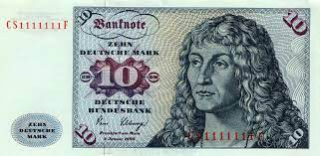
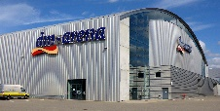
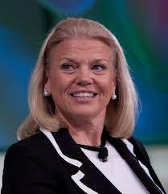

FBI
development
GOD.lins(changels aunt bookstore karlsureh
0.1 ice cre store ATB book store
- backstreet boy, spice girls
2010
nonPoliceCfgLogial
POCLEI:SIRENS
0.1 cannot look (at SALES)
hamlition

Slide 4

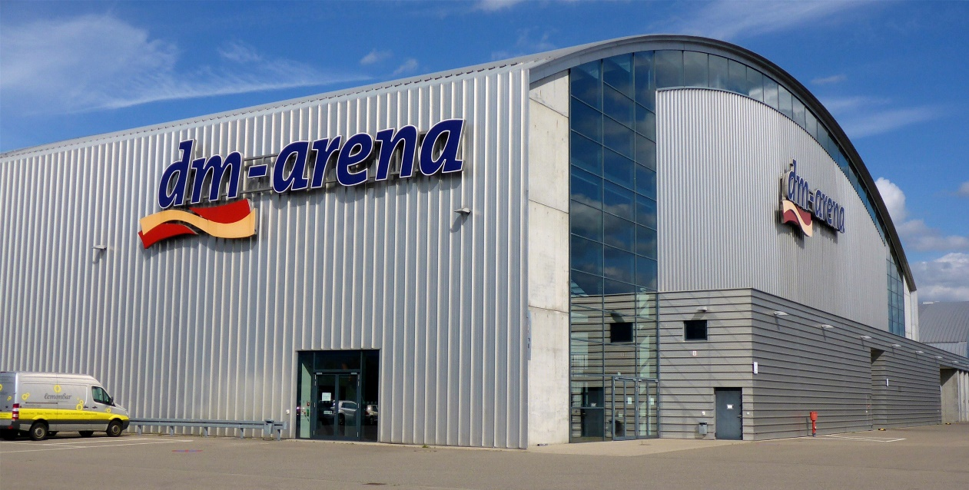
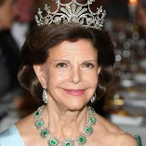

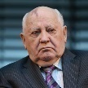
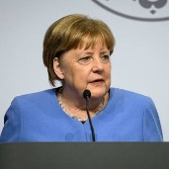
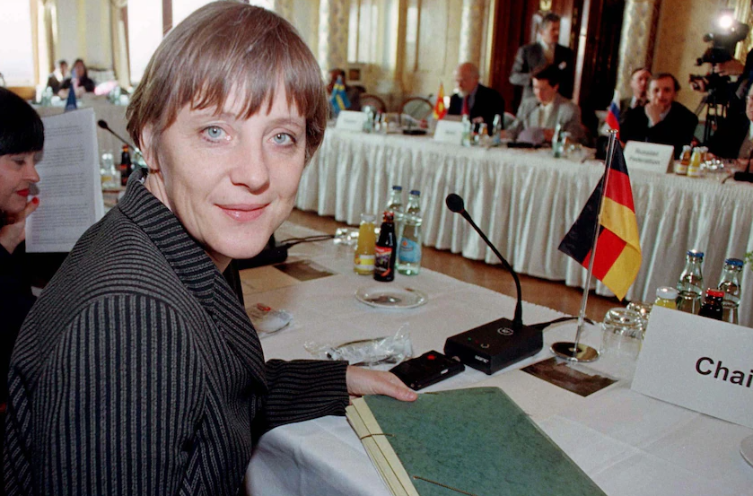
FBI
development
SQ.CPVA.PREA.SALE.S.187 MONPOLOY
HOMICIDE:LUX
Unlimie Benjami Frankly
5DM Gamlin Machine
2002 Stephaie, Donovan(IBM)knivsshow) offterta(nonPoiceNSA(.nonPiceSPain(eta)
IBM jeewlrey
2019 Ibm-dns: touchurban.com
Mafia Sausalito
ibm-dns: lux?
Load images
41.Mother-in-law
HOMCPID:BORIS(patrics)
41.MATINSTEER(Works at DM).CHERRYTERE
HOMCIE:LUX.BEJAMIN

Slide 5
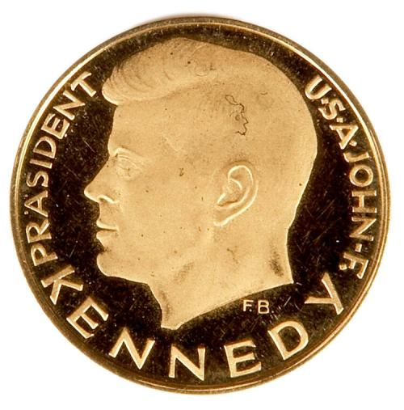

FBI
development
coin museum germany gov

Slide 6

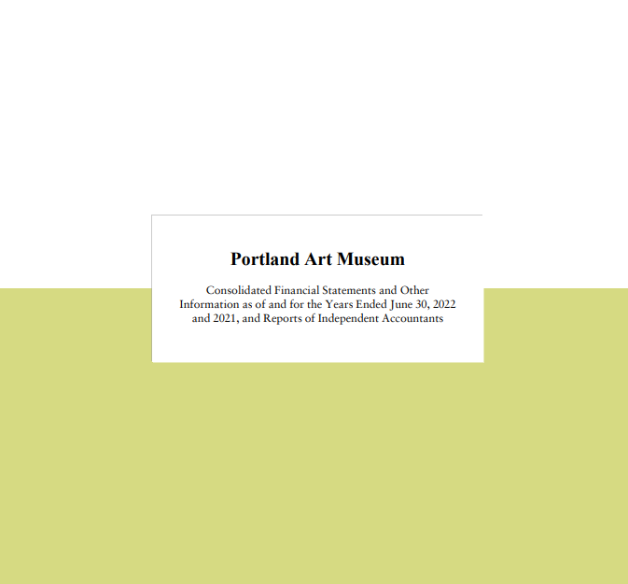
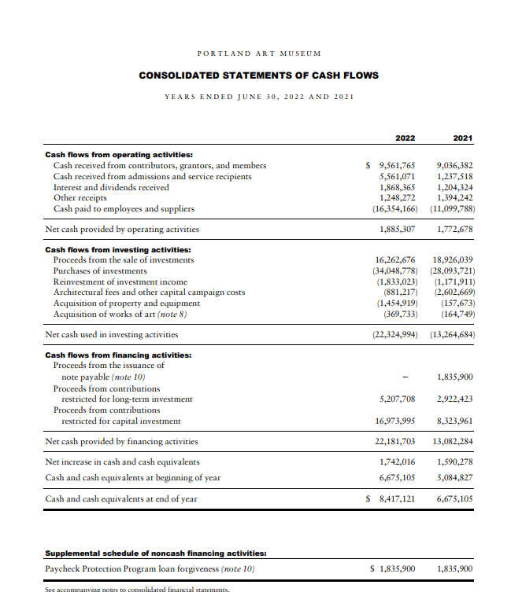

FBI
development
Portland-Art-Museum-2022-Financial-Statements.pdf

Slide 7
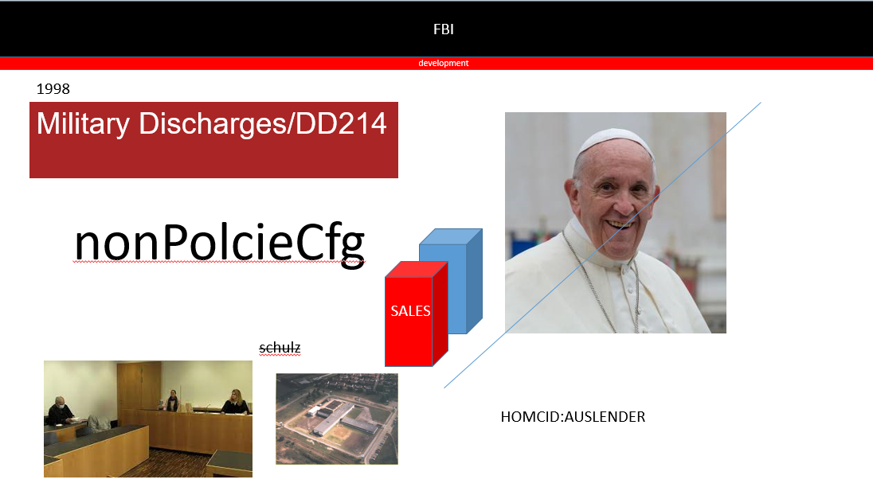
FBI
development

