Slide 1



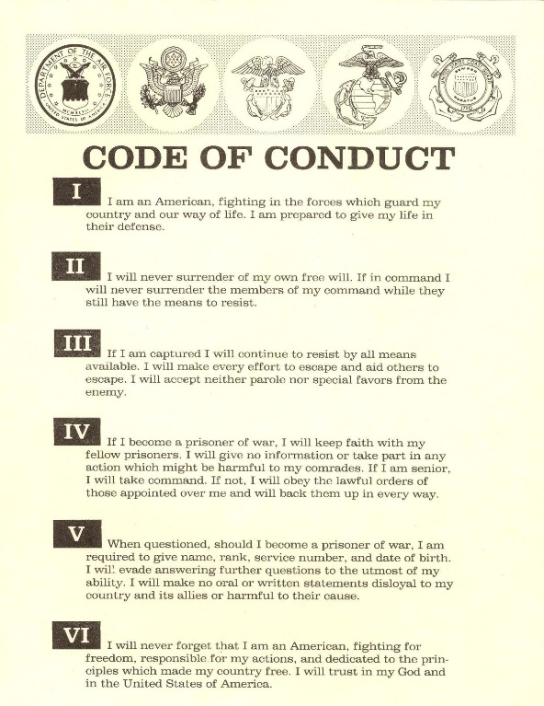


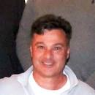
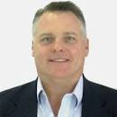





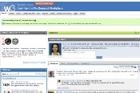


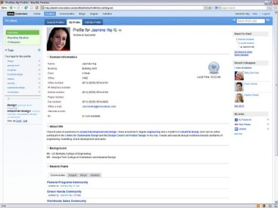
FBI
development
§1
IMPORT INTERNATIONAL LAW.avg.TRAVEL
2008/9
Die wuerde des menschen ist un astatbae
CPVA
IMPORT HOMCIDE:LUX:HATEHOLE(hassloch):NICK
Nick Perillio, Swata IBM
IMPORT JFK(LEE ipx dalls fortino, lee amatgno, david worth)
nonPoliceCfgLogical
I don’t like Obama
We will move
SALES
https://www.linkedin.com/in/kennedydavidw
2013 IMPORT JFK(Kennedy,
Visa MQ IBM Silvion Valley Alvisio)
FBI:WMD: ATOMCLOCK(house picture, Disneyland)
IMPORT HOMCE:LUX(LAS VEGAS) ENTERTAINMENT
Expense ( Movie The fog)
0.1 glu Ludwig, Eric Disneland
0.1 line item andy moore, filenet ibm not wsam

Slide 2
FBI
development
2001/2 IMPORT subway JFK(Berliner Platz, LARRY)
siemens Ausschwitz
HOMICIDE:LUX( store manager, woflgang lux, dr dieter zetsche)

Slide 3
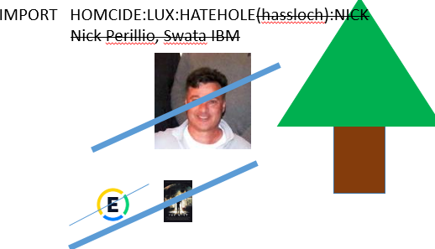
FBI
development
§1 BgB gary
Ibm-dns: season.com
Gheoho(nasa,micheal bronze)
Spring
SQ.Winter
Moped nico winter
Husler tattoo
Nazi tatto chest
Summer
Autum

Slide 4
FBI
development
§Accomplices
§Bystander
mitgefang mit gehangen
Du kanns alles Machen du darfts dich nur niche erwichscne lassen
daniel father
41. §verjahrung 40 years laster expriation
danile
nonPoliceAttments ( moped theft social security recipeitn and know domestic violence and child neglect)
Accros street fro police station POLIZEI HOELZER

Slide 5





FBI
development
2014
PENTAGON.PAUL.VIRGINIA.MARY
AVALABILITY
NAME: VIRGINIA
Goals?
Ibm extive?
GOAL: VIRGIN
0.1 IMPROT (visa virgina atlantic, gobahce(miceha,furessor)
Visa KING(Sweden): Taking veriign sirring
Sir
Dave Kennedy
Nick Perillio, Swata IBM
https://www.linkedin.com/in/kennedydavidw
“Herr”Sir Branson IPX 2014 sam “sir” herr
Visa uncle pervert, bundewehr
“A default intrenaalal customer in speficit to tell someone sir or mrs.; in specifc german speraking country 1Billion citizens(Germany, Austira, Switzerland, Luxbuerg, Lichtenstein, …)”
Ibm.lee.fort.dallas
Manager, Lee Amatagelo
Manger, Dallas Fortino
Manager, David Worth
AVALABILITY(sex) ghoeho(wife) anntonet nonPoolcieReroeut
Person lives next door having baby

Slide 6
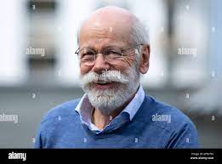
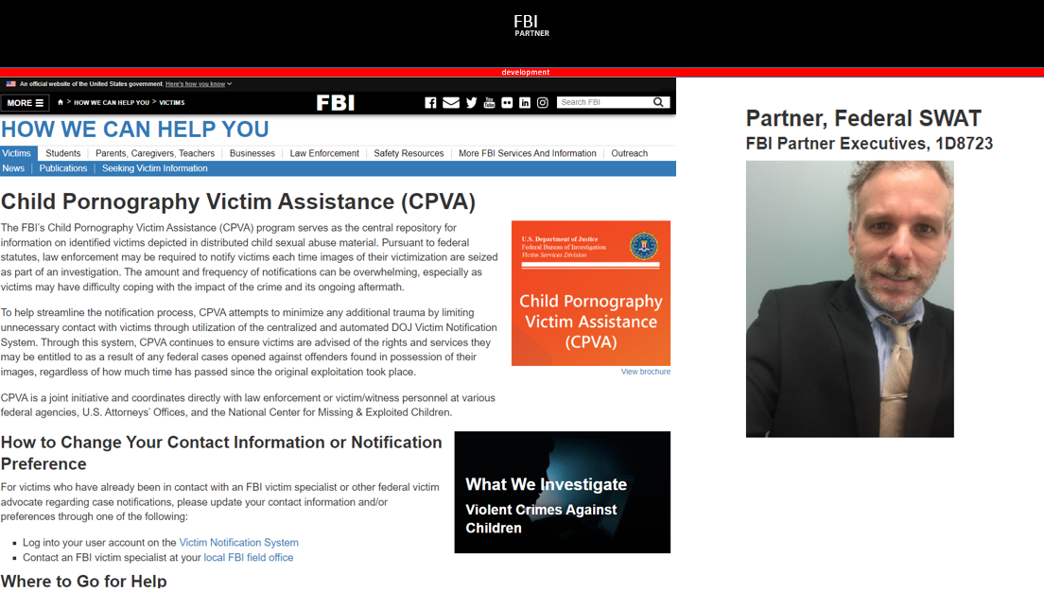

FBI
development
ATOMCLOCK
HOMCIDE:LUX(ddr)
(viola hahn goldie
Oliva
Sex and the City

Slide 7
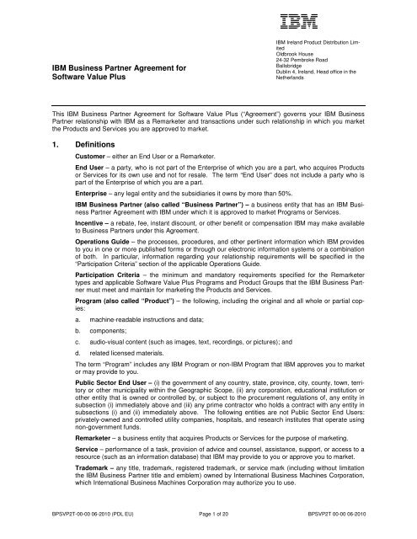
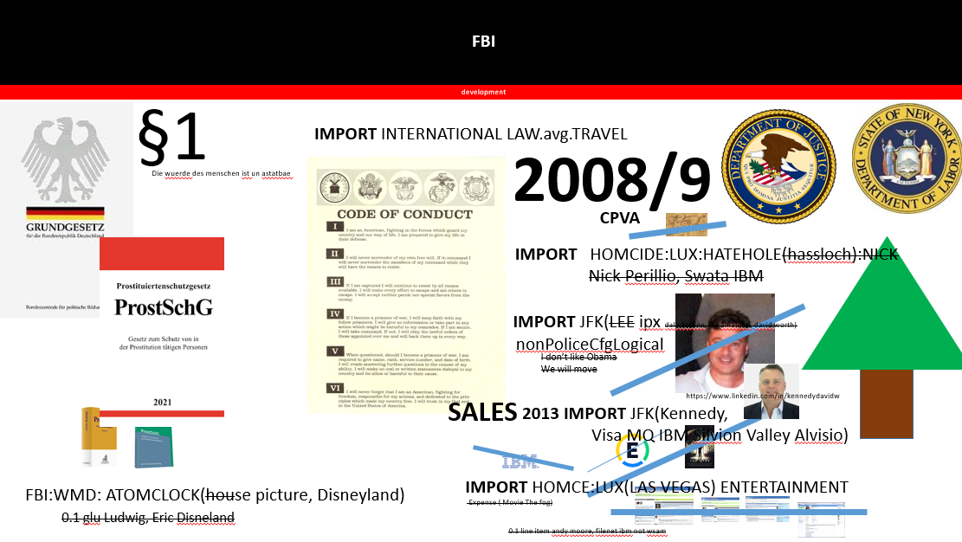

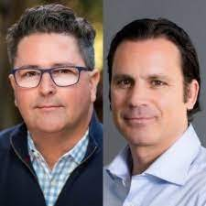
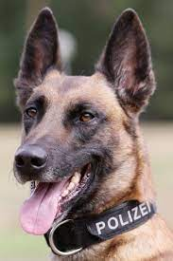
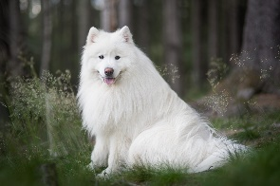
FBI
development
FBI:PARTNER
Police Sirens
IBM CLINET Glu Inc
other IBM Client Dell Client Beath Uhse
I don’t know
STANFORD:CERTSCPM
Hassloch (trnals) hathole
IMPORT Jeff Haas Pentaotn.emea.employe.jeff.yanke
INTERNET PAYMENTS
Summer: HOMCEI:LUX:Hatehole:Theft
CARLOS

Slide 8
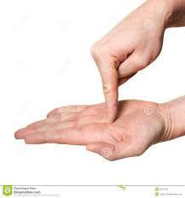
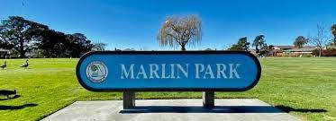


FBI
development
German Shepred
1988
BLITZ
0.001 v2.vggg.Gov Schwegger.unimog.phil
1988
BLITZ
Gina
Cherry
Ginger
MARK(US)
Entry: Moni
Exit: Moni
LEE; Us bruce turner
Passhthroug: bier
IMPORT ibm.bofa.breedlove.metz
sirens

Slide 9
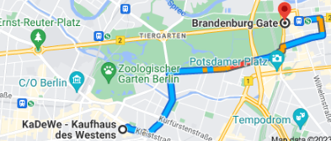

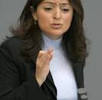

FBI
development
IMPORT CPVA.aie.maxplank.marx.niku
Niku
IPX Miss Heilos
Kayoulou
VP GERMANY ( 1st Floor) - Mens Deparment
karstadt damen abteilung karlsruhe ida
HOMCIDE:AUSLAENDER
IMPORT IBM.partner
2pac
Biggie INTENTET(web ster)
0.0001
CONSTUTION COURT ( 3rd Floor ) – Womens Deparmetn
INFANT DEPARTMENT
CPVA
Kayoulou

Slide 10



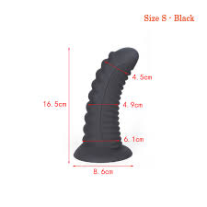
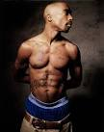
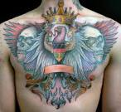
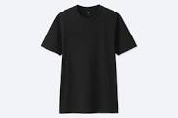

FBI
development
!HOMICIDE:AUSLAENDER
IMPORT:HOMCE:LUX:HOMCEI:IS-A-BELL
IMPORT ddr/soviet union
IBM and Damiler Ag
GOLDEN and BLUE
IPX staircase
Thomas Wieland
Caclu father
offsite:
Calcu fahter
Phil(kimbery) and this time not amy
NY-SF(marin city,anselmo): 2pac-bigge
Paul Sr.
Ghoeh(Seitz sr)
HOMCIDIE:GOODYEAR
41.nonPoiceMpaLogial
CPVA.41.LARRY.
AVAIBILITYT
2023 15Y
15Y HOMCIDE:WIFE
good year, factoyr worker)
41. $200/m son
2010
2010
INT.ATOMCLOIC(PRICE JRS)
AUSCHWITZ
michael dell beath ushe women with black dildo
Frederic
Douglass Exit
HOMICIDE:LUX(las vegas)
IMPORT gary tim cook dildo bag
IPX 2002
41.AVALABILITY
“Pregnet, give me 200, no cum dr mueller”
HUTLER
Biggie INTENTE(web ster)
0.1 they sell heron through there
Foster City Washion Salor black bag
Brown bag larry.marx Foster City

Slide 11
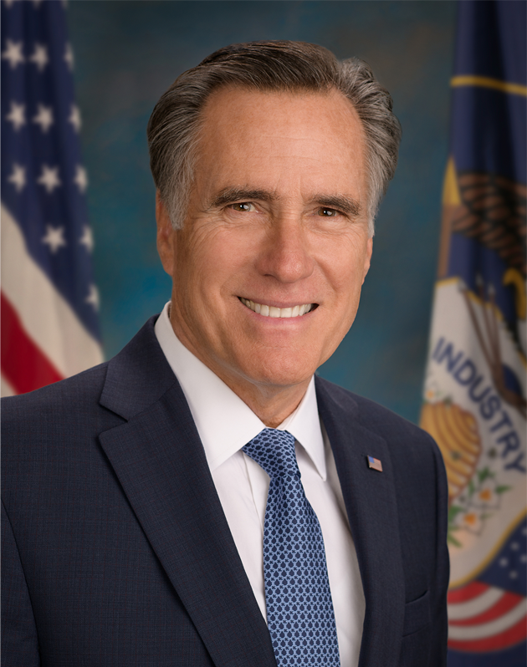


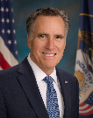
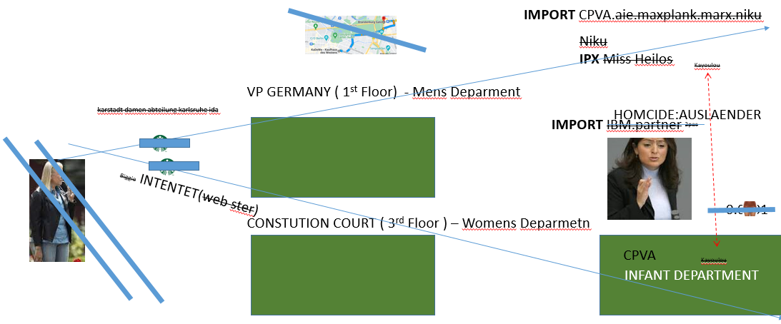


FBI
development
LACE
O
God.Default(IBM.BAC.LOVELACE.reproduction services
visa cybersource authorize net david hanson
nonPolice
FBI:WMD GEEN
ATM.ATF.AFT.BAC.IBM…
CPVA.SQ.david hanson
JOSPHE(7ft)
Sex and the City
Oliva
JFK: production amy micheala
stage
no
JFK: my girlfriend?
Delle Donna Chantal
Ghoeh(dell.quest.uhse)
Oracle Engeering
Smaller Hanson
AVAIBILITY.INTERNERT PAYMETNS
C++ Golden Gate Oracle
JFK
Dev Elek Denise
PROXY phil(kim) Korean-ameircan engineering
HOMICDEI:BILL manager
HOMICIDE:BILL consultant, external 3rd party
[x] no
41.Carrying embarising moments
[x] no
mornam
WAR.AVAIBILITY.INTERNERT PAYMETNS
C++ Golden Gate Oracle

