Slide 1

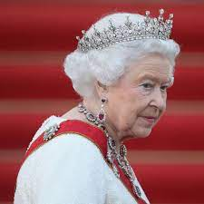

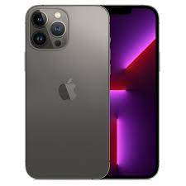


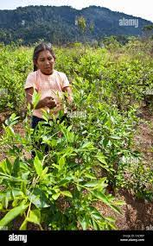

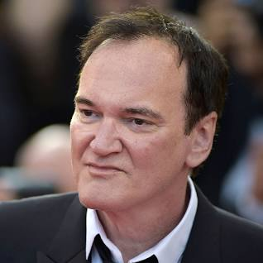


FBI
Development
HOMCIE:NANA.avg
FBI:KIDNAPPING:CPVA, PENTAGON VIRIGIN MARY
IMPORT SAN QUESTION.CDCR.HIGH
Brainzilen Coin Plain nacken women
start
end
FBI:KIDNAPPIGN:PHONE CPVA(c++)
HOMCIE:IS-a-BEL:L.ag
CHART
§Elerabuse
§422.6 Hate Crime
To find the crimansl
2005-2023
mexan caction with scars face
mexican actor question tarantino

Slide 2
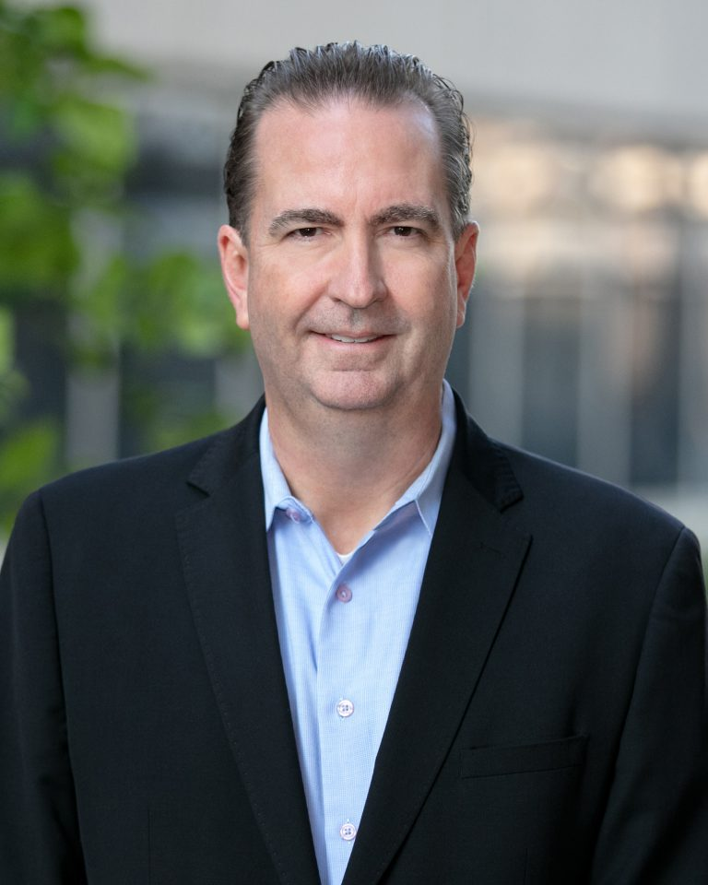

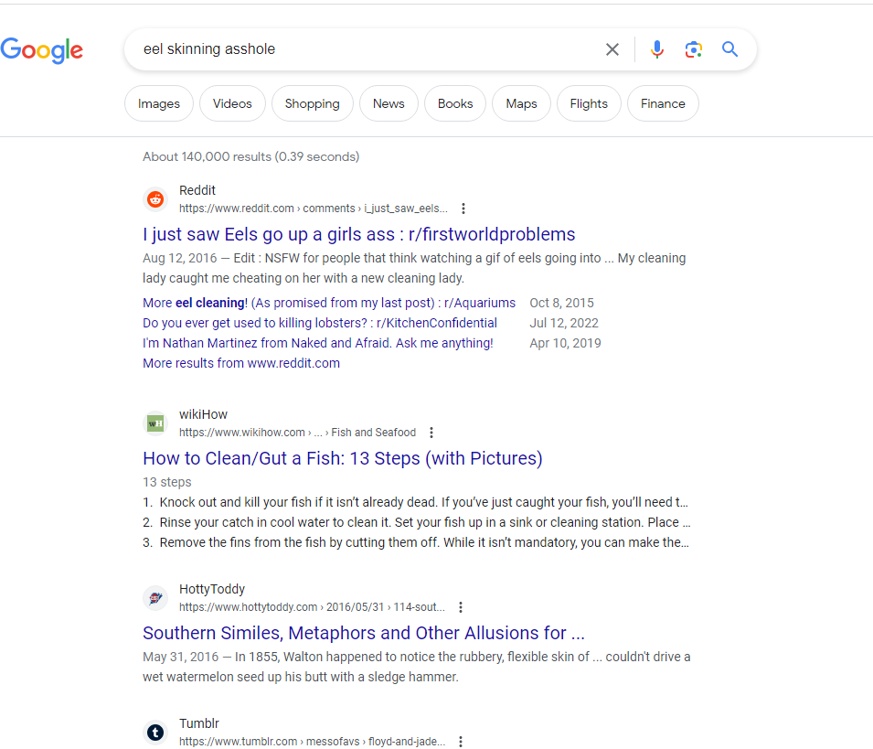
FBI
Development
SEVERITY 1 HOMCIDE-IS-A-BELL
MAINSTREET(GOD.nonPolicUsage(pulp fiction))
PREA(Italy river po(trnal ass) fishing)
https://www.italiadomani.gov.it/en/Interventi/investimenti/rinaturazione-dell-area-del-Po.html
HOMCEI:HANNES(Johannes,rampf))
41.5.phil
CHART
2005-2023
The depency for Visa
To use pulp fincea nd god
In television with 87 homcidess
Skinng eal, roset, asshole with knife
SEVERITY 1
Dev MARY.marx(denst)
1D8723.Sibling (dev)
1D8723.Sister
1D8723.wife (stage, produdciotn)
1D8723.dauther(stage, rpodcution)
Eal farm HOMICIDE:COINTOWN

Slide 3
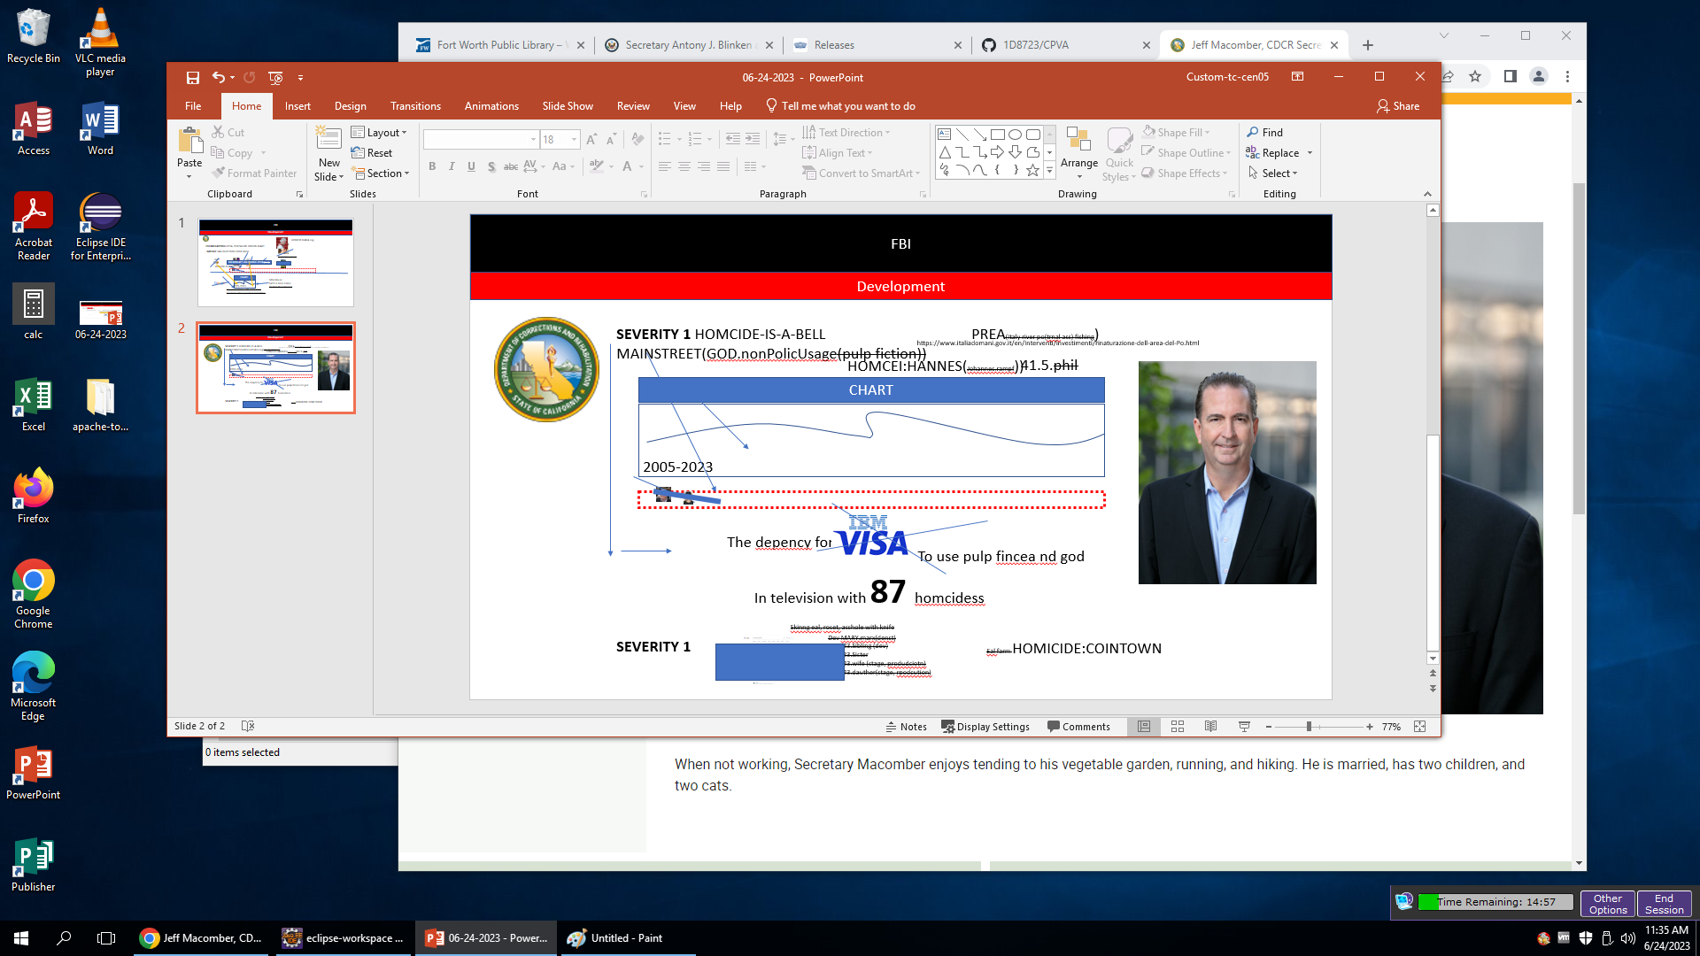
FBI
Development
CDCR Secretary
Execitve Beifing ~int32

