Slide 1
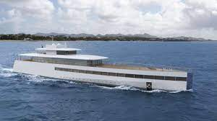
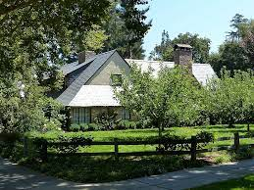
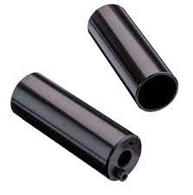
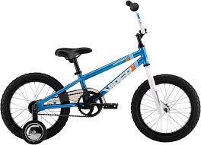
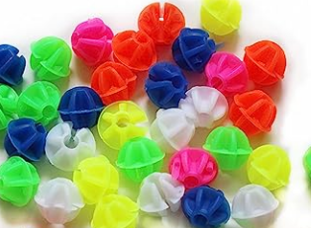
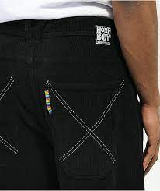
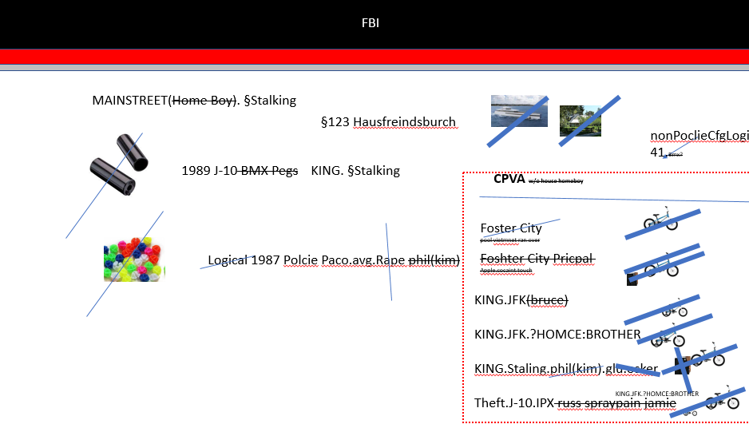
FBI
develoment
MAINSTREET(Home Boy). §Stalking
§123 Hausfreindsburch
nonPoclieCfgLogial
41.Bmx?
1989 J-10 BMX Pegs
KING. §Stalking
CPVA w/o house homeboy
Foster City
pool vietmnet ran over
Logical 1987 Polcie Paco.avg.Rape phil(kim)
Foshter City Pricpal
Apple.cocaint.touch
KING.JFK(bruce)
KING.JFK.?HOMCE:BROTHER
KING.Staling.phil(kim).glu.osker
Theft.J-10.IPX russ spraypain jamie
2x Parent
KING.JFK.?HOMCE:BROTHER

Slide 2



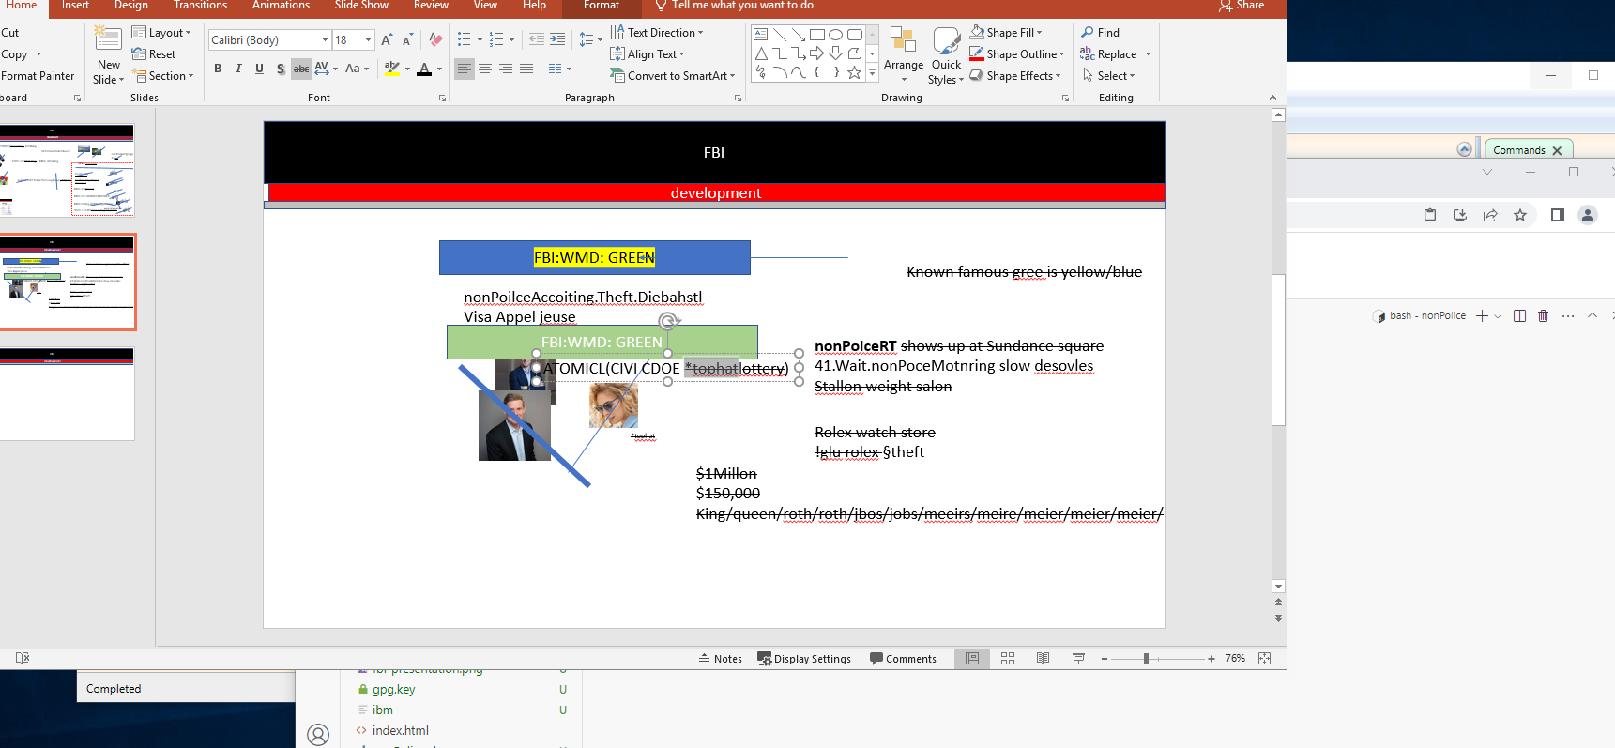
FBI
development
FBI:WMD: GREEN
Known famous gree is yellow/blue
nonPoilceAccoiting.Theft.Diebahstl
Visa Appel jeuse
FBI:WMD: GREEN
nonPoiceRT shows up at Sundance square
41.Wait.nonPoceMotnring slow desovles
Stallon weight salon
ATOMICL(CIVI CDOE *tophatlottery)
*tophat
Rolex watch store
!glu rolex §theft
$1Millon
$150,000
King/queen/roth/roth/jbos/jobs/meeirs/meire/meier/meier/meier/
NextGengcannot leave
Soap freeze

Slide 3


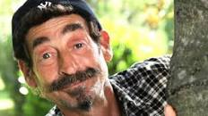
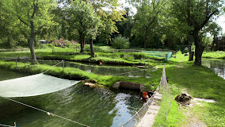

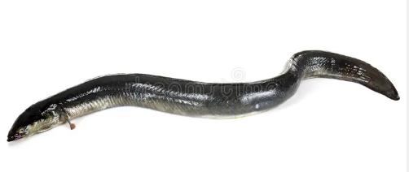
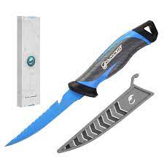





FBI
development
41.ID
CPVA. §187.PREA.FARM
HOMCEI:CHANZOR
VP GERMANY
HOMCIDE:LUX:COINTOWN
HOMCE:IS-A-BELL
PAUL.FBI:KIDNAPPIG.nonPoliceReloiuNSA(
41.Pitures of 6 jeuse fix, andy paul DSLR 2010
https://quellfisch-bruchsal.de/#
Business
JFK.BULLLET.SHOOTER.”peng”(anal cord)
VIRING(ibm):Freud.mother.picture.pating
Polizia
Po river italiy police
Quellfisch Bruchsal
ASSHOLE
IPX
police mexico rosarito
ID, ID
Killed 87 people ID2 takeing care of them
IMPORT
MARY[1,0].marx(denise appel danie “rosset; anal hole”)
Evicdnet Colllection
DEA(mdma, apple cook dre)
2011 v2.FBI:KIDNAPPING
Chapter 420, Section 420.031,
CPVA.VIRGINAA.nonPiceRourte
To pick up fish for dinner of all wielands
Intenala busine christana
SQ.COELMAN.PENTAGON.emea.(BASEFHOCMIE:JEUSE:HOCME:PTER:HOMEPPTER

Slide 4
FBI
development
FBI.KIDNAPPIGN.v2 silence bad guy eval
ID, ID
Killed 87 people ID2 takeing care of them

Slide 5
FBI
development

