Slide 1

FBI
partner
development

Slide 2
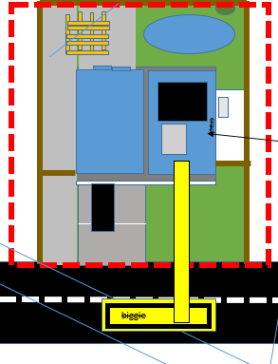

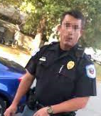
FBI
FBI
partner
Development
Application
Journal
Marketing
FBI
development
roof
Download
Sales
LACE
Ibm.cleint.bofa.steve.breedlove
Ibm.cldiet.bofa.metz
ocs
facebook
docs
DEA
(mdma,moby(a))
HOMICIDE:MAYOR

Slide 3
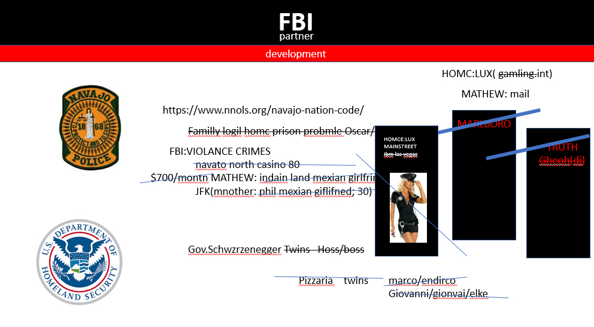

Slide 4
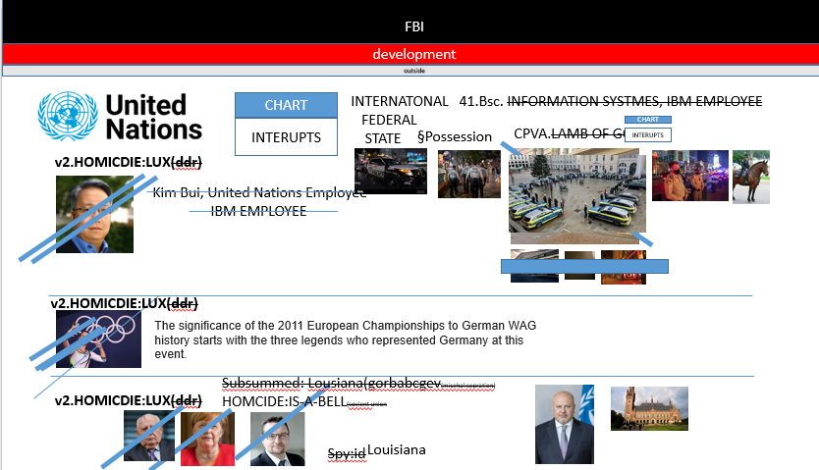
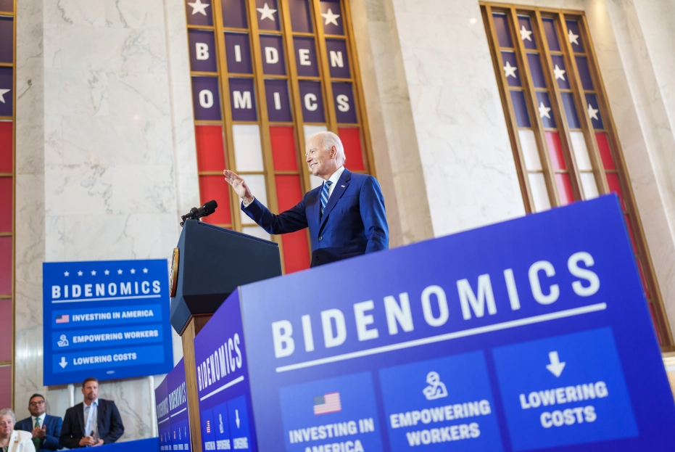
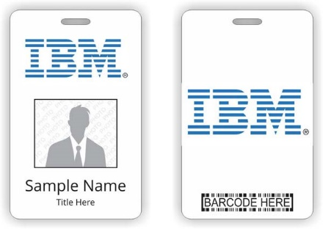
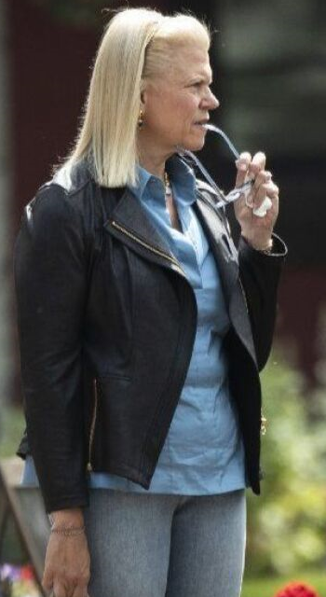
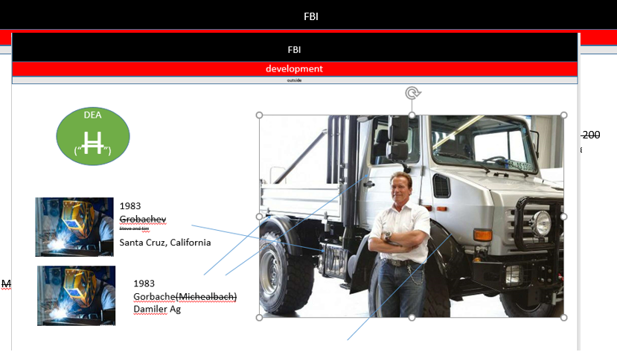
FBI
partner
development
CHART
INTERNATIONAL
INTERUPTS
FEDERAL
CHART
INTERUPTS
STATE
CHART
INTERUPTS

