Slide 1

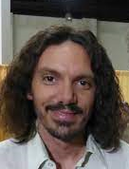
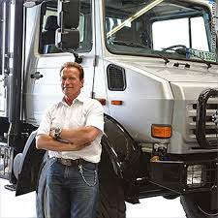
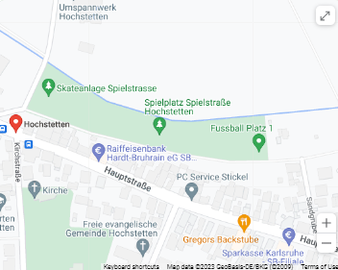
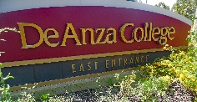
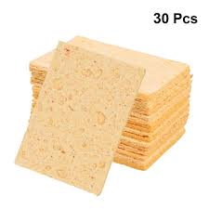
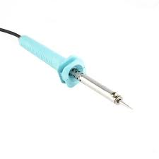
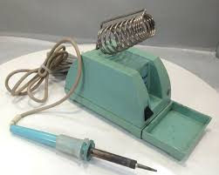
FBI
development
July 6th, 2023
HOMICIDE:LUX
ATOMCLOCIK(Phil(kim)).NAVY.KOREAN WAR
CIVILE CODE Andrew on the radio glu hr ‘asians’
docs
Apple.telsa.Korean
Apple.Yang.tango.TERMAINTOR.chinese.school.shooter
Hidden
Jerry Yang Phantom
..
niclouseQa.Touch.nonPocliCotnetnITems.son under treee
…
INTERNET PAYMNTS john chinese-white son
Hide CPVA and give docs to Korean acting as anti-KOREAN WAR
2011 ATOMCLOCK
1994
Police Sirens
Welders
Kim Gerlaceh
Kim collar
Nikolaie hiemer
pigglywiggley.client.touch.apple.Accenture.damiler.ibm.roth
VIRIGNAI.MARY.JOSPEH.TERMAINTOR
KING.MAINSTREET(Welder)
Gorbache(micha)
1980 gorheoh(micehala)
IPX
1980 redhouse
41.VIRIGINA
.coscot.schultz
41.§Domestic Violence
41.§Assault
41. §Murder Attempted

Slide 2
FBI
development
§Civil Code evidence collection
Apple.telsa.Korean
Yang.tango.T.chinese.
chinese-white son
…

Slide 3
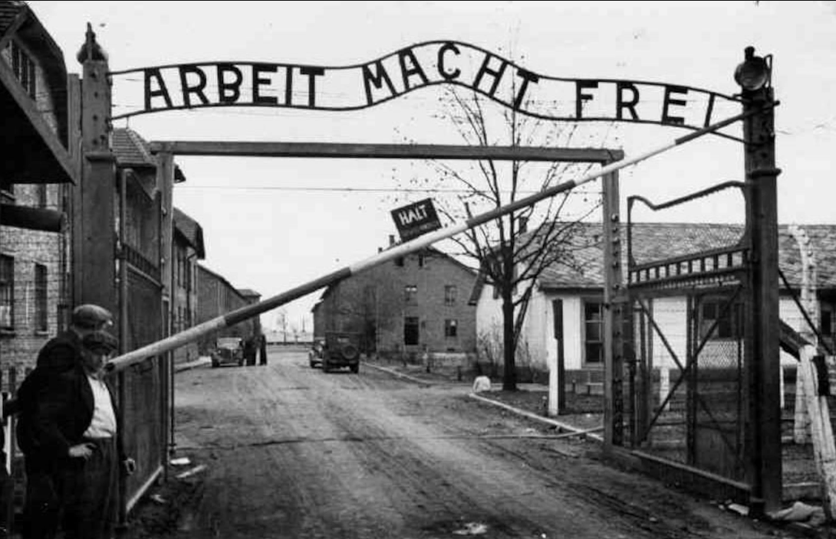
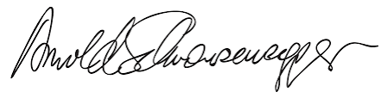
FBI
development
July 6th, 2023
Auschwitz
Holocaust
Thomasi-is-dieter.FBI:KIDNAPPING.AVABILITY
Do you work here? No
§Civil Code evidence collection
Tranl: Work make you free
2005 IBM Oakland
2005 IBM San Francico
2006/7 Marin City
2006/7 San Anselmo
2007/8 IBM Stock Market
2008/9 Dell Quest
2010 INTERNET PAYMENTS
2016 apple
2017 damiler.bertelmans
2018/9 ibm.client.moody
2019-2023 POLICE
Source: https://www.usafa.af.mil/

Slide 4
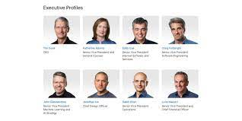

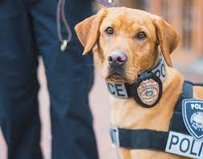
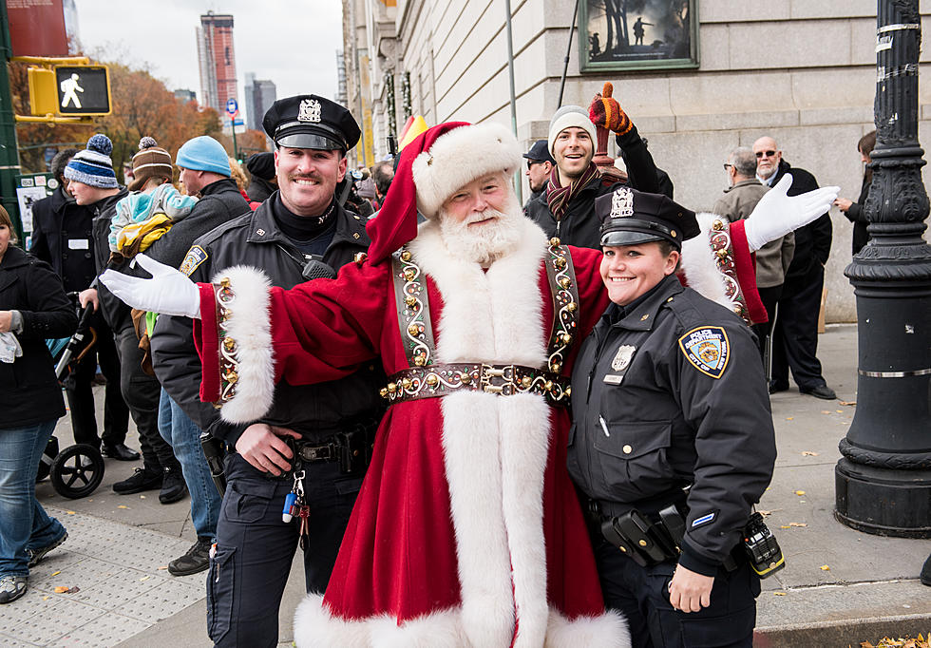
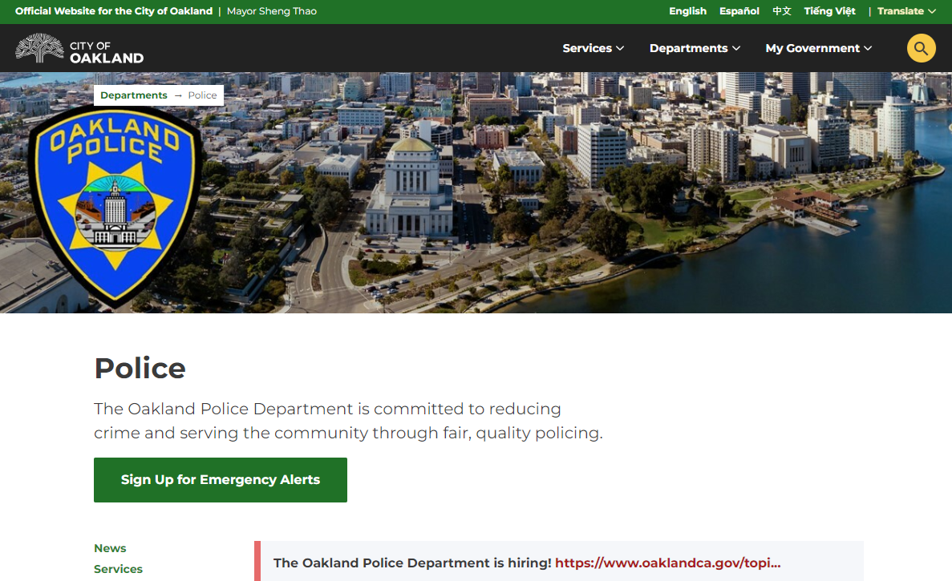
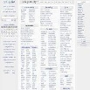
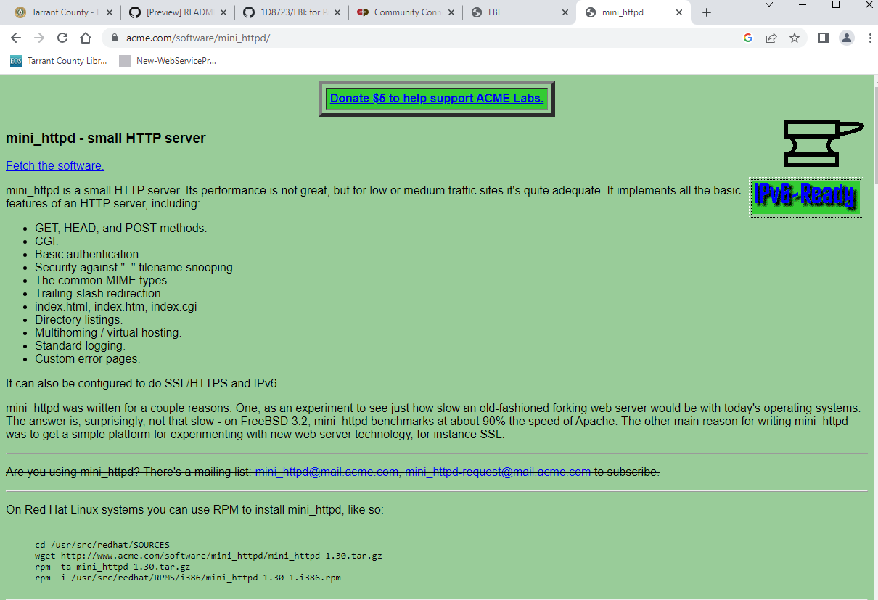
FBI
development
AUSWSCHITZ
10:06am !WHITE
Loud car noises
41.nonPOliceCfgLogi
nonPocilNlouse.Thest dr dre petsnick
NAME CHANGE(free pizza)
nonPoicleHomicdie(reiser)
POLCIE OALKAND
IPX
POLZIE KARLERUHE
Roy, wsam Oakland Suse Reiser Muder Wife, Peterson HOMCI:CHANLROI(elke) Jason Petersson
WWI.IPX roth(Harold,bier green/red) SUSE, take house udner)

Slide 5
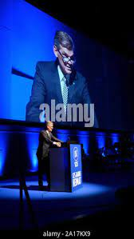
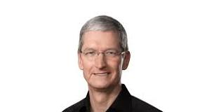
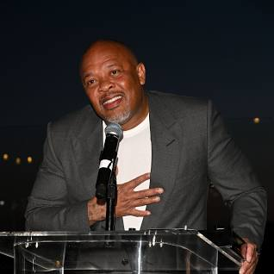
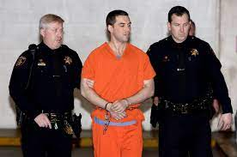

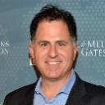

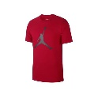
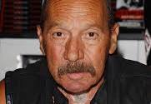
FBI
development
elping outside
41.MURDER SUSPECT MANAMGNET
NAME CHANGE(free pizza).AVAILABILITY
41.nonPociCfgLogial(baffon)
nonPioceMPA.nonPolciCfg
41.Bafoon manament. WHITE
PREA.gheorh(Jackson)
c5
O
hi5
IBM Damiel Apple Visa Scot Peterson
docs
tango
unterhause
Hertie lebensmittel
2014 HOMCIDIE:CHANLGORE(elke) veranda
United States v. Peterson
1995
IPX
CASE NO. 06-CR-0266-02 CRB (SK)
JFK(berlin zoo)
25Y
41.Bafoon manament. !WHITE
& Hans Reiser
NAME CHANGE(free pizza).AVAILABILITY

Slide 6
FBI
development
§Civil Code evidence collection
Apple.telsa
Yang.tango.
…

Slide 7

FBI
development
VIRIGNA.AMRY.gorbahcei(michalaa)
HOMCIE:JSUE:HOMCE:PETERHOMCE:PETER: Christian called, asked funny way, what time
ATOMCLOCI(time)
Time, space Drive license insturctor

Slide 8
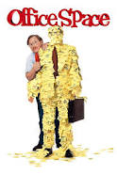


FBI
development
elping outside
41.CPVA.MURDER SUSPECT MANAMGNET
CPVA.NAME CHANGE(free pizza).AVAILABILITY
Glu
Frederik Douglass Exit
CIVILE CODE gary
HOMICE[]
Appe.siri
Sqway:
Susi
Wake up Suse
Suse
Gheoh(mcihala).freind
Motor cycle intervals
NAME CHANGE(free pizza).AVAILABILITY
Hans Reiser
https://en.wikipedia.org › wiki › Hans_Reiser
In April 2008, Reiser was convicted of the first-degree murder of his wife, Nina Reiser, who disappeared in September 2006.
Appe.siri
Sqway:
Susi
Wake up Suse
Suse
Gheoh(mcihala).freind
§Bystander
Oakalnd, suse linux(raid)
PREA: Greenspan
2005 Wsam/roy ? (baby)
FBI:WMD: IBM Hercule Choy
NAME CHANGE(free pizza).AVAILABILITY
[x] no

Slide 9

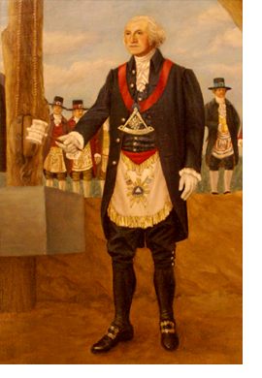
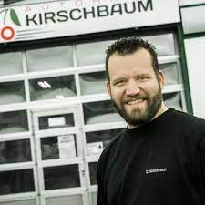
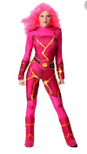
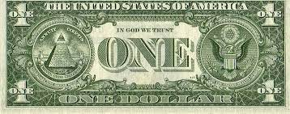
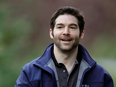
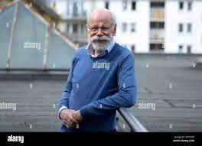

FBI
development
AUSCWITZ(pets nick)
IPX Gov.TERMAINTR funriss/furnis
VIRGINAI.MARY.backup[2].
CVPA.NAME CHANGE(free pizza)
NAME CHANGE(free pizza, free maosn VP GEMRAN hrion)
HOMCIDE:CHANLOR
x/y ciggerete machein ddr(spy)
TERMAINTOR FBI
(ford IPX JOEPHSE spy(riecardsr)
Import ATOMCLOICE(LINKEIDN,Tim(o))
Ibm.damioer.stanfore.fer.pmp
IMPORT LINKEDIN
PENTAGON.emea(jeff)
CHEKPOINT CHARLIE(zigareteautmted)
What He's Learned
LINKEIDN
1&1
Ziggerette autmetd

Slide 10
FBI
development
What He's Learned

Slide 11
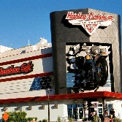

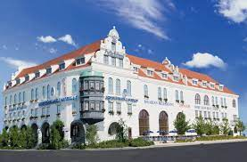
FBI
development
HOMCIDE:LUX(ddr).IPX.HOMCEI:IS-A-BELL(soviet union)
Roth.ibm.dmielr.Retiement spy
Pope france
Pope france sectary
Angela
LABOR CODE, CIVIL CODE IPX
kit
stanford
Retiement spy
1:17PM office ring phone, build failes SQ.CPVA.nonPoliceCfg(C++,namic)

