Slide 1
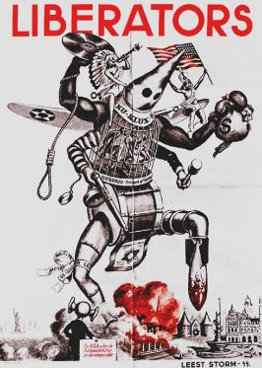
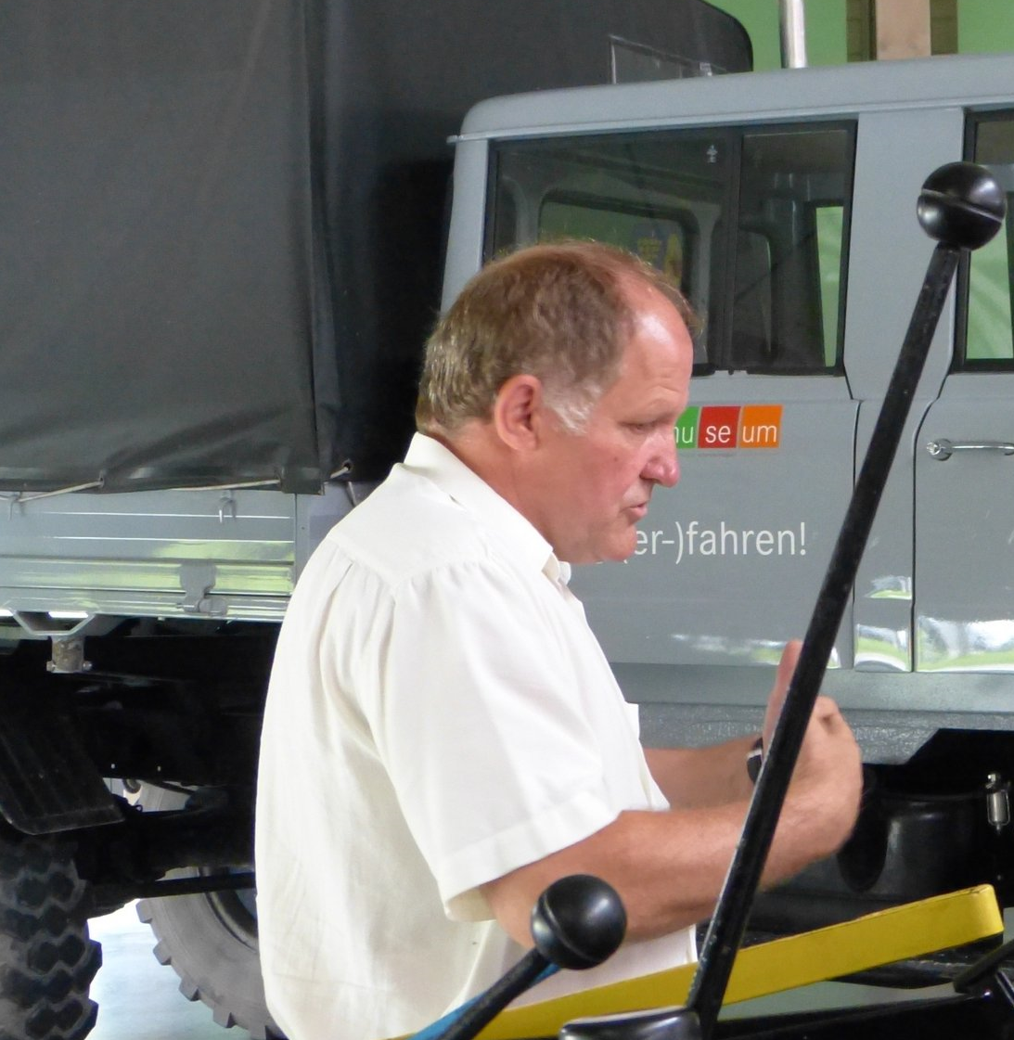
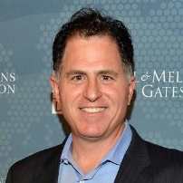

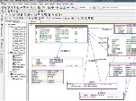
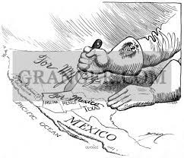
FBI
PARTNER
development
https://www.fbi.gov/history/famous-cases/kkk-series
Roth.ibm.damiler.unimog: Red/white gaggenau
vgst
Heitkamp, uwe
2010 WW2.INT.IPX
MLK.marx.JFK.marx
Touch.accntuer.apple.damiler.ibm.roth nonPolcieAttamentLgoial.marx
Gorbache(Micehal King)
Recive phone call move from germanyt o ameirca for interview with micehl king
Quest toad; (tranl) dead
2010 KING.SQ IMPORT HOMICIDE:CHAZNZLOE(angelo and angelos brother)
2021 WW1.000.tw.png.marx

Slide 2
FBI
PARTNER
development
https://www.fbi.gov/history/famous-cases/kkk-series
2010
VISA IRELAND
Gorhohce(carrol)
WW2.Vgst.hand
VISA FRANCE
Gorhceoho(droz)
000.tw.pns
2023
copy
Gorhohce(carrol)
WW2.Vgst.!hand
copy
Gorhceoho(droz)

Slide 3
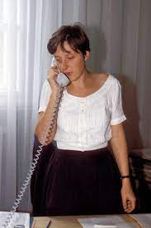
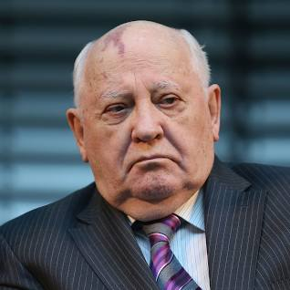
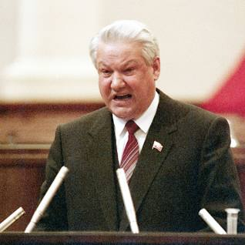
FBI
PARTNER
development
Patricia
Micheala
HOMICIDE:IS-A-BELL
(soviet union)
HOMICIDE:LUX(ddr)
HOMICIDE:BORIS

Slide 4
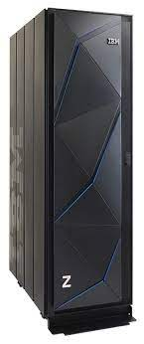
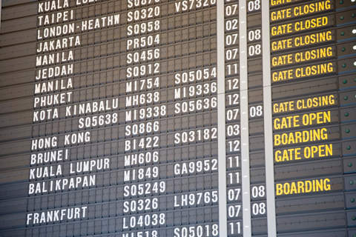
FBI
PARTNER
development
000.tw.pns
FBI:WMD for Towns
IBM Armonk, NY
Fort Myers
- Edison Bank
- Bank Account
FBI:WMD for Airports
FORT MYERS.VIRGINIA
- Edison Bank
HOMICI:LUX 2016
- smoking in gabling section at las vegas, airport
- person can create ticket at airport

Slide 5
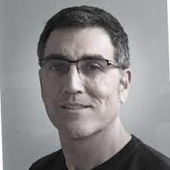
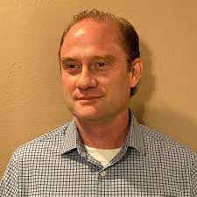
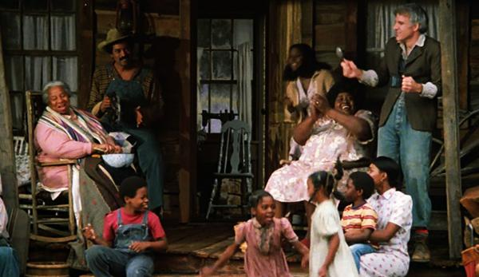
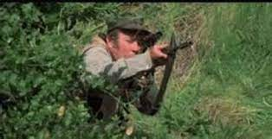
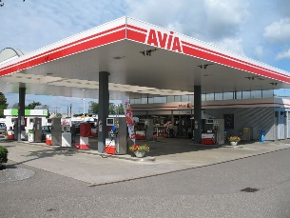
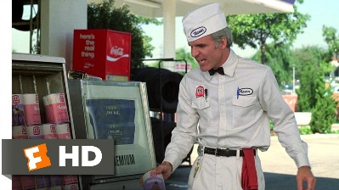
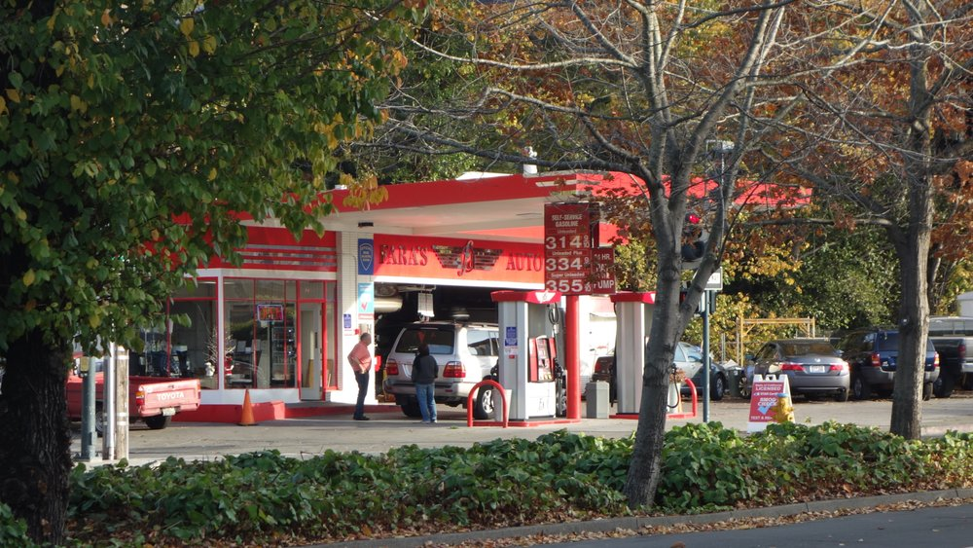

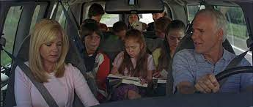
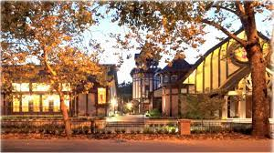
FBI
PARTNER
development
SQ.PREA
nonPoliceCfg
Phil.JFK.MLK
JFK
INTERNET PAYMENT HOMICID:LUX:HATEHOLE: employe jeff haas (tranl) hate §422.6
Davut, WORTH
Dallas FORTNO
Hate
LEE
https://www.linkedin.com/in/lee-amatangelo-4837b810
San Anslomo, California
Sunil raj: go have bus with 6 children
40 ring, upgrade

Slide 6




FBI
PARTNER
development
SQ.nonPoliceTV
WWI.MLK(kaiser permanente comercial staying alive)
Police Sirenes 8:50

Slide 7
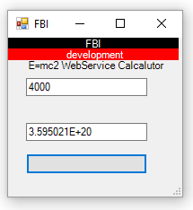
FBI
PARTNER
development
Police Sirens 9:52
0.0001 black color nonPOlciForsicieLogial PRICE.jrs librian voice

Slide 8
FBI
PARTNER
development
Install MATHEW(kraft):

Slide 9
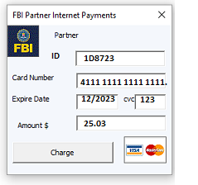
FBI
PARTNER
development

