Slide 1
FBI
development
Could not create SSL/TLS secure channel.
[Net.ServicePointManager]::SecurityProtocol = [Net.SecurityProtocolType]::Tls12

Slide 2
FBI
development
nonPolice.war

Slide 3
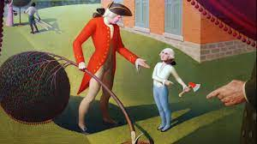
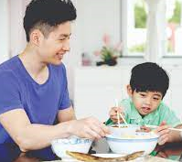

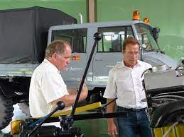
FBI
development
Self-Heling.CPVA.algorigh.VIRING.MARY.C{VA
Call you Dr. Rice
shell
x
x
Database
CPVA
MQ
LINUX
x
WebSphere Console
c/c++
x
Tomcat
Development
MACHINE LEARNING ALGORITHMS
J2ee/java
2005 W/SAM monit
oring boss arun,arthur
2010
IBM Autonomci Computign ( Self-Helaing )
x
24x7
Ibm rational Pattersn
Ibm Best pratices
Ibm ratnai quality assurnarce
wsadmin
x
virtualization
https://www.redbooks.ibm.com/redbooks/pdfs/sg246665.pdf
Ibm self healing CPVA
Gor(dell,uwe/uwe)

Slide 4
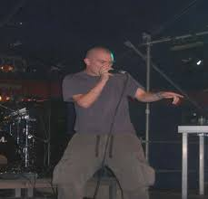
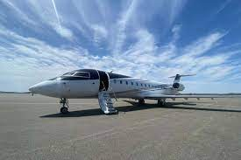

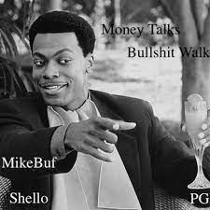
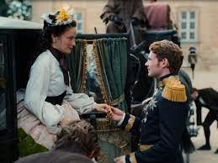
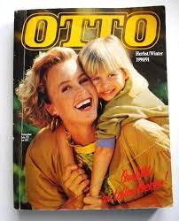





FBI
development
SQ.CPVA.MAINSTREEET(sahne”whipchream”,stofper=“food lust”)
DEA(herion, german itailein(eybrow).PACO
41.SQ.CPVA.MAINSTREET(mcpalnlos (trnl) micro cheererk without a plan)
nonPoicleContentItem
IPX
Auschitz.Pope.St.Margin
2015 CHI-FRA IPX ghohc(depress)
41.DL Money Talsk bulshit walks,
PNTAGON.VIRGIN.MARY.FRIDAY.HOMCEI:LUX.noNPiceINtutpLogical
tv helicopter germany stores chain

