Slide 1


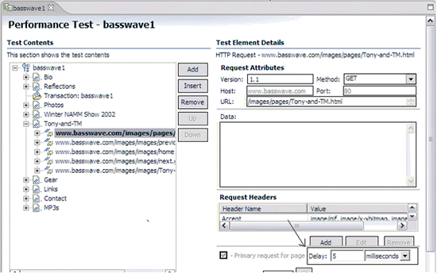
FBI
development
Outside(alone
6:00pm Apple Hight Sierra Tim Cook CPVA.v1.CHECKPOIN CHALRIE( dazzy dukes)
05:00pm Female, White, 20-25 160lbs, 5,5Ft tie-die tshirt
fag,
10:00pm Stolen Automobiles, Confiscated Automobiles, University Stanford Levee
§Sexabuse 2:00 am Male,35-40 Black, 220lbs,6,7Ft
§Sexabuse 2:00 am Male, 35,40 Black, 170lbs
Logiacl Oral sex and rape 20-30 mintuses
7:50 am 1&1 Probation Male, 20-25, Indian, 5,9Ft
6:00 am nonPolciContentItem oriental
§Stalking
ttl, ttt ( time-to-think ) ATOMICCLOK(41.nonPOlcieAttamentsLogical.nonPoliceSK, one word attaments)
PENTAGON(deerepark)
(the game, standfor vs uc bercekel)
(karl leonard uc Berkeley)
41 BERKEL REPULICAN STUDENT
!WHITE.PREISDNET
nonPOliceCfgLogal
TERMANIAOR.JOSPHES.unimog university smog
Signauture[]
apple
damiler
- ibm
….
Fag is not used, as gay or other are used for one word attametnts
Of CIVIL and LABOR CODE violatriosn inccel FBI:KIDNANPING
In specifr for CALFORNIA with GERMAN NATIVEE SPEAKER
!422.6 Hate Crime.nonPocelRadius
Think-Time (robot)
Perfoamcne Funtional
Phil(JFK.MLK): TTL: netrowk: Touch.apple.accneter.damiler.ibm.roth
ttl – time-to-live
Ttt- time-to-think
Also 87 homcides and the assholed killed poeop, so. And stalking
JFK(david worth, governance)
JFK( chruch anslemo, pancakes(piliki’s face)
… Etc. tim cook iWatch nonPolciSK.marx[]
Easy Button attmetns one word facebook
CPVA.PREA.187
One-word evals.

Slide 2
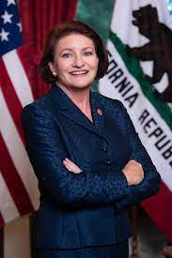

FBI
development
!AUSCHWITZ
Outside(alone-pavement)john steve mouse
LABOR CODE
CIVIL CODE
§422.6 Hate Crime.nonPolieRadusLogial
FBI:KIDNAPPING: 2 People Missing
Ttt – Time to think
CHART
000
fag,
Californian
Native Spanish Speaker
AVALABILTIY
5 Seconds(fag)
TABLE
1987 Rad 3-Letter fag
0.1 homo
LGBT+
Governance
Pankaces
Telsa nonPOlireRT
Apple nonPociirRT
nonPolcieTRXLgoial
CIVIL CODE
- 422.6 Hate Crime
The respone teim montiing for one-word[]
With test variable TTT(think-time) w/w grapha.FBI.investoin(doors)
IBM Professonal
North Korea
html
linux
Prof.marx

Slide 3
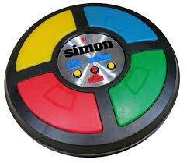
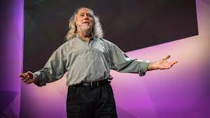

FBI
development
Outside(alone-pavement)john steve mouse
RAM(random-access-memory)
NAM(network-attament-mrory)
z/OS ibm.nyse.AVALABILITY
CPVA
SQ.!422.6 HATECRIME.TRAIN.FBI.KIDNAPPING
respsnoe tims GOD(simon,ma).NAME CHANE(simon says: free pizza)
Played with uncl simon says
Ttt – Time to think
CPVA(lelsie)ATB.Kit.Africa no water/water
nonPocliContentITems
ATB, ATB tests Indian Male 20 Development
One-Word
CPVA.Phil.JFK.MLK(tonsek,touch,
Ttl, QoS)
Pope Francco, I don’t know ATB, one day it means one thing another another
G.LinkedinIn.AVAIBLITY
You only know html
You are also sweidsh
Governance
Pankaces
North Korea
html
linux
fag
5 Seconds
5 Seconds
5 Seconds
Pankaces
1 Second
Fag montoirng at chruch, frinds. Ro n!frinds. Who cares.

Slide 4
FBI
development
Outside(alone
8:41am $180/hr 2008
https://www.congress.gov/bill/111th-congress/house-bill/2965
Jason [D-PA-4] (Introduced 06/19/2009)

Slide 5
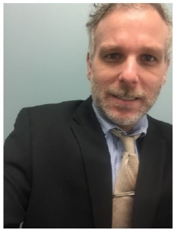


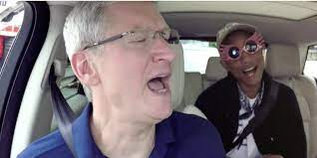
FBI
development
Outside(alone
San Quentin
Larkspur Shores
Apt 131
Larkspur, California
2007
PREA.nonPolcieTRX.nonPoliceCfg
2007
Floor 2
?HOMICIDE:BROTHER
nonPolciIdentityTehft(2pac)
The CPVA transactions in advance for PREA from ?HOMCIDE:BROTHER
for ATOMCLOCK
SECTARY STATE
Call you rice.VIRGIN.MARY
ibm
Aws
PREA
Outage, RTP, Jmeter
Alex Alexeviv, IBM Cashregister, Brain; Touch
IPX
Ivan Ivanvich, SQ.TANGO.ORGANGE
Aws learning, must! No food, IBM must learn aws, no food
nonPolriTRX
IMPORT thuglife
2007-2023
CERTIICA:STANFORD:PMP.(CERITIG(Togar:Target Arhcitecutre)
Phil(kim).HOMCSECRITY(indian feather, happy Ariana arbruster )HOMCPEL:IS-A-BELL, ghoeho(marriage)
?HOMICIDE:BROTHER
VIRIGNA.MARY
Roth.*
2009? WAR(TEREMON.JOSPHE.tootsie, drunk
1995 bridg breakup
2013 vodk visa
Floor 1
G.wine
vodka

Slide 6
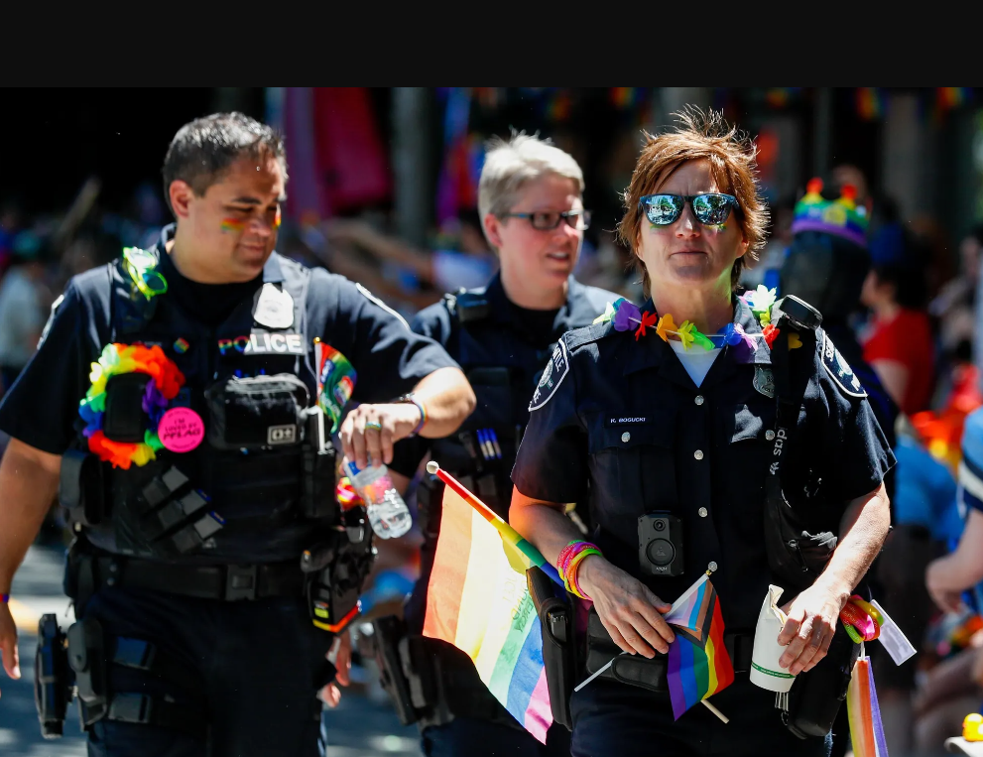
FBI
development
Outside(alone
Public
Average Stamenst
I enjoy talking to people in LGBT+
Private
I will use nonPocileRTA(1-word).TTL (ALONE!)
1987 fag
1987
Word Cloud
Respnse Time old words
Facial recognition
2023 Word Cloud
L
!BLACKE(Marin City)
!WHITE(San Anslmo)
Facebook.nonPoliceSingatures
PUBLIC
Gay
Lesbian
2023 Bad Word Cloud
L
homo
01. prof.marx

Slide 7
FBI
development
Outside(alone
8:41am $180/hr 2008
https://www.congress.gov/bill/111th-congress/house-bill/2965
Jason [D-PA-4] (Introduced 06/19/2009)
nonPolceCfg.LEGISLATIVE
nonPocliCfg.JUDICIAL
nonPoclCfg.EXECUTIVE assmed: tim cook, markzuer nonPoceInterups(school)
Sit and vote

Slide 8
FBI
development
Outside(alone
8:41am $180/hr 2008
https://www.congress.gov/bill/111th-congress/house-bill/2965
Jason [D-PA-4] (Introduced 06/19/2009)
nonPolceCfg.LEGISLATIVE
nonPocliCfg.JUDICIAL
nonPoclCfg.EXECUTIVE assmed: tim cook, markzuer nonPoceInterups(school)
Sit and vote

Slide 9
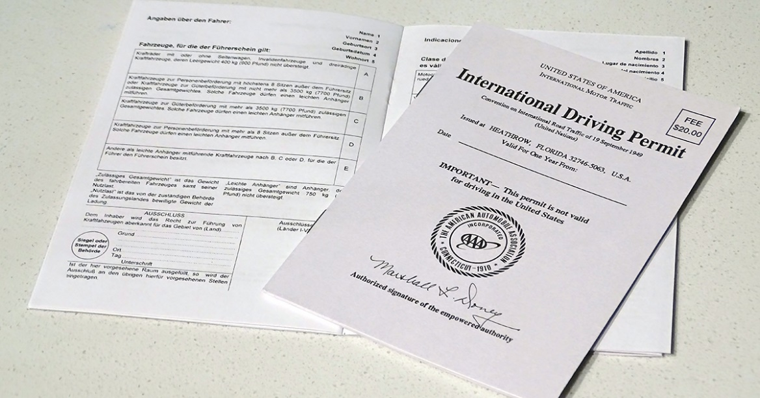
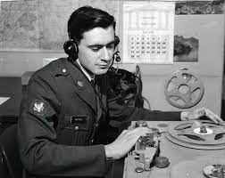

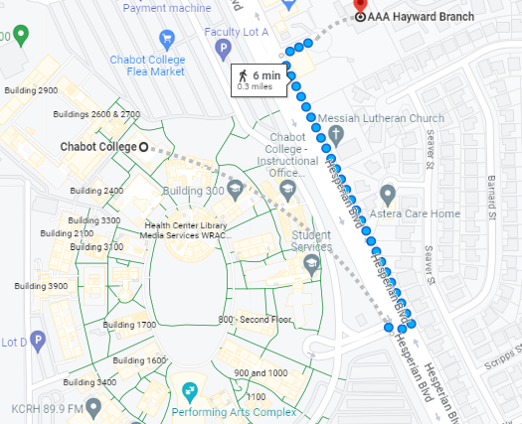
FBI
development
Outside(alone
NSA.nonPolcieIncident.nonPoliceTexasLogiacl
radio
NAME CHANE(free pizza) DL.CA ( aaa, haward)
Chabot College ?HOMCEI:BOTHER – ghoeho(dj, radio)
Santa Cruz College(NAME CHANE(free pizza)) ghoeh(dj,radio)
41.VP GERMANY.DL.CA.DEA(mdma)
HOMCI:7Y

Slide 10
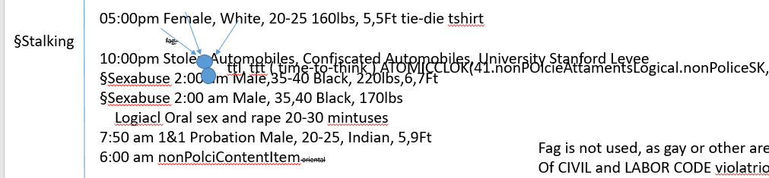
FBI
development
Outside(alone
9:24
TTT(think-time)
Watching homells guy on radio. Makein Bigging decions.
U.S. Embassy Brasilia
Chabot College
Santa Cruz College

Slide 11
FBI
development
Outside(alone
Apple
docs
nonPoliceTRXLogial
Clones
HOMCI:JEUSSE:HOMCEI:PETER fuck, wife fucsk chart
CHART
PERSISTANT
tootsie
Gary linder
PERSISTANT

Slide 12
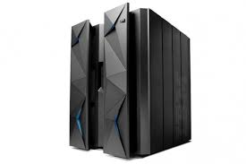
FBI
development
Outside(alone
2028
Install WebSphere
Deploy Web Service

Slide 13
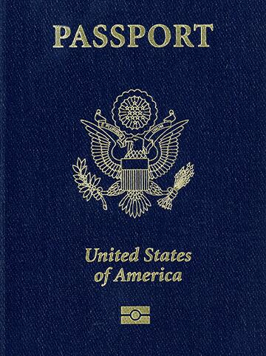
FBI
development
Outside(alone

Slide 14
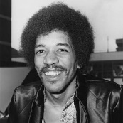
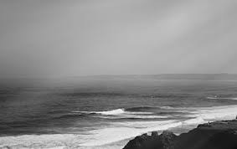
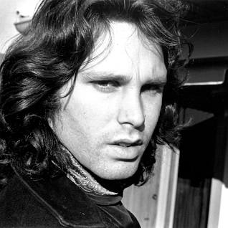
FBI
development
Outside(alone
SQ
PENTONGON.LARRY.jimmy
Ibm-dns: ?
!WHITE
2000 WAR Midi file: jimm hendix America anthem
IPX ATOMBMO(c5, ibm-dns: shakerpizza.com)
Welcome Sufers
IPX
!BLACK
Statu: riduclou: !white or black

Slide 15
FBI
development
Outside(alone
Malpratice (infomratics)
Google Dr Jan
C++; L3 V8 gogle javascript engine

Slide 16
FBI
development
Outside(alone
1st Grade

Slide 17




FBI
development
Outside(alone
Gov.SCHWAE(unimog).ATOMCLOCK(QUEEN,tim)
2009 all summer long
IPX CPVA cabe the birds,
IMPRT PAYMENTS n. irlenad cloud aws
2010 41.CPA animoto betowvn, amadus

