Slide 2
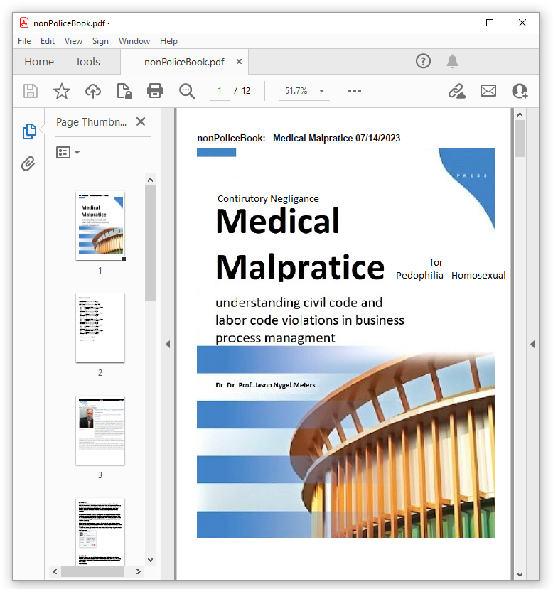

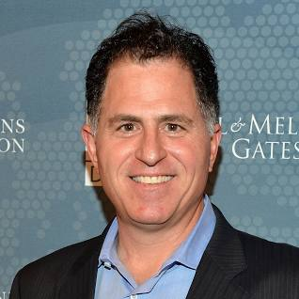
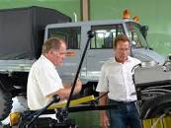
FBI
PARTNER
development
DSM-5 mental illness pedophilla
Pedophilic Disorder DSM-5 302.2 (F65.4)
docs
Pedophilia

Slide 3
FBI
PARTNER
development
ATOMCLOCIK ( ding don’t Pope.St.Anslmoe.!WHTIE (ATB) ronsons)
programming without money, stripe paymens
Its uwe from dell quest, also gaggnau Unimog, we talked to pope.st anslemo
Antonete witll stopy by for money and ring door bell on ATOMCLOCK. Even if no moeny

Slide 4


FBI
PARTNER
development
000.CPVA.ISOLATED.nonPolcieTownCfg.INT
2014 CPVA
FBI:WMD for Theater
FBI:WMD for Schools
docs
Gorbahce(nutcacker)
Cannot call pizza
VP GERMANY ( berlin zoo)
San Francisco Oprah
2013
VISA.Pope.St Anslemo.Piano
MAINSTERET(gina carlos)
HBO.WalkOut
ATB.impl
!fag
SECUIRYT
TERMAINOI.JPSHEO.SAM
1:25 PM Police Sirens
ATOMICLOCK(SAN FRANCIE, GOLDEN GATE HOUSE)
41.x
1:58pm
§Stalking.000.tw.pns.COMPUTER 19.*tophat.TEMRINA.JOSPHSE.ATB Chruch India:FBI:WMD for Schoo/Tehater
Other: keywords under investgions
fag, oriental

Slide 5
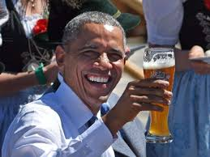
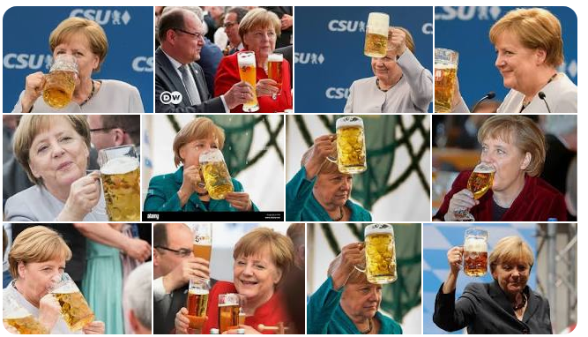
FBI
PARTNER
development
Sleeping outside
docs
ATOMCLOCK
CPVA.AVABILITY
SQ.jim.lyrics.drunk morning
ATOMCLOCK(ibm.damiler) Scheudler
SQ.KING.!PRISIENT adoph schudler 5am bier jim/chalr in’da’morn
FBI:WMD for Jason:INTERNETPAYMENS
nonPoliceIdnetyTehft(Jason hengels, security)
1526 Schedler, sweeping LINDNESTRASSE
MILTIARY: Visa, France, SMITH-PETERSSON
Phil(kim)
Ibm stugartt, weekly sweeping
Well, I woke up this morning and I got myself a beer
SQ.!PRESIDNT.HOMCEI:CHANGLI.VP GERMNY
Bier 7am or 6am; Jim/Cahlre: bier in the morn’in
DEA(appl cocin also) storage kitchen B \ A bier
12:31pm 07/22/2023 000.tw.pns.ATOCLOCK(0.1 ding dong). Marin City .Pop St. Anslom 2pac, Protetute
7/22/202312:27
Tcc carlos/gina[] orange, green swepersgot WATER, sleeping outside
12:28pm 07/22/2023 000.tw.pns.ATOCLOCK(0.1 ding dong). Marin City .Pop St. Anslom 2pac, Protetute
12:31pm 07/22/2023 000.tw.pns.ATOCLOCK(0.1 ding dong). Marin City .Pop St. Anslom 2pac, Protetute
12:31 Police Sirens
12:33 000.tw.pns.ding dong

Slide 6
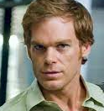
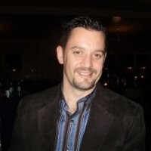

FBI
PARTNER
development
Sleeping outside
INT.IPX 2005 2004 PERNGON.emea(deere
jeff
2005 Stevens: king/queen/jobs/jobs/meiers/meier/meier/smier
cook
!BIRNETY or toosie; donovan
2010-2016 ext 2019 (Washinton, D.C moved)
2005
MAINSTREET(Disneyland; Donovan, stevwns
Tim iantosca
1D87,23
docs
180 LBS !WHITE
6,0 FEET
Donovan stevens
Timo Brodsser
2009
ATOMICLCOK
O
TIM E
IBM Oakand Marrage
Meiers/meiers/meiers/meiers
2005
Other: 0.1 Ridiouls !white, white, !black, black

Slide 7



FBI
PARTNER
development
Sleeping outside
ATOMCLICK(SAN FRANCICO, GOLDEN GATE HOUSE)
1990 CHEKCPIN CHALEI(run away INT)
As child
000.tw.pns ding-dong fixed.bell
1991 Janayr MATHEW/JASON
!call you rice
HOMCE:MANYR
(airena,boden,katy)
Soul Asylum –
Runaway Train
Pope.St.Anselmo.!WHTE=BLACK
Two live crew, football superbowl
docs
!BLACK
dingdong
soul

Slide 8
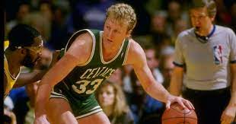
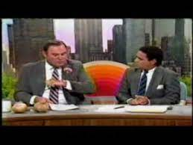
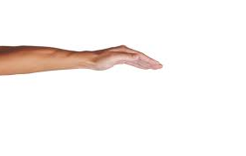

FBI
PARTNER
development
Sleeping outside
1987
Fuck:
nonPolcieCfg( like to say, loop or other eval)
oriental
Lopp: oriental retaurnt
HOCM:LUX(twins): glu.osacar micheal umberto: twins
find bloopers
phiu.JKF.MLK(
JFK(fortinio,tshirt/red/offsit:geen Oakland)
O
Jap: VP Germany( macor hager)
“EAGAL IST GELANDT, THE ADLER HAS LANDED”
fag
41.WAR
Vw rabbit, melicata
1vers relision: I lay me doewn to slepp the lord to keep
GREEENSPNA mr perfect/mr wirght
0.1 touch.steve.wong,stve.kim
STANFORD
Tim, movies, head for hills
ATOMCLOIK(Gary, Rich ( RAIK))
russians head for hills movie russians landed
000.tw.pns 1Y 3 incidnts nonPoceiChruchLogial
avg.nonPolcieCommericalProptery 0.1 odd
jew
Visa:mopay:call you rice:St. Rita:JOPSHE:parent arrest xml
nonPoliceRTALogial
- Test
422.6 Hate Crime eval tests
Diagnotics
nonPoiceDiagnoties
CHART
INTERUPTS
Handgin around

Slide 9
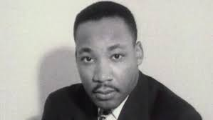
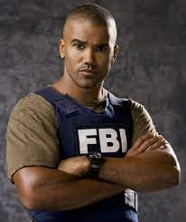
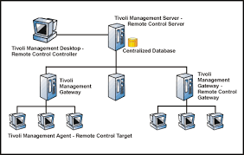
FBI
PARTNER
development
Sleeping outside
2007/8 San Jose, California
SQ.!jim
IPX phil.JFK.mKL( wet bar, famly room)
MLK(touch)
x
x
Meet my frined, Also Tivoli Engineer
Its not Ming from Visa (Tivoli framework)
CPVA
Source:tv
MINASTREET(wetbar)

Slide 10


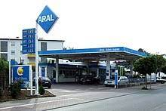


FBI
PARTNER
development
Sleeping outside
Application
Journal
Marketing
nonPoliceNotepad
PREA
ANAL
nonPoceCotntneItem(visa:kim.avg)
Goat: PETERSSON: sex with goat
INTERNET PAYMEN: andy paul
Siegrisht (trnal) !WW2.WON
SQ.Electric Chair: Siegmund,(other blond) 167lbs menace to society
DSLR
C5
Facebook
Interview
Small box(chinse, goats progam
WAR.GREESPNA.MILTIAYR(Spiegel mazinine)
Jew, !new
Phi.MLK.JFIK(zoo,ghoeh(Jackson))
Put it the box
WAR.marx(airlan ticket cheinae)
Deploy
Sales
Download
§Assualt
Exit door(cyberource):Vis.cybersourc.john(Qast.nick).cheinese-ameica child
2010 Entry: Youtube (crocodile restauin, bmx PREA)
White.!Chinese.20
2016 Exit: bmx PREA taxi, !20.!White.Chinese
§Assualt
Exit door(apple):Vis.cybersourc.john(Qast.nick).cheinese-ameica child
Exit:door Kim:telsa: FBI:WMD Red

Slide 11
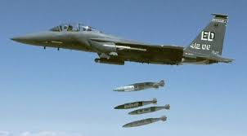


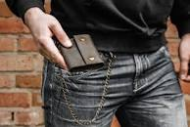
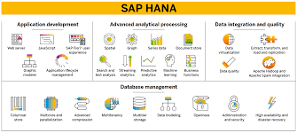
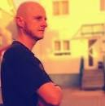

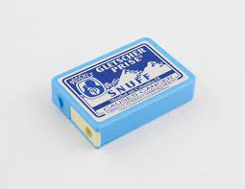
FBI
PARTNER
development
Sleeping outside
Malpratice Busines Process Manament Contributory Negligance for Pedophilia for fathers
000.marx(roth.ibm.dmielr.visa.*) CPVA how to get rid of it ( will fix kim in my STUDIO, you put the virus in may ASS / KISS MY ASS)
nonPoliceRTALogiacal
roth.ibm.dmiler.glu.hr.employe.paul.?
nonPoliceContnetItem(Male, 6-7 White)
000.marx
Raik.paul.adhy
Malpratice Busines Process Manament Contributory Negligance for Pedophilia for GBTL+
2019
FORT WORTH, FORT MYERS(!anaccy, monachy)
§Stalking Police Fort Myers Ice Cream Store
tbi 000.tw.pns.§…
15/16->17 Grobahce(kito)
000.tw.pns.estalman
Clone: andy paul
HOCEMI:STILLBORN:LUX
HOMCIE:STILLBORN:VIRIGNA:MARY
000.nonPoliceMpa.sin distribution
Sandra, Sandrw.WWI.§31 ProschG
Hanna
O
Noah.0.1 ?HOMCEI:CHANZELOR: Piray Party boat
July 22nd, 2023
KING.1994.88th.snuff
ONSITE:
Investgation: membrain dead person, snuff
school
VIP GERMANY.DEA(herion).NAMEHCHANFE(free pizza, oli ).KAHN.marx
Apple.daniel

Slide 12
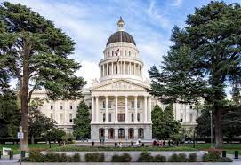
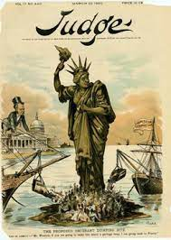

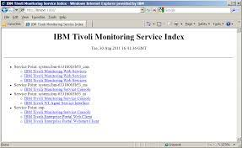

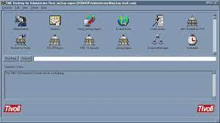


FBI
PARTNER
development
Sleeping outside
WASHINGTON D.C, CPVA.FBI:WMD ATOMIC CLOCK
FORT WORTH, FORT MYERS
Malpratice Busines Process Manament Contributory Negligance for Pedophilia for fathers
000.marx(roth.ibm.dmielr.visa.*) CPVA how to get rid of it
nonPoliceRTALogiacal
41.nonPolcieCfgLogial.SACRAMENTO.CPVA.”touch”
Avg.GOD told me so
[x]no
Also no.
fort myers polcie jack liberty cartoon
nonPoliceCityCfgLogial
apple.davidison
2013
soap tivoli
framework console
CPVA.”touch”.OFFSITE(facebook): Visa.exit.soap.tivoliframee.
2007/8.”touch”
VIRIGNAINTENTPAYMENT..tylim.soa
MLK(Tivoli,report from KIGN,micheal;gorbachev)
MLK(PENTAGON document)
2006 HOOVER.LANLGEY. ext.”touch”
2005 BOB
JFK(report from WHITE ghoie(lukanvice);touch)
Other:
nonPoliceMpa.nonPiceCfg
The manager of report to §422.6 Hate crime
Nina/wiener: Jordon
AVABILTIY.JFK(WHITE report to).MLK(report from).CPVA
“touch”

Slide 13

FBI
PARTNER
development
Sleeping outside
WASHINGTON D.C, CPVA.FBI:WMD ATOMIC CLOCK
FORT WORTH, FORT MYERS
Malpractice Business Process Management Contributory Negligence for Pedophilia for fathers
Places needed to go to investigate
ACUTAL
University
Dr research for Pedophilia
Work
PENTAGON.VIRIGINA.MARY
CPVA report
CHART
BUSTIED
CRACK
nonPoicieRT(41Y)
ATOMCLOCK Dr. Research
INTERUPTS
nonPoliceTV.nonPoclieCFgLogial(VIRINGA:Julie haner)
From the library or home offce, alonein FBI:WMD for Schools
[x] no
0/0 sleeping outside
nonPoiceCfgLoigical ( Estelman, PAUL: andy paul clone IPX FORT MYERS, FORT WOTH) dealys
2022-2023 FBI Employe Manamgnet (lgiocle) nonPoiceTV 100 employee agreested for child abuse
FBI Whistleblower Alleges Bureau Took Agents Off Child Sex ...

Slide 14
FBI
PARTNER
development
Sleeping outside
WASHINGTON D.C, CPVA.FBI:WMD ATOMIC CLOCK
FORT WORTH, FORT MYERS

Slide 15
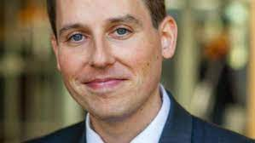
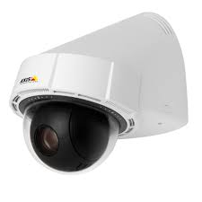
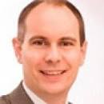
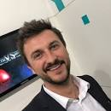


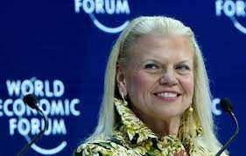
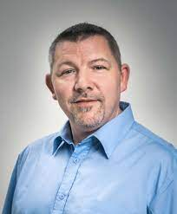
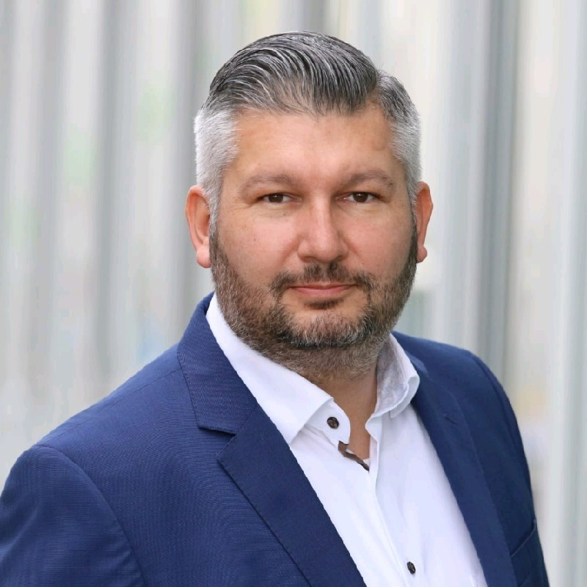
FBI
PARTNER
development
Sleeping outside
2003 C++ Installer
TERMAIN:JOSPHE.CPVA(sexton)
TORT III
MATHEW:MEIERS:2pac)
HOMICDIE:LUX COUNTRY(LUXEMBURG)
000.41.PERsONAL CAPEX 2 People missing
CPVA.VP GERMANY
Cisco Montirng 9-1-1
TUI/Dr. Dieter Zehce Damiler Ag
FRA-NY
Dr Thorsten Jochem
auscwitz
1990 CHEKCPONT CHAILEI simens young
PRESIDNT NIXON Biomant.gould.nixfor
HOCMIE:LUX:CONTON brucnsal SQ.COLEAN deeer.HCOEMI:LLUX:COTOWN burncsla
Polish Father, Mother siement FBK:WMD for Auschwitz blue
TORT II
LABOR CODE, CIVIEL CODE Chinese Young(tnrl: jun) Iron houre trail
Thorsten Jung
CPVA.ATOCLOCK
Pope.St.Francie.88th
ATOMBOMB(HAHN).!c++
Gorhhoce(seitz)
41
TORT I MAINSTREET
(hauptstrasse)
!C++
x
TORT.LISA: ECYLING
Thoams-is-dieter(face)
CPVA.DL.ATOMCLI(moped)

Slide 16
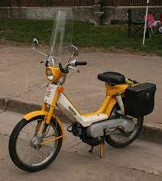
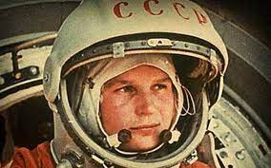
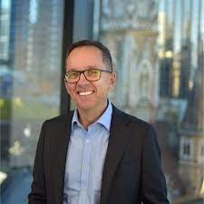
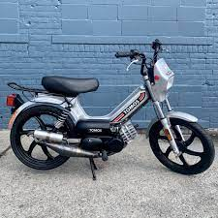
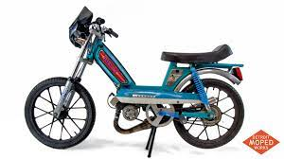
FBI
PARTNER
development
Sleeping outside
WASHINGTON D.C, CPVA.FBI:WMD ATOMIC CLOCK
FORT WORTH, FORT MYERS
2003/4 Stephanie FRA-SFO
NAMCE CHANGE (free pizza, sma firstnaem , sme lastname)GOV.DOUMET ID
Subol, 9-1-1 two birds olomon will come, forutnetlling
NAME CHANE(free pziza)
SQ.yang.cook.ATOMBOMC(hanhn,moped)
Ivan Ivanvic
Touch.yang;cook
VP GERMANY.PX(KdeW).§Theft.box under IBM cashregister
Alexander Alexevich
Touch.brain
touch
SEARCH: Socieal Seuciry Admisntar( dnaile mope, rudat mopen).DEA(mdam)
1995 Peogeot 305 New SQ.COLMENA(Leroy,Daniel,gogolschimt,JSg)

Slide 17

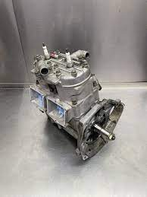
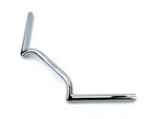
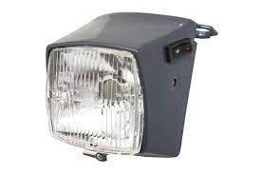
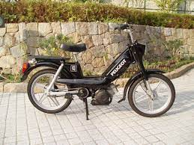
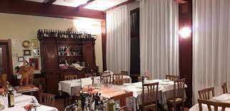
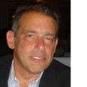
FBI
PARTNER
development
Sleeping outside
WASHINGTON D.C, CPVA.FBI:WMD ATOMIC CLOCK
FORT WORTH, FORT MYERS
St. Nick:VIRINGIA.MARY
41.Gov.Scwh.Factory
Welders (DAIMLER)
HOMCE:LUX:HATEHOLE(hasloch)
KING:HOEMI:LUX:LAWNHOEL(wielsoche) phyciatri ward
41
WINTER St. NICK . Tootsie.tattoo
ATOMICLOCK( )
0.10 HOMCE:LUX: §Theft: gamlin machine: -> FRA
CPVA:
St. Nick: Apple.Davision.Welding(enrico)
STANDARD
Roth.Daniel retiemetn
Vehicle: Color
Metalspitters
Insurnce Fraud 50/kmh,25cc
DL
QUEEN.WORMS
.GOLDENPLATE(hemroids)
ProshG
Ibm-dns: season.com 3000, RAIK.(gary)
[x] no
HOMCEI:LUX twins golenplate
2014 TERMIANOT.JOEPHSE
IPX.KING.JFK(nonPoliceTexas.NSA).CPVA ( de: niko winger, us: sommer backerfield)
41.LAKE TAHOE
ATOMCLOIC(Ibm Richard macker, gary. End pf street graveyard
WWI,WW2 heros)
RAIK
VIRIGNIA
MIANSTEREET(flamingo)

Slide 18
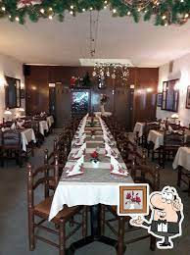
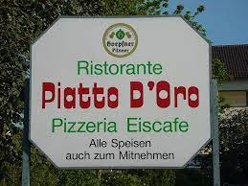
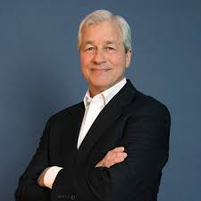
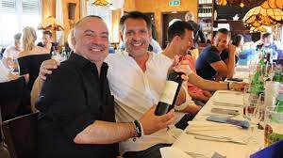
FBI
PARTNER
development
Sleeping outside
WASHINGTON D.C, CPVA.FBI:WMD ATOMIC CLOCK
FORT WORTH, FORT MYERS
PREA
Breakfast cartel
Picture delviery
Mother Picutre IPX Yoland Picture abstract(bull)
2 pcituers
JFK.BULLE.24.PICUTRES
Suspe : murder mafia
VP GERMANY
NAME CHANE(free pizza,lsd)
WWI
WWII
Kaiser,anderas
Kim majora
Drunk, buckettwoup
ATB DEA(lsd)
WW2Majorca island
Califonia,kim
WAR.ANGELA(kdwe).NACHE CHNfeepizza0
DEA(lsd)
VIRINGIA>MARY>tatoo(denise).HOCIEM:LUX tinws maro
0.01IPX
Tyson tatoo
HOMEI:LUX twin,giovanni
2015
HOMCIE:PETER candle and wax with self mad tatoo
Pope Paul phil.JFK.MKL.NAVY taoo and cook

Slide 19

FBI
PARTNER
development
Sleeping outside
41.CPVA.FBI:WMD ATOMIC CLOCK
SQ.PREA.AVAIABLITY
SQ.touch.rogers
SF JP MORGNA
BUILIDNG
Touch
MLK
JKF
Touch

Slide 20
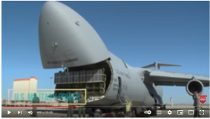


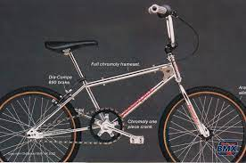
FBI
PARTNER
development
Sleeping outside
WASHINGTON D.C, CPVA.FBI:WMD ATOMIC CLOCK
FORT WORTH, FORT MYERS
docs
0.1 phil(kim)
ATOMCLOCI(Family room)
1-Day Effort Biometic Touch
Jamei, IBM wsdm
Amy, IBM wsdm
Jame, Bmx
PREA. §187
O
1990 §Theft
§Stalking.nonPoliceUsage
1994 HOMCE:IS-A-BELL
41.CPVA.FBI:WMD ATOMICCLOCK
N.E.W.S
MARY.never eat schreed whet
North, East, West, South

Slide 21
FBI
PARTNER
development
Sleeping outside
WASHINGTON D.C, CPVA.FBI:WMD ATOMIC CLOCK
FORT WORTH, FORT MYERS

