Slide 1
FBI
development
1994 tarantula Spain,
Horse Salmi Breafast
gorhceo(,jaskoin,visa,taratunlas DEA(HOMICKYSTAL).ATOMICBUNDKER(Hahn)
PENTAGON.VIRGINIA.MARY
Angel.elke
maxim magazine nude
double
thin

Slide 2
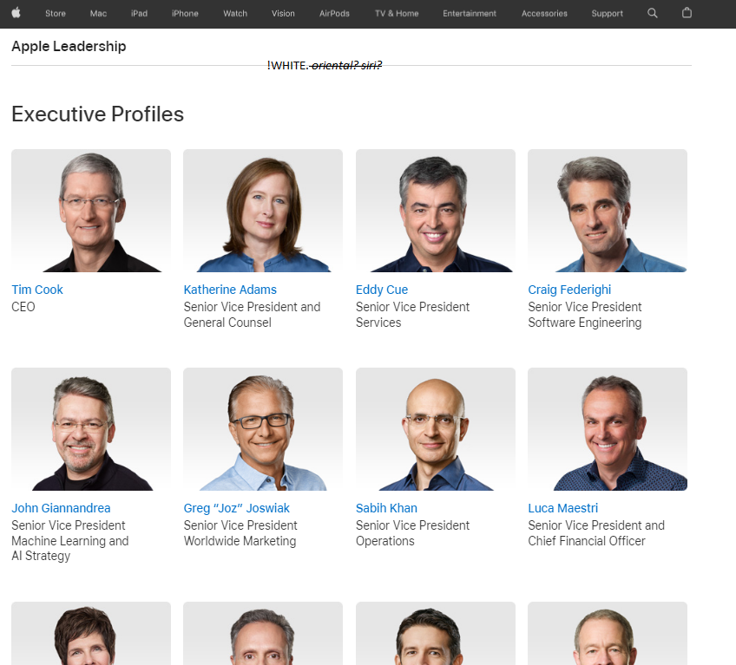
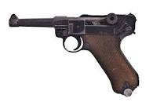
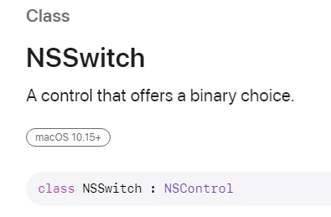
FBI
development
41nonPoliceMpa.nonPoliceCfg
Thonsa-id-dieter: !BLAKC. bat
Microsoft
CPVA
IBM
Had not used apple
Will not use apple
Apple only for report pedophilia
2014
000.nonPoiceiMotnried.nonPioceCTX(apple).ext
Linkedin Dog Pound nonPoiceSexAbusie( wiuner mushinai)
Cp[mter 3Snoop doggy dog
CPVA.2014 train bershire hathe TERMINARO.JOEHOPHE.SAM
apple
000.tw.pns.VRIGNIA.MARY ding/dong
marin city 2pace
!saint anselmo
PENTAGON.VIRING.MARY
ss gun crisitan
HOMCI:JEUSUS
STATE
suicide
SQ
Tim dre cook
tnago
aws

Slide 3
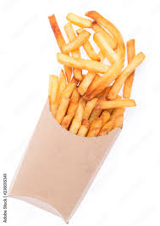

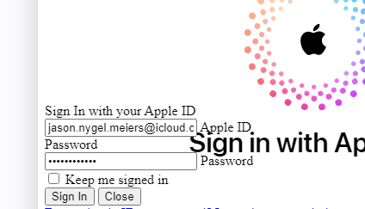

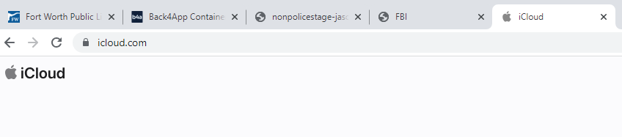
FBI
stage
E=mc2 Web Service Calculator
2007
G.Confluence
url: nonpolice.stage-.b4a.run
2014-2019
Avg.Atlasian:
https://nonpolicestage-jasonnygelmeiers.b4a.run/nonPolice/wsdl/nonPolice.wsdl
Freedom Fry’s
$0, $0.97 cents client
Stalking
Production

Slide 4

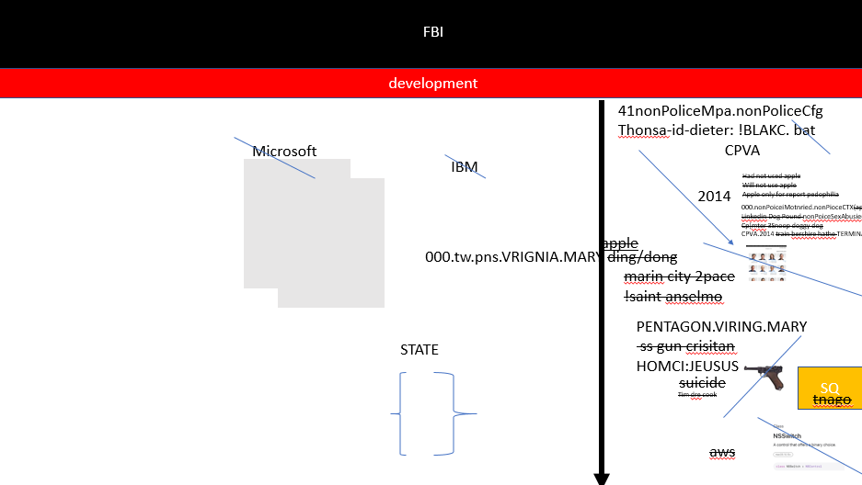
FBI
deveopment
Slepping ouside
11:28 am Saturday, 7/22/2024
DEA(crack cocain)
§Stalking
- Black dogs (male, apparment) has appment 11:30am
- Black dogs (femail, church)
- Black 2 have replation ahd cloehts jogging new.
!WW2.!§422.6 Hate Crime
- Towing with car, towing witout car, mexican
000.tw.pns.ATOMICLCOK(Marin City.2pac ding dong)
!BLACK

Slide 5

FBI
develoment
DIVERSIETY
J-I-M
nonPoliceChurch
WHITE St. Andrews
!WHITE Brenda, !WHITE nonPoliceAudience
!BLACK St. Patrick Chruch, Indian
….
Saturday:
11:00 – 6pm !WHITE Library Mae
!DIVERISTY

Slide 6
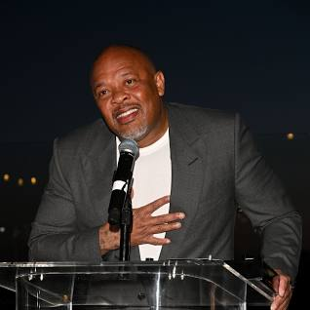

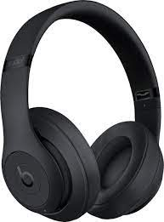

FBI
develoment
I am techonlisgs like telsal,(silent: he is acommunist. I am black have forotemnt my alg, until fureht notice afor atock bobm)
You wored ther I drive by with music, in car.. A car
He is !white, he worked there.
2023…
Ther is a guy in ashelter…..
11:43am 000.tw.pns. Computer 18. garbage bags, black male 40

Slide 7
FBI
develoment
SF
LARRY
Gorbacheck()
Visa sam
JFK

Slide 8

FBI
develoment
nonPoliceCfgLogial
CHART
41.PREA.187 (shared it ait no fun if hmes can have none, PREA.asshole)
nonPoliceUsage
CPVA:FBI:KIDNAPPING:AVAIABILITY
G.Dog Pound
nonPoliceCfgLogial
CHART
1994 PENGONT.BASAE.PAUL.PS.SHOPPING.CAER.PLATIC
Warren g
Dog poutn
VP GERMANY.NO CHILD LEFT BEHIND wutang shulz (ingo)
DEA(MDMA)
Computer !18
Snoop Doggy Dog
Public Disbance Car
nonPoliceUsage

Slide 9
FBI
develoment
CHART
nonPoliceCfgLogial
CHART
Computer !18
Snoop Doggy Dog
Computer !18
Snoop Doggy Dog
Public Disbance Car
Public Disbance Car
nonPoliceUsage
nonPoliceUsage
!BLACK

