Slide 1

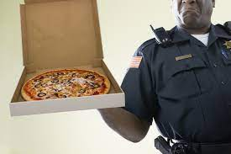
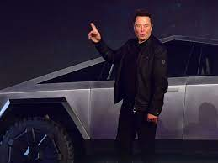

FBI
partner
development
MAINSTREET:HOMCIDE:GOODYEAR(gorbache(seitz)

Slide 2
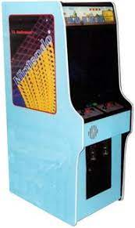
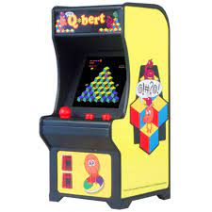

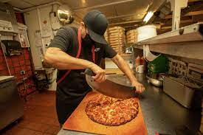
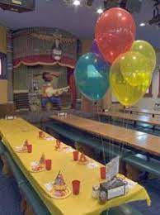
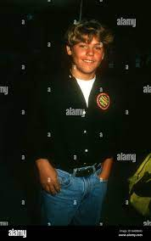
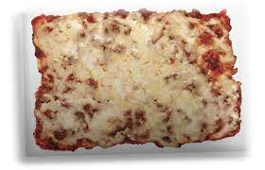
FBI
partner
development
Phi(pizzaoven).JFK.MLK
1987

Slide 3
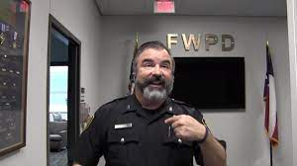
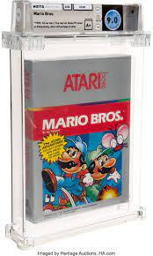
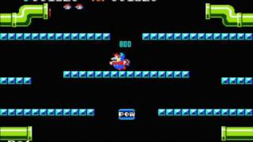



FBI
partner
development

Slide 4
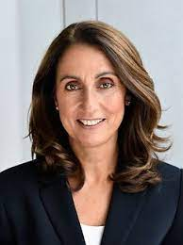
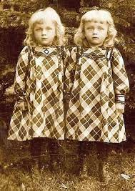
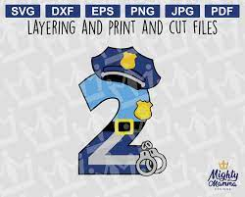
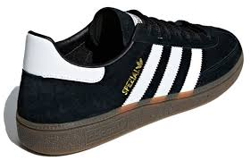

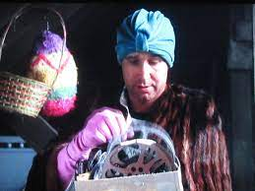
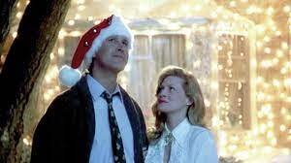
FBI
partner
development
41.DEA(cocaint,apple; steve and tim)
PAUL:LISA:HOMCE:LUX(twins,lisa/marla)
1980-1984 PAUL
HOMICIDE:LUX:gorhoche(dpress,biliski,ATOMICCLOCK(tim,hard-to-find)
1995 88th Piato Doro
1988 March 23rd
Enrico Chellimi
1987 March 23rd
GRADE
Police Sirens: 5:16pm

Slide 5
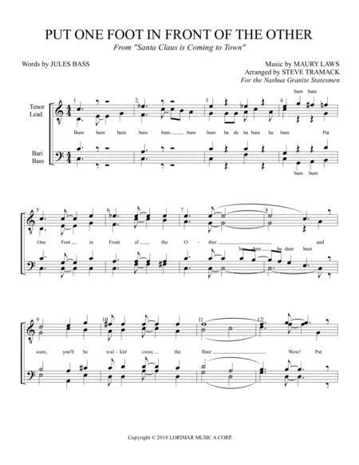
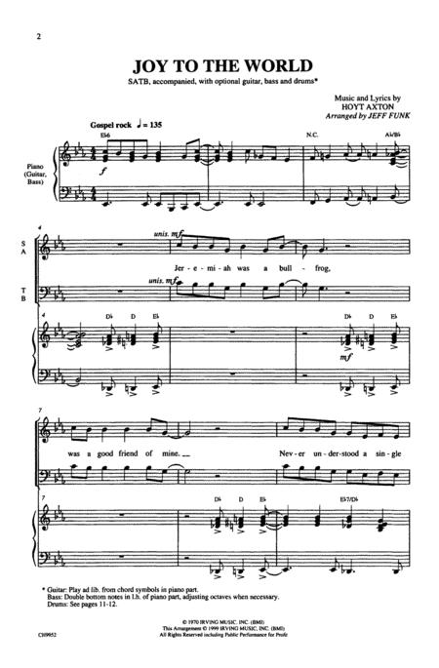
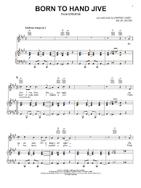
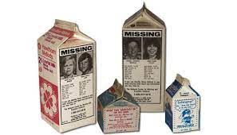
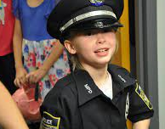
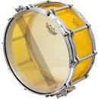
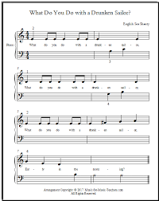
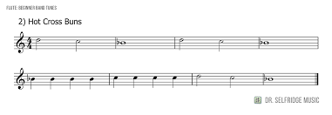
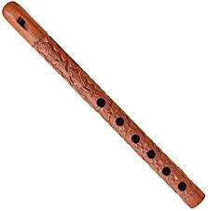
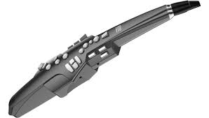
FBI
partner
development
1988/9
MUSIC
Elementary School, Davis, California
WW2.CIVIL CODE(delta).1D8723
Tyson
nonPoliceLanguage.lingusti(trailer ***)
!blond(us)
!Blond(de)
Do you want to be on the back of a milk carton?
1991/2
MUSIC
ATOMICBOMB(Hahn, Otto-Hahn-strasse 3).RHEIN-MAIN:AIRFIELD

Slide 6
FBI
partner
development
41.DEA(cocaint,apple; steve and tim)
PAUL:LISA:HOMCE:LUX(twins,lisa/marla)
1980-1984 PAUL
HOMICIDE:LUX:gorhoche(dpress,biliski,ATOMICCLOCK(tim,hard-to-find)
0.1
Gov. Schwarzenegger
VIRINGA.MARY.Call you Dr. Rice 0.1
1988 March 23rd
1995 88th Piato Doro
Enrico Chellimi
1987 March 23rd
GRADE
Police Sirens: 5:16pm

Slide 7
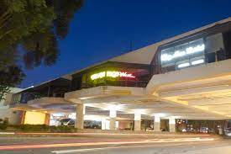
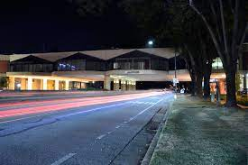
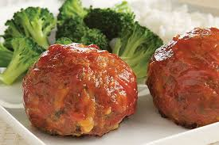
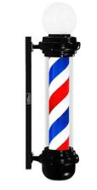
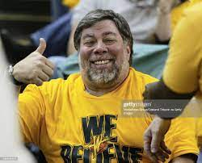
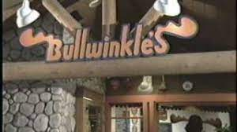
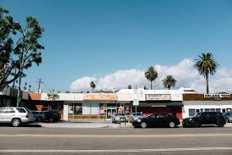
FBI
partner
development
Deborah Meiers
Cupertino, California
Accouing Assc.
cupertino mall bridge
JFK(bruce)K.KING
CPVA:Mark(us): leslie mothers job accountant(big 4)

