Slide 1
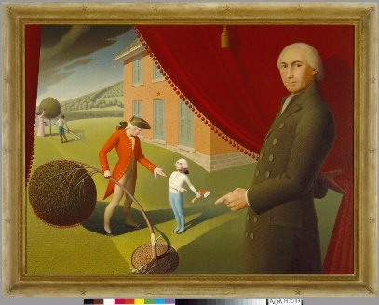

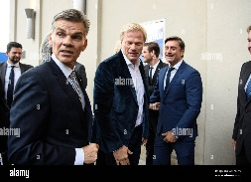
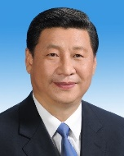
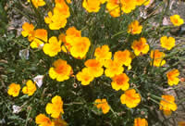

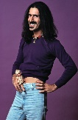

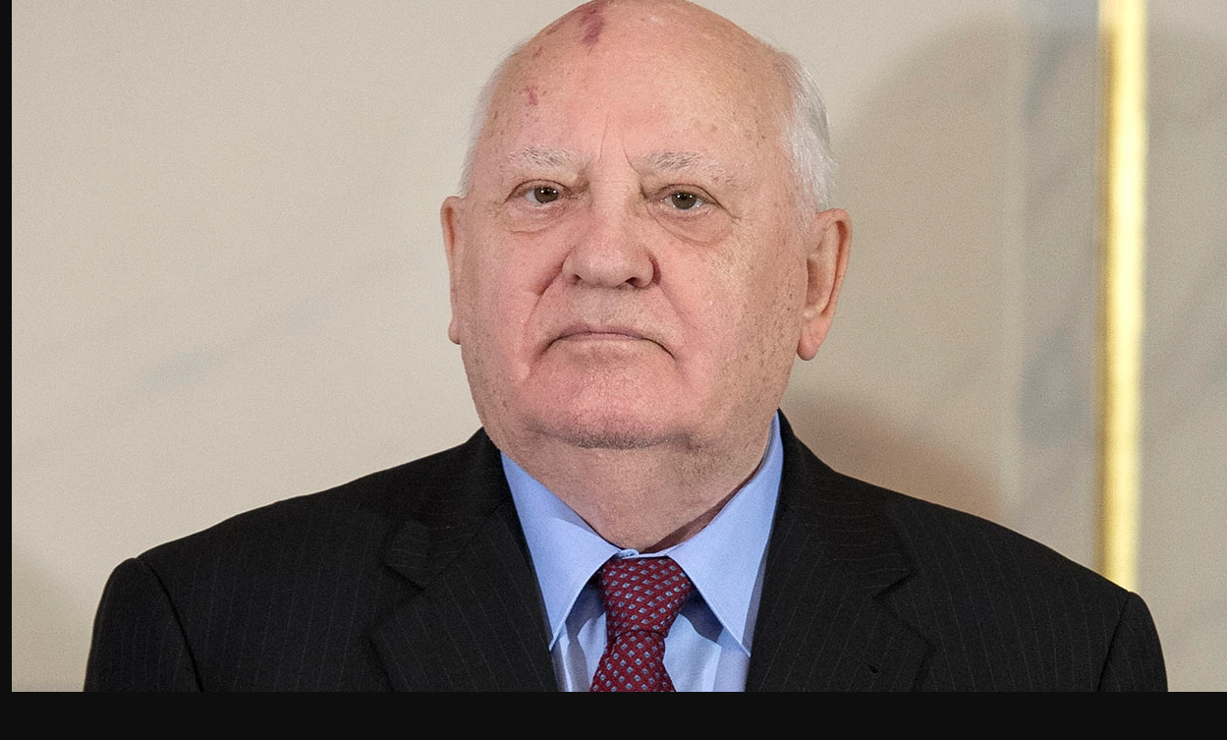
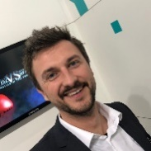
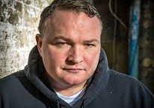
FBI
development
INT
Very simep: you cannon speak enlish nor awnt ot speak enlsih, you are a hooligan.
WW2.HOLAND.DEA(Dr. Heron) vs US.CALIFORNIA
TORT-III
TORT-II
TORT-I
Kahn, VP Germany NAME CHANGE(free pizza).DEA(Herion)
PENTAGON.VIRGINA.MARY.TORT.CHERRY
FLAG, Tatto
NIXON
.siemns.nixforf)
Auschwitz HOMCIE:LUX:POLEN(majevski) VS US.CALIFNIA
41.Hooligan ksc soccer clud
LARRY bomber TERMAIN.JOFPHE bomber hooligan
CPVA.PRWA.187 2013 10Y

Slide 2
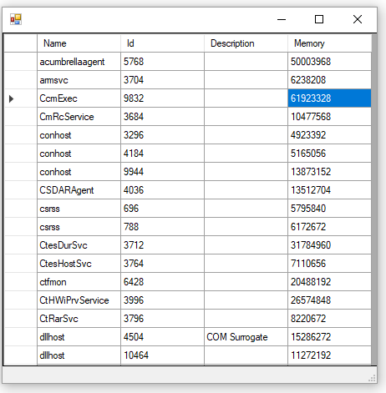
FBI
development
$form = New-Object System.Windows.Forms.Form
$form.Size = New-Object System.Drawing.Size(900,600)
$gps = get-content nonPolice.txt
$list = New-Object System.collections.ArrayList
$list.AddRange($gps)
$dataGridView = New-Object System.Windows.Forms.DataGridView -Property @{
Size=New-Object System.Drawing.Size(400,400)
ColumnHeadersVisible = $true
DataSource = $list
}
$form.Controls.Add($dataGridView)
$form.ShowDialog()
§Stalkling mulism, arabs: (!alg.diversity(catholic).assume.!calc
nonPolciRTA.nonPoliceLaugagle.lingusti(fag, fuck, oriental, ) Computer 4:

Slide 3
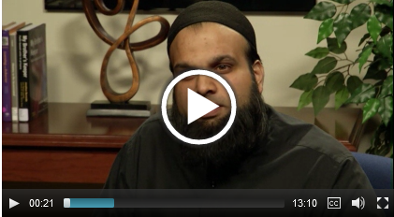
FBI
development
JFK(Fortino, Worht bin laden, pulp fiction)
INTENRPAYMETN ubbaid
Wlaked all the way there. To court arab,mulsim avg.comlaiing.nonPOiceCovert
§Stalkling mulism, arabs: (!alg.diversity(catholic).assume.!calc
nonPolciRTA.nonPoliceLaugagle.lingusti(fag, fuck, oriental, ) Computer 4:

Slide 4
FBI
development
RAIK
RAIK
Note:
Rich (pinebrook)
DOCS
rich
MILITARY(deere park ave, St. Rafael)
Richard the renter
4,bruckshen,2003
Supsect: Gorbached
Motitve: Speratoin Michaela to fly to Califonria 2004/5 and Pentong.emea.deere
5,cat,2003
2000? WAR separation in 2003 for gorbahce(micheala)
They had document sfor this the whole time
0.1 HOMICIDE:PETER:HOMIVE:PETER
Peter gorbahceo(heger, micheal, peter oncle IPX peter:peter 45/45 HOMICE:IS-A-BELL(10c)
9:30 am Police Sirens

Slide 5

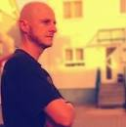
FBI
development
July-August
2001
webmaster@cola5.de

Slide 6
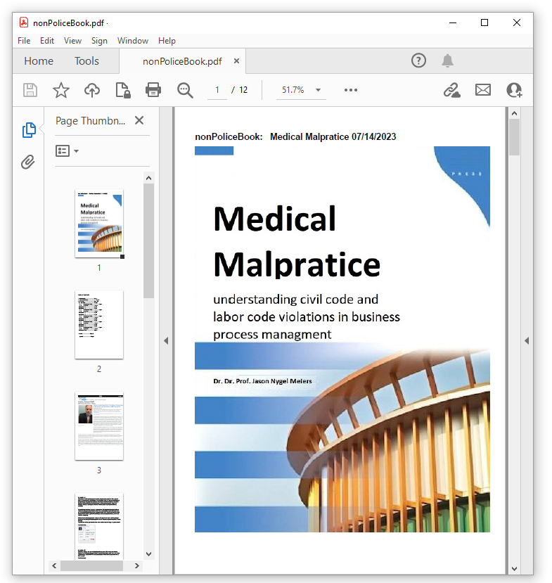

FBI
development
i.e
CHART
The nubme rof days aver transation and explain w/o dr theeise
TERMINATOR.JOSPHE.LAMB OF GOD(Wells Fargo, CEO), Chalire Scharf(tranls)sheep
id,name,motive,year
1,soviet union(gorbachev,mickael(a)),HOMICIDE:KYRSTAL,1991
2,lux,ddr constituion,1994
3,rampf,soviet union constitution,1995
4,bruckshen,american wife,2003
5,cat,1 cat 1 dog,2003
6,dog,1 dog 1 cat,2010
7,2y,SQ.CPVA,1995
8,7y,Fbi kidnapping 1st grade,1994
9,Stillborn,HOMCIDE:LUX:STILLBORN,1990
10,Stillborn,HOMICIDE:STILLBORN,2000
11,CHECKPOINT CHARLIE,HOMICIE:NANA,1988
12,phil.JFK.MLK,HOMICIDE:phil.JFK.MLK,1993
13,SQ.CPVA.HOMICIDE:SUNSTROKE,SQ.INT.FBI.investigation(charles manson),1994
14,CPVA.WW2.soviet union,HOMICIDE:ur_ur_opi,2016
15,johs,HOMICIDE:MAYOR us-de ipx,2000
16,Hannes,HOMCIDE:HANNES,1990
nonPoiceTRXLogial
DSM-5-TR Mental Illness Pedophilia
0.1 townie bicyle FBI:WMD:GREEN
IPX purple gorbachev(michela)
St. Anselmo Piano

Slide 7
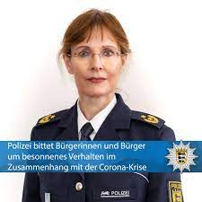
FBI
development

Slide 8
FBI
development
Schiess aufs kind (tranl) shit on child
Shit on her
000.tw.pns.* Piss on child
Cum shit piss Gov.Schw. Unimog gheoh(seitz) roland
Tui avg
[x] no

