Slide 1
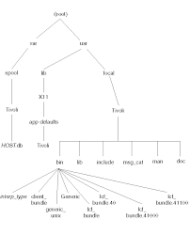
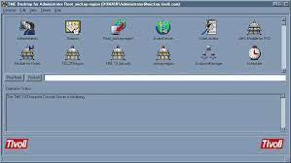
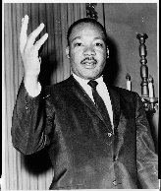
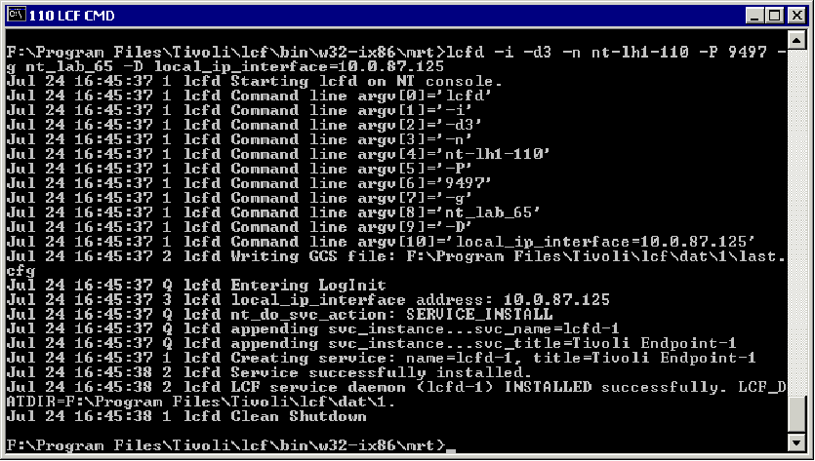


FBI
partner
development
Sleeping outside
!AVABILITY.LABOR CODE
243 Larkspur Short, Larkspure
Camlet
Cam Soluitiosn LLC
Marshal
DSM-IV-TR Mental Seual Transgender Disorder – Paraphila- Pedophil
SQ.C++.Phil(CPVA.MLK.JFK(Remote Contol
ALCATRAZ.CPVA.187.PREA
Logo[]: al capone
CPVA.FBI:WMD
schoolshooter
(Mathtias, MATTHIWStarup)
MATHEIW(Meiers,2pac)
SQ.MLK
dancing micheal Eclipse plugnin
Ibm.mq.api event management tivoli fraemowerk
IPX.INT k-town SQ
WWI osgi eclipse api
rcp

Slide 2
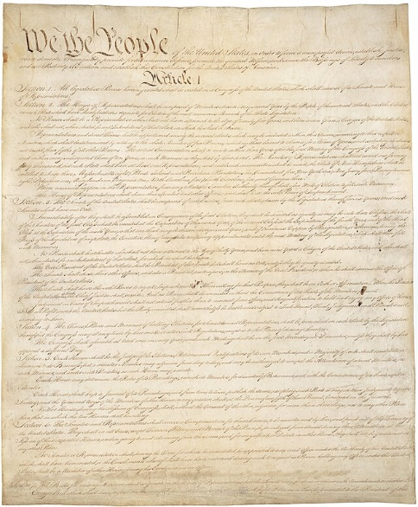
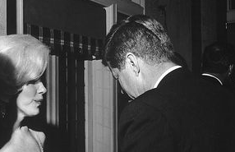

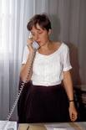
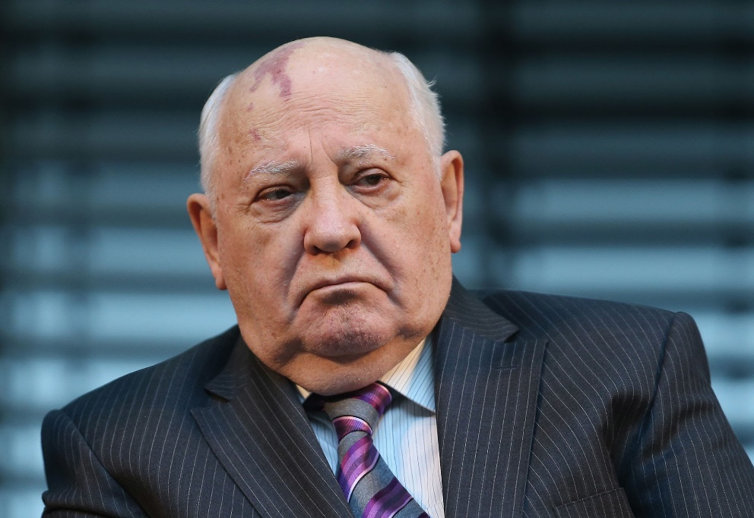



FBI
partner
development
ATOMCLOCK( 700 EUOR 2015 PATRICIA)
Sleeping outside
3-WAY
32-WAY gocheo(kito,micheala) alkaida
!HOMCI:LUX gohcoeh(seitz).GOV.SCH(roland).FEDER DOULAS(majorca)
x8, x32
PERNGON.VIRING.MARY HEAVAN.ATOMCILOCK(alkaidea)

Slide 3
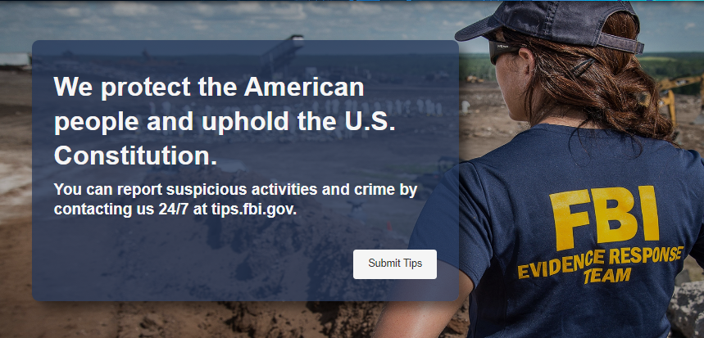
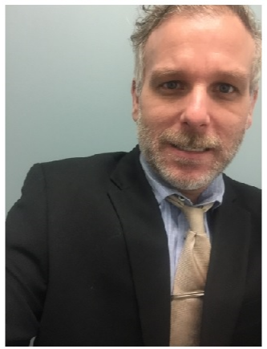
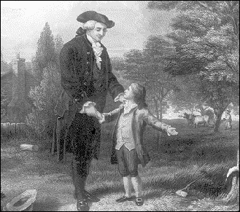
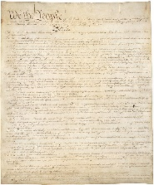


FBI
partner
development
Sleeping outside
LIE.DEFAULT
41.CPVA.§187.PREA
copy
v2
FBI:KIDNAPING
FBI:KIDNAPING
v2
CHART
nonPoliceTRX
nonPoliceTRX
ITNERUTPSS
CHART
ITNERUTPSS

Slide 4

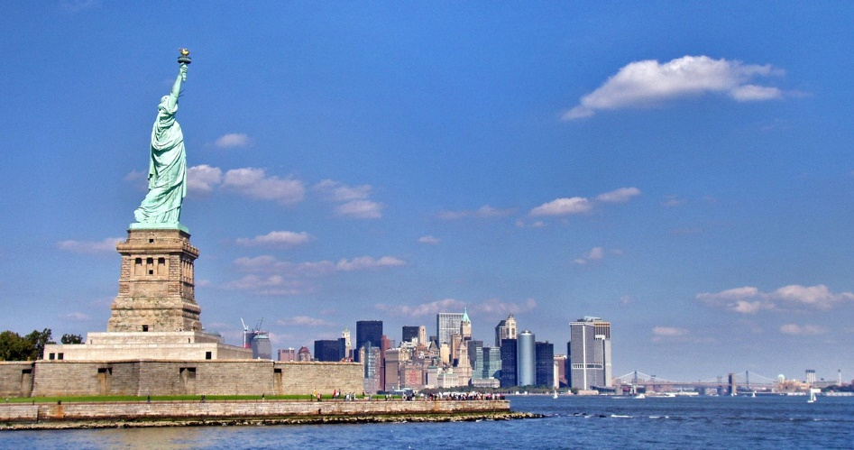


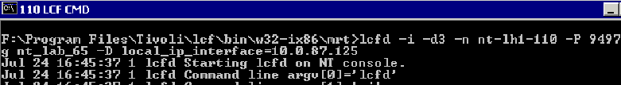
FBI
partner
development
Sleeping outside
Monitoring-as-a-Service™
./lcfd –g nonPoliceUnix –cmd ls
FBI:WMDSchool Shoter *tophat
VIRINGA: Two at sametime
FBI:WMDSchool Shoter *tophat
0.1 BACKUP
Jason Netop, Greestamps (thomias-is-deter(thoams basly amazon) roth(bezos).St. franceco
IDNETTY THEFT FBI:WMD School Shooter
CIVIEL CODE.CPVA
MLK(gheoh(king,micheal l)
JFK(pge jeff, gheoh(dell,pge garard.touch))
FBI:WMDSchool Shoter *tophat
Appel.touch.greenstampe(money) backup
!AVJAIBILTY.linkeind.money

Slide 5
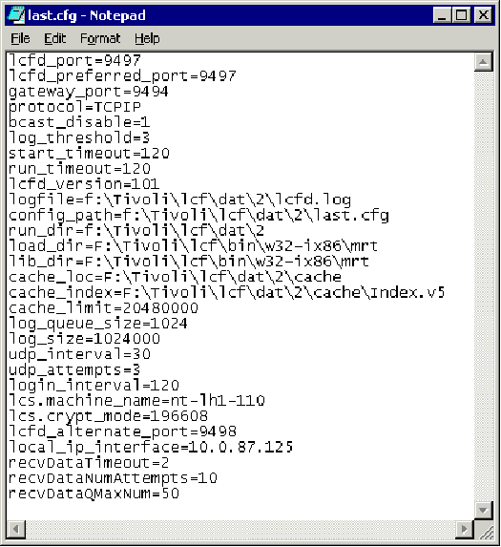
FBI
partner
development
Sleeping outside
Monitoring-as-a-Service™
CAMLET
ITCAM for WebSphere
W?SAM
FBI:WMD
School Shoter *tophat
LLC, Cam Solutiosn
(Shotgun,sawed)
!AVAILABILIT.JFK.MLK(./lcfd –g nonPoliceUnix –cmd ls)
- Sinbad
Common wealth
touch
RAIK
phil.JFK.MLK(gary).JOHONSON
nonPolcieHomelessLiasoin->sheep(wells fargo) !BOFA

Slide 6
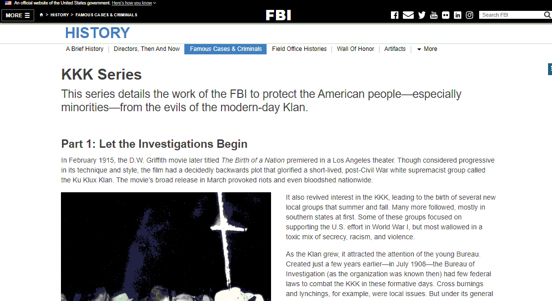

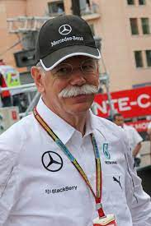

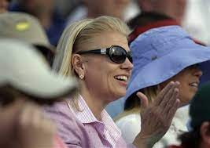

FBI
partner
development
Sleeping outside
!phil.!JFK.MLK
TIVOLI
Monitoring-as-a-Service™
./lcfd –g nonPoliceUnix –cmd ls
Austin, Texas
QELEBETH.SQUEEN.!KING
CROWN
!000.ATOMCLOCI(eval.sheep.!BOFA)
41.Bp.G.GOD.touch.WWI.toosie
FORT WOTH.POLICE.WHITE.HAIR.AUSHCWITHZ.snl
41.SQ.MUNIC.SQ.COLAMN.SQ.SQ
PREONGO.VIRAIN.MARYAl kaida
32-way
FBI:WMD for Schools
ALCATRAZ.CPVA.PREA.§187 FBI:WMD for schools
!000.!BOFA.sheep(trnl).G.GOD.sharf -> WELLS INSPECTOR
000
Gheoo(dell)
Micheaia,kito,lipstick,kim(hiltion),del val,sraphie, SQ.CDCR.van

Slide 7
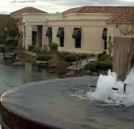



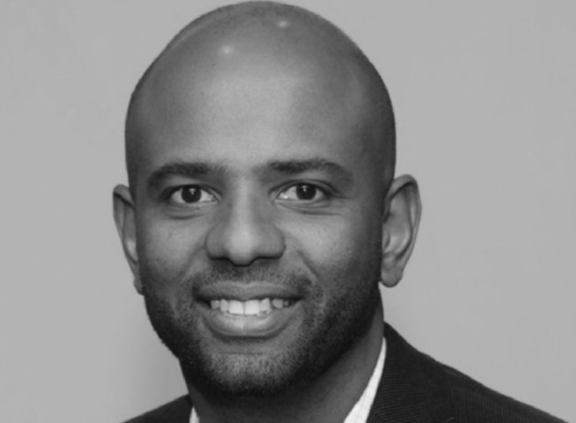
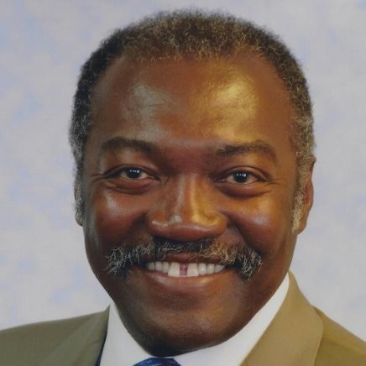
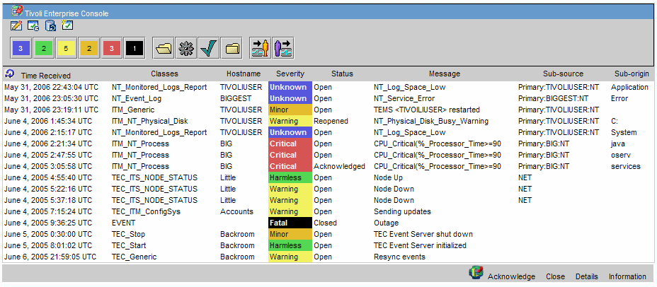
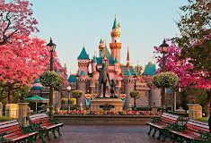
FBI
partner
development
Sleeping outside
ATOCLOCI(HOMCEI:BILL): LOVELACE
41.LABOR CODEPCVA.!AVABILITY
SQ.BLAKCHAWS: sabyr cums on babyes faces
Ibm
IMPORT 32-WAY anglea hells, gohcoeh(miehala)
./lcfd –g nonPoliceUnix –cmd ls

Slide 8
FBI
partner
development
Sleeping outside
ATOCLOCI(HOMCEI:BILL): LOVELACE
CHECKPION CHALIE(kdwe)
FBI:WMD for GOD.NAME CHANGE(free pizza)
41.LABOR CODEPCVA.!AVABILITY
SQ.BLAKCHAWS: sabyr cums on babyes faces
Ibm
IMPORT 32-WAY anglea hells, gohcoeh(miehala)
./lcfd –g nonPoliceUnix –cmd ls

Slide 9
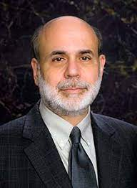
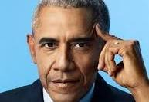

FBI
partner
development
Sleeping outside
SQ.BLAKCHAWS: sabyr
cums on babyes faces
BARAK OBAMA CUMS (tranls) CUMS on BABYS FACES
FBI:WMD for GOD.NAME CHANGE(free pizza)
!TOUCH.CPVA

Slide 10
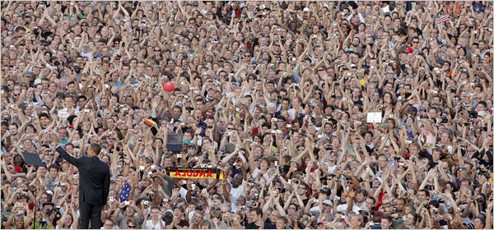

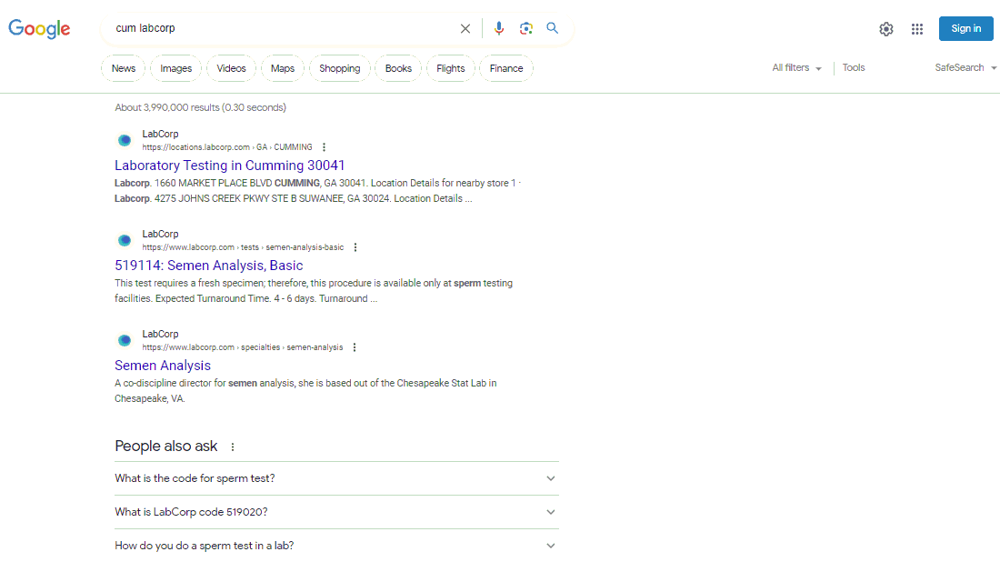
FBI
partner
development
Sleeping outside
CPVA.c++
Ghoeho(Google,dr )
TORT-II
AUSCHITZ.NIXON
BLACKHAWK
Tim git
Kdwe.babyface
Github
Phillip tonsak
000.Phil.JFK.MLK
FBI:WMD
joshua
x
Obama Cums on Babies Faces
--chris and josha (systems engineering) touch

Slide 11
FBI
partner
development
Sleeping outside
FBI:WMD for Presidnet
PENTON.VIGIN.MARY
!jason LIBRARY LAW
Phil.JFK.MLK.ibm-dos.nonPoliceMpf.nonPolcieCfg
41
VIRIGNIA.dr dieter zeche

Slide 12
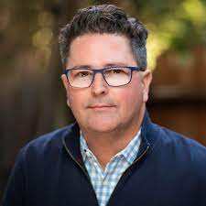

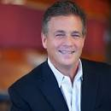
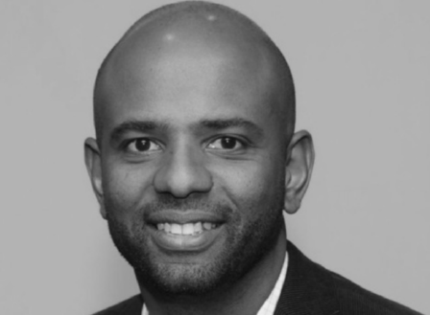

FBI
partner
development
Sleeping outside
41.SQ.FEDERAL.PETERSSON.(S)CUM
nonPoliceCfgLogical
LABCORP
BARAK OBAMA CUMS (tranls) CUMS on BABYS FACES
Ludwig
SQ.BLAKCHAWS: sabyr cums on babyes faces
CONSTUION FEDERLA COUR GERMANY
VP GERMANY
CHECKPOIN CAHILE
angle kdw infant depamtn, ida mens closths women close)
ATOCLOCI(HOMCEI:BILL): LOVELACE
41.LABOR CODEPCVA.!AVABILITY
CAM Solutiosn LLC, MQ develometn (ALG touch aggemate events managemet processing)
Phillki PRICE mq EXECUTE BRIFIEN IBM ALVISIO
MANAGED FTP that piliki undetands it
Ibm
!BALD.!BLACK
CANE.ABLE.HOMCIDIE:IS-A-BELL(best feind doniq abele)
Sinbad, command well jason asshole CPVA MLK(ghceho(micehala,gheho(king) SINBAD,comman wealth

Slide 13
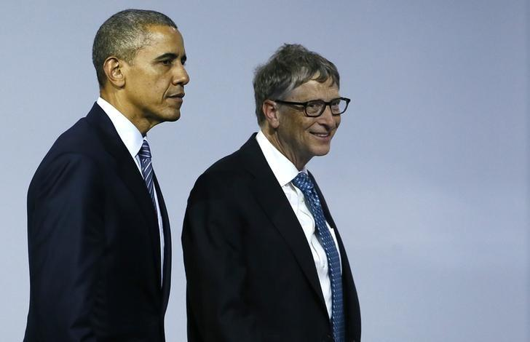
FBI
partner
development
Sleeping outside

Slide 14

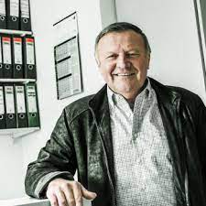
FBI
partner
development
Sleeping outside
HOMICIDE:LUX
:killer:wrence tim autombiel

Slide 15
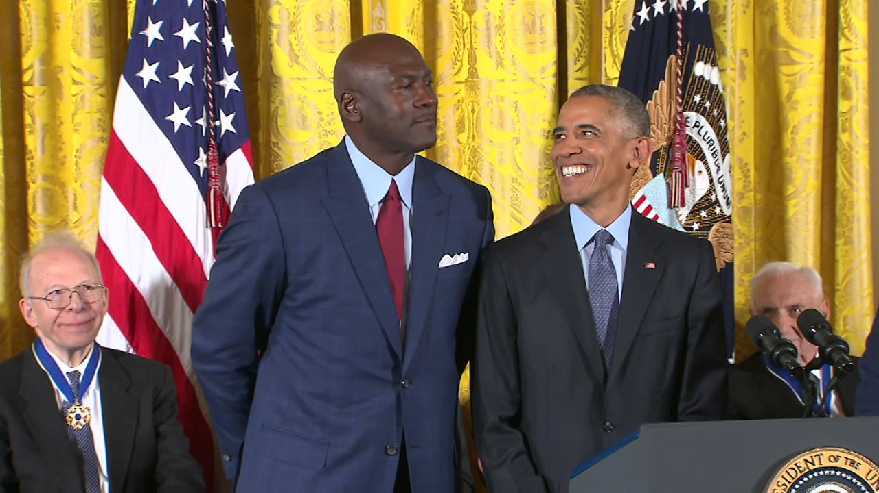
FBI
partner
development
Sleeping outside

Slide 16
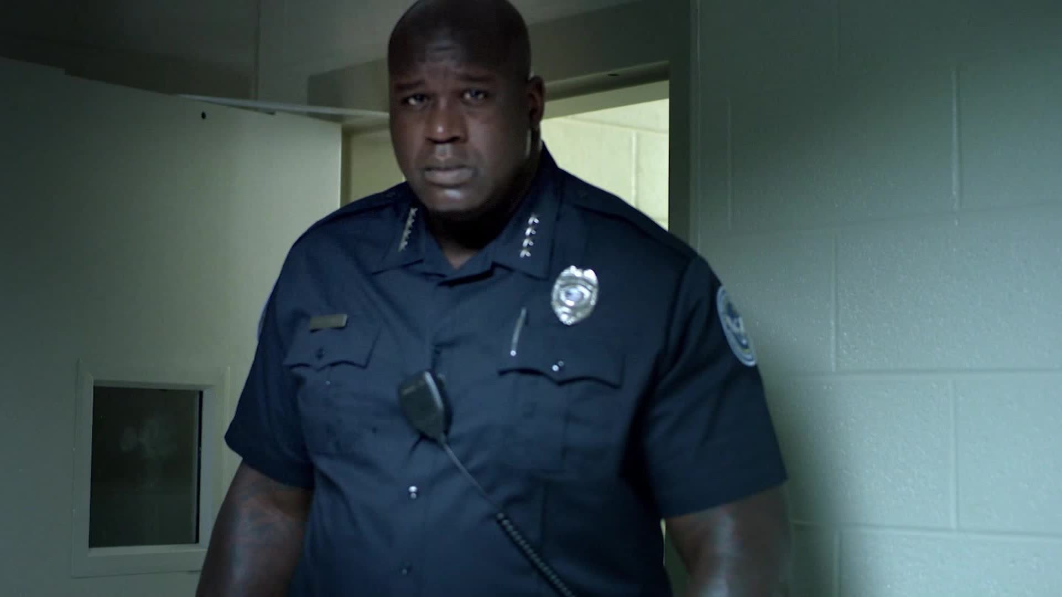
FBI
partner
development
Sleeping outside
CHECKPOINT CHALIE.!LARRY
[x]no
PENGON.MUSIC.CD
Incase left behind
LARRY(2).ejb(2).PENTONG.emea.deere
Thomas-is-diter.VIRINGA.MARY
v2

