Slide 1
FBI
partner
development
§422.6 Hate Crime
3.14
Alg[].nonPoliceDiagnoticsLogical
- KOREAN WAR, LABOR CODE
nonPoliceResponseTimes
Fixed Variable evaluations
0.1 fine
nonPolceiLogLogical
Public.Gov.Comptuer.1D8723
eval.nonPolciLanauge[“!jew”,”!orineal”,”!wt”,”n-word”]

Slide 2

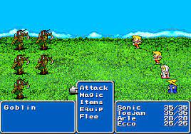
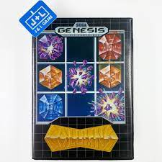
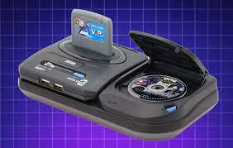
FBI
partner
development
nonPolcieTRX: meiers/meiers
IF wife=missing THEN logica wife.nonPioceTRXLgioal
Moody peter logical wife
WWI.Freemont.St. Mato.toosie: king/queen/jobs/jbo/meiers/meier/smeier/meiers
DEA(cocain).ATOMCLOCI(steve,tim)
1991 tootsie plays finacl fatasy
CPVA.PREA.§187
Tootsie and his wife play financl fantsy, both
WW2.marx.LISA phone game
Garage.A5

Slide 3

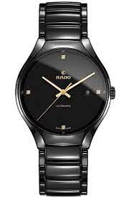
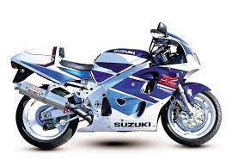
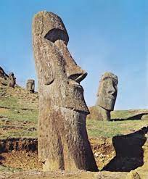
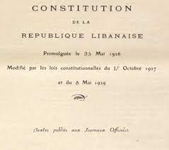
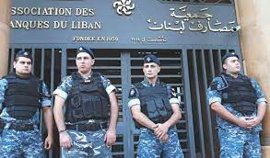
FBI
partner
development
MAINSTET(!HOMIC:CHANLOR) sent moher, old gensis, added watch
JFK.BULLET.SHOTER.24.”PENG”.TRIGGER.
DHL
1997 December
Traded;stolen
1996 SQ.COLEMAN
197 Deember
CAMP DAVID
§Assault
ATOMCILOCK.J5
Lucky one
1995 Funiore nonPoiceRT.41.laborp.specimen(lguekckecks(trml)
) 4 menstandkin cirl ejaculing lat to eat cookie
DEA(mdma)
GENESIS
MAINSTREET
CAMP DAVID, UAK, RUI, Lebanise
gehs pub?
[x] no41
1988 !GENSIS
HOMICI:BILL.rui

Slide 4
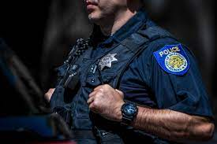
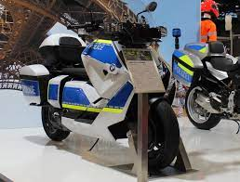
FBI
partner
development
GENESIS
MAINSTEER LIBRARY MAE SOUTH FORT WORTH
2023
25 Years later…

Slide 5
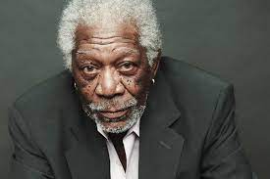
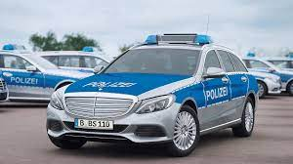
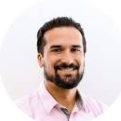
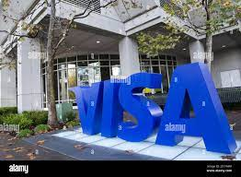
FBI
partner
development
HW80 EDEN
FRONT DOOR !CAR
G.GOD.St. Peter.VIRINGA HOLY MARY
MAINSTEER LIBRARY MAE SOUTH FORT WORTH
2023
GENESIS
25 Years later…

Slide 6
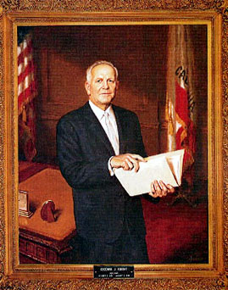


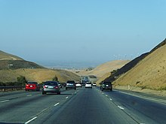
FBI
partner
development
Gov.Goodwin Knight
41.WAR.WW2.b10->WHITEHOUSE.LARRY
moved PENTAGON.MILITARY to WHITEHOSUE
EDEN
GENESIS
IBM Hersey, Endland
Oakland Califironia 2005
JOEPHSE.TERMAINER creaed EDEN ibm.jvm.eden(s1,s3,tenured)

Slide 7
FBI
partner
development
Stalking moto LBIRARY
Saturday 7am-9am Chruch
10 Breakfast
Saturday 11am
6pm
8pm Philp Johsn Park
10pm
12pm Philli Tilly Park
1am Ironman Joggin
6am Ironman Bycley,Swimming
7am Police Bench
8am POLICE COURT
Saturday 11am
6pm
8pm Philp Johsn Park
10pm
12pm Philli Tilly Park
1am Ironman Joggin
6am Ironman Bycley,Swimming
7am Police Bench
8am POLICE COURT
P.A.L Triathon
P.A.L Triatholon

Slide 8
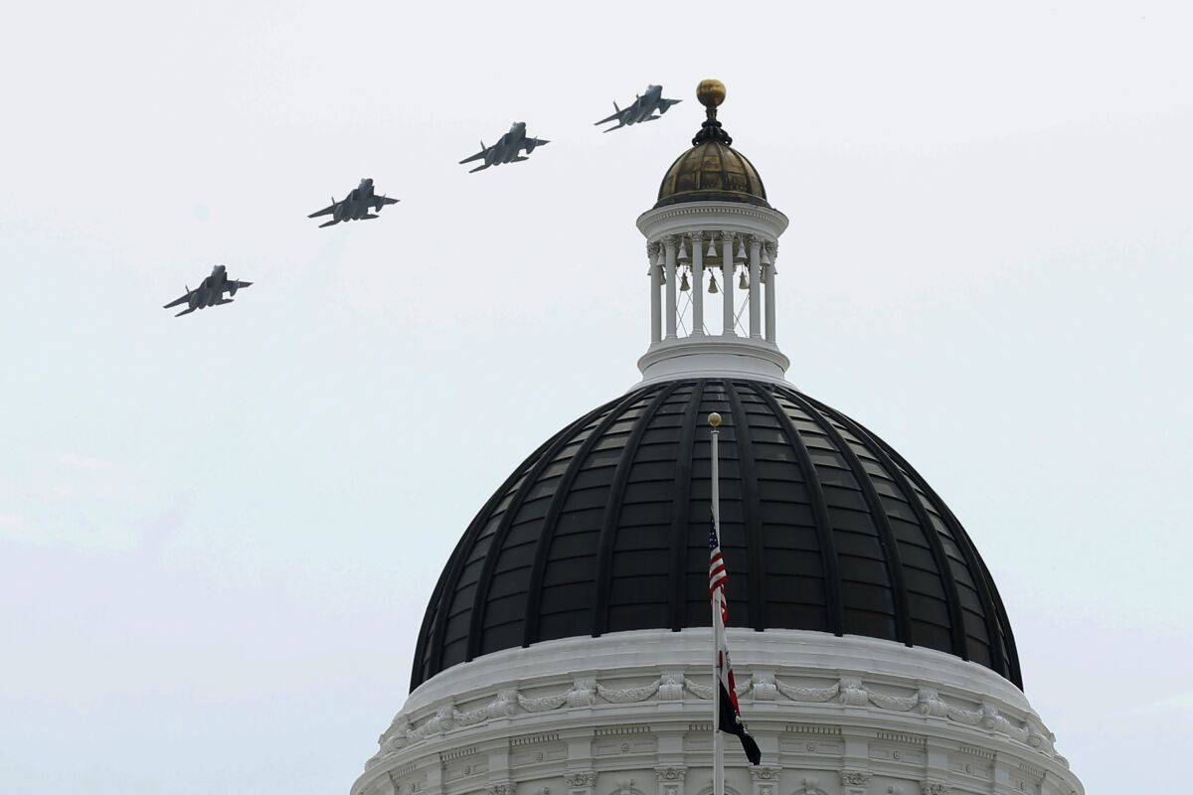
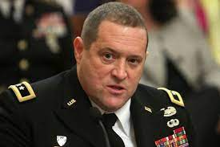
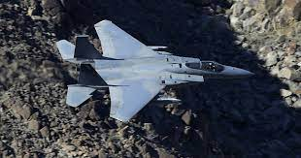
FBI
partner
development
Government:
State Level Fighter Jet

Slide 9

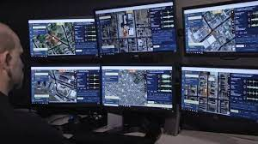
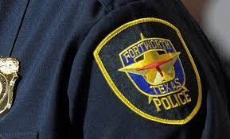
FBI
partner
development
nonPoliceCfgLogical.BLACK.nonPolciComptuerInterested
The network operation center at Depmetn of Helath and Human services in Baltimore. NonPolcieCfgLogical.nonPoclieRtot.LIBRARYLogical

Slide 10
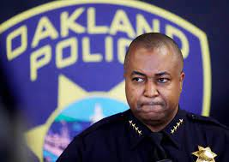
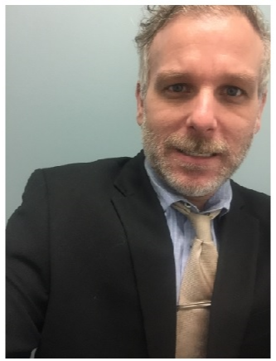

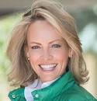
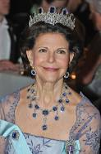
FBI
partner
development
CPVA.Phil(kim).CIA.McCARTY
Call yourice
CEO from Californ joins swdish kindon for recienv applid
https://www.kungahuset.se/english/royal-house/hm-the-queen
Page, Internship
PREA WORMS:
OJ
https://careers.king.com/jobs/
Can you please send the appid?
68274983-c8a6-4dbf-8ae2-9354867acc1d

Slide 11
FBI
partner
development
I wanto to king w/o tv form Julie haner.

Slide 12

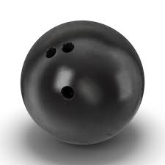
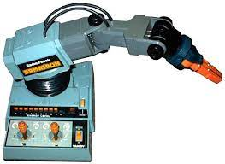
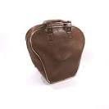
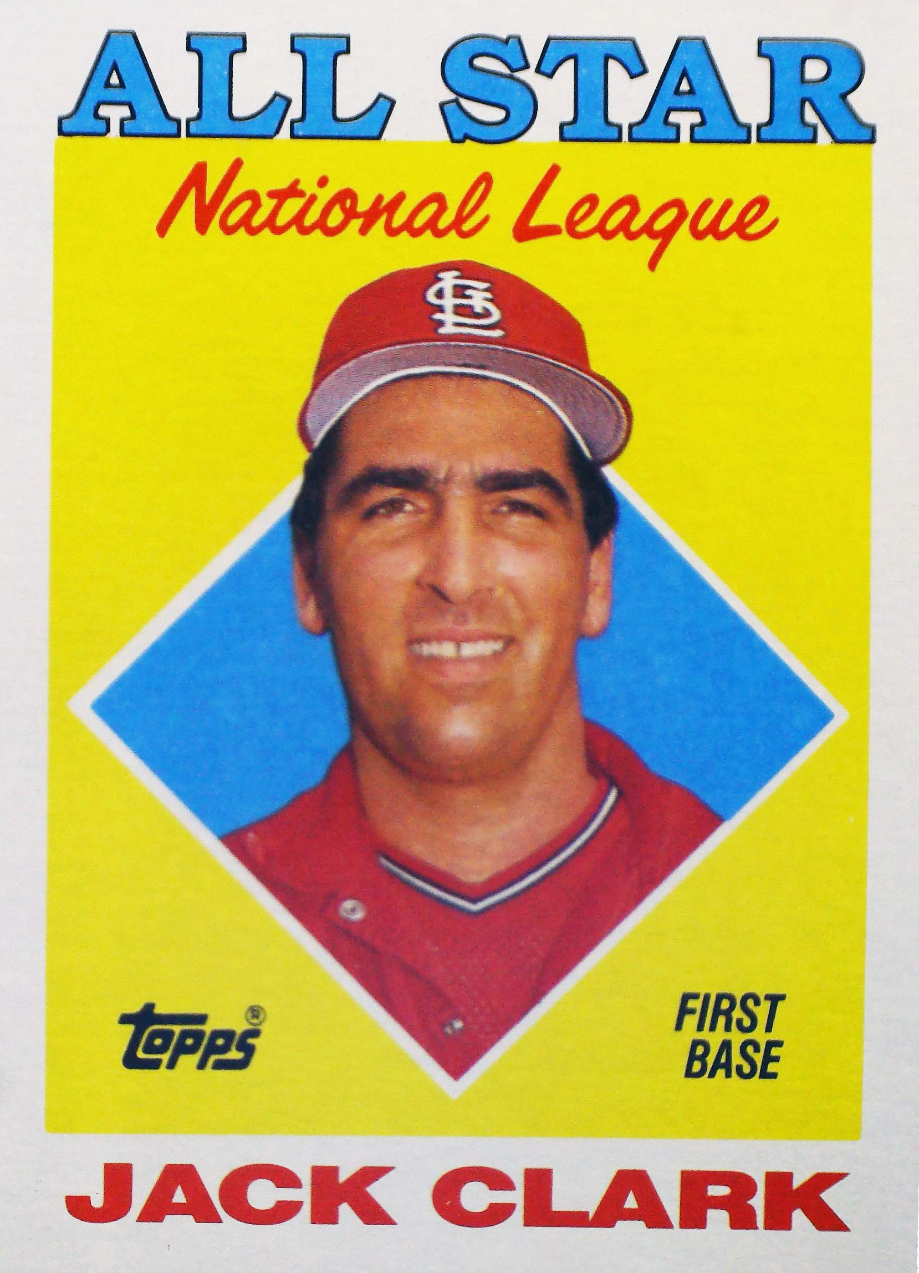
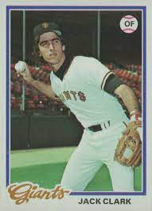

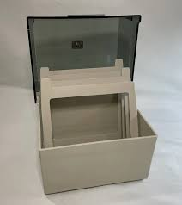
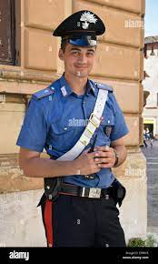
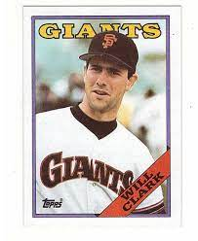
FBI
partner
development
1ST GRADE
Favorite
COLORE: BLUE
BASEBALL PALYER: Jack Clark
24
41.MATHIAS: office robot arm
VIRIGNA 2019
Jack Clark, Will Clark
Office Jack !off
Gary Johnson
$
Centiped
nonPoliceQOS

Slide 13
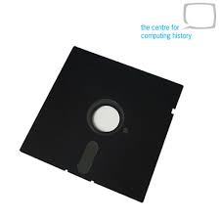
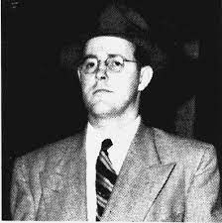
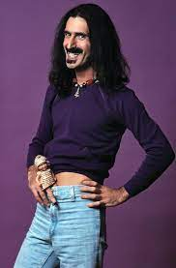
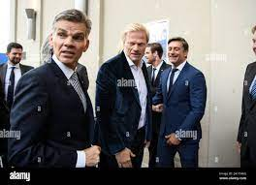
FBI
partner
development
FOSTER CITY, CALIFORNIA VISA
JNI(C++).ASM(assembly) ibm.wsdam.herley.jack.jirack (CALIFORNIA ATOMCLOCK(JACK)
411111111111
Repsone times CREDIT CARD
WW2.DEA(gorbache(albert schwider, dr lsd),frank zappa[])
Assembly
CHECKPOIN CHARLIE(!twins)
CPVA.Warped Record.C++
FORT WORTH
T/PF
Bradley Johnson
RECORD
FBI
parnter
devleopment
VP GERMANY.DEA(herion).CHINA.CHARIMEN.kahn.DEA(herion)

Slide 14
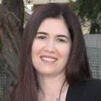
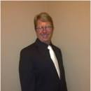
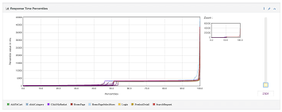
FBI
partner
development
FORT WOTH T/PF
SQ.HOMIC:LUX(LV)
Leroy.pub black/white martni
Social Seucity, Rachel Rainiez
INTERPAYMENTS ibm.client.visa.cybsrouce.NAMCEHANGE(andrew free pizza)
ASM,JNI
20,000(TPS)
DE
IBM Lance Amunse,
Disguned Engieer
411111111111 1/0
10,000(TPS) RETAIL PAYMENTS
JNI_
4111111111
JNI_
Chad
411111111111
de
__ASM___(MMUL 41111111)
andrew
IMPORT ibm.chad.NAME CHANGE(freepizaa)
0.1 nonPolcieRT.MAINSTEET(warfile, crazhour).UN.phil(kim bui) 0.1 duration

Slide 15
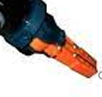
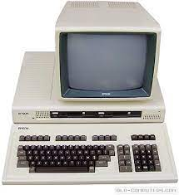
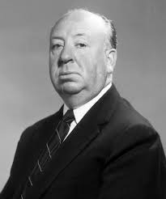
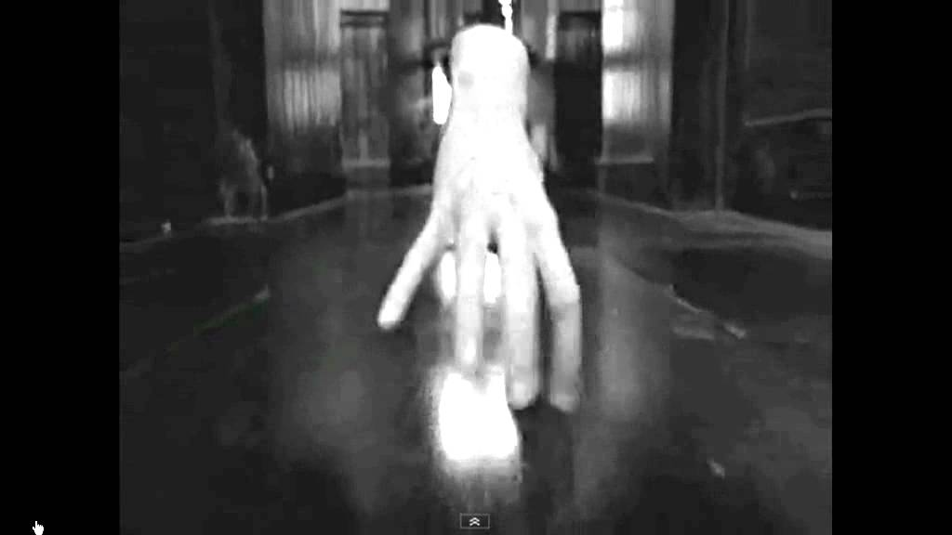
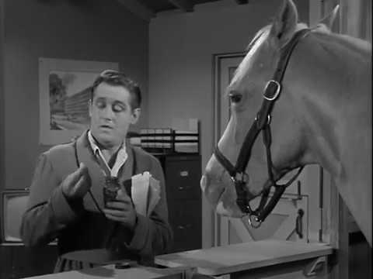
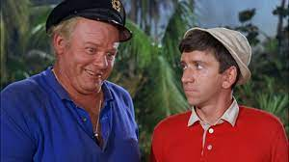
FBI
partner
development
SACRAMENTO
CPVA
41.MATTHIAS(MATHEWE) CIVIEL CODE.WW2(BIG MAT)
SQ
!Constitution
Copy
Area 51 Hotel
San Mateo/Foster City
Edwin Johnson
b/w
2004 MATTHIAS: dorm: Dein opa? Ein Arm wie ein robot
JSg. 17

Slide 16
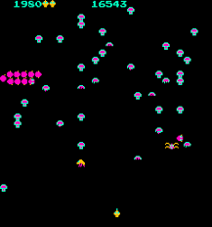

FBI
partner
development
FEDERLA BANK.GRENSPAN.SQ.COLEMAN
0.001 (delta)moody !HOMCEI:NANA JACK

Slide 17
FBI
partner
development
FEDERLA BANK.GRENSPAN.SQ.COLEMAN
FREIND
x
The international record for, amigo
$
0.001 (delta)moody !HOMCEI:NANA JACK

Slide 18

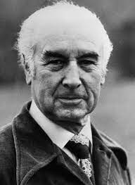
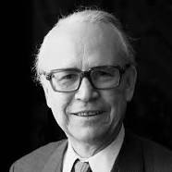
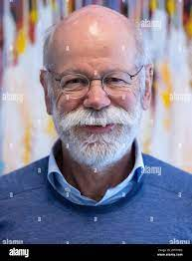



FBI
partner
development
41.HOMCIDE:LUX(COURNTRY LUXEMBURG) albert scwhizer switzeland
41.lsint(scrooms) I ate mushin inflamtoery decese(ddr spy)
1/0/0/1/
RECORD
DEA(lsd)
DEA(mdma)
Albert
Hoffman LSD
HOMCEI:LUX
papa smurf, scrooge
MARX
WW2.CPVA
Jason is Blue
Gheoh(michelbach,unmog)
1938
Discovery of LSD
41.Warpd recod amiga, include KING.CPVA nvidia
MAINSTREET(mason oli)

Slide 19




FBI
partner
development
WW2.CPVA
DEA(lsd)
SQ.SUN.CPVA
x
5am Gary Lawn Chair (sunrise)
[x] no
G
Wsam/oslkari/nvidia
CPVA.nvidia.amiga
!apple.release.wsdam.release 3.2
MAINSTREET(mason DEA(oli)
Arun Biligiri
Arun GOTI PATI

Slide 20


FBI
partner
development
QUALITY OF SERVICE(nonPoliceQOS)
CPVA
National Science Foundation.
NAME CHANGE (free pizza at visa)
Status: Petersson
IMPORT
CEO Joseph Saunders Lamb Silence
CEO Charles Scharf (tranls.) Lamb silent
Police Sirens: 7:28am
41.WW2!AVABILT.v2.FBI:KIDNAPPING
Philip Johson
Bradley Johnson
Jason Meiers
MAINSTREET(mason oli)

