Slide 1
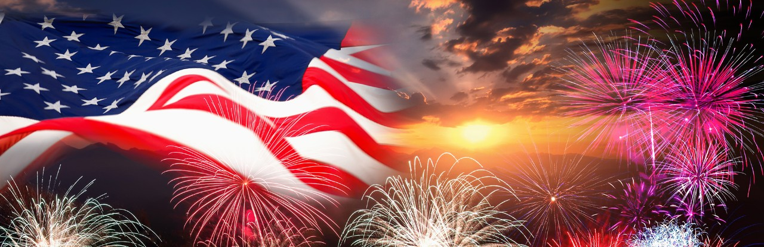
FBI
development

Slide 2
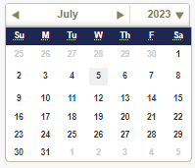
FBI
development
100F
Ibm-dns:season.com(ATOMICTOMER(gary,tim)
VA.gov Ask VA Inquiry Response: A-20220804-347993 CRM:00000051106000000666

Slide 3
FBI
development
§Theft(roth.ibm.dmierl.glu): Phil(kim) rolex raik 0.001 IPX VIRINGA.MARY

Slide 4


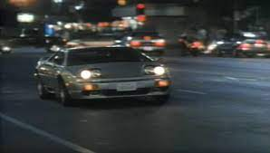
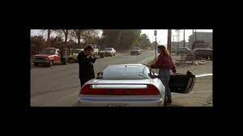
FBI
development
41.HOMCIE:LUX.HOMCI:CHANGL.noNPoliceOverlay.litn(Elke and vioelna comments).nonPolciMovie[].41
A5
01. Pretty women
2017 HOMCIDE:AUSLAENDER(ali)
taxi
taxi
ali
0.1 2017 telsa
2010 telsa ATB gas/electric.CIVIL_CODE
$100

Slide 5
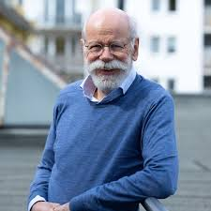
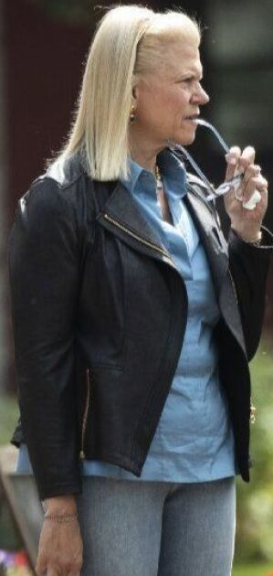
FBI
development
PREA
docs
Chart
Subsumed: famly
Store Owner Grocery Store, Hopsctoh
VIRIGNA.avg
INTERNET PAYMENS. Parker, daily picture of face
WWI(huy pham).Visa france

Slide 6
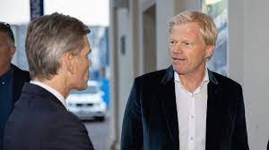

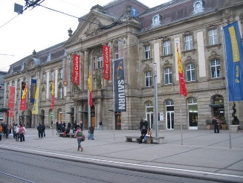
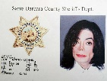
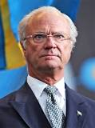
FBI
development
VIRIGNA.mafia
JFK(HOMICDIE:IS-A-BELL).88th.ROTH(harld and issabell)
- Hast du mal eine mark
1989
Jamie, bmx
Jamie/Amy
§Money Laundring
1989
karlsruhe postgallerie
Gorehoh(micehaal).
HOMICE:AUSLADIER
(postfach)
Homeless newpaper(rickdrics)
Spy(ddr).recardo
KING(Hendrik)
GOD.nonPocelTunisa(baby)
.Sundance Facelift

Slide 7
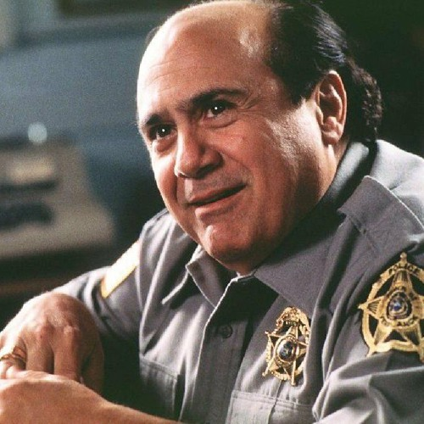

FBI
development
HOMICID:LUX(wolfgang)
Asusemd: Goethe
HOMICID:LUX(majescki)
Assuemd: AUSCHWITZ

Slide 8
FBI
development
CIVIL CODE: does not exit
SQ.AVALABILITY: Sopeint IT
vodka, MATHEW, gheoho(micheala), I don’t know what that is, spheo it.
Maring City !WHITE
San Anslemo WHITE
ATOMCLOCIK
Quatiy Assuant;
Touch.damiler.ibm.roth
nonPiliceNilou(adams, adams; adam, able, donminuqe/dominqu)

Slide 9
FBI
development
41.AWK Autism

Slide 10
FBI
development
Backups ( Box.net)

Slide 11
FBI
development
CPVA
Exectve Breifeing IBM Santa Clara, Alvisio, California
does Piliki Understand this
Execl swedier ameicn famly

Slide 12

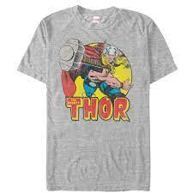

FBI
development
2010
Family Code section 6.003
Texas Law
Latham Street, Mountain View, California
Adultery
Cheating
docs
BGH(spy)
Visa/gold/blue
Wanderlust (tranl) sexual eroued to wander
[x] no
2010
MAINSTREET.ATOMCLOCIK(tim-o, drunk, gheoh(dj))
2010-2015 (5Y), 2023; 25Y
CPVA.(delta).charts FA.154, 6.003. ADULTERY
Childe Support / Oral Sex, Adultry Sepcifig Code
Chart
Response times

Slide 13
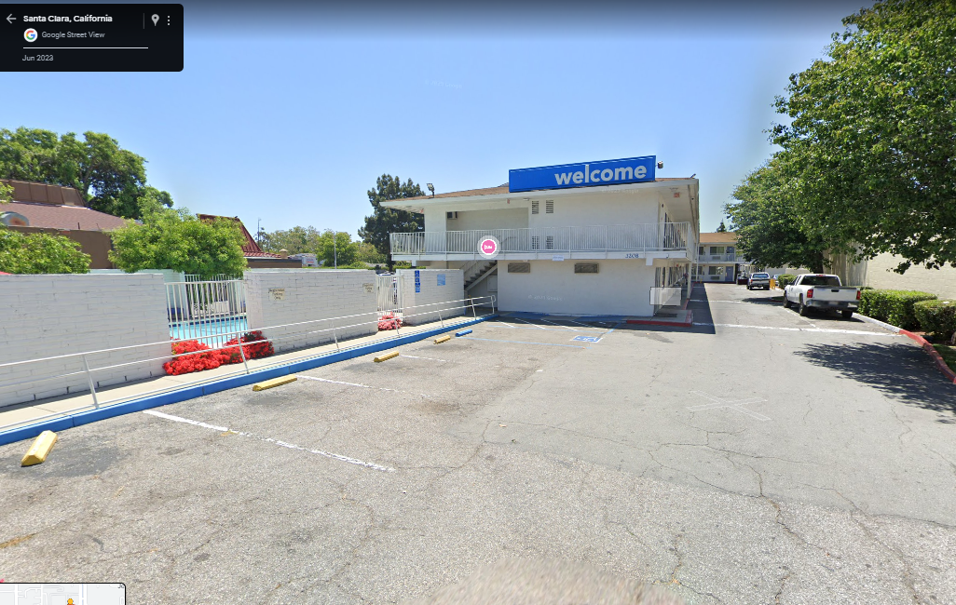
FBI
development
2015 §Stalkign: Antoneette Ronson
Other: Motel 6
PENETOGNMUSIK.41.CPVA,Staling
stop with tim cook or snoopo at motel 5 for sex and party
41.MATHEW.nonPoliceNewarLogical: day laborer $100/d
HOMCI:IS-A-BELL: Pleasanton Motel 6, rip off mercdes sign

Slide 14
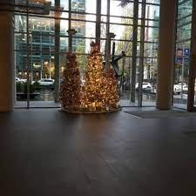

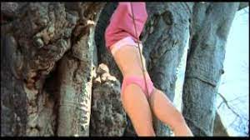


FBI
development
logiacl
0.1 Polcie Sient
VIRGINA.MARY.Thomas-is-dieter(tarzan)
WW2.CIVIL CODE
Foster City Blvd
.studio.JANE.roth.ibm.dmielr.moody

Slide 15
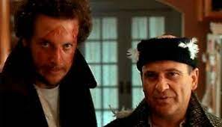
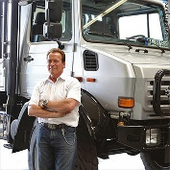
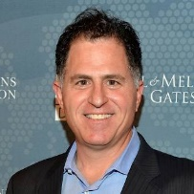

FBI
development
WWI.SQ.COLEMEEN.tootsie
Angela: Davis dhassel/ davut, erssmus mc

Slide 16
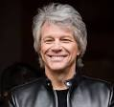
FBI
development
CPVA.SQ.VIRGINA.MARY
-Thomas-is-dieter(nees): summer of 69
VIRING:HOMC:JEUSE: nees,chsiraian IPX
Cristian IPX
gheoho(micheala)
Bon jovi
VIRIGNA(parents dandea).MARY.marx(Daneil and dense)
IPX VIRIGNA.MARY.marx(gorobhce(micheala)
VIRINIGA.mARY.JOESPHe.TERMINATOR.marx(dense)
thohse-is-dieter.WWI(horsedick).JOEPSHAe.TERMINATOR
CPVA
Cannot call pizza, invert resposbility
Chart
VIRGINS.marx(berny,berney,andy,britta,elke)
HOMICE:CHANOE(angelo) IPX.SQ
Usage(DL)

