Slide 1
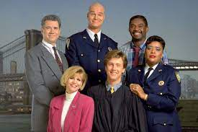



FBI
partner
development
1986/7
x
Yoke_er: treffens sich zwei kommt nur einer
x
1993
PREA.linguist(umdi (slag) around the world)
x
x
LARRY.pole.P.A.L

Slide 2

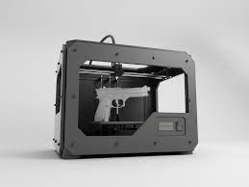
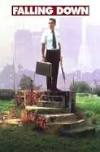
FBI
partner
development
FORT WORTH LIBRARY, MAE, Polci Sirens, Firetruck Sirents, Presentation, Full Person Employee
2018/19
HOMICDIE:IS-A-BELL(falling down) roth.ibm.damiler.*
Tony robbins voice
FBI:WMD for Town
FORT WORTH LIBRARY, MAE
IPX Golf Lessoins Hayward
Ken Rogers, z/OS
Frederik Douglass, Exit
IX
Visa, Ty Lim
VP GERMANY.CHECKPON CHARLIE “POT”
FEDERAL DEFAULT.1D8723
CHART
HOMICDIE:IS-A-BELL
!41.HOMCEI:NANA.lottery
ITNTERUPTS
Adam(s)/ Abale(Able/Cane) apple.touch.greenstamps
HOMICDIE:IS-A-BELL(soviet union)
small recoder;
30y godlen watch
Bertalsman,Aravato: csu, bavarian
Visa: small recoder; mccarthy
Damiler: small recorder; thaosm-is-dieter

Slide 3
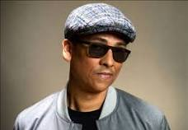
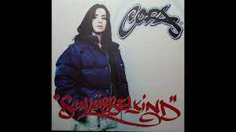

FBI
partner
development

Slide 4
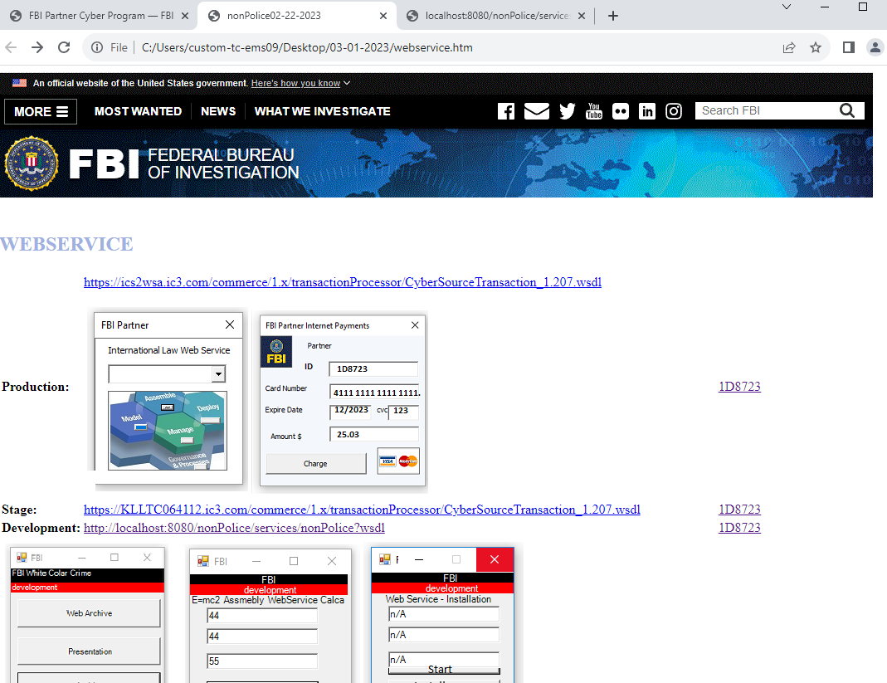
FBI
partner
development

