Slide 1
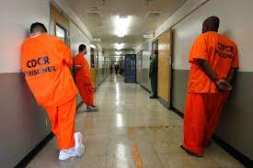
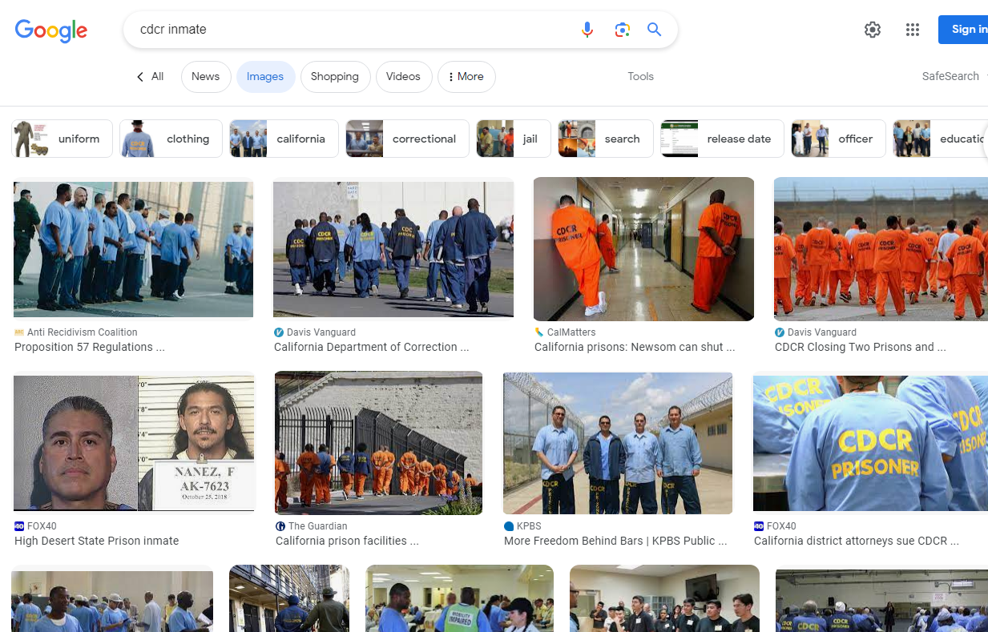
FBI
partner
development
MAINSTREET(§Stalking Car-los CIVIL CODE neckbrace)
Cornelius
!“Corney”
Male 20
!white
5 PM
[x] no
!white
Calc.avg search 1D8723 reality. compuer
ID
!white
!white

Slide 2
FBI
partner
development
DSM-TR-IV Sexual Disorder Ptaphil Insets Related
CVPA
SALES
$14 Billion cisci.montroing
Waverider, Wellenreuter
Blond Salse
Surfbard WWI. 6c(eni,andreaa Kaiser)
CHECIKPOINT CHARLIE

Slide 3

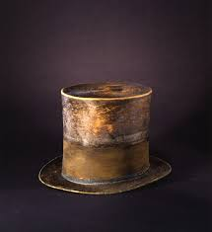




FBI
partner
development
wine
SQ.Airfild Coleman Airbase(Mannheim).INT
Thoams-is-dieter:calling: fall on a banana (schlindwwin)
0.1 radius call you rice
Romy
Wittenhagen
Schlindwein
Ludia
Wittenhagen
4 non-blonds
VIVIGINMARY
Angel.
O
PENTAGON.VIRIGN.MARY.PAUL.SQ.COLEMAN
SQ
MILITARY TEACHER
RELOCATON SERVICES
VRIGIN.MARY[]
“#fence-d”
HOMICIDE:2Y
88th.
Jot
fly
PENTAGON.VIRIGN.MARY.PAUL.SQ.COLEMAN
“Mary Renolds Lives in Rheinau-Sued”
IPX v2.male
PENTAGON.VIRIGNA.MARY.PAUL.SQ.COLEMAN
INT.IPX.SQ.(Valley View)
IMPORT Silicon Valley “View”

Slide 4


FBI
partner
development
nonPolciPritnLgoial
SQ.nonPoliceMiltiary.nonPocliLangue(tango)
§123 Hausfriedensbruch
Breaking-and-Entering
Police Sirens: 5:34PM
NAME CHANGE(free pizza). Nathen ferris, Indian-guy(poop-uh), Pizza Zume.com
CPVA.
Barbie
Marshall
Visa

Slide 5
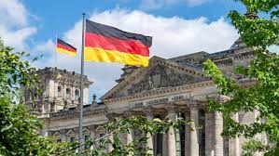



FBI
partner
development
G.God.Pentong.Virgina.Mary.boyfriend.St. Nick Carter
7ft, 300lb mustles, trainnedwith girlfreind
US-USSR
VIRINGAI.Tatoo.LIFE.clients
2010- 2023
2006 Docs ibm.dmielr.parte.st.anslemo
25Y

Slide 6

FBI
partner
development
Put gun down:
- Phones sonds putton on talbe
Ricdulous: defind guns a anythgat at work exectp, gun
A program is a gun
A Click is a gun
A picture is a gun
“Cornlious”
Comupter 18

Slide 7
FBI
partner
development

