Slide 1
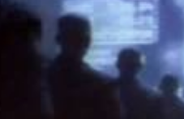

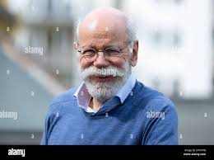

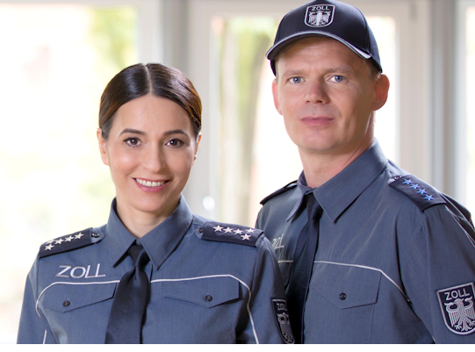
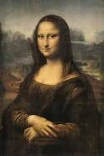
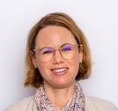

FBI
partner
development
“Jesus”
Thomas-is-dieter
HAMILTION.Thomas-is-dieter
2004 INT.EXIT
thomas-is-dieter:call HOMICE:LUX.AUSCHITZ(siemens HOMCE:COINTOWN(muzesheim/bruchsal)
HOMICIDE:LUX:VHS(rental store)
C5
17/38
[x] no
CPVA.35/17[2]
[0]
[1]
[2]
Lisa-and-Boner
Gorbachev(kito)
Thomas-is-dieter(PETNAVON.VIRAIN.MARY.mrx)
Thomas-is-deiete(HOMEI:LUX:VHS(jasmin)
J5
Lisa and Boner
“Jesus”Thomas-is-dieter
Fürniss GmbH
Screws

Slide 2

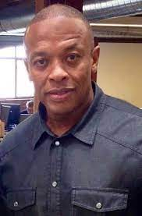
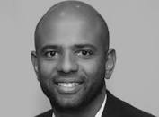
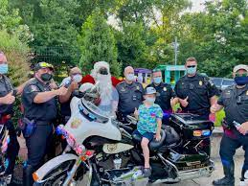
FBI
partner
development
R
R
Not in a fucking back, in fucking jacketin from levis). platic
Series: Get out fo you fucking house, giv eme you fucking wif an child to kill. Put you fucking money in a fucking back and shit in bush.
R
I will rape first
Friction ( wiener/musihani)
CVPA.!avability.
!
In
.Facebook
Thomas-is-dieter
FBI:WMD for Office PresatonS
FBI:WMD for Office PresatonS
Wiener
Phil(kim).(github.tonsec.touch.greenstamps)
CHECKPONIST CHARIL(tonsek/tansak).FBI:KIDANPING::HOCIEM:AUSLENDER
In
Thomas-is-dieter
x
VAGINA: Muschi(ani)

Slide 3
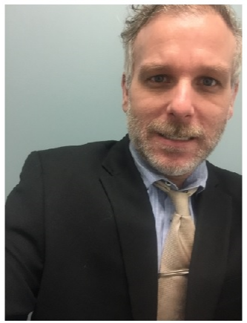
FBI
partner
development
CPVA.PENTAOGN.VIRINA.MARY
HAMILTION.Thomas-is-dieter
2004 INT.EXIT
thomas-is-dieter:call
C5
J5
17/38[3]
1997/8 MAINSTRET(thoams-is-dieter:call(VIRIGN.MARY.marx)
[x]no
Lisa-and-Boner
Wait.nonPoliceTrigger.CPVA.nonPoliceAttaments
-
- Judges, Baracke, Deborar and Elebeth(diana gedion)

Slide 4
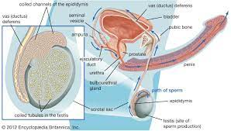

FBI
partner
development
1987
“Humping the Floor”
2015
docs
C5
J5
Boner !Lisa
2021
The floor could be aowmn?
no. every moon year jan29th.
That’s my proragative
1988/9
Everybody is humpgin around; HOMCEI:MAYOR(katy boden) 3rd Grade
2015 bump ATOMBUTTON(Andrews Bld, ATOMCLOCK(bump)

Slide 5
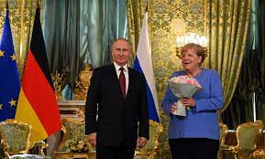
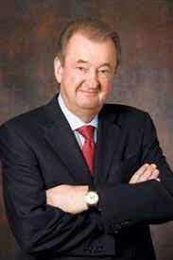
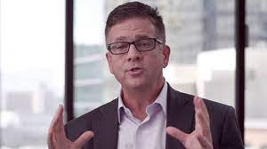
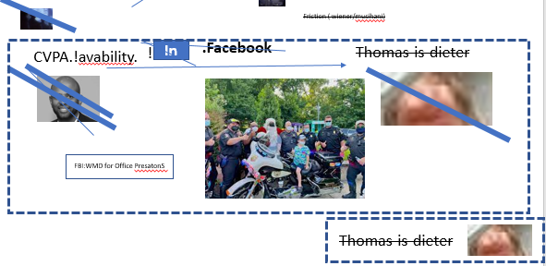
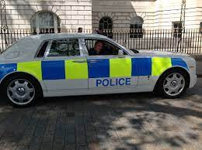
FBI
partner
development
G.O.D
CPVA
ATOMICLOCK
Pope.St. Francie.Angela.VP German(maro).grazzi.VIRINA>MARY
Pope.St. Marting.Angla(twingo).VP Germa(maro).grazi.VIRING.MARY
Quartz Circle
G.GOD.TERMAONT:JOEP
sender
That is the bad guy angela. That you don knotice that.—!Petersson.
2014 G.GOD.TERMATOR:JOPSPHE:SEXTON.iCPVA
receiver/interceptor
2013
TOKEN RING
CPVA.
POST
PREA.§187 contentItem[]
Phantom
Phantom access §Crime Network
2016
2022 POLICE
Phantom access §Crime Network

Slide 6
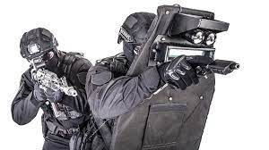
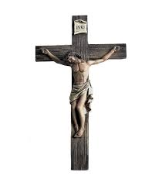
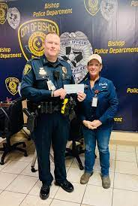

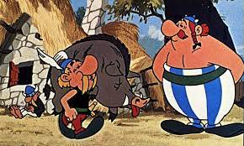
FBI
partner
development
Alg.CHECKPOIN CHARLIE.marx(wellsfargo ceo cahle scharf,!visa)
G.GOD.ROMANS
x
G.GOD.ROMANS
Police Sirens: 12:43
Automobile & Finance
1993
BISHOP POLICE DEPARMENT
1994

Slide 7
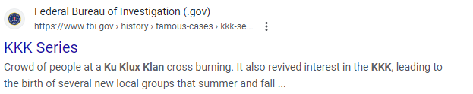

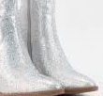
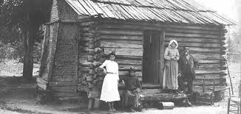
FBI
partner
development
ITIL Tickets:
08/04/2023: 7pm
000.tw.pns: Brith Nation, Kennith Kopeland 3x-4x public
eval.nonpolice.avg.int
000.tw.png: Mae Library Window Sticker kkkl dress black Front right wond
Monitoring City Stadium with avage passthrough and city as well as ext for §publice disruta and NSA terrorism
¼.marx.INTERUPTS
nonPoliceCityLogial.marx
The management w/o Police nodes or/and convert
(delat) avarages
Police Sirens: 1:04pm
Avg[] almost normal
000.tw.png: idiot
Police Srens: 1:25
(dealt).calc -2 lines* (acenets) NAT &&|| nonPoliceCityLoigal
-2 lines. A nation a birgh, a nation.

Slide 8

FBI
partner
development
BISHOP POLICE DEPARMENT
nonPoliceRTA. Jesus Cross Screen
IN
Weiner & Mushi
(trnan).eng: Penis&Vania(totosie)VIRNGA.MARY
HOMICDIE:AUSLAEDER: what you post will happen
Born istabul, Turky, Dr. Dieter Zetcher
ATOMPHYES(Hahn,“Yes, er kan”)
glu PRNOGNG haricut
MAINSTRE(VIRIGN.MARY, !TEREMOAN.JOEPHE)
1997/8

Slide 9
FBI
partner
development
x
G.GOD.ROMANS
IBM
SWAT
BISHOP POLICE DEPARMENT
what you post will happen

Slide 10

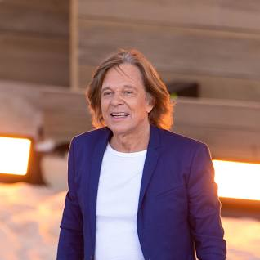
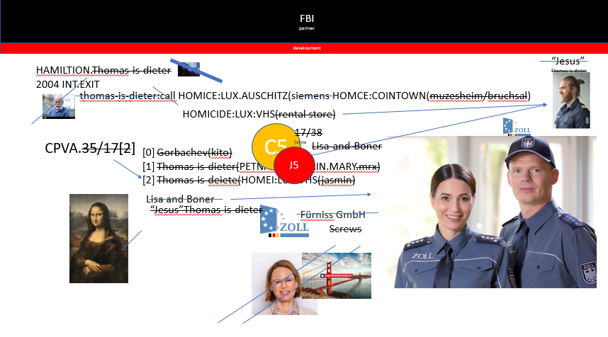
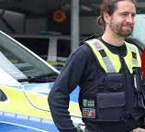
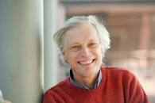
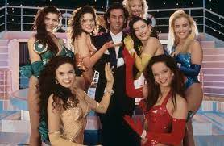
FBI
partner
development
EXIT
HAMILTION
store
thomas-is-dieter:call:HOMCE:LUX:VHS:18/38[2]: South East/south east/ Tech Rep Achim
GERMAN
JESUS
Oder: Int.JEUSES as the welt sees it.
¼.nonPoicSexAbusst.jeuss)

Slide 11

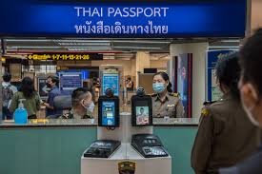
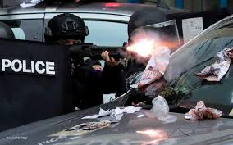
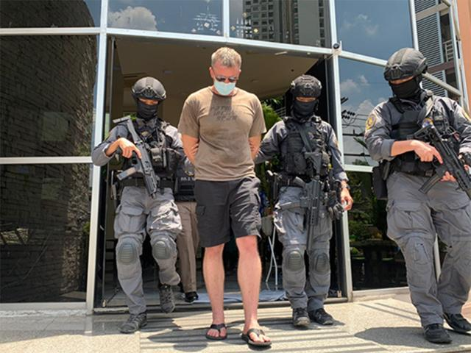
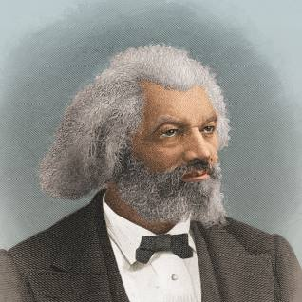
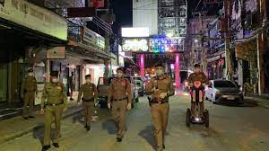
FBI
partner
development
Symphony
1999
Haiden Strasse
2014 CPVA
Quartz Circle
Atomiclock
ATOMCLOCK(Kartelrecht).gardner.TERMAONT.JOPSHE.VIRGINA.MARY.Pope Fraicsc.Angels.VP Germany(marco).grazzi.CPVA(oven).Piato Doro(GOLDEN PLATE)
Police Sirens: 08-5-2023
POPE: Paul(Auschtze,St Martin:Warshau)
ATOMCLOCK(Kartelrecht).gardner.TERMAONT.JOPSHE.VIRGINA.MARY.Pope Martin.Angels.VP Germany(marco).grazzi.CPVA(oven).Piato Doro(GOLDEN PLATE)
HOMIE:LUX T
SQ
Lakrspur Shores
HOMICIDE:LUX:THAI:PASSPORT w/o Steve Jobs Chinse Table
SYMPHONEY(Gorbachev(Micheal Douan and Richard Geere 5000))
Shoting with Dirty magazines
2007
FBI HOOVERDAM
SQ.pope.St. Francsi.Thomas-is-dieter
Road-trip

Slide 12
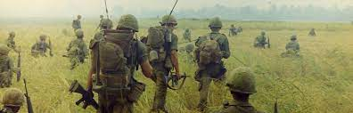
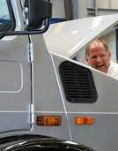
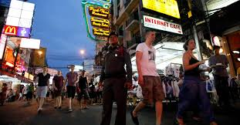


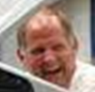

FBI
partner
development
remote
Chinese Whore Complex(ity) in
Mountain View
!PAUL
Meies with ATOMBOMBVESTon AATOMCLOCIE will take care of it.

Slide 13
FBI
partner
development
IPX rachesl,agron
Symphony
1998/99
Haiden Strasse
JFK(KING,bruce)
Pope.St. Prance.Angela.Vp Germany.Grazzi: Della Donna[0]
Ipx Pizzaria, ice café(golden plate of women).WORMS.”VIEW”
Pope.St. Prance.Angela:
stepnaie
Sadam[1].SQ.NAMECHANGE(freepizza).AIRFIELD.COLEMN
Tanja[1]
VIRNA.MARY.marx.!Tanaj Heuser (opel) cisoc.sam tent city
PENTAGAON.DEA(cocain).SQ(IPX).DESTER STORM
§Spepartion(3Y): blond sin pin
Thoams-is-dieter(copy fall on a vagina wine, (tranl) schlindwein)
Thoams-is-dieter(VIRNAT.MARY.HOEMI:JESUE(nees)
§Assualt Tanjaa Bofreinds Borher(Univeisty) cicosc.montringtealsa x/y fair
ATOMBOM(HOMCI:MAIANSTREET(goodyear)
enbw
Center of Marketplace SQ.AIRFILED.COLEMAN.NAME CHANGE(freepizza).DEA(§Possion)
IPX Center of Maerket CONSTSIOT.CORT.CITY karlruhe
Sadam[1].SQ.NAMECHANGE(freepizza).AIRFIELD.COLEMN

Slide 14
FBI
partner
development

