Slide 1
FBI
partner
development
Sleepign outside

Slide 2

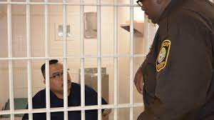
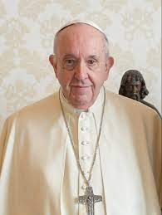
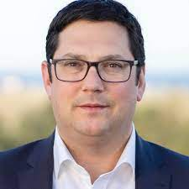

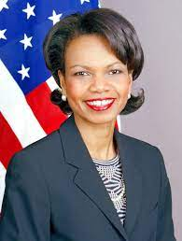



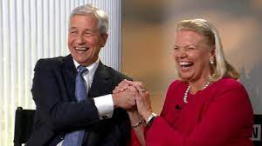

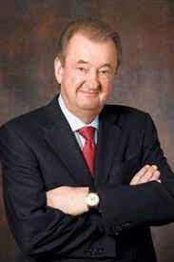
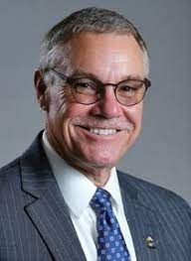

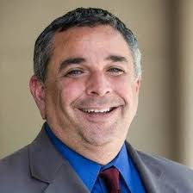

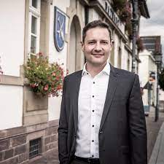
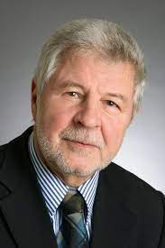
FBI
partner
development
Development
outsdiee
INT.IPX.HOMICIDE:MAYOR
Dr. Dr. Prof. St. Peter Joe Fisahn
LEVEL:v2.FBI:KIDNANAPT(paul,Russia,!paul.sr)
LIVE
Murder on
In Room
Pope
St. Peter
LEVEL: CPVA.PREA, !§187
VIRINGIA.”!BLOND”
88th crush
Scham,shamlippen
Infant vanain lips
x/y stoage crush
child
Visa
mopay
0.1 Jeff Wiener go doen in hisotyr mopen Christmas
!IN
MAINSTEYR(!HOCMI:MAOR)
30Y:HOMCEI:MAYOR.IPX
Google/janstrasse)
Call you Dr Rice
PENTAGON.STUDEN.JOEL.!WW2.”BLOND”
Katie Boden
Arian Johns
CHECKP CHARLIE(IPX).1D8723.PASSTRU
<<deceased>>
“Peng” Visa Employee
St.Micheal:JFK(Einstein/Gynsisk,kaput; gorb(dr;!prof))
FBI:WMD for School Shoerter
JFK(Gynasium St. Gabiel) x//y docs
FBI:WMD:GREEN:DUBIN
Police Sirense:5:04PM

Slide 3

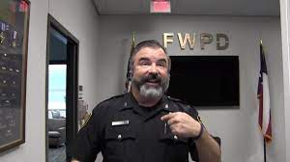


FBI
partner
development
Development
outsdiee
1990/1 WEEKEND
ATOMICLOCK
HUDSON
1991
PENTGON.VIRIGN.MARY.FRIDAY
Friday
Saturday
Sunday
8am Breakfast
Dec
Jan
Feb
2:00- 5:00PM Nintendo(Hudson)
5pm-8pm “Church”
J-10
1990
8:00PM Simpson
9:00PM In Living Colar
Friday
Saturday
Sunday
2nd-Weekend
Santa Clara Blvd
8am Breakfast
Sep Oct Nov
Marlin Ave
1990
Sunday
2nd-Weekend
Santa Clara Blvd
Friday
Saturday
8am Breakfast
Jun July Aug

Slide 4



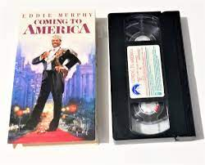
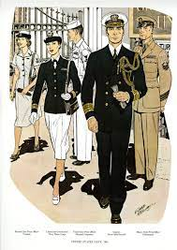
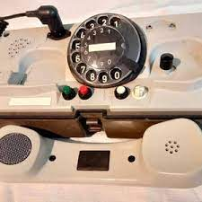



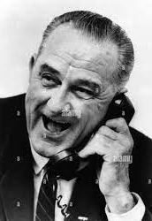

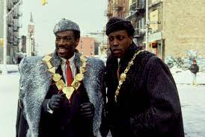

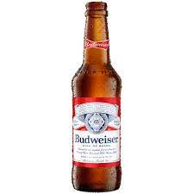


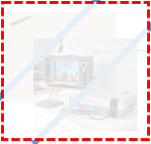
FBI
partner
development
Development
outsdiee
HUDSON
!SUMMER
1-800-USA-NAVY
Attena
VIRING.MARY.pizza.oven
CHEKCPIN CHALEI)JFK(francise)).!LARRY
IPX
VIRIGNA.MARY
Stanford.CPVA.Town house docs
“JACK OFF”
Auschwitz
Police Sirens: 5:33PM

Slide 5
FBI
partner
development
Development
outsdiee
HUDSON
!SUMMER
1-800-USA-NAVY
Attena
VIRING.MARY.pizza.oven
CHEKCPIN CHALEI)JFK(francise)).!LARRY
IPX
VIRIGNA.MARY
Stanford.CPVA.Town house docs
“JACK OFF”
Auschwitz
Police Sirens: 5:33PM

Slide 6
FBI
partner
development
Development
outsdiee
1990/1 WEEKEND
ATOMICLOCK
HUDSON
1991
PENTGON.VIRIGN.MARY.FRIDAY
Friday
Saturday
Sunday
8am Breakfast
Dec
Jan
Feb
2:00- 5:00PM Nintendo(Hudson)
5pm-8pm “Church”
J-10
1990
8:00PM Simpson
9:00PM In Living Colar
Friday
Saturday
Sunday
2nd-Weekend
Santa Clara Blvd
8am Breakfast
Sep Oct Nov
Marlin Ave
1990
Sunday
2nd-Weekend
Santa Clara Blvd
Friday
Saturday
8am Breakfast
Jun July Aug

