Slide 1
FBI
Partner
development
Sleepogn outside
v2.FBI:TERRORISM
ATOMICLOCK.Gov Schwegger.v2.FBI:KIDNAPPING
CIVIL CODE(SOLD)
LABOR CODE(office space).CIVIL CODE
FBI:HOMICIDE:DOG:G.GOD.HOOVER
INT.CIVIL CODE
FBI:TERRORISM
Police Sirenes: 8:47AM
$180/hr 2007 45 Minutes

Slide 2

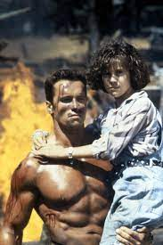
FBI
Partner
development
v2.FBI:TERRORISM
Sleepogn outside
v2.
HOMICIDE
HOMICIDE:LUX.marx(jasmin)
“Hoover”
v2.nonPoliceTRX
HOMICIDE:DOG
G.GOD
2017 HOMICIDE:ur_ur_opi
ATOMICCLOCK
ATOMICBOMB
MasterCard Olympics

Slide 3





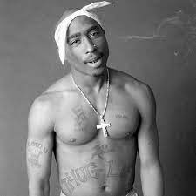
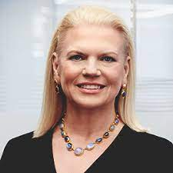
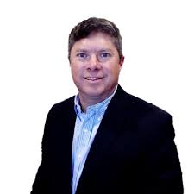
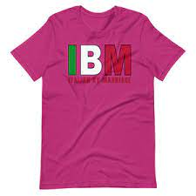
FBI
Partner
development
Sleepogn outside
v2.FBI:KIDNAPPING
CPVA.PREA.§187
TOGAF:CERFIED:ENTERPISE ACHEITEC:TARGET
!PMP:CERTIFIDED:VIRIGN:MARY:STANFORD
WEBSPHERE:CERFIED
Workday, Human Resouce
Apple.Tango, China
UeberEast, India
!apple.phil(kim).180lbs
LITTLE
MATHEW
Metin Telle, Erico Chellmie
!Pope.Cologn.
!
!Pope.Monestary.St. Anselm.marx
FEDEAL GERMANY
CALIFONRIA STATE
Enterprise 0.1 !41.ELKE.step:HOMICIDE:PETER
Governour.Joepshe.Viringa.Mary
v2.FBI:TERRORISM
ATOMICCLOCK
G.GOD
HUSTLER
Joseph

Slide 4
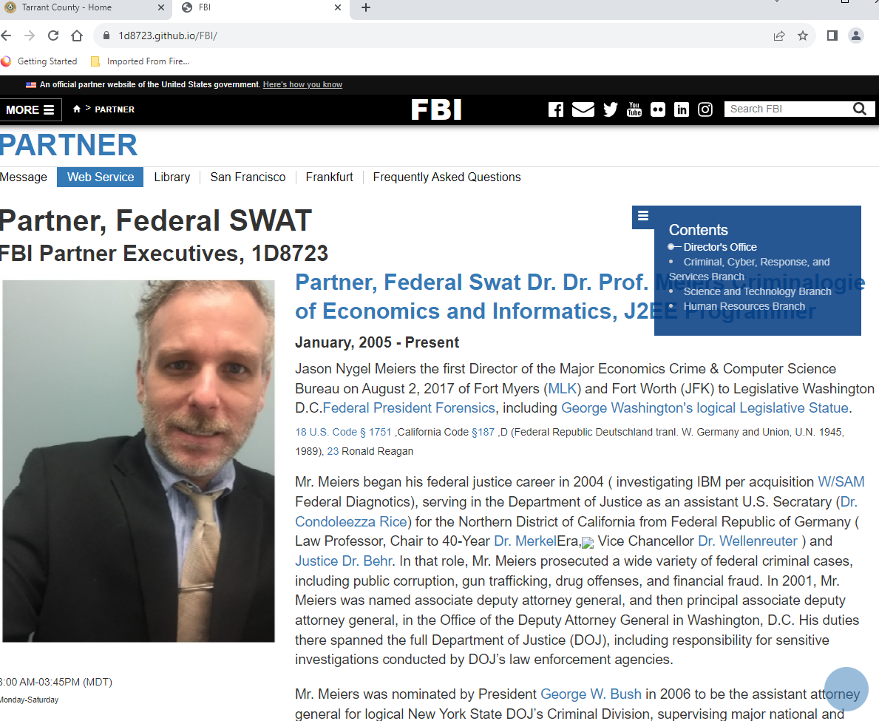
FBI
Partner
development
Sleepogn outside
“Big Decission”.etal

Slide 5
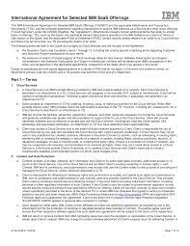
FBI
Partner
development
Sleepogn outside
!BSc. CPVA.PREA.§187.PENTAGON.VIRGINA.MARY
“Jeff”.YANKEE
Subsumed: family
IBM Sold
Roth.ibm.dmailer.pwc
Roth.ibmd.amiler.accenture
Roth.ibmeil.damil.igs

Slide 6

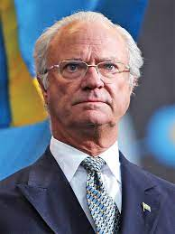
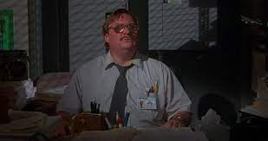
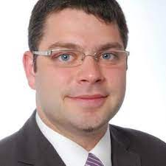
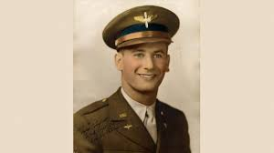


FBI
Partner
development
Sleepogn outside
CIVIL CODE(human resource workday )

Slide 7

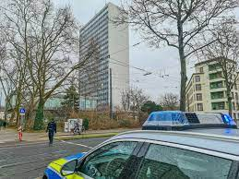
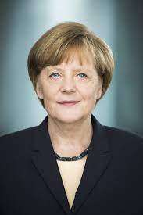
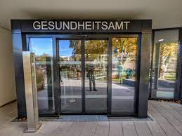
FBI
Partner
development
Sleepogn outside
!HOMICIDE:AUSLAENDER
A.I.D.S
Aydan Özoğuz

Slide 8
FBI
Partner
development
Sleepogn outside
0.001 0.0001
NAME CHANGE(free pizza).G.GOD 2000/1
Two birds will come salmon, likely osama bin laden.
Paegan: a person who does not acknowledge your God. gentile infidel
re·pent feel or express sincere regret or remorse about one's wrongdoing or sin.
!jew
Gospel: the story of Jesus Christ's birth, death, and resurrection
Sabbath:

Slide 9
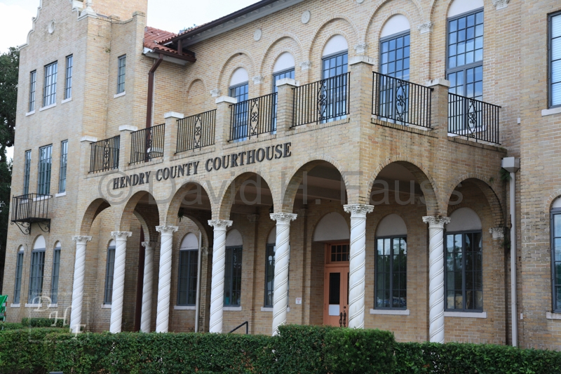
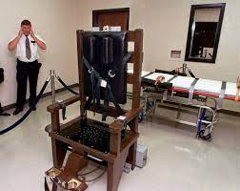
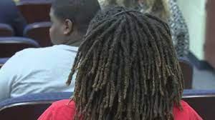
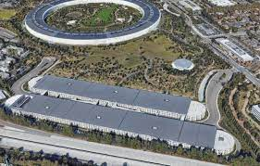
FBI
Partner
development
Sleepogn outside
2019
2023
Otis;HOMCEP:DOG
G.GOD.HOOVER.marx(bob lee; ibm.damiler.r
2023 Summer
High at park
Phil(kim)mastercard.”park”.legal
2010 !HOMICIDE:BILL
2023 000.tw.pns.!HOMICE:LBILL.CHRUCH

Slide 10

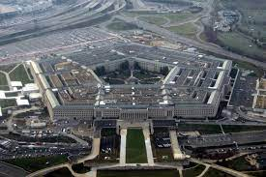
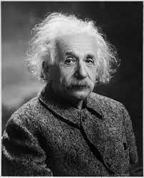

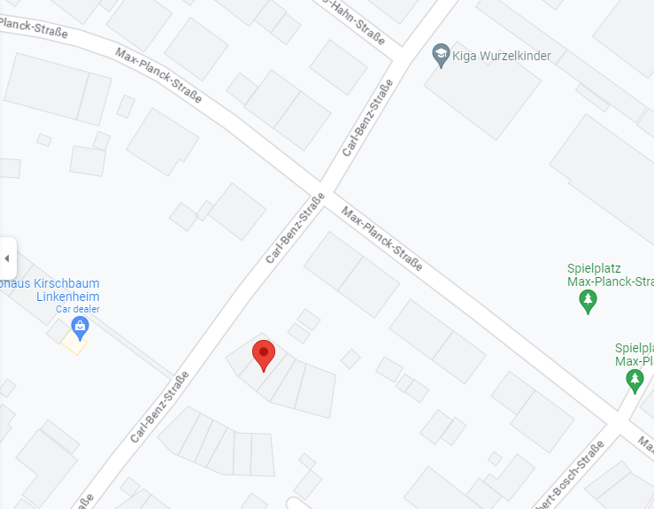



FBI
Partner
development
Sleepogn outside
PENTAGON.VIRGINA.MARY
!HOMICDIE:PETER
“Friction” aka “Fucking”
ATOMICBOMB(playgournd, HOMICIDE:NANA HAHN)
ATOMBOMB(max-plank)
G.God.INT.US
Chart
Fucked
“Playgorund”
25Y
VIIGN MARY:!HOMCEI:JEUSES
Popping the Cherry; Kirsche
Fucking the cherry
Fucking
Fucking as much fucked as fuck the cherry to fuck the cherry fo God
…

Slide 11
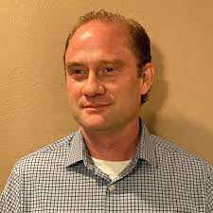
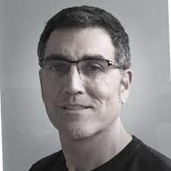


FBI
Partner
development
Sleepogn outside
G.GOD.ubahid
JFK
JFK(Seatle, Waschinton Mutuaal, Amatango; LEE)
!JOEB
LEVEL: NAME CHANGE(wfh free pizza)
Police Sirens: 9:08AM

Slide 12

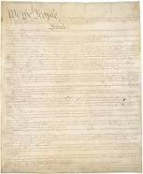
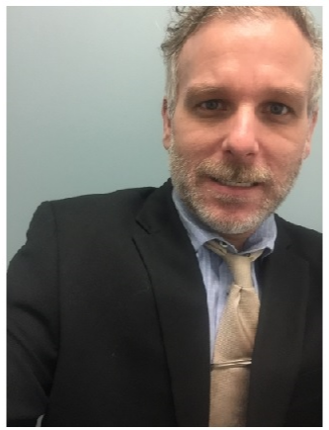
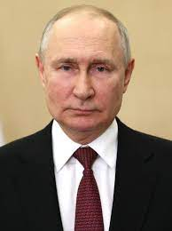
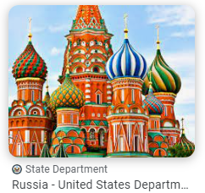
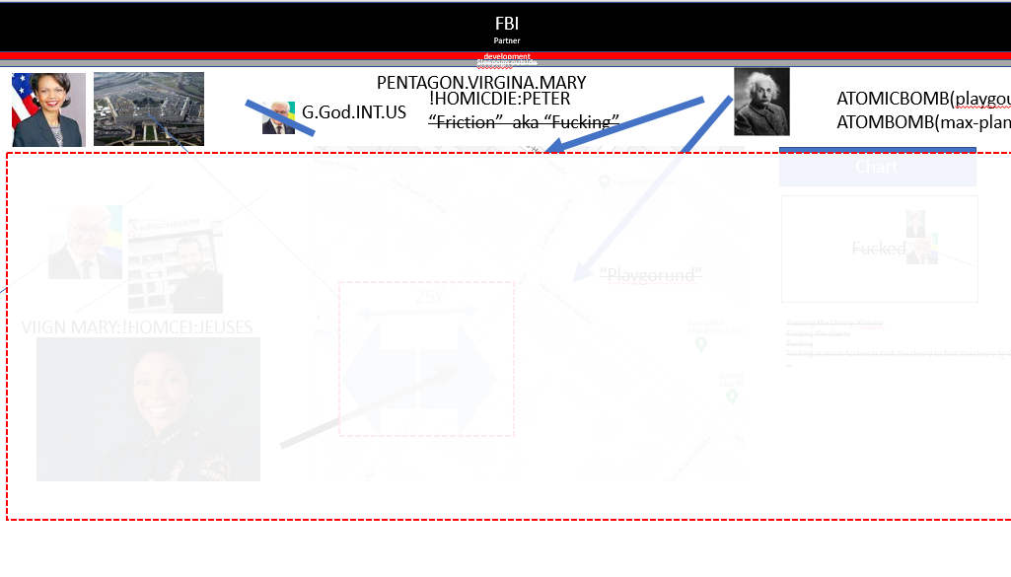
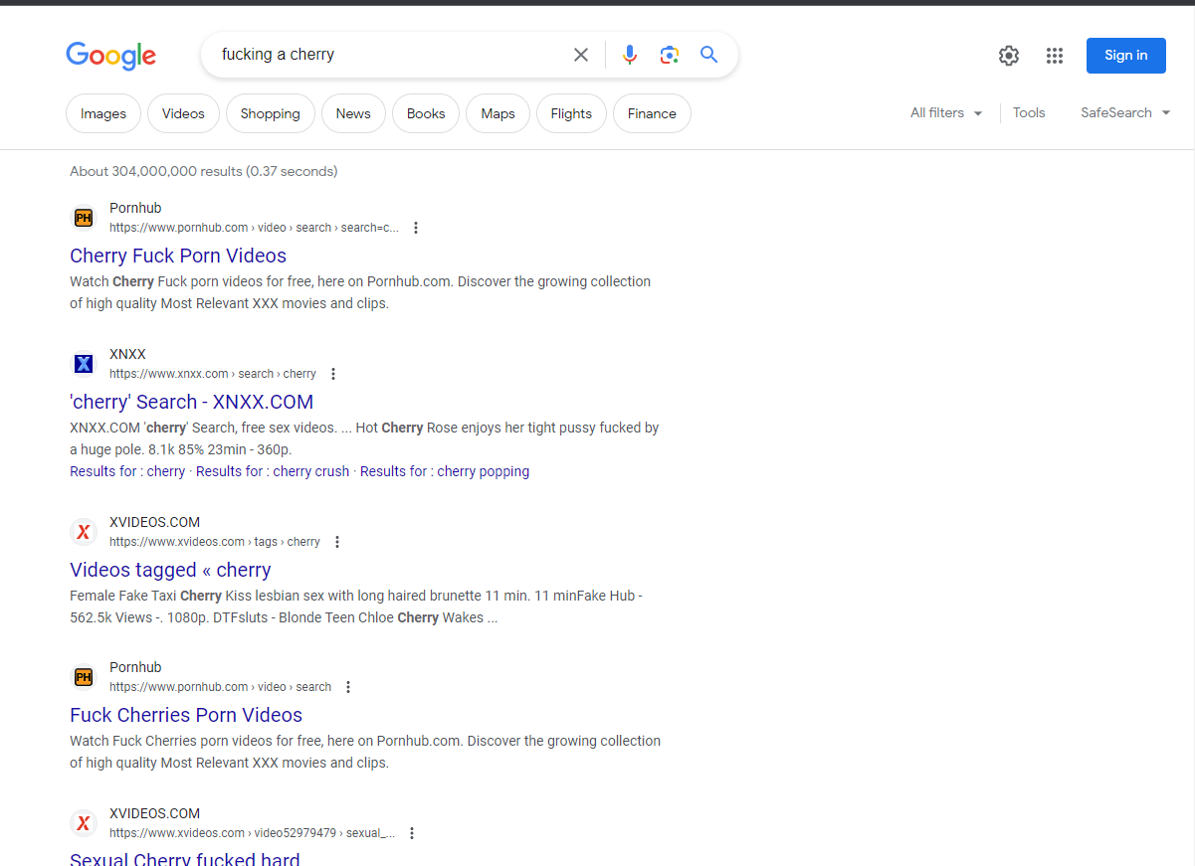
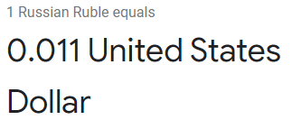

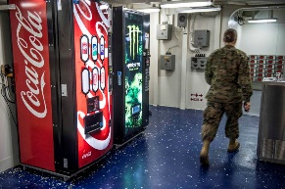
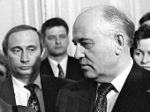
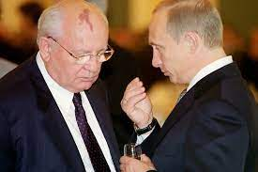
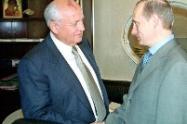
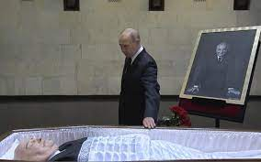
FBI
Partner
development
Sleepogn outside
Dr. Dr. Prof. St.
!PETERSSON
NAME CHANGE(free pizza)
PAULSSOUN
PETERSSON AND PAULSSON
5 Minutes
1980
1990
2000
2022
President Vladimir V. Putin calls the end of the Soviet Union a “genuine tragedy” for Russia, and he blamed Mikhail S. Gorbachev for bending to the
demands of a treacherous and duplicitous West.
Federal Republic W. Germany
WAR IN YUGSLAVEIA
Afganistan WAR
…
Chart
Peter
nonPoliceTRX(dell.agg)
Peter and Paul Grobahcei(mika,!C5)
Paul, Paul Sr. FATHER, GRANDFATHER
CPVA.HOMICIDE:ur_ur_opi.!WAR.soviet.prison
v2.FBI:KIDNAPPING
dell

Slide 13
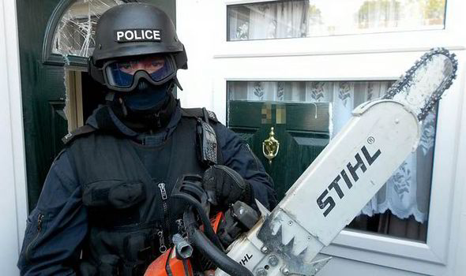
FBI
Partner
development
Sleepogn outside
“!Jason”
Friday, 13, 2023

Slide 14
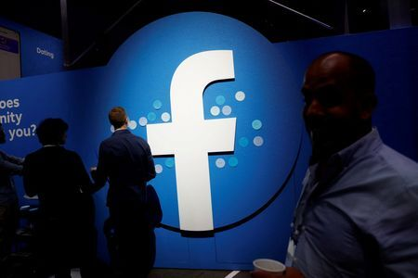
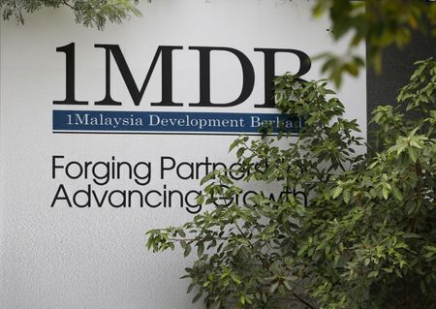
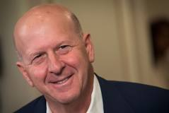
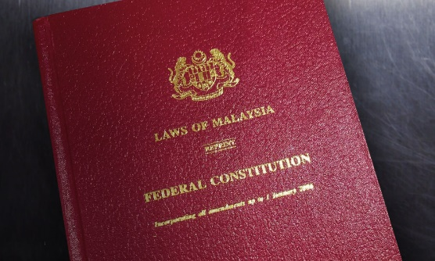
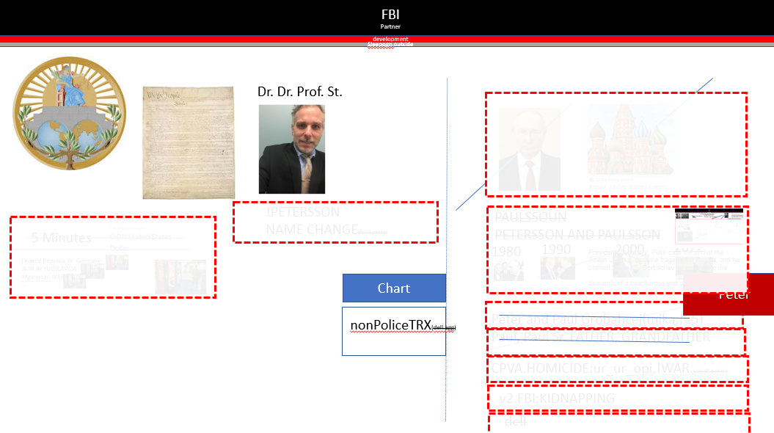
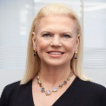

FBI
Partner
development
Sleepogn outside
0.01 WestLaw
Facebook faces possible Thai legal action over alleged advertising scams
0.CPVA.nonPolice Email
new york times editor business: ellen.Pollock@nytime.com
(1Y) Chart
MLK(tiovli_fraome: gentate_movie)
HOMICE:KYSTAL: sax
HOMICEIDE:IS-A-BELL(soviet union)
Malaysia may sue Goldman Sachs over 1MDB scandal - PM Anwar
MALAYSIA
Business Law
MLK(tiovli_fraome: gentate_movie)
[]
0.CPVA.nonPolice Email
new york times editor business: ellen.Pollock@nytime.com
SQ.VIRIGNA: ibm Artlce , Cloud Computing, tech wwork publising
Monitoring,
CPVA.”Finance”.NOC
$25,000
!G.God.Larry.PREA.!avg

Slide 15
FBI
Partner
development
Sleepogn outside
Police Sirce: 10:22AM

