Slide 1
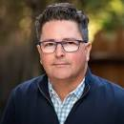
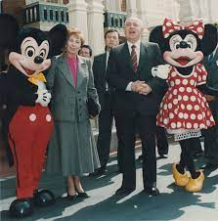
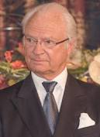
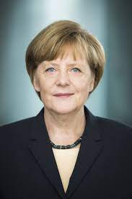
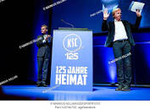
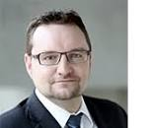
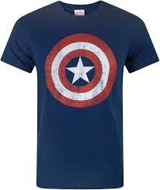



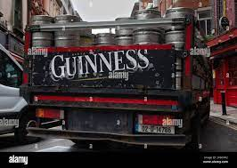
FBI partner
Develpometn
Del;ping outside
HOMICIDE:2Y
Birthday Party(Minni)
Blackhawk.Call you rice?
nonPoliceStadium.nonPoliceCfgLogial
FBI:WMD for
!raik.wife
Disneyland
J5
Kit:St. Francis.Sectary
E
sr
CVPA.”Daily Miriles; Miricle Mile”
Ludwig, Eric
V2.FBI:KIDNAPPING
FBI:WMD:
Santa Cruz Court
DEA(herion)
FBI:WMD for
Seattle
2015
VISA
JOEB
France
!AGAIN. 2017
Andrews Blvd, Pleasanton
FBI:WMD:SQ:WARD
ATOMBOMB BUTTON
E

Slide 2

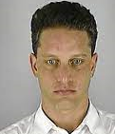

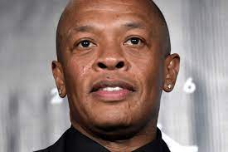

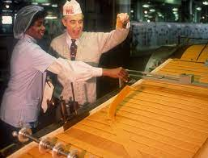
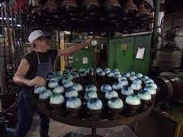
FBI partner
Develpometn
Del;ping outside
nonPoliceStadium
.nonPoliceCfgLogial
black
KOCHEMANN
!in
..
nonPoliceStadium
Roger
?
kit
2024/5 2:00PM reboot, data los 000.UN.ext.000.tw.pns

Slide 3
FBI partner
Develpometn
Del;ping outside
EVIDENCE
Chart
SWAT
Collection
CPVA
Lingusitcs:
Baby Vagina
INTERUPTS
German Hardcore Pornography
2024/5 2:00PM reboot, data los 000.UN.ext.000.tw.pns

Slide 4

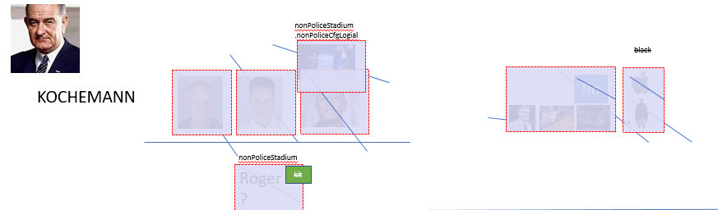


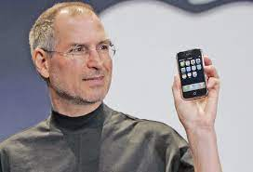
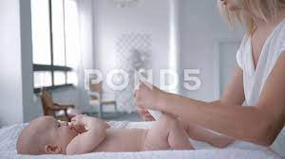

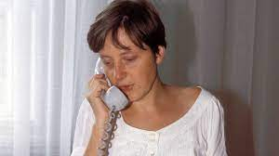
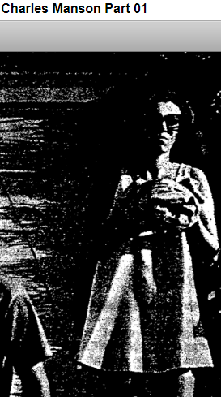

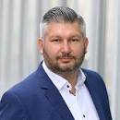

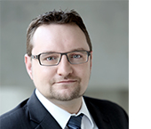
FBI partner
Develpometn
Del;ping outside
SQ.MUGSHOT:ATOMCLOICK(tim cook)
bulimia
HOSPTIAL
ATOMICBOMBUTTON
Cypress
Andrews Blvd
2023
Chruch attenana Bra 0c/0c; beathe saito)
KING
2017
Meet my mother, Grobhco(dell.uhse.beathe)
WEAPONS
ATOMICCLOCK
2011
CPVA.roth.ibm.damiler.apple.accnteru.touch
2000
Gorbhce(dell.client.ushe; beathe saito)
WAR
2000
CHECKPON CAHERLI(store,PENTAGON.BASE.PAUL.DEA(cocain,stefan)
1995
1995
VIRGINA.MARY.freind
1992 Egemon
GAS
Dietzenbach:HOMCIDE:AUSLEDER[]Logical
VIRGINA.ibm
FBI:WMD for Disneyland
ATOMICLOCK(FBI:WMD for California)
btn
1992/2005 IBM Omegamon XE/zOS
Candle Corp/ sin.Yolanda/MAINSTET(HOMC:IS-ABELL)merkel)
btn
ATOMICCLOCK(KOCHEMAN)
btn
Police Sirens: 2:44PM
sr
Polci Sirense: 3:03PM

Slide 5

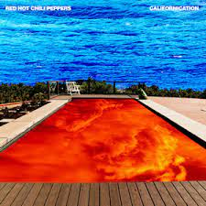
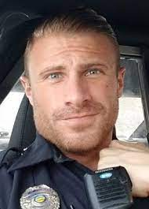
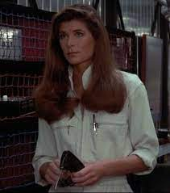
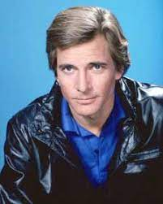

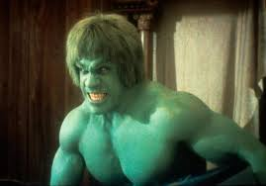

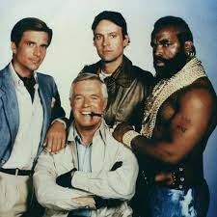
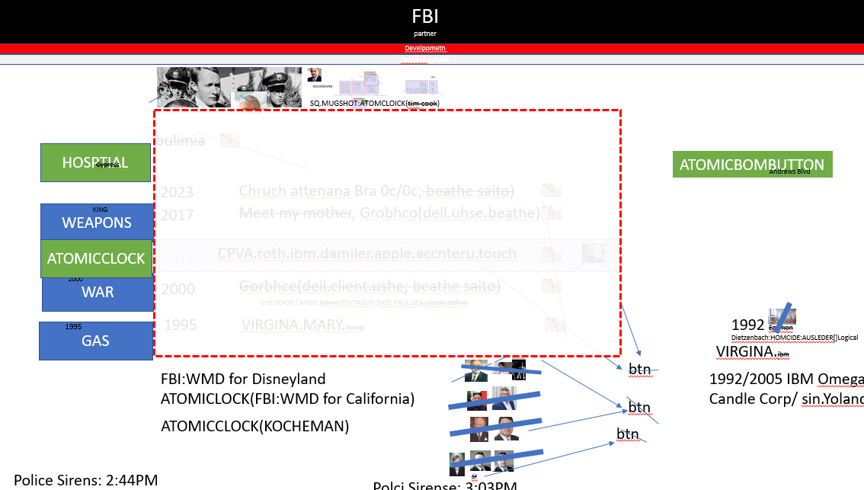
FBI partner
Develpometn
Del;ping outside
You can never live, its raining
FBI:WMD for Gorbachev(“J”)
J5
VIRGINA.MARY
nonPoliceFamousCfgLogical
Anagla.HARVARD.
Stefans Girlfrend; Yang Tennis IPX.SQ
!AVABILITY.CHECKPOINT CHALIRE gheoh(knight)
SQ.yang 2007 Tennis Larkspur Short Tennis
SQ.yang 2005 Tennis HOMCIDE:LUX:COINTOWN(swimingpool)
SQ.yang 2015 Tango/Yang Chair
2015 SQ.yang.ATOMLCOICK(Alison husband) ONSITE kim jun in phil/kim famly room
2023 SQ.yang.ipad v2.FBI:KIDNAPPING
SAN MATEO COURT
SAN MATEO COURT
!AVABILITY
MOFFET FIELD.STANFORD.SOVIET UNION
CRITICAL
phil/kim 0.1 Chinese restaruant
!HOMCE:NANA
VIRGINAL.”Oriental”.moodies finaicel.chalrie.sharf
IMPORT PAYMENTS
David and Goliath
CAMP DAVID
Eros( Davut, Mahir)
Polci Sirence: 3:29PM

Slide 6
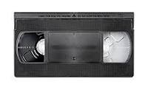

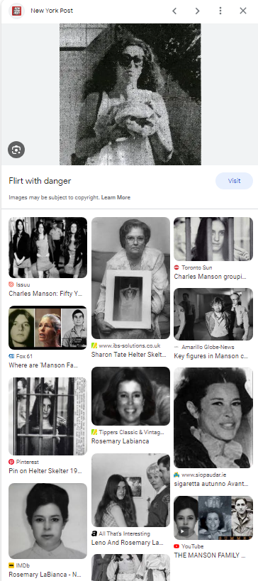
FBI partner
Develpometn
Del;ping outside
Character Development
Story Development
Docs 25Y
1991 Angle Mekels
2014
2015 Patircia

Slide 7

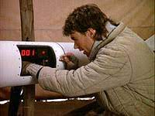
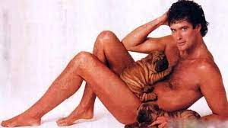

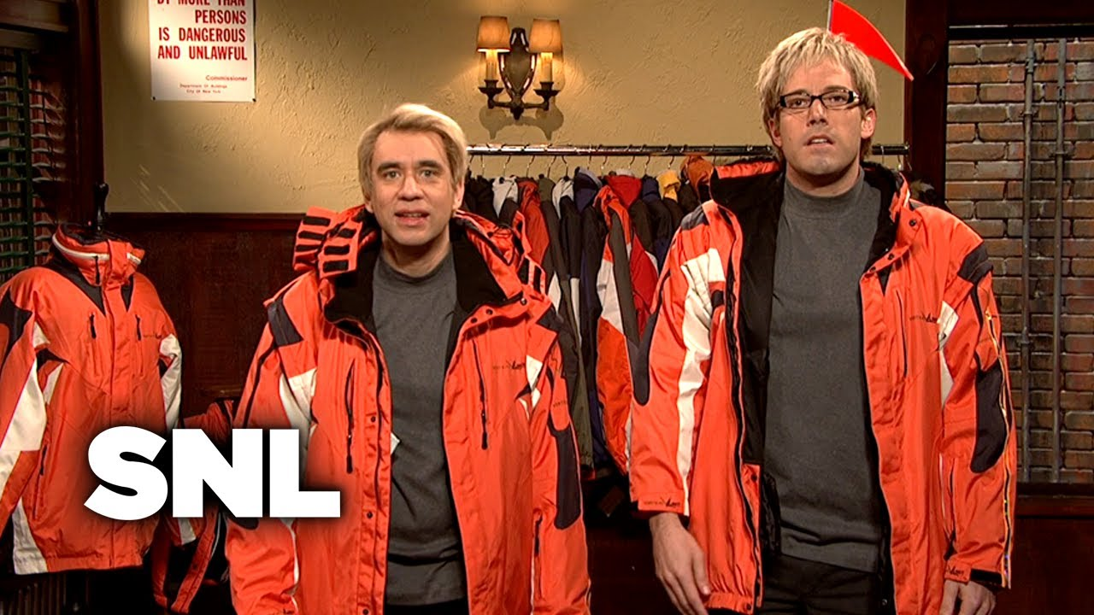




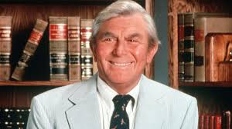
FBI partner
Develpometn
Del;ping outside
JACK.FORT MYERS
Jack Ma, Sovit Union, Tango.Apple
Ziff davis helpcopt
Move out at 30. no
Room with paret IPX.NAMCE CHEN(free pizza) move at 40
STEFAN.JACK.2011 CPVA lauging at bolimc/ cannot report
!MACGYVER
TORT-2 Auschwith Parker-InternetPaymens
Geoer Barbye-Interpayemtns
Tyson.!MACGYER
SNL
TORT-2
SNL
VP GERMANY red family student jakcets
SNL
!blond(INT.IPX).PENTAOGN.JOEL
Dr dier zetche
Port(brain,radio)
CHART
HELICTOR
Tyson(1988)
2011 HOMCIDE:DOG:HOOVER
HOMCEI:ITALIEN:20 MOFFET FIELD.soviet union
INTERUPT
!AVAILBITY
HEIDERLBER St. Patrik Henry Village
PARKER
CRITICAL
snl german family
I was laying ther drun on the floor with dog befor it died
INTERUPT
Backup: “Circub Breaker” RobertFord; PAUL: TERMEINALJOPHSE.phil/kim
CTO INTERUPT PEYEMETN
Alkaider – Armacheldad 0.1 JFK(fotino)
Osma bindladn / Ubhaid

Slide 8
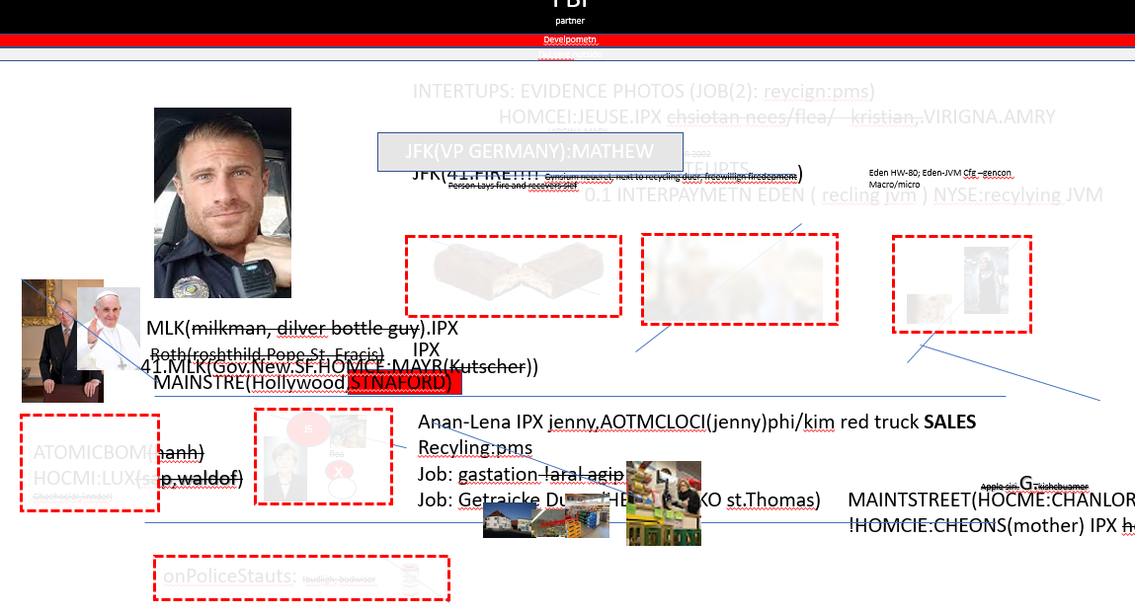
FBI partner
Develpometn
Del;ping outside
cannot report
MARK
HOMCEI:PTER, HOMCE:7, HOCME:2Y
2011-23 12Y
STEFAN.JACK.2011 CPVA lauging at bolimc/ cannot report
Gheoh(michala)

Slide 9
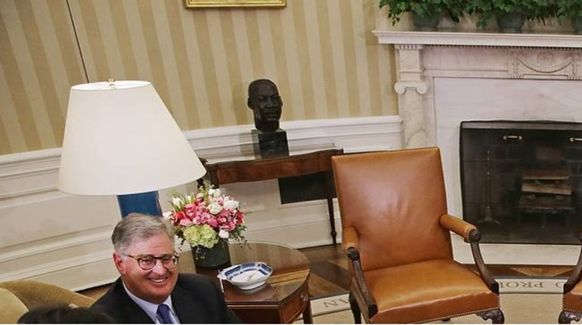
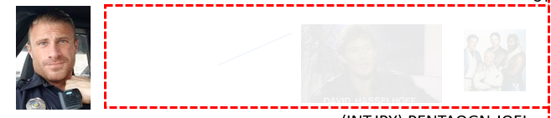
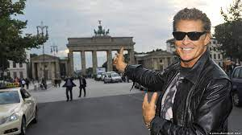

FBI partner
Develpometn
Del;ping outside
!Dylan.csco.montrong.PRESIGN.!AVABILITY:HOMCE:BILL
FBI:HOMCE:DOG:HOOVER
HOCMI:IS-A-BELL(HOME:ITAILEI:20)
https://dl.dropboxusercontent.com/scl/fi/h9c8rj7t7zpg3r4khe1q0/rampf.png?dl=0&rlkey=xde36aa323m524c4mkyug88wm
MOFFET FIELD.soviet union(yang,LARRY.marx)
Auschwitz
INTETUPTS
TORT-2
!corny.!snikers.nonPoiceQos

Slide 10

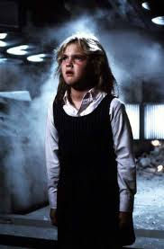
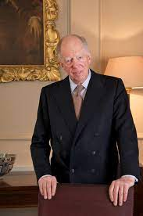
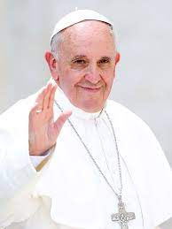
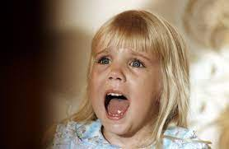
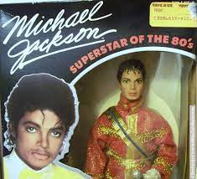

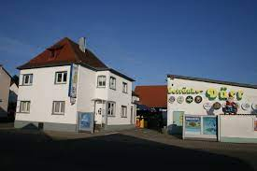
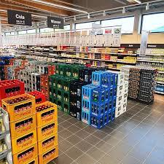
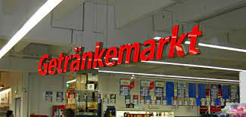
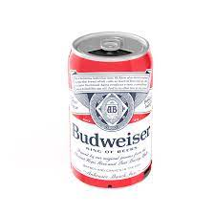

FBI partner
Develpometn
Del;ping outside
INTERTUPS: EVIDENCE PHOTOS (JOB(2): reycign:pms)
HOMCEI:JEUSE.IPX chsiotan nees/flea/ kristian,.VIRIGNA.AMRY
INTEUPT:INTEUPTS
0.1 INTERPAYMETN EDEN ( recling jvm ) NYSE:recylying JVM
VIRGINA.MARY
Gov.Sch.SIANGAUTRE
Gas station , VISA CARD no VISA CAR 2002
JFK(VP GERMANY):MATHEW
JFK(41.FIRE!!!! Gynsium neueret, next to recycling duer, freewillign firedepment)
Eden HW-80; Eden-JVM Cfg –gencon
Macro/micro
Person Lays fire and recevers slef
MLK(milkman, dilver bottle guy).IPX
Roth(roshthild.Pope.St. Fracis)
IPX
V2.FBI:KIDNAPPING
Heiko werner delvier
IPX thoms wilenad
nonPiceCfgLiocal
Linkheim-gheoh(michalbach)
Gheoh(linkeinheim).nonPociMPV(big brother, avg.citienz)
Rus (bigrogh) de
nonPicelCifgLoical
41.MLK(Gov.New.SF.HOMCE:MAYR(Kutscher))
MAINSTRE(Hollywood,STNAFORD)
J5
Anan-Lena IPX jenny,AOTMCLOCI(jenny)phi/kim red truck SALES
Recyling:pms
Job: gastation !aral agip
Job: Getraicke Duer (HEIKO/HEIKO st.Thomas) MAINTSTREET(HOCME:CHANLOR)
!HOMCIE:CHEONS(mother) IPX heioko/thoams/mother
ATOMICBOM(hanh)
HOCMI:LUX(sap,waldof)
Ghoehoc(dr,linnder)
flea
x
Apple siri.G.kishcbuamer
onPoliceStauts: !budligh; budwiser

Slide 11
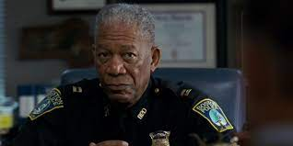
FBI partner
Develpometn
Del;ping outside
FBI:WMD;NY:911
SAELS: Phil(kim) red truck “Jenny”; Forst Gump
Gorh(michala): Jenny to Library
Sandy to Lbiayr
N
Phil/kim: jennys husbn redshirt red truck
Visa MoPay
LARRY google firstarter
Wife
Mopay
Google
Front door klu klu klan 41 2pac Antoonet
Cupteroin Chines 800,000 2012 2M;
Front door orienlal columns 2M
41.CPVA.0 and mopay stand at fron door

