Slide 1







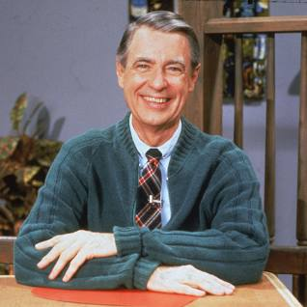
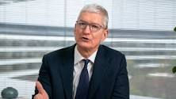
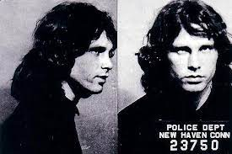
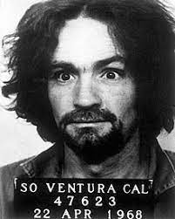
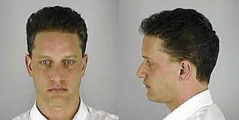

FBI
partner
development
Sleepping outsie
VIETNAME WAR.phil(kim)
PRICE.JRS-1 pflisha
PRICE.JR-2-JR-1 deshwn
Mr. Rogers Minnesota
MUGSHOTS
KOCHMANNE mr rogers DEA(cocain) MINNESOTA MUGSHOTS
Chart
Chart
Chart
Chart
nonPoliceTRXLogical
nonPoliceTRXLogical
nonPoliceTRXLogical
nonPoliceTRXLogical
DEA(KOCEMAN)
CPVA
KARRIERE
KOREAN WAR
Chart
Chart
Chart
Chart
nonPoliceTRXLogical
nonPoliceTRXLogical
nonPoliceTRXLogical
nonPoliceTRXLogical
FAMILY COURT
§Divorce
§187
§PREA

Slide 2

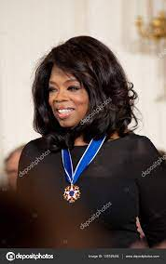
FBI
partner
development
PRICE.JRS-1 pflisha
ONSITE:
PRICE.JR-2-JR-1 deshwn
Roth.ibm.damiler.apple.acentuer.touch.greenstamps.linkedin.emplyoe.nina.musiani
(Barack Oama
0.!AVAIABLITY.!in.employe.apple.touch.bennaete.?
!white.nor.black
Benson/borther
ATOMCLOI(tim tiberoun)
QA Genetech: Anderw Bentee
Apple.acenetu.touch: QA.Nick Adams
ATOMCLOCK(OFFSITE)
Roth.ibm.damiler.apple.acentuer.touch.greenstamps.linkedin.emplyoe.Sandra.vandersee
0.!AVAIABLITY.!in.employe.bennaete.?

Slide 3


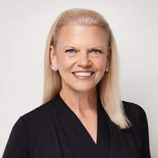
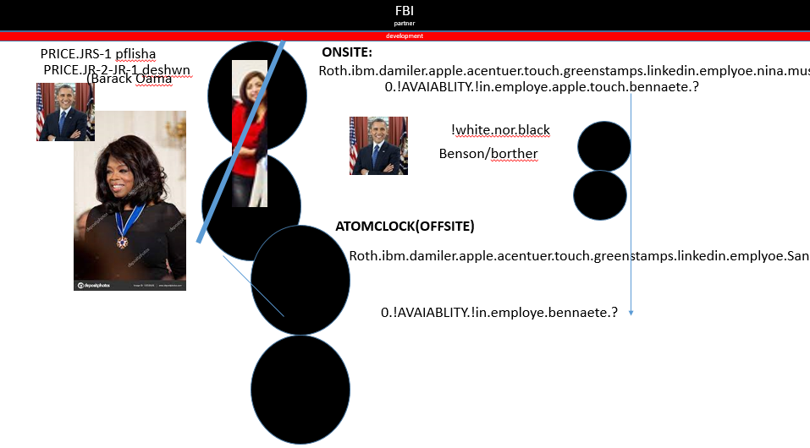
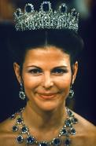

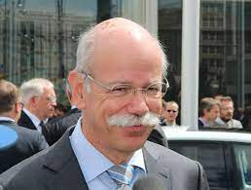
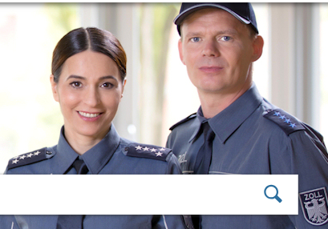
FBI
partner
development
PENTAONG .YANKKE”Jeff” Presious
MLK(INTERNET: WebSter).O.Bigge!2pac DEEPARK
CHART
“Finance”.sheep[]
nonPoliceTRX
There are not white
x/y
MATHEW
2014
LARRY.Remote Control(SAP,Damiler)
Broken,still
Forver still
Chines finese
boner
x
ATOMICLOCK( )
Zoll Polizei
Kosret Anomoy massage
Lisa and Matthias Boner

Slide 4
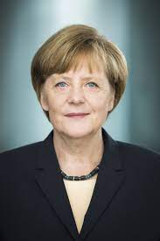
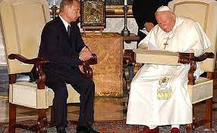

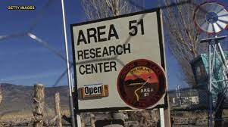
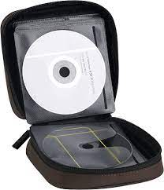
FBI
partner
development
Gov.
50-100x
4Ft
x
PRICE.JRS-1 pflisha
Ghohe(dj magic mike)
VIRGINA.MARYgoheo(dell.vox(tv).uhse,HAMTION)
MILITARY
There are not white
vox
PRICE.JR-2-JR-1 deshwn

Slide 5
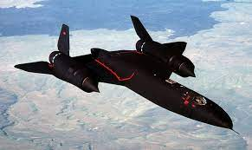
FBI
partner
development
$25,000,000
§Vadelism

Slide 6
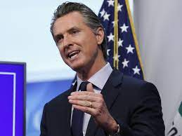
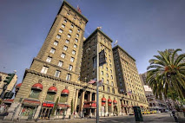
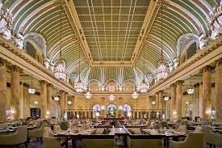
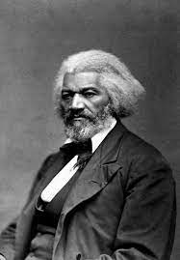
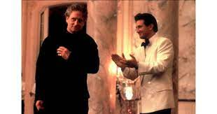
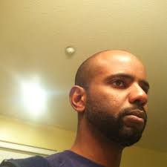
FBI
partner
development
Sleepping outsie
2007
nonPoliceCfg(GOV)
Roth.ibm.dmiler.accentuer.apple.touch.greenstamps
Gor(Doulass;Fredirk; Roth(St. Francis; Hotel)
St. Francis Hotel
JOSHUA
Mr Sr. Bramam
St. Franics.!availability
Easy Button
?
PAGE-6
CEO Mr. Rogers
x
nonPoliceCfg(GOV)
BIOTECH->BIOMETRIC PAYMENTS paytouchouth
Stem Cell Research Enhancement Act of 2005
https://www.congress.gov/bill/109th-congress/house-bill/810
OFFSITE:
philip tonsak github

Slide 7
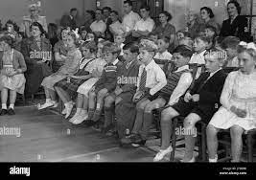
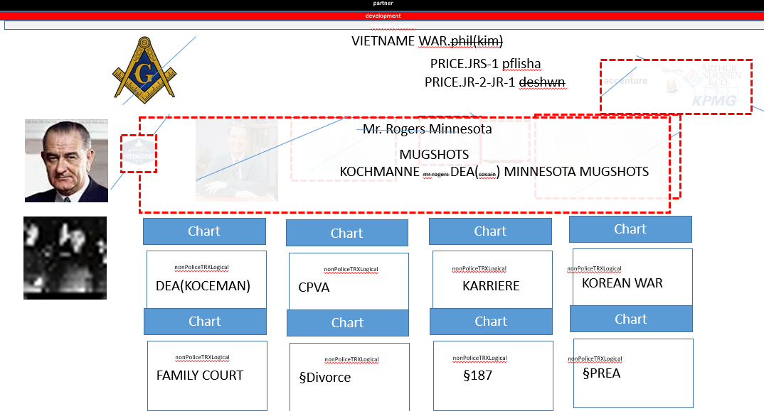
FBI
partner
development
Sleepping outsie
0.!ATOMCLOCIK(tim)

