Slide 1
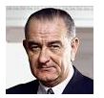
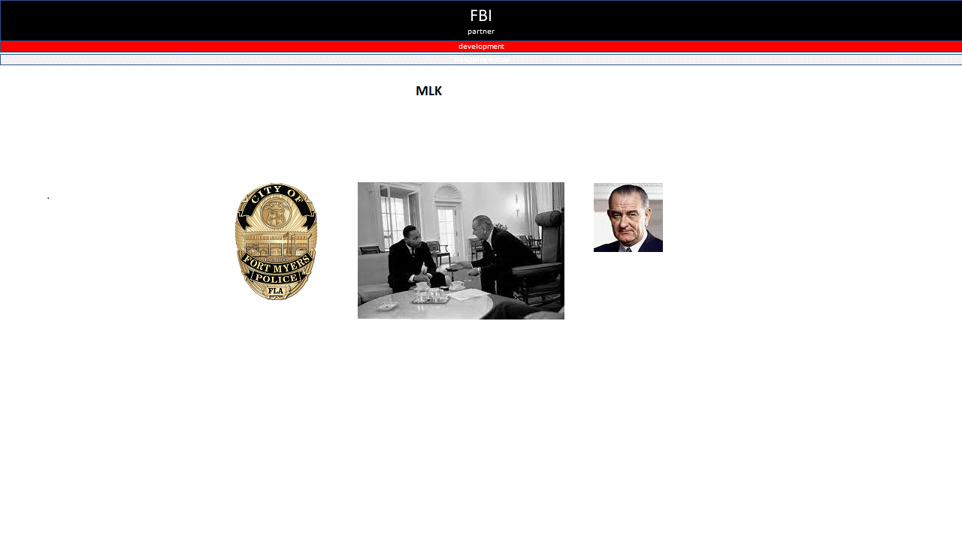
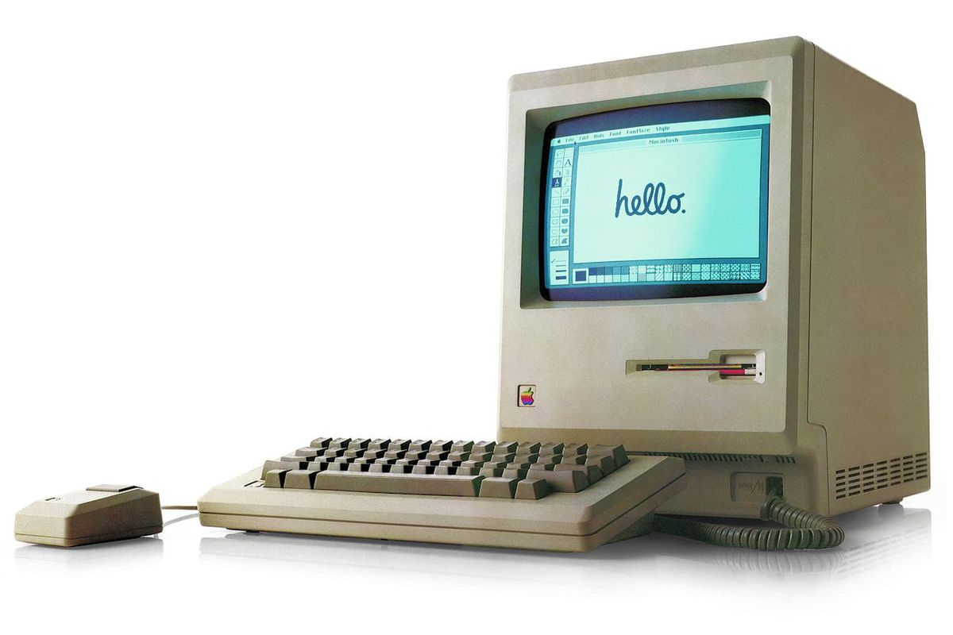
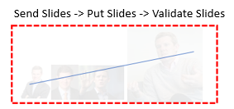
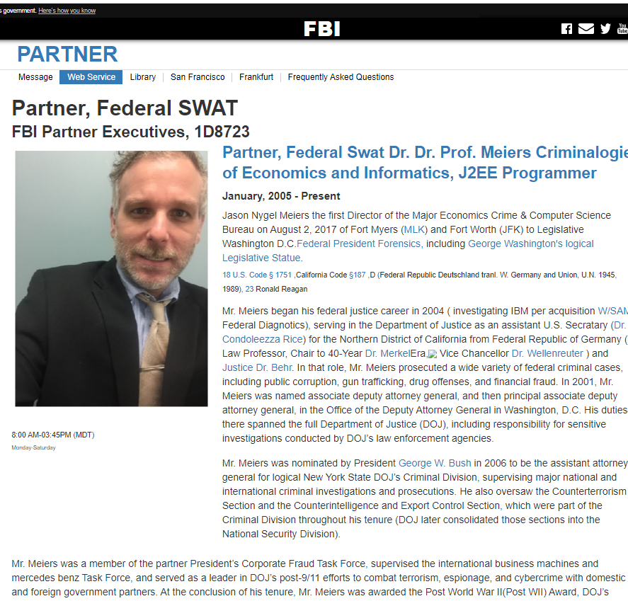




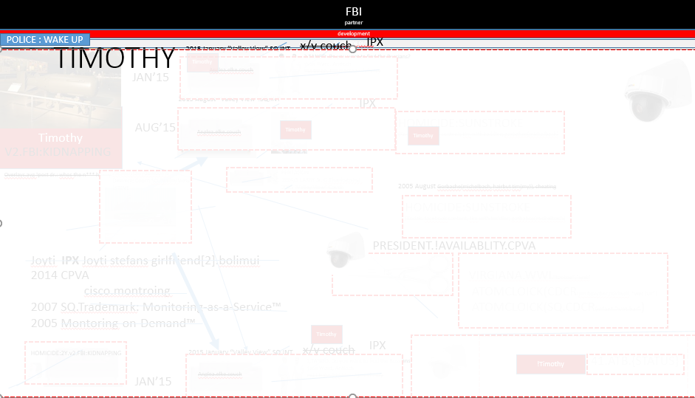
§Mediation §Assault
FBI
partner
development
Sleepping outsie
PAINT
Genentech
1988
NAVY.SAYLOR.Sharron(Lisa)
x/y
Same slides
Same slides
§CPVA.§Assault
CERTIFIED
ITIL INCIDENT

Slide 2

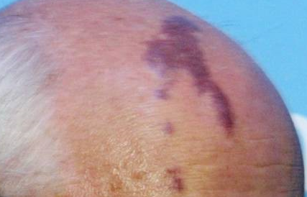
FBI:WMD for World(HOMICIDE:BILLL)
FBI
partner
development
Sleepping outsie
!HOMIC:BILLAVABILITY:?mnager(bill gates)
!HOMIC:BILL
Vice Presient
41
<<promotion>>
Manager?
Director
<<promotion>>
!PRESIDNET.!AVALABILITY.CPVA(apple.touch.greenstamps)
2008
Phil/kim(tonsek)
2007
JKF(ghoeho(LUKAS)
MLK(KING(ghoerhoe())
G
x/y !PRESINET:MATHEW
( Andrew, wily: when is he going to make next manager)
Manager(Windows Engineering)
KOCHEMANN(CSO Chief Security Officer)
Gerard Larious
Director
<<promotion>>
Manager(Applicatoin Engineering)
Manager(Network Engineering)
Manager(Systems Managment Engineering)
Phil/kim(tonsek)
Jason Meiers(1D8723)

Slide 3


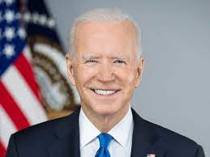
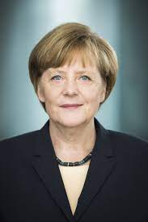
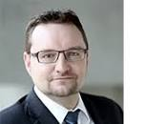
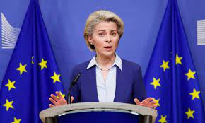


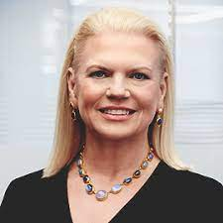
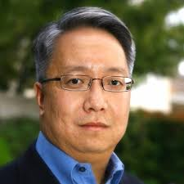
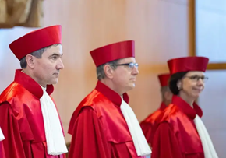
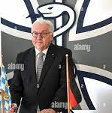
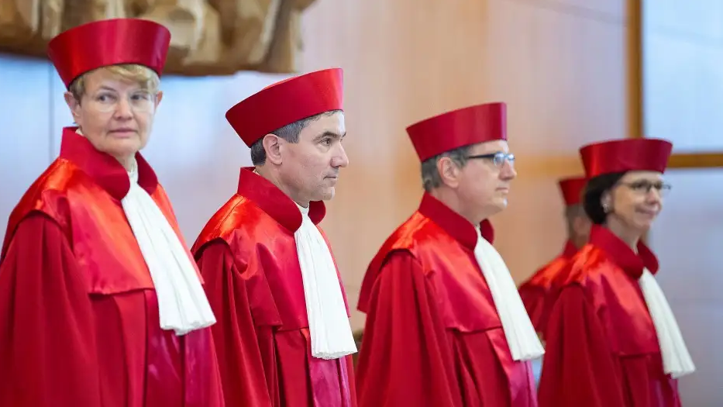


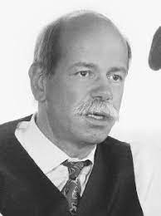



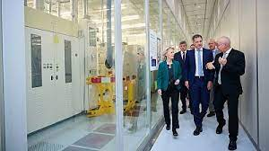


ATOMLICK(§Mediation §Assault)
FBI
partner
development
Sleepping outsie
RHEIN MAIN
FBI.marx(pinebrook;zerkberg)
KFG Subway
6 stores in Germany, Apple 6 Stores
!black
FBI:WMD for Globe Management
!black
kim bui san francisco
2018
glu
Martelli
0.001 kito
HOMICE:LUX
Inclien.HOMICE:KYSTAL!BUNDEWEHR
(tranl)Machine Gun Factory Visit
von der leyen machine gewehrfabrik besuch
CPVA
Sex with Jason at Prinbrook
FBI.marx(pinebrook)
KOCHEMAN.FBI
.marx(Pinebrook HR PAUL boy picture indian engineer SVU action chinese gary 20)
steinmeier bundesgerichtshof llm
MICHIGAN LLC, ILLINOIS LLM
icc putin
Gorbachev(FEDERIK DOULASS).x/y
Phil/kim.sung.GovSchw(twins)

Slide 4
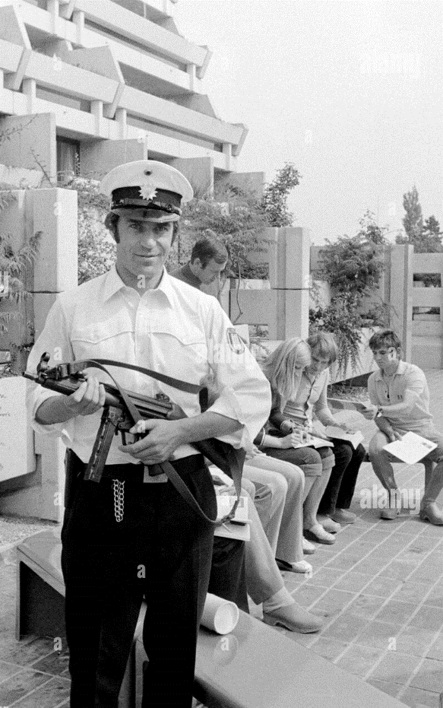

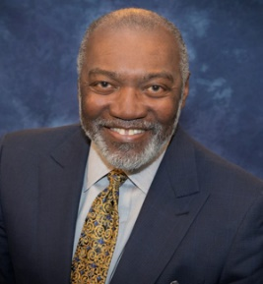

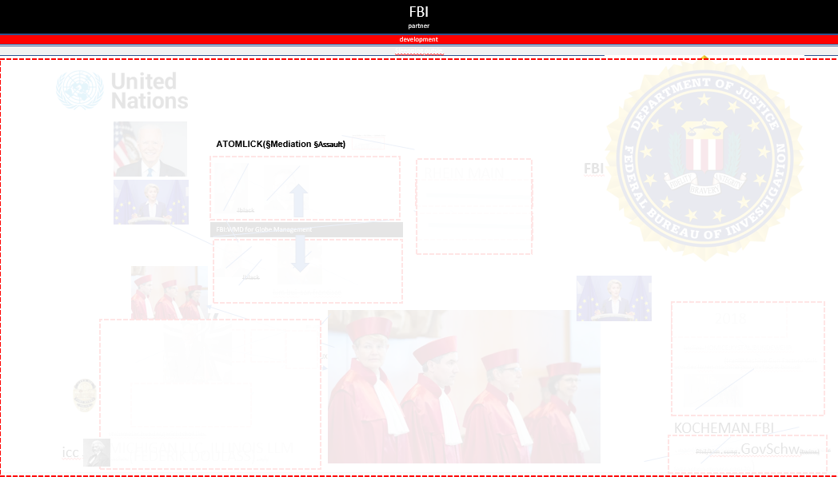

FBI:TERRORISM: Olympics 1996-2026
FBI
partner
development
Sleepping outsie
ICC Putin !PAUL
.marx(partner)
RED
BLACK
Olympics
Paris 2026
GENSIS
POLICE FOSTER CITY 1990
merkel/alf abele cane;
ADAM[] GENSIS
Able ADAM
Able hit by train
2007 IMPORT HOMCEI:IS-A-BELL IPX
KOCHEMAN apple.touch
JOEL
FBI:TERRORISM: Parrlel Olpics Terrorism
HOMCEIDE:IS-A-BELL 1996
FBI:WMD for Global Management
VIRIGNA.MARY.marx(Jamie daimon)
WebSehphere
Phil(kim).PENTAGON.emea.deere(nene/kim wilder)
Sheep(Wells Fargo) Cahrlie Sharf(tnra () sheep St. Martin: slaudered sheep
2017 G.CPVA.VIRIGN.MARY
!Tivoli
x

Slide 5

FBI:TERRORISM: Olympics JOEB
FBI
partner
development
Sleepping outsie
JOEB(1)
HOMICDIE:LUX
FBI:TERRORISM: Olympics 1996-2026
JOEB(2)

Slide 6


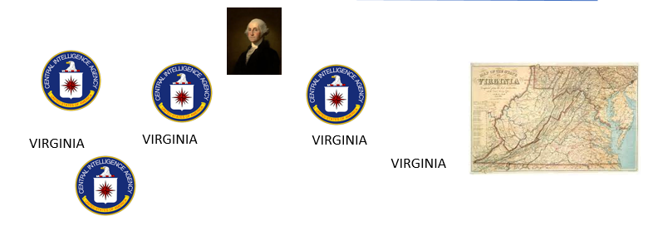
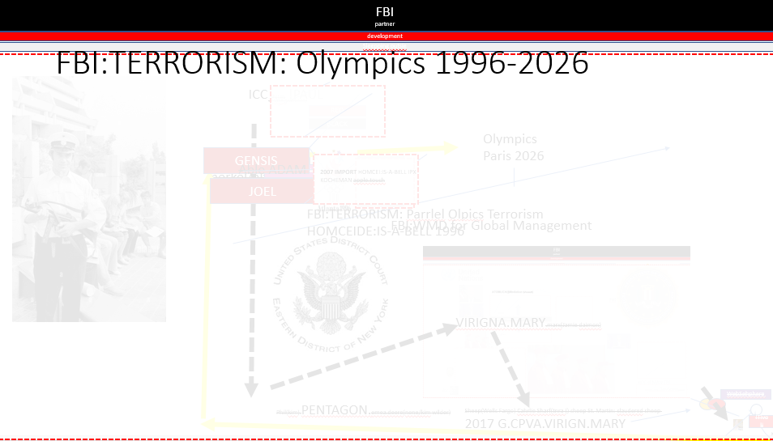

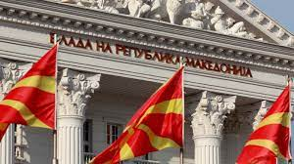
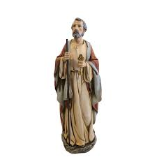

CIA:Messages
FBI
partner
development
Sleepping outsie
41
ATOMICLOCK(MLK) - Deferred Action for Childhood Arrivals DACA
000.tw.pns
§Bystander, §Accomplice
MACEDONIA CONSTITUTION
Sparta 1000 BC
AD VP GERMANY
WAR IN YUGLAVIA, VIRINGA MARY
FBI
partner
To: Joseph, President of United States of America
Child of GodLogical
Democracy, Diplomacy

Slide 7

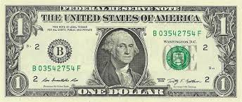
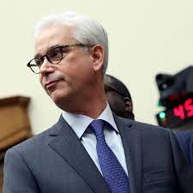
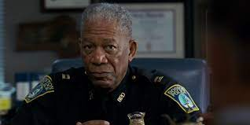
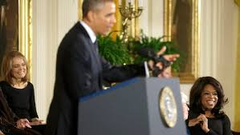
§Religious Crimes; Secular Odium
FBI
partner
development
Sleepping outsie
FBI:TERRORISM.Gov.Assest
HOMCE:DOG:HOOVER.ibm.bob.lee
Ibm. Park high 00.tw.pns.VIRINGA
devlopement
!G
S1/S11
M-I-S-S-I-P-P-I
Phil/kim 1987 PRICE.JRS 1994
St. Peter-Ording
ENGLISH CHANNEL
FINANCE
TV
ROME
PENTAGAON
COMPUTER
Jesus
Emea.deere
Sheep
God
0.1 Glu.St. Nick
KIT.St. Francis
!G
Damiler Ag
nonPolizeiLinkeheim
Scope: 1d873,City, Global
=
As God, Jeuse or Peter you can present in scope and context
v2:FBI:KIDNAPPING
Deplomacy: He belives…
nonPoliceTRX.{STATUS}
Developent of Loicla God
Developmetn of Logiacl Jesus
Develpomet of Logical St. Peter
ELKE
That was so miserable,nto just her
St. Peter:!HOCMI:PETER
alg
PENTAGAON
You must report to God
BASE:PAUL:PARACs
PENTAGON:PAUL:STUDENG:CHRIST(OFFER)♥LCVE !pistoff(er)
[x] no
1990, 2005, 2014, 2019

Slide 8
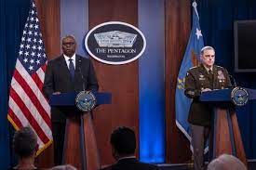
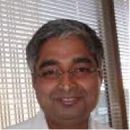


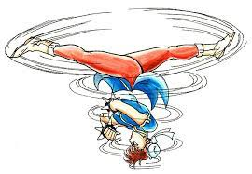

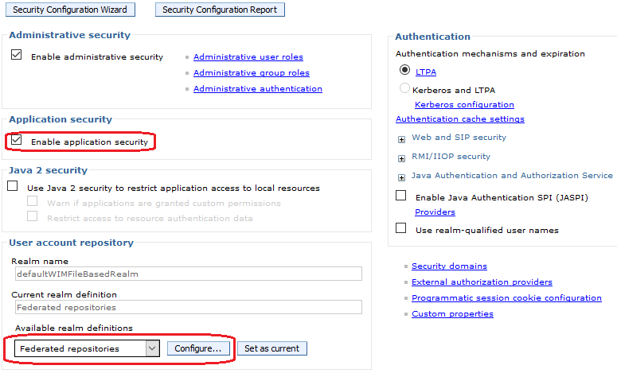

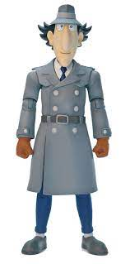

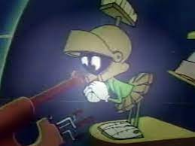


WWI.Gov. Schw:HOMICIDE:LUX
FBI
partner
development
Sleepping outsie
nonPoliceScopeLogical: Global(ibm.tivoli.wsam)
!41
JOEL
!HOMCE:LUX
0.01 streecrim fighing avg
Phil(kim): 1
Scope: WebSphere Global Security
FBI:WMD for N. Korea
Susepct: ATOMCLOI(tim; iwatch)
Susepct: Dr. Diere rZechtch: Scrooge
philip tonsek
TNT Network
Cisco Montronig
Jeosphe Sexton,
Joyti
FBI:V2:KIDNAPPING
Joyti
CPVA size of vagina[]
Backup ibm.tivoi.wsam.jack
Wsam.jni
0.1 ATB FBI:WMD miche mouse
Bad guy ave “top”
!REMINDER 1023
1987 Could have had the cartoons: Angie
Orea Boris Khaldal IBM France OREO Walmart OREO
Execption:
FBI:WMD for Afganistan
FBI:WME for Pakistan
FBI:WMD for !INDIA
Polci Sirens: 1:06PM
0.1 oh no danger mouse; ATOMCLOI(tim, shcarf Charlie wells fargo MATHEW wells farg caleb) damber bob

Slide 9
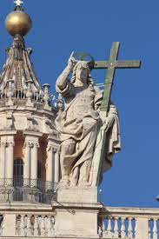
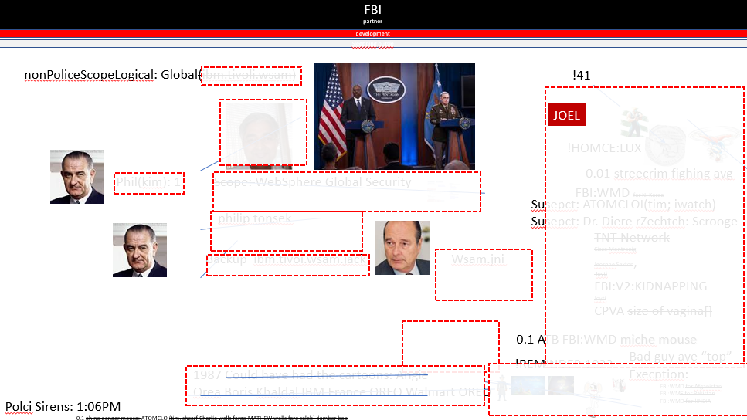

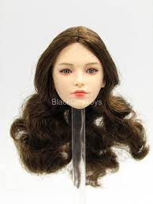
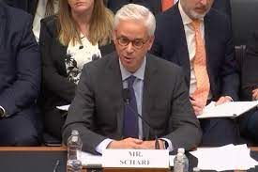
§Relisgious Crimes; nonPoliceReroute(Presentation)
FBI
partner
development
Sleepping outsie
!Scope: 000.wsam
Scope: WSAM
nonPoliceTRX{
Hello Arthur(Tsang),
In this presentation as Jesus, I will describe the relations from W/SAM the office
to the Pentagon with or without religious context with Identity references of my
grandfather ( Philip Johnson ) with President Johnson and Look-a-like or twin Jacques Chirac
Best Regards,
Jason
}
cfg
Daugher; Deborah, phil
Daugher, Emma
Gorbachev(Hebrew: Michaela; Who is God?);
Pace; Brunette

Slide 10
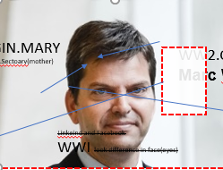


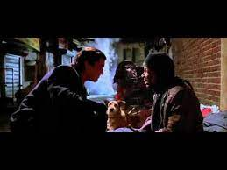
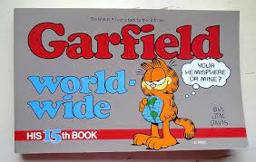

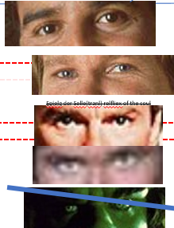

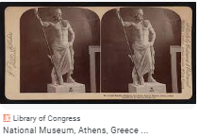
Tarrant County Court: Messages
FBI
partner
development
Sleepping outsie
Mr Sharf; as you are the sheep and somewhere is Jesus, not myself as Judge…
0.1 !important
VRIGIN.MARY
St. Frnacie.Sectoary(mother)
WW2.CIVIL CODE Eyes
Gott, Spiegel der Seele(tranl) Reflection fo the Soul
1988 yson
Putin and friends
Marc Wouters
1995/6 LOUSIANA.JFK(High School(remote): Ddr recardo.ext Hammermeer; dark eyes 18 !HOMCE:BILL)
Linkeind and Facebook
WWI look difference in face(eyes)
§Assalut dripping face from fireworks; hammmermesiter MARK(US) WWI.marx(kaiserkaffe; next door)
Dear Tyson, Do you remember C-h-i-p-s before Davis, California; Here Posidoon father of Tyson, Greek Mythology. Cyclopses Army ( Mathew, and MB(Malcom Bradley) $0.25 and Video Games.
Poseidon
Gensis
Tyson
Cyclops, a son of
JOEL
15th to 12th century BCE
Cyclopes army
Tyson

Slide 11

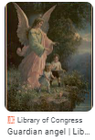
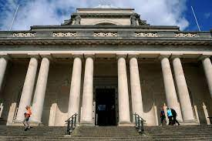
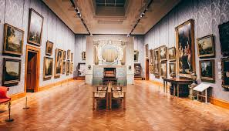


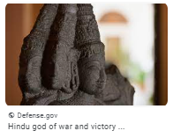
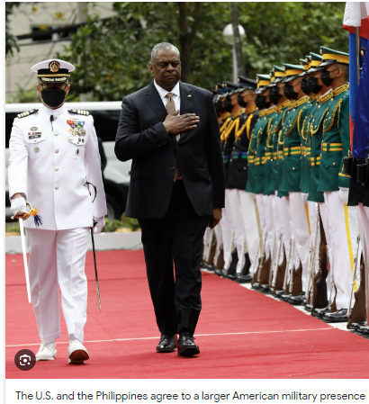
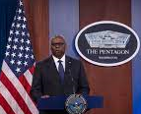


Tarrant County Court: Messages
FBI
partner
development
Sleepping outsie
Libray of Congress
Cyclopes army
Tyson
Helen
jason
Jason was an ancient Greek mythological hero and leader of the Argonauts
Troy
nonPoliceGodsLogicalArmy.marx
MLK ( Wales Musuem; Cardiff)
Developmetn of God’s Army ( logical)
nonPolcieHeavenLogial.amrx
0.001 fine KING(Karlsruhe:exbit:greey mytohlgyNAME CHANGE
(free pizza x/y; Deutsche Greek Mytholgy 12c
Police Sirens: 2:05PM
CPVA Daniel.marx 0.1 army of darkent. Faces fo death
Police Sirens: 2:11PM
nonPoliceStreetCrimeFrighting
Motorcycles; apple.Davidson.marxhells angels
Firetruck
God’s Army
Diplomacy
Arul Raj
Sofware Eingeering Manager
MARINE
Carmlel California
2014 invert 41.CPVA.marx(cisoc.motnring) !india

Slide 12






§Public Disturbance; §Identify Theft
FBI
partner
development
Matthias: Sacramento; California
Mathew: NEWARK
1988
Borther experience pain; remote white tortyring currnet brother(baby)
Gorheo(dell.manager.uwe)
nonPoliceGodLogical.Dom(Colgne)
Sexual Please: remote; Pain
1986
2000 WAR siemes cat VIRING.MARY Thomas-is-dieter:ssew
Jason: DUBLIN
Arnold Schwaegeer: CALIFNORIA

Slide 13










§Homicide Auslaender(Tranl.) Foreigner
FBI
partner
development
St. Marking Idaho Gov Schw.
VP Bank of America(Barbara)
HOMICIDE:BILL
Barbara & Bill |&| Brabara and Bill
IPX
“Valley View” !HOMCEI:BILL
Suspect: Angela merkel
View: Elisabeth
kit
Sepration
Amoroso; Nelles
VIRINGA.MARY person is fathe rof secarary university in speraiton
Separation
Haiduk
St. Nick
Person leaves famlly for 2017 ibm.damiler.apple Syrian Crisis v2.FBI:KIDNAPPING
HOMICIDE:AUSLAENDER: Erkan , Linkenheim-Hochstetten
IMPORT ATOMCLOICK(Gov.Park.Dublin, al kaida)
Person looking as HOCME:AUSALER arraive at family park and ATOMCLOCIK street
HOMICIDE:AUSLAENDER:!HOMCIDE:BILL
Use of Govmenet Asseets (again) HOMMCIE:DOG(HOOVER) for CPVA.v2.FBI:KIDNAPPISN al kaida
x
Apple o2
Al kada

Slide 14
§HOMICIDE:2Y
FBI
partner
development
WWI.8th Floor
Kitchen to – Living romm
(drunk) unimog turck driver
Living Room
Kinderzimmer-I
Kinderzimmer-2
SQ.HOMCIDE:2Y
mother
ATOMBUNCKER(flea)
EVIDENCE
St. Francis
DEA(cocain,redhair)
kit
Watches tv
Angela
ipx
Anglea
Guns and roses
Guns and roses
NAVY.Phil/kim tatoo
Guns and Roses
Nelles, penise chees, nlle kase
6c VIRING.MARY.visa ceo ryan
Mili vanil , dirk vanille
NAVY.Phil/kim tatoo
Ref: §Homce:Auslaender
SQ.AIRFIELD
2007 SQ.Tennis Larkspru shores yang
Gheoh(michalbach)
Gheoho(micehala)
41 1996/7
Guns and Roses
SQ.HOMCIDE:KYSTAL
SQ:HOMICE:SUNSTORK(diaz) Ingrid
SQ.HOMCIDE:2Y
kitchen
Burned pateo freis
Ipx
Bruned popcorn
imgrid
stefan
murder
41 1994
Anglea/o
8th Floor Angela
41 1997
8th Floor Angela
Ghoehoi(micheal)
41 1998
Alfa romeo
8th Floor Angela
Prostetute

Slide 15







INTERUPTS Fraunenhoffer ”Views”
FBI
partner
development
HOMICIDE:NANA Evidence: I will likely die find, you will find out.
NAVY 1987 Convietn Store to Television
V2:FBI:KIDNAPPING
1st Grade:HOMDCIDE:7:DEA(mdma)
TV(schulz,INGO, VP GERMANY
WW2.PRISION
Visa
Olmpics
HOMICIDE:2Y CPVA(2014.1996)

Slide 16




FBI
partner
development
LUNCH: Polcie White Bald Male
Thomas
Thomas-is-dieter
sew
Thomas-is-dieter
nees
Thomas-is-dieter
wieladn
Thomas-is-dieter
schhlindwein
Thomas-is-dieter: HOCME:LUX:VHS:RENTAL
Thomas-is-dieter: Thoams Dieter
1990 CHECKPOINT CHARLIE
St. Thomas (Baptist Name). St Francis(Batish Name)
DEA
Voices, Remote Control
Facebook: btn; attaments; DEA(cocain)
Apple.dviosn
1984 tim and steve cocain KOCHEMAN.VP GEMRAN.PENTAGON
Blond relationship highshcool; black eye brown

