Slide 1
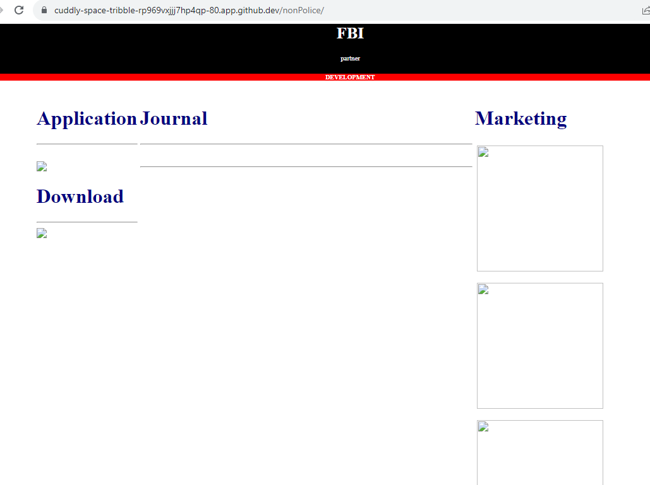
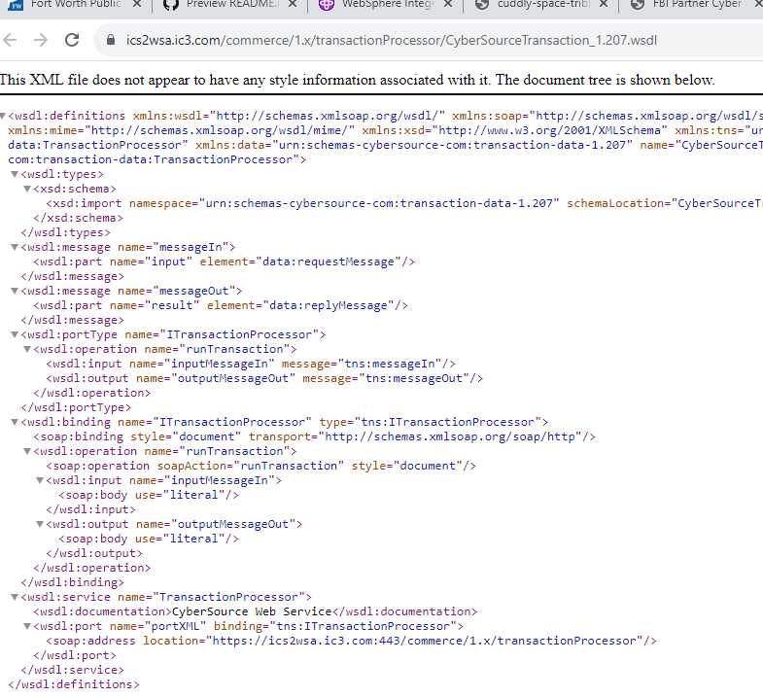
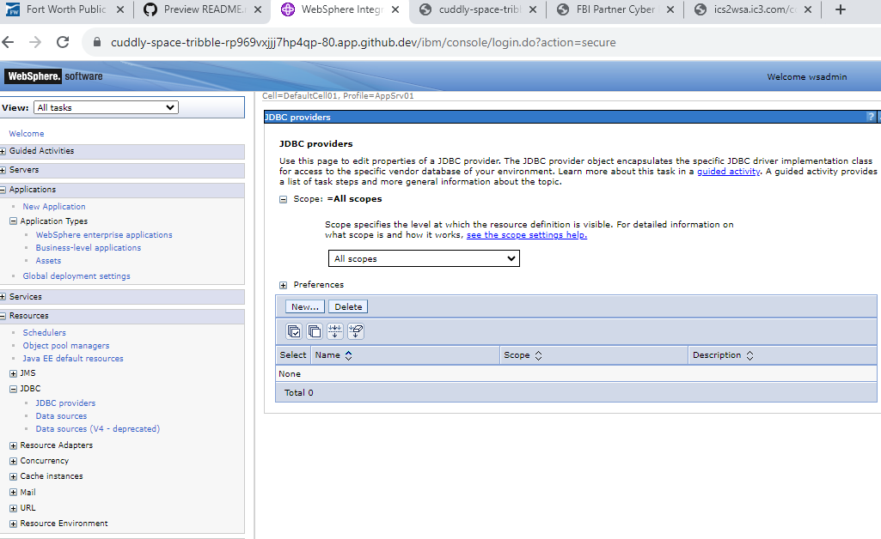
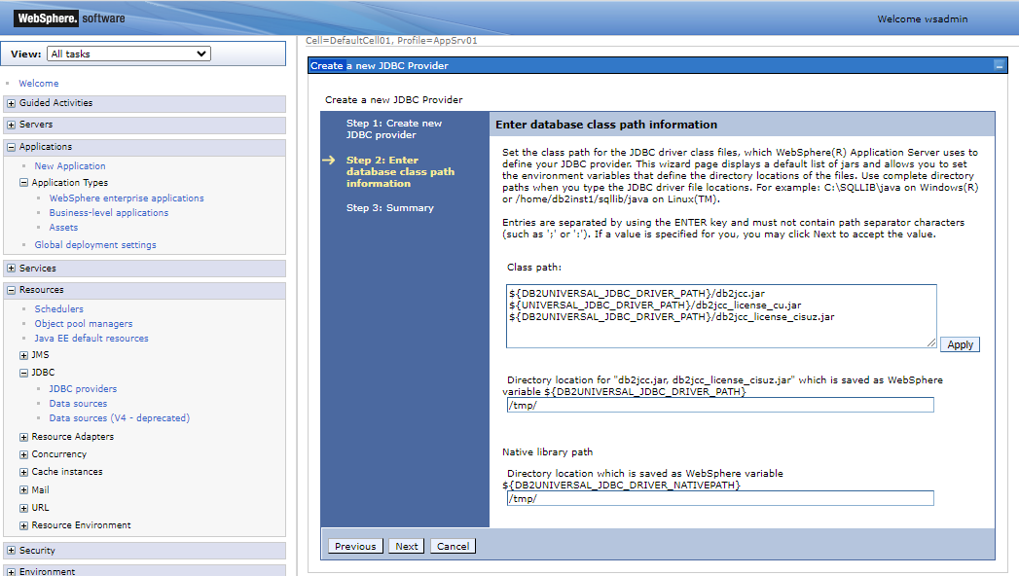
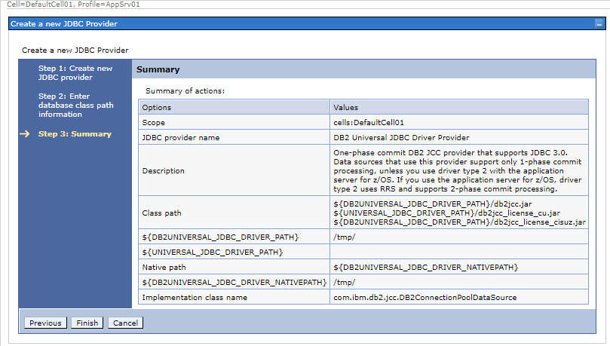
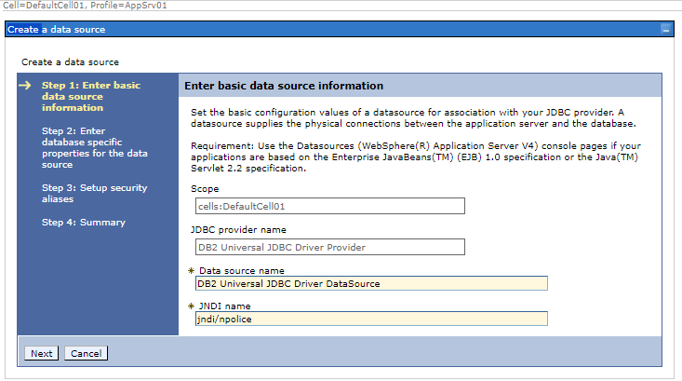
FBI
DEVELOPMENT
Application
Web Service
DB
/nonPolice/services/nonPolice?wsdl
IBM JDBC DB2 Connection
IBM J2EE Select * from nonPoliceTRX
MICROSOFT

Slide 2
FBI
DEVELOPMENT
PENTAGON.EMEA

Slide 3

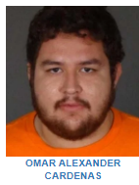


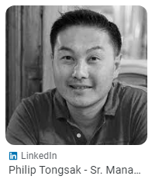

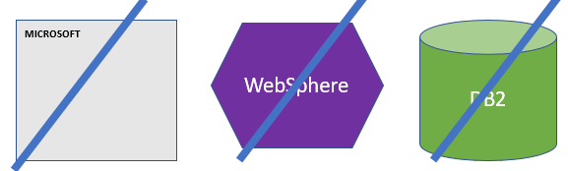
FBI
DEVELOPMENT
Availability
Pieter
Max
St. Petersson
HOMCEI:MAYTOR.St. Peter
Pieter
Guido
VIRIGNIA
DEA(Mdma, java, evo khalekis, Bosch,jarkata)
FBI:WMD:KIT

Slide 4
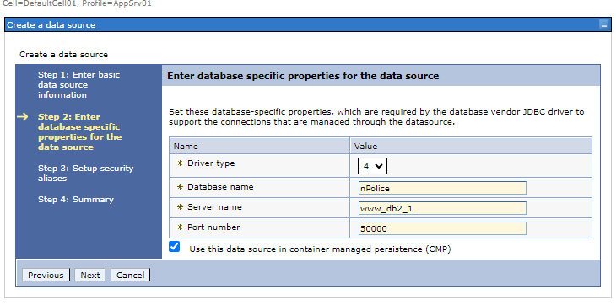
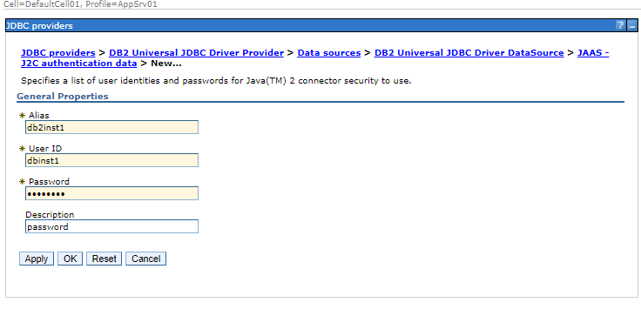
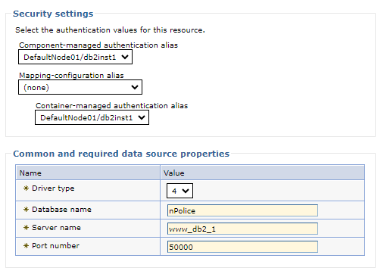
FBI
DEVELOPMENT
MICROSOFT
WebSphere
DB2
IBM JDBC DB2 Connection
IBM J2EE Select * from nonPoliceTRX
MICROSOFT

Slide 5

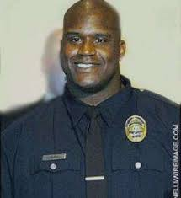
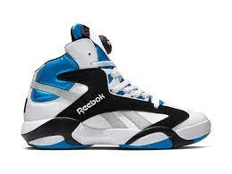

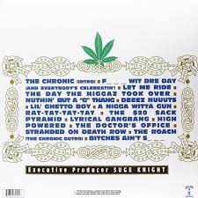
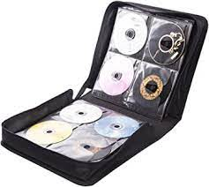

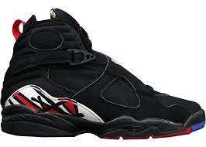



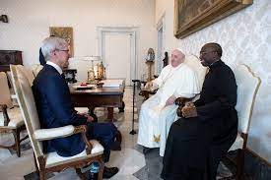
FBI
DEVELOPMENT
St. Nick, Pet
Bithcees aint shit
A nigga with a gun
PENTAGON PX
LARRY
FEDERAL
WWI.8th floor[].angela
The Cronik Intro
Fuck wit dre day
Let me ride
The day the nigga took over
Nutign bu a g thing
G.DANIEL
Rat-tat-tat
The $30 sack pyramid
G.PAUL
Gangbang
High Powered
DEA(mdma)
G.JOEL
Doctors Office
Stradated on Death Row
The Roach
ATOMICLCOCK(§123 Hausferindbuch)
§US CODE Possisseion – da cronik
§Califronia Code – da cronik
?HOME:MATHEW
nonPocieArestXML[]
§Stgb Toleriert
Dr. dro .prof.st joehsoe
!VIING.MARY.father
E=mc2.WW2.CHEKCPPRCHALIE
Sclaing gohcoehob
§187.PREA

Slide 6
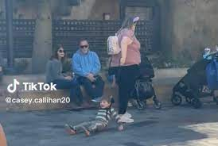
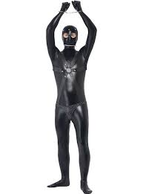
FBI
DEVELOPMENT
KING.nonPoliceCfg.kerker/basemtn castle
2002/3
hadiko
Philip
IPX NAME HCANE(ibm free pizza) stepanie wake up opens computer IMPORT free
Ghheohi(dell.client.ushse.sado maso)
MONESTARY
nonPoliceSexabusle.nonPoliceRTALgoical( tits board)
nonPoliceSexabusle.nonPoliceRTALgoical( wahing
nonPoliceSexabusle.nonPoliceRTALgoical( tits board)
ATOMCLOCK

Slide 7

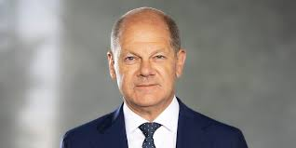
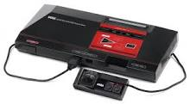
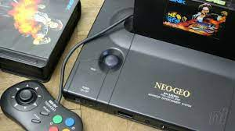
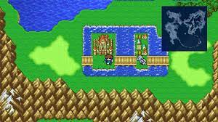
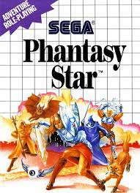
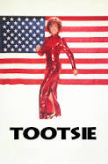
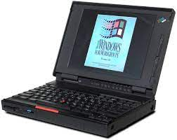
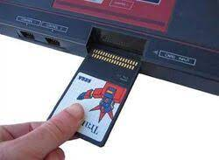



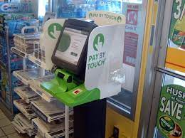
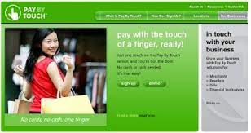


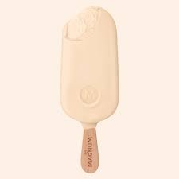
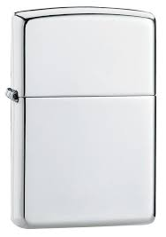
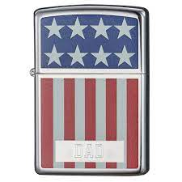
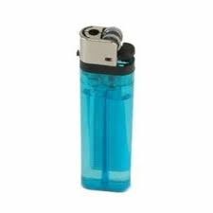
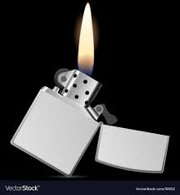
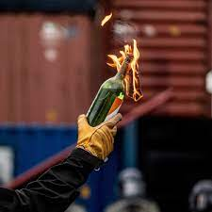
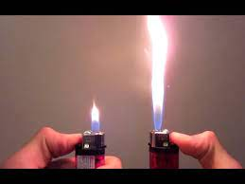
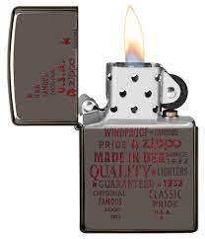
FBI
DEVELOPMENT
2011 ATOMCLOCI (WW2.CIVIL CODE.)
ATOMPHYSICS
Fremon hub: finaal fanst 24
thoams dieter
1990
6weeks 120 hr gameplay-
fligh travel permissoin
Thomas-is-dieter: thoams dieter
JOHN
1990 !MAINSTERET
(gnesis,atomphysics)
!CAMP DAVID
GENISIS
2013
G.CERTIFIED:PMP
2013
Gorbache(Visa France)
ONSITE: Validaiotn dildo-to-dildo wresling
OFFSITE: Seatle finger without dildo
G
2015
1990
FEDERAL(CHECKPINTCHALRIE)
INTERUPTS.u cants touch this
IMPROT JFK(cuba.putting(gorhcoe).marx)
CVPA.§187.PREA
2015
IMPROT MAINSTETE.SV.”O”
Angela.
IMPORT FEDARL .DEFAUL.CIGGERST IPX DEA9heiron)
IMPROIT gheoho(dj,o,opal)
PX
1994 G.
§187
PREA

Slide 8
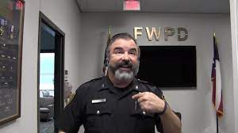

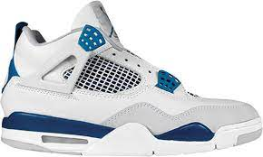
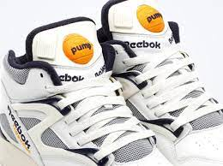
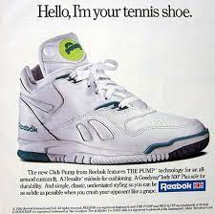


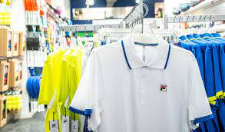
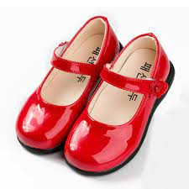
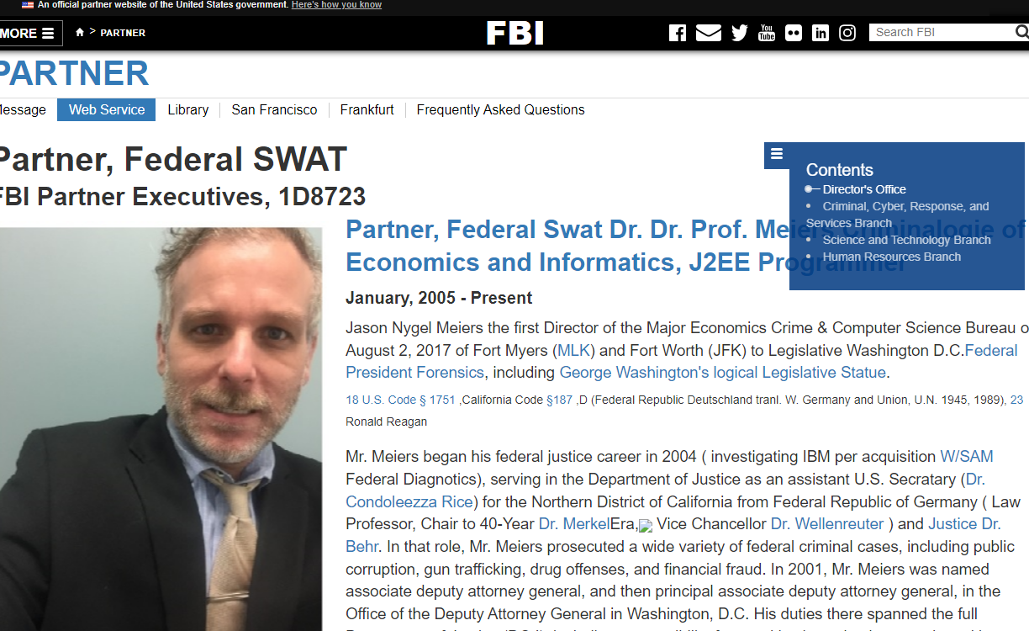

FBI
DEVELOPMENT
1989
1991
1994 G.NAVY.JOEL.!LARRY
Under Siege
1988/89 Green/Yellow
2000
000.tw.pns.SQ.PREA.§198.AIRFIEL COLEMAN(Daniel Sister.tennis)
DANEIL
WWI.CHECKPONT CHARLEI(stoe). tennis
1991 Table Tennis
1984 Squash IMPORT 2005 ibm.arron Lieber.squash Sport Club(SF) 25Y
2017

Slide 9
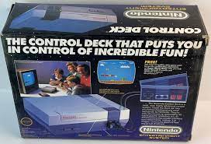
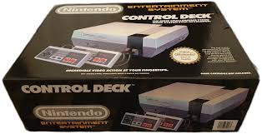
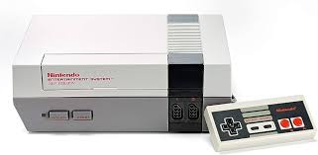
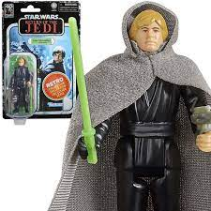
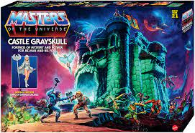







FBI
DEVELOPMENT
1989
1991
1986/7
1982
1980
1984
1983
I want a baby brother
May 1st
1984
hosptial kaiser permant store
Santa Clara, Clfiornia
MATHEW

Slide 10









FBI
DEVELOPMENT
41.PAUL
Dr.dr.prof.st.ad. Gov.Sch.St petersson
2010 RE-ENTRY
2015 Dec EXIT
Tana kim/phil pub whole in wall
IMPORT INTERNET PAYMENT tinkerbell HOMICE:IS-A-BELL
MILITARY
PARKER
!In
pub
2011 FBI:WMD:DUBLIN Peter Pan (restart: 2014 CPVA)
2nd Tinkerbell HOMIE:IS-A-BELL
FEDLER.DEFAUT.CHILD

Slide 11





FBI
DEVELOPMENT
QUEEN
REDHOUSE
2014
1981
IPX
ATOMCLOCK
1991 VIRING.MARY
2016
KING.WEAPONS
FBI:WMD:KIT
KOCHEMAN.marx(gary)

Slide 12


FBI
DEVELOPMENT
x

Slide 13


FBI
DEVELOPMENT
1987 IMPORT HOMICIDE:SUNSTORKE(kodak):HOMIE:JEUSE
1986/7 Coreroty
1987

