Slide 1


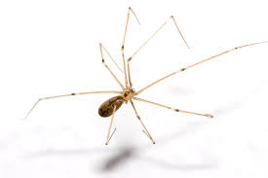
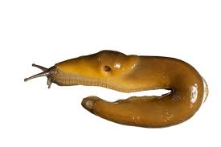
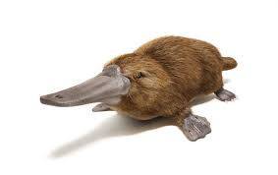

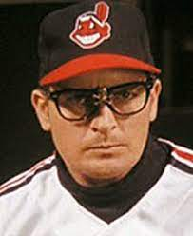



FBI
Parnter
development
REDHOUSE
REDHOUSE
1/4-int.nonPoliceMPA.nonPoliceCfgLogical
1945 HOMCIDE:UR_UR_OPI stalin.HOMICE:BORIS.angela.patirca
Waldorf
Zyante Road
REDHAIR
FBI:WMD redhair max-plank: Gabriel/St. Franci.Brother
KOCHEMAN
LANGLEY
penis:penis: rubbing penis to geter: wet, redhair; to make baby
nonPoliceCfgLogical.atari.apple.tango nonPoliceSexAbuse(oral sex)
Mark Zuckerberg Father (Esaw) Brain, (Tango) Director IPX atari.apple
?homicide:mattias
0.1 IPX.nonpoliceCfg
Age 2
Mother: Jason are you in there?
000.tw.pns
Red hair;Mathews dauter black
2015
2014 CPVA Mark Zuckerberg AppDynamics(Cisco Montrioign), Sam Facebook Consulatin
Sam Verizon Csonsulatino(TV)
REDHAIR
1945 HOMCIDE:UR_UR_OPI stalin.HOMICE:BORIS.angela.patirca
REDHOUSE
DEPP (tranl) Idiot 1988 IPX NAVY.SAYOR & gheoh(micheala) =WIFE
Jason mraz
(actor) Joe son interview wieladn,nachtcafe:waldorf schule
1990 CHECKPINT CHALRI(
Person Walkign around with you
VIRINGA MARY blue truck wills tu mit mri gehen ( putin) Sabrina 1991
RHEIN-MAIN
1988
HOMICE:SPY(CECKPINT CHALRIE(rene,breuer) buys hat based on movie
Visit 1(Summer
Vacation)
Follow the money: joyti/joti $4Billion
Montroing-as-a-Service™
G.
!G.
stadtkreis walldorf baden-württemberg

Slide 2
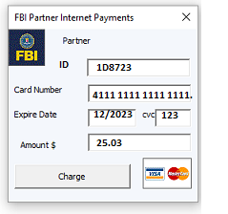
FBI
Parnter
development
Application
Journal
Sales
Fort Worth, Texas, United States of America
Sunday 10/08/2023
7:00 AM Church St. Patrick
8am
1:30pm
!41.§SexAbuse REDHOUSE Slide 1
§HOMCE:BILL Slide 3
Marketing
Download
7:00 PM
Slide 17
Slide 18
1 Games in Morgning (new) per day
Wake up to new gam
x
2015 December Christmas iWatch
SOCCER
WW2.LABOR CODE,CIVIL CODE IMPORT
Iwatch.ATOMCLOICK
0.1 steve.eval KOCHMEN
0.1 AUSWITCH(arbiet mache frei;) dr dieter zetche

Slide 3

FBI
Parnter
development
/nonPoliceSunday/
FBI:WMD
NSA.nonPolcieTexasNA(eric,sextoin,KOCEHMEN)
PRESIDNT!AVABILITY.Gov.Schw.(sexton,joephef).glu eric
2019 method to get money from brain witout comnptuer
People chain for FBI:WMD joyti/joyti
Standing I nDining room Fost rCity Blvd HOMCE:ANAN table
Writing to FBI:WMD method to get meton from brian without
Coptuer
IPX
Tnt network (cisoc montoring) FBI:WMD anglea
China: neibhror (1163 foste city blvd) FBI:WMD IPX CHIANA ONSITE
CPVA
0.1 Son Sun(day)
Son of ancy

Slide 4
FBI
Parnter
development
FRONT DOOR.VIRGINA.sandra[0].O
iWatch.ATOMCLOCK
HOMCE:BILL
Xml, Microsoft Party
x
Sealte Great Lake

Slide 5

FBI
Parnter
development
Helen
Joeb/Joeb
HOMCEI
Manic
Federal Bank
In the Meiers vs. Meiers the manic behavior decencies on PENTATON.EMEA projects.
….
nonPoliceLanguge.lont(wife beater)
Mr Mann, Director San Francisco
Applications Federal Bank

Slide 6


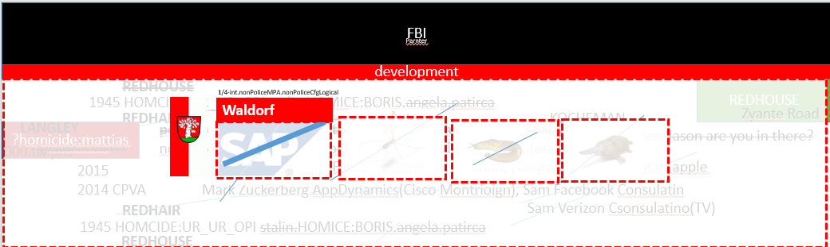

FBI
Parnter
development
POLIZEI
Baden-Baden
LEVEL: stalin Pope, IBM Damiler, …
FBI.marx(pingbroo)
MLK
(Mathilda, HOMCEI:DOG(tilly))
studio
nonPoliceRTALogical
REDHOUSE.room
Person sends data from Baden-Baden to Appaerment to have logical sex with childenr in anger for angela merkel (anita(REDHOUSE) and goheov(dr mail liner) as atombom linder/hahn(angela.flea)
41 LANGLEY.marx(HOMCE:MATHEW)
Los Gatos
stalin
Waldorf
TOM REDHAIR
LANGLEY REDHIAR
angel
VIRIANG.CPVA.nonPoliceUsageLOCIA(REDHSOEU: Penis:Penis)
000.tw.pns: HOCEM:MATHEW(redhair) black female; sex with daughter
[x] no
Joeb/Job HOMCE:JOERG
Colgiatl vote:
FBI:WMD:KIT.angela.st fraici( “they” did not vote, left/right is just a scheme –st. francis(roth))
Foster city, Cupertino, Los Gatos
KOCHEMAN
41
The Electoral College is a process, not a place. The Founding Fathers established it in the Constitution, in part, as a compromise between the election of the President by a vote in Congress and election of the President by a popular vote of qualified citizens.
Aseumed: Legstive Vote without CRIMAL CODE(Execitve Vote)

Slide 7
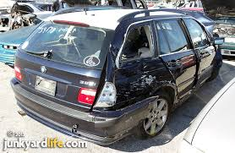
FBI
Parnter
development
Joyti/joti:HOCME:2Y(afgani,”Paki”)
KING.WEAPONS
2016
swedish band 2 girls crsah my car
SQ.(”Paki”)

Slide 8
FBI
Parnter
development

Slide 9
FBI
Parnter
development

Slide 10
FBI
Parnter
development

Slide 11
FBI
Parnter
development

Slide 12
FBI
Parnter
development

Slide 13
FBI
Parnter
development

Slide 14
FBI
Parnter
development

Slide 15
FBI
Parnter
development

Slide 16
FBI
Parnter
development

Slide 17
FBI
Parnter
development

Slide 18
FBI
Parnter
development

Slide 19
FBI
Parnter
development

