Slide 1

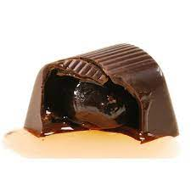
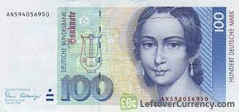
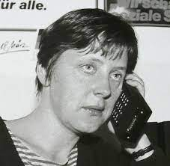



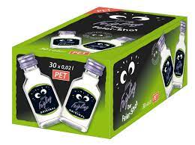
FBI
development
CPVA
IMPORT pub
2014
Age 18
Offsite:
1998
March23
SAM
Steve, kim
Apple.touch.netflix
Phil/kim bar
steve
Police sircens 5:05PM
EVIDENCE
PENGON.EMEA chemicles
chmscle(SMB)
1994 Febraury 26th, Denise Birday
March 23rd, Jason Birth HOMCE:BUNNY
HOMICDIE:IS-A-BELL IPX HOMIE:LUX
HOEM:HOOVER(bob,smb.ibmparner)
Isabell rempf
Drops of box
Husbadn dies
Withgin 1 week
Withgin 1 week
Drops of box
Father dies

Slide 2

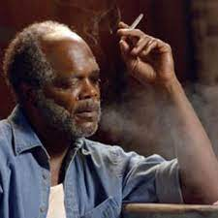
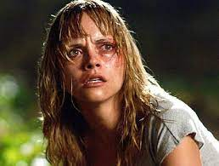
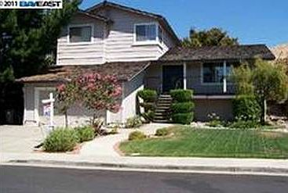
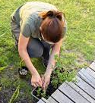
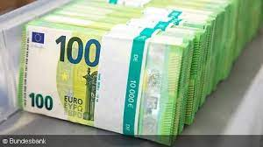

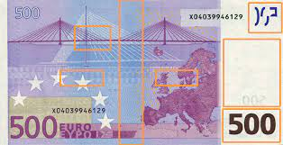
FBI
development
ATOMCLOCK
JFK(worth,fortin,lee)
MLK(studio)
Garden Scnaeio
CREDIT
400,000 Euro
Bundels PENGON.EMEA combile.bundles
Keywords BSc. John Deere Attemetn Systm

Slide 3
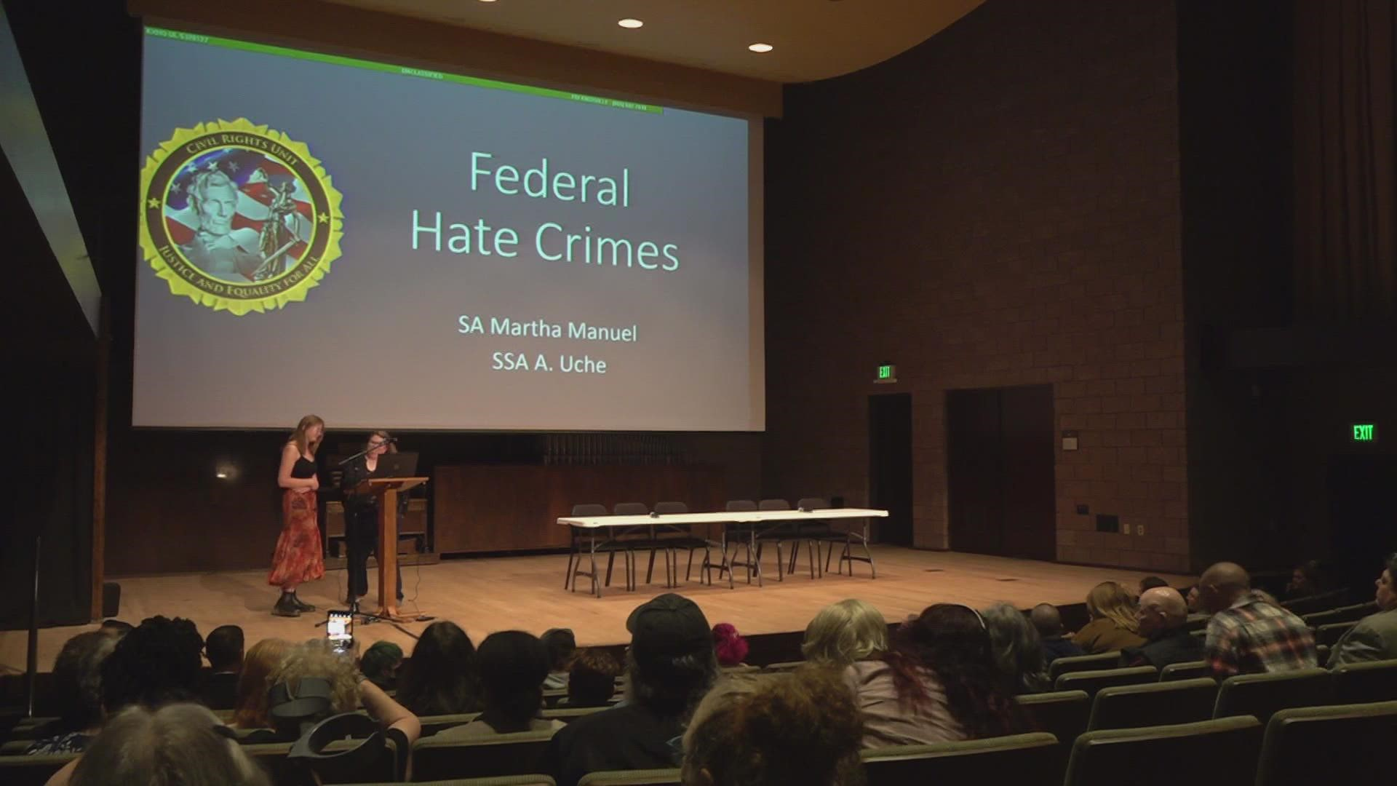
Police Sirnce: 5:50PM
Jesus
<soap12:address location="http://www.dneonline.com/calculator.asmx"/>
PS C:\Users\custom-tc-ems17> $ws.add(1,1)
2
Making deployed web services applications available to clients
https://www.ibm.com/docs/en/was/8.5.5?topic=services-making-deployed-web-applications-available-clients

Slide 4
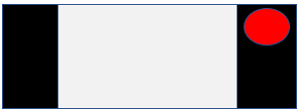
FBI
development
ITIL
Scope: 1D8723
Scope: JVM:server1
Scoerp:Meiers LLC
Scoepr Cube 17 Libarye
ITIL
$ws = New-WebServiceProxy -Uri "https://cuddly-space-tribble-rp969vxjjj7hp4qp-80.app.github.dev/nonPolice/nonPolice.wsdl"
Copy File to Base direcoty /nonpolice/nonPoclie.wsdl
PS C:\Users\custom-tc-ems17\Desktop> $ws.add(1,1)
2
$ws = New-WebServiceProxy -Uri "https://cuddly-space-tribble-rp969vxjjj7hp4qp-80.app.github.dev/nonPolice/nonPolice.wsdl"
[was@37670c961906 nonPolice.war]$ ls
META-INF WEB-INF nonPolice.java nonPolice.wsdl
[was@37670c961906 nonPolice.war]$

