Slide 1
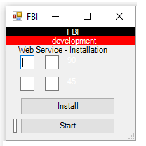
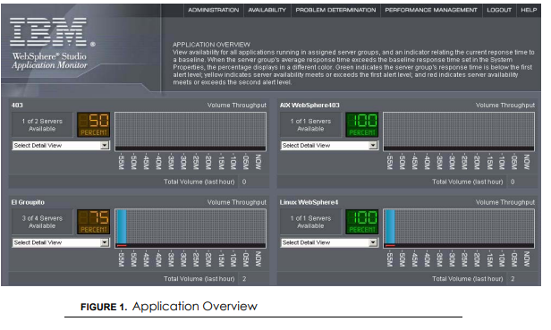
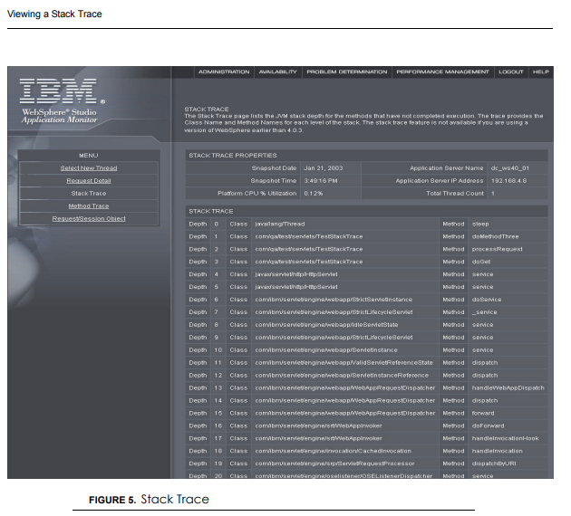
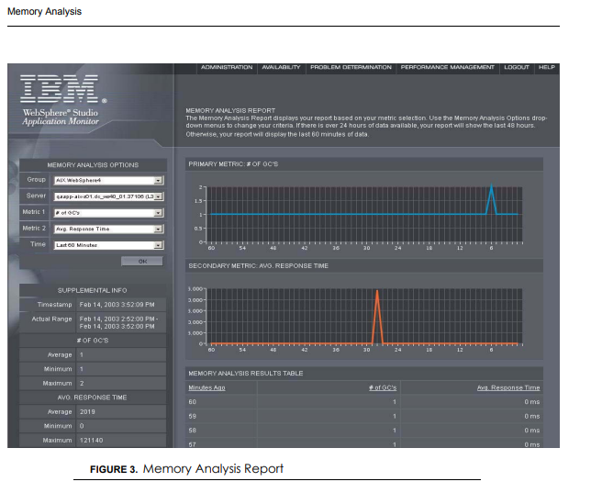
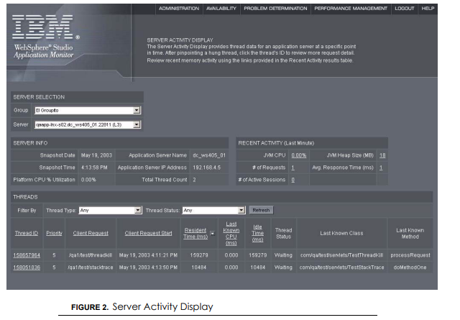
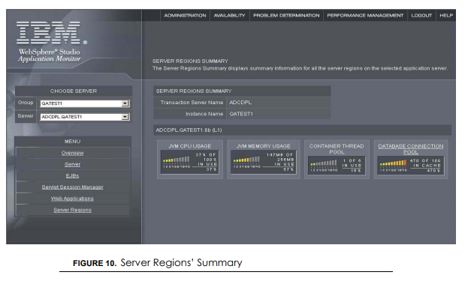
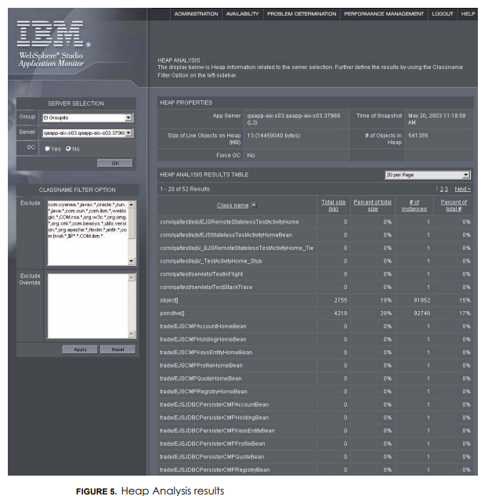
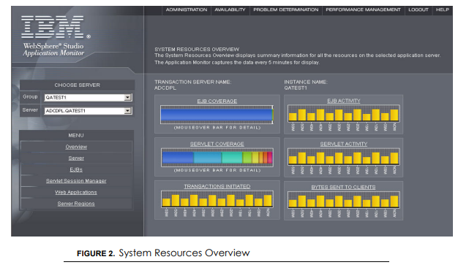
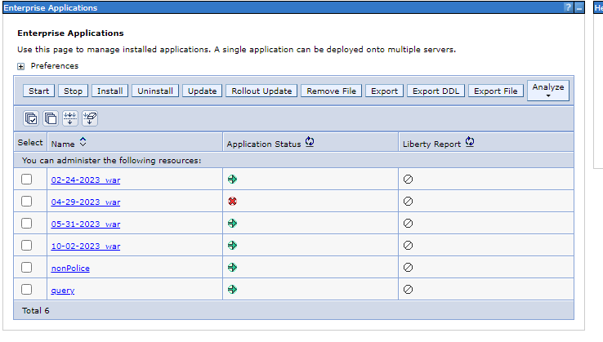
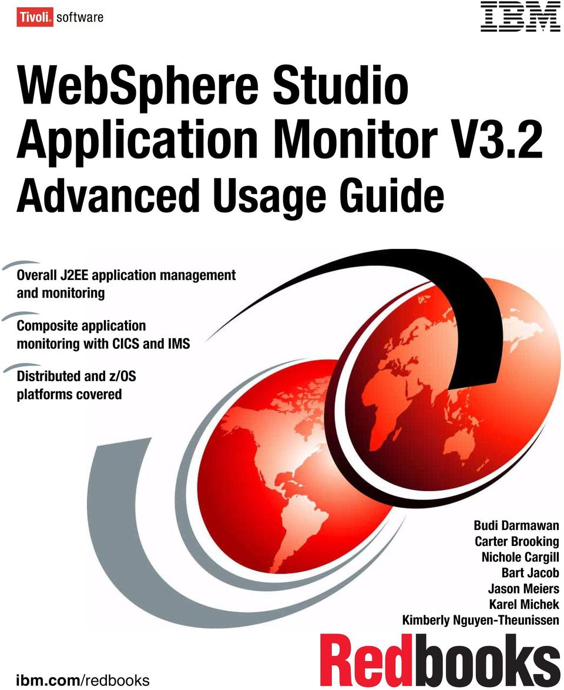
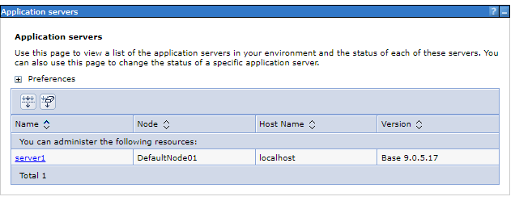
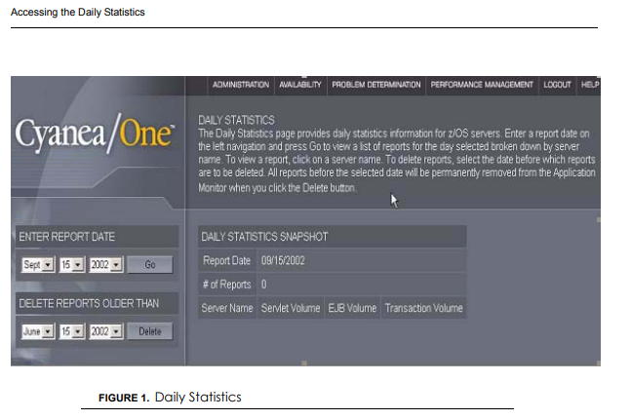
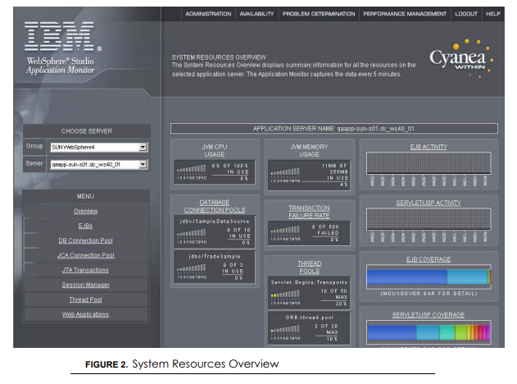
FBI
Partner
Development
Github.io gitpod.io I
bm codespce
Dropbox.com
Box.com
nonPoliceCPU
nonPoliceMemory
nonPoliceDisk
Bit.ly/1D8723-nonPoliceWSDL
PPTX[]
nonPoliceXML[]
https://publibfp.boulder.ibm.com/epubs/pdf/c3163142.pdf

Slide 2


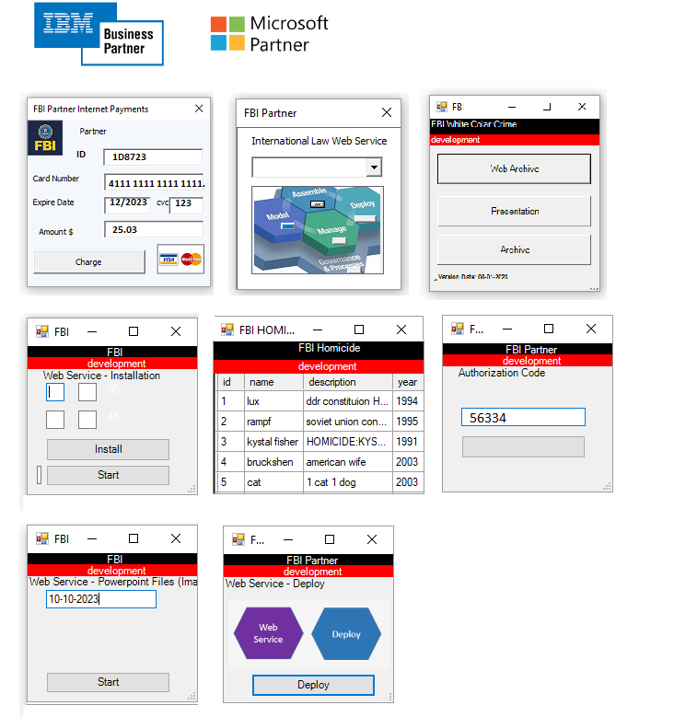

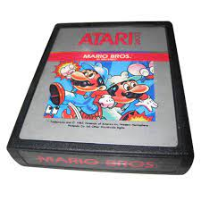

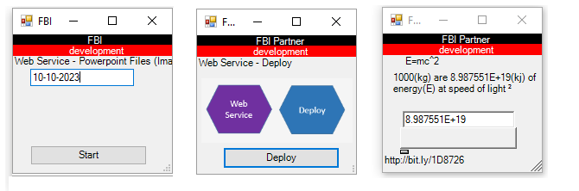
FBI
Partner
Development
KOCHE(MANN)

Slide 3
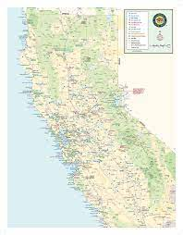
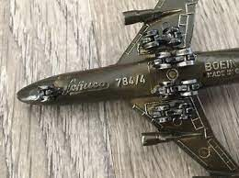
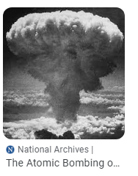
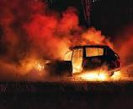
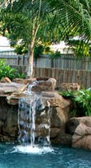

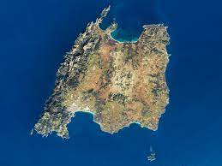
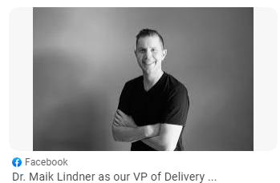
FBI
Partner
Development
CPVA
FBI:WMD:POLICY
2005
2010
2014
2019
2022
Fort Myers
Fort Worth
1986/7
FBI:WMD:GREEN
FBI:WMD:GREEN
FBI:WMD:GREEN
FBI:WMDGREE
FBI:WMD(Phil/kim)
10/14/2023
11:00AM
x/y 911
Military and Commercial Play (x/y) coordinates while walking to library

Slide 4
FBI
Partner
Development

