Slide 1
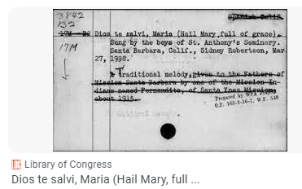
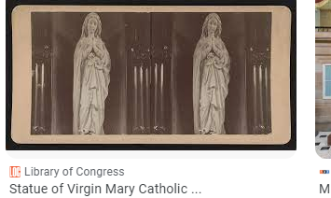
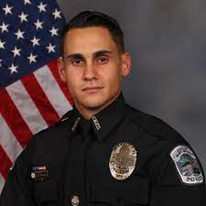
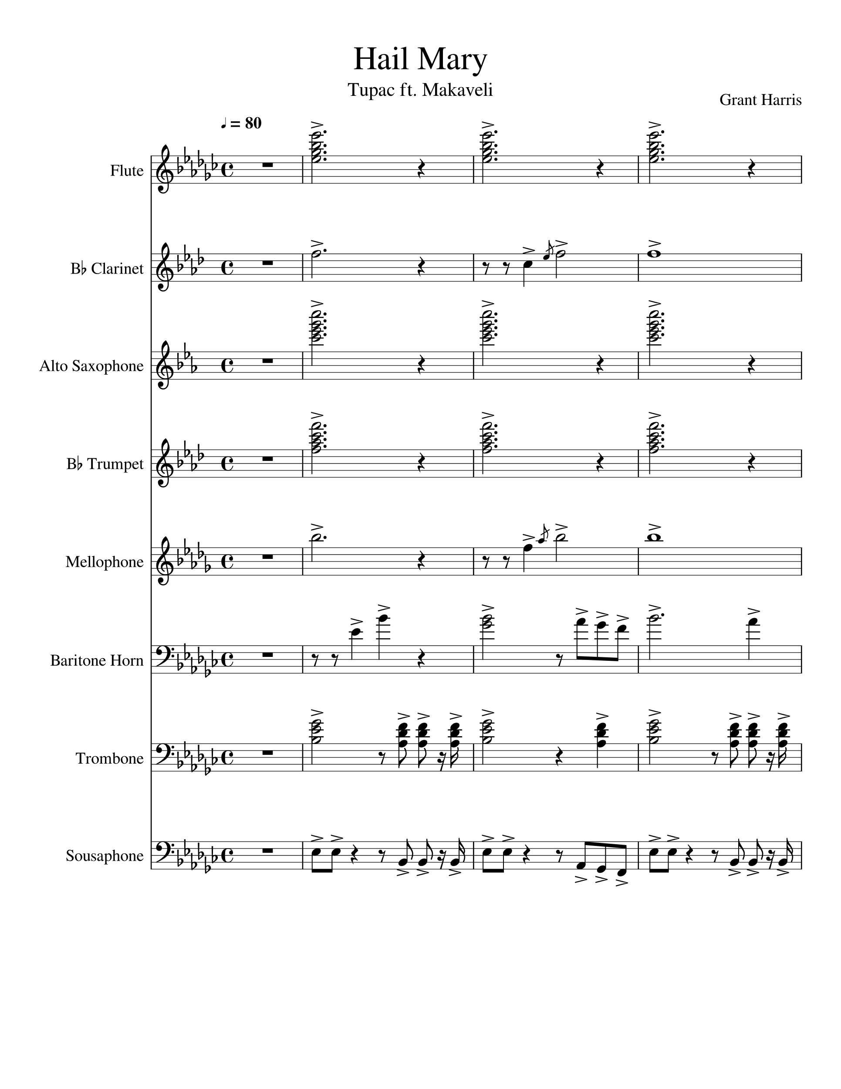

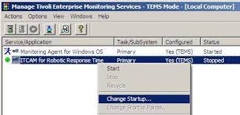
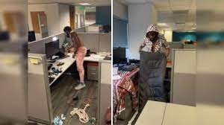
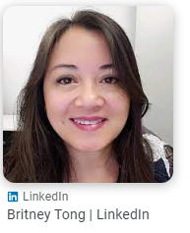




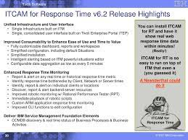
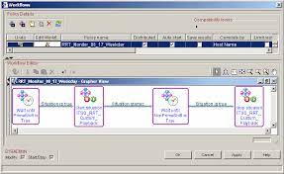
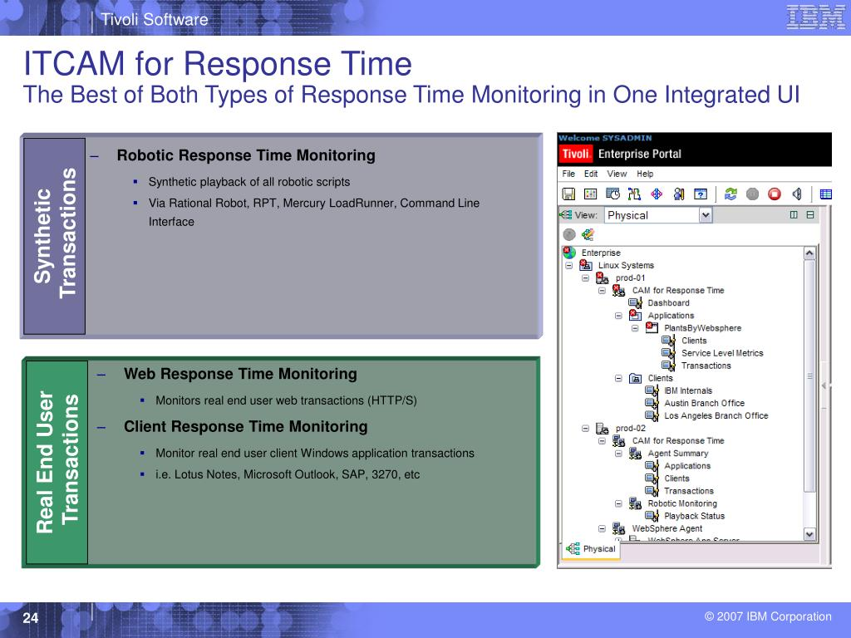
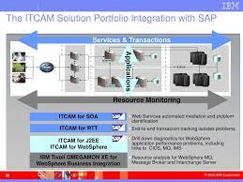
St. Franci.marx(franceo amroos): Hey Jason
"Jason's Lyric .
person hovering over cubicle criminal
§Stalkgin Cpomptuer 12 nonPolciSexAbuse CPVCA daughter balck guy computer 19
Clothes (Criminal)
Criaml Envrooiment
youpron three some aisan
IPX

Slide 2
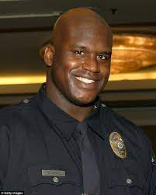
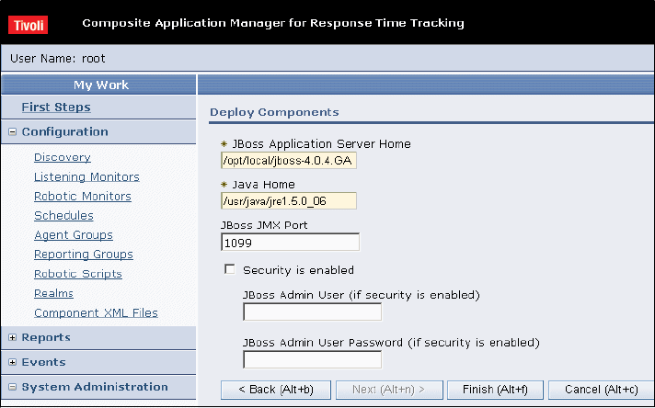
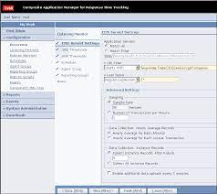
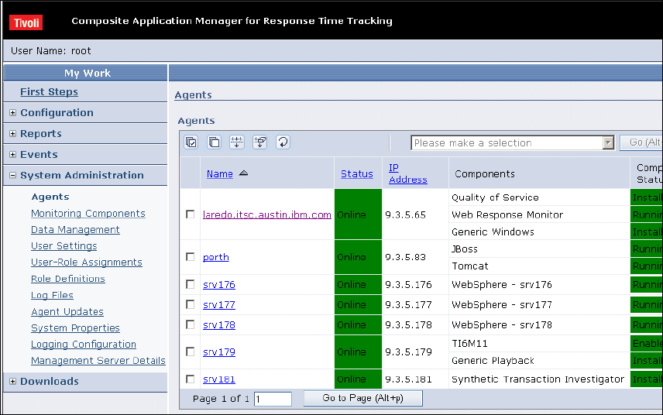
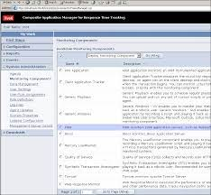
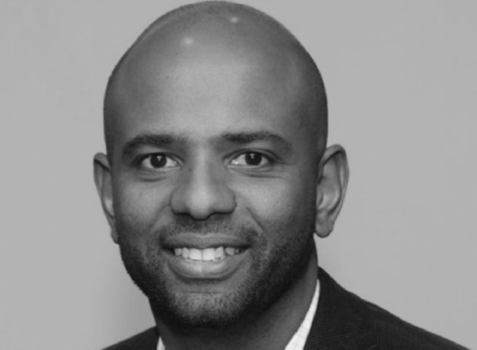
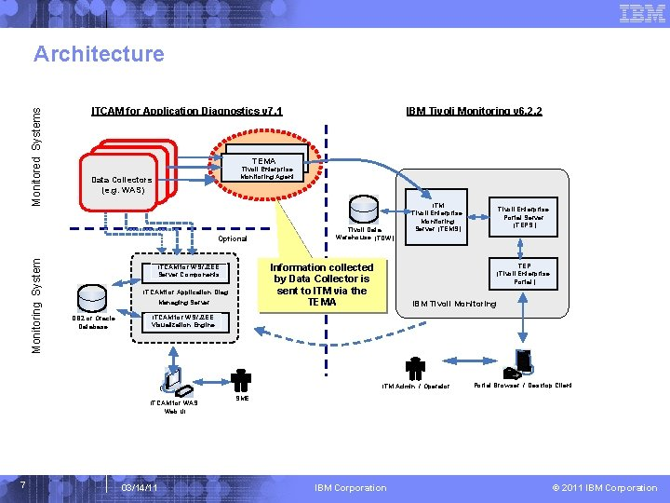

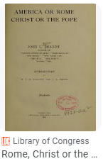
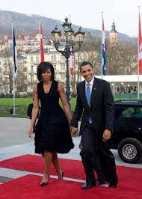

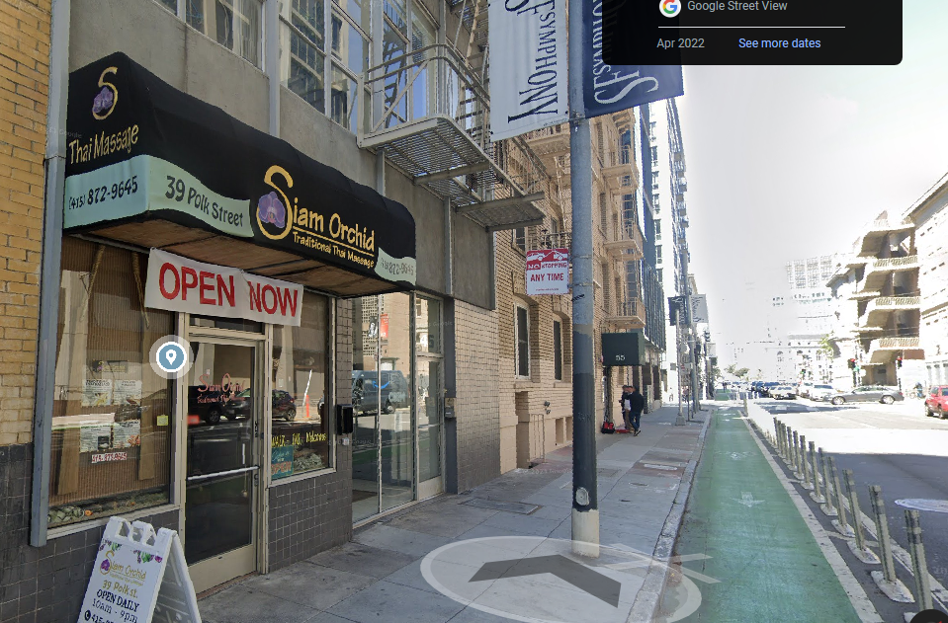
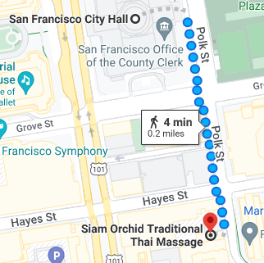

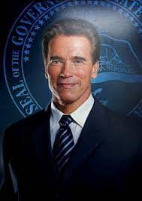

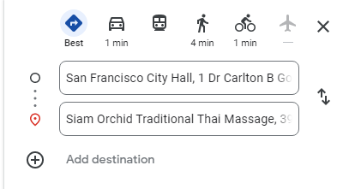
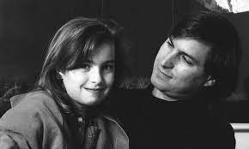
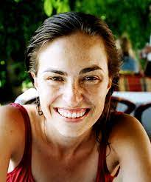
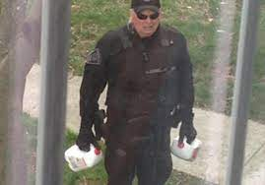

LARRY.VIDEO GAME
Phil.kim rainbow massage
V2:FBI:KIDNAPPING
JFK(Gov. Newsom.St. Anselmo. …, HOOVER)
lisa jobs brannon broke a nail

Slide 3
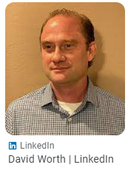

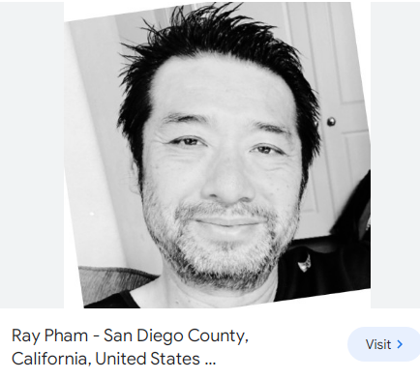




INTERNET PAYMENTS
Middlefield Road 777
Moutain View, Califrnia
INTERNET PAYMENTS
ARMY
NOC
Murano: Car
Wife: White
106lbs §Aggreated Idnety Theft
NOC
!In
Homcide:nana.anglea.apple.touch.greenstamps
Apple.touch.greenstamps
PAUL
Stalkign Comptuer 12§:lauging
INTERNET
paul tran svstech

Slide 4

db2 import from csv
ITIL
db2 IMPORT FROM "/tmp/homicide.sql" OF DEL INSERT INTO db2inst1.nonPoliceHomicide
ITIL
SQL3149N "25" rows were processed from the input file. "25" rows were
successfully inserted into the table. "0" rows were rejected.
Number of rows read = 25
Number of rows skipped = 0
Number of rows inserted = 25
Number of rows updated = 0
Number of rows rejected = 0
Number of rows committed = 25
IPX HOMCEI:NANA HOMCE:GHOST(bejamin)
Copaird Newark, Fostr City
DEA(danilel basement, Ken, art,free)

Slide 5



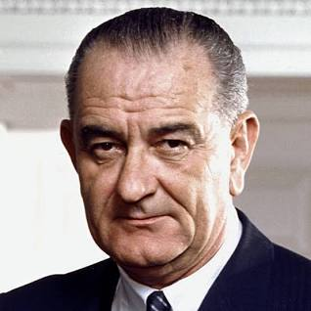


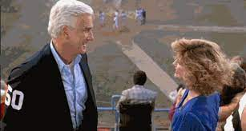



DB
HOMCEI:NANA IPX HOMCEI:GHOST
Favorite Movie
Favorite Actor

Slide 6

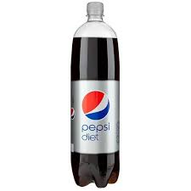

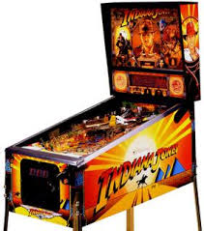
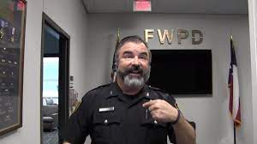
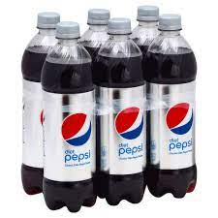
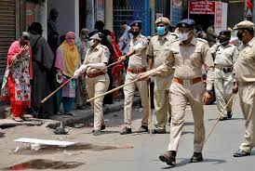

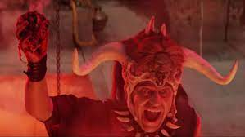
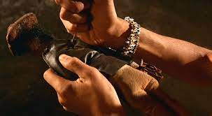
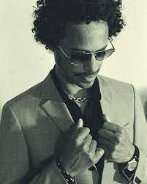



IMPORT LinkedIn pinball machine
KING Hendrik pinball machines
§Aggravated Identify Theft Jason (Al) Mailman ; Fremont Pinball Machines
Police Milk Homicide San Francisco, California
Gov. Newsome
Schlecker (mother)
Ken Rogers z/OS W/SAM
Police Sirens: 7:11PM
Pub prisma hendrik
1980 Video games
1955 pinball (first pinball)
Born 1980
Jason
Al’s Son
§Aggrevated Identfy Theft Jason (Al) Mailman ; Fremont Pinball Machines
Al walks around with 6pack pepsi
0.1
Joyti/Joyti Facebook
Remote Calls
indiana jones vhs raiders of the ark
1983
Germany Al Kaida: crusaders (Americans)
Police Sittign of person in fron soul nonpolcieCfg(CPVA)
MILTIAYR
buy cd(robot); eagle eye cherry

